Slide 1

Insect Classification
Guide:
Ozgur Ozturk
Team Members:
Dishnat Fapot
Krishna Sai Biradar
Akhil Kumar

Slide 2
Introduction
Agriculture, which is considered the backbone of the economy, contributes to the country’s economic growth and determines the standard of life.
Insect pests are known to be a major cause of damage to commercially important agricultural crops. Categorization of insect pests plays a crucial role in agricultural pest forecasting, which is vital for food security.
This study aims to classify and detect the insects in rice, wheat, etc. using different Approaches and insect pest detection algorithms.

Slide 3
Research Question
Does the Hybrid (Resnet50 and VGG16) model approach help in the classification of Hierarchical Classes?
What is the best method of data augmentation for improving the overall accuracy?
Which of the Approach (Noise, Gaussian, Cascade) fits best to gain a higher Accuracy in our Model?

Slide 4
RELATED WORK
The Author (S.-Y. Zhou & Su, n.d.) compared various models such as ResNet101, MobileNetV3-large, ShuffleV2, EfficientNet, etc. It has been observed that the proposed model by the author which is the combination of two blocks had showcased higher accuracy among all. It had reached about 52.32% of accuracy without any augmentation involved.
The Author (Han et al).has introduced noise, which can help to improve the performance of the model, and that is what a GAN model does it takes the random noise as the input and generates an image using just enough features which can help to determine its class gaining a very high Accuracy.

Slide 5
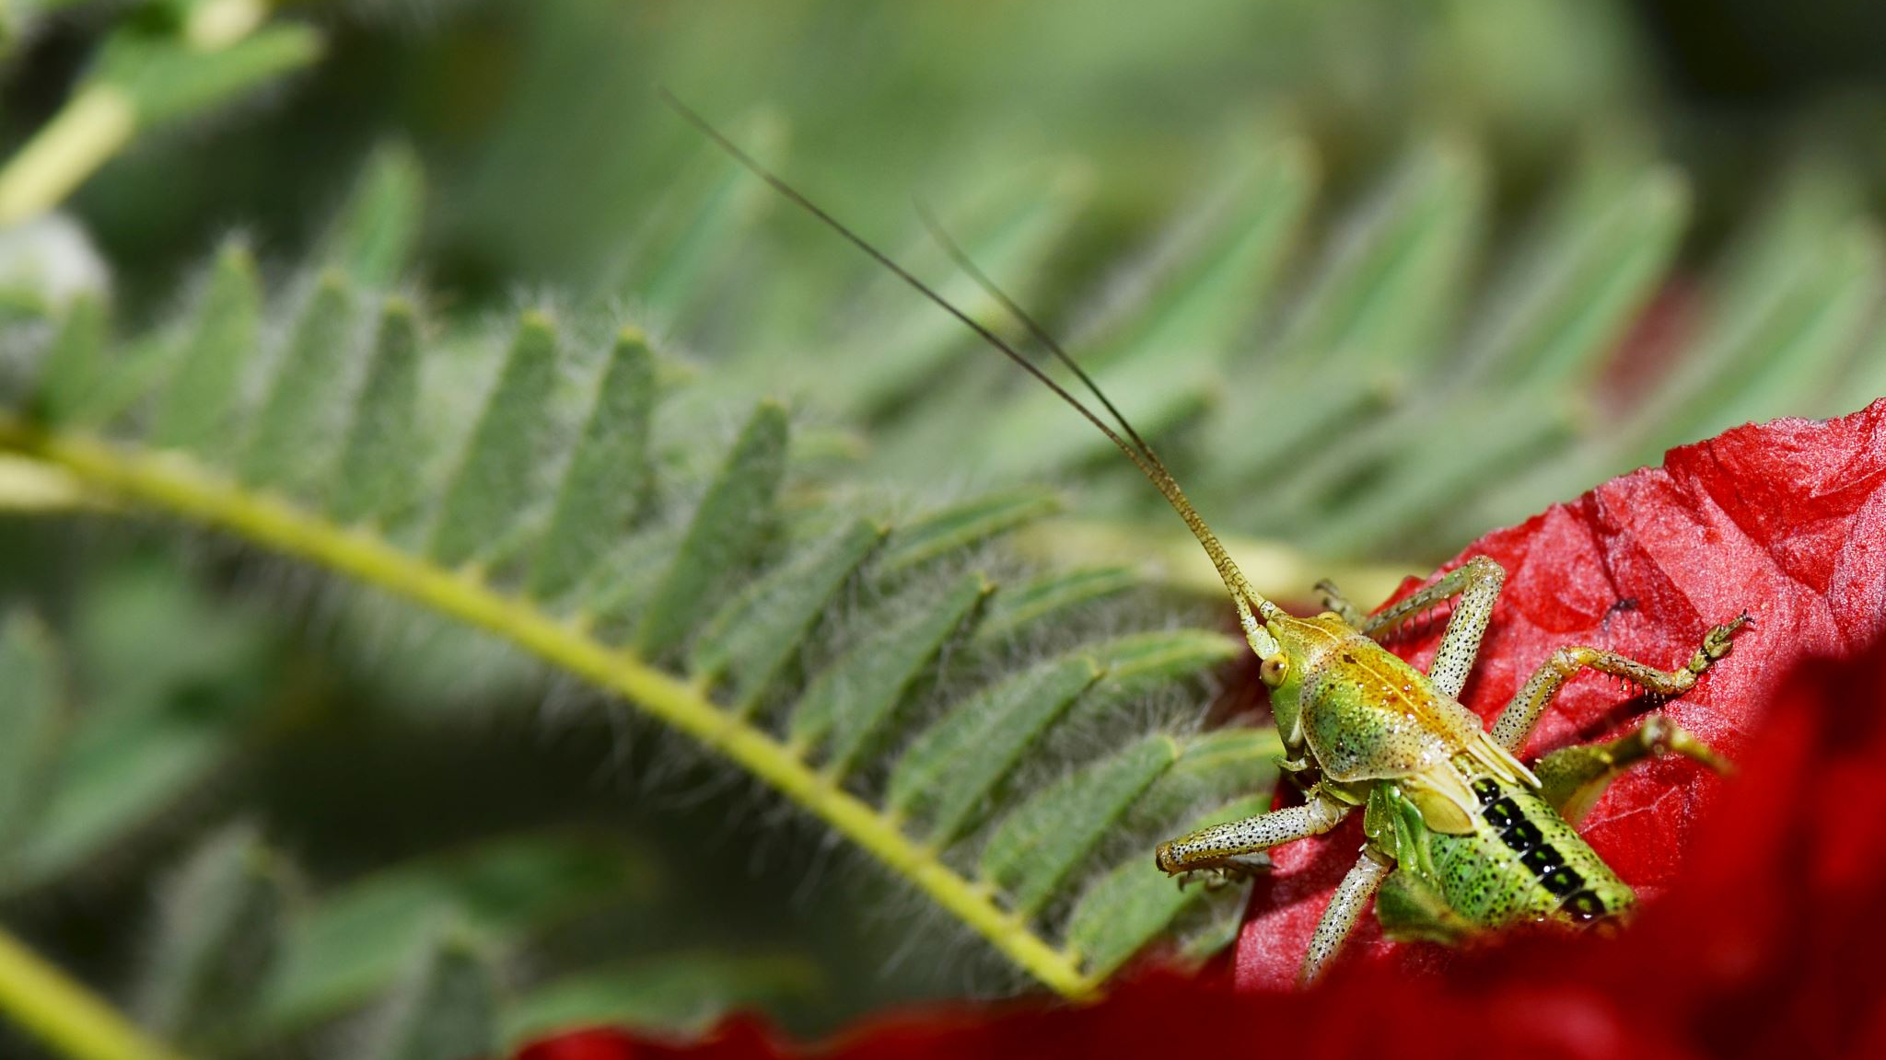
Dataset
IP102 is a large -scale dataset of insects. It containers over 75000 images of 102 categories.
The dataset was collected from various vital sources including the Internet, field surveys and laboratory exp.
The insect pest categories in the dataset cover a broad range of pests that commonly affect agriculture, such as aphids, mites, leafhoppers, beetles, caterpillars, and many others.
The images in the dataset show the pests at different life stages, including eggs, larvae, pupae, and adults.

Slide 6
References
https://github.com/xpwu95/IP102
Li, Yanfen & Wang, Hanxiang & Dang, L. Minh & Sadeghi-Niaraki, Abolghasem & Moon, Hyeonjoon. (2020). Crop pest recognition in natural scenes using convolutional neural networks. Computers and Electronics in Agriculture. 169. 10.1016/j.compag.2019.105174.
Nanni, Loris & Manfè, Alessandro & Maguolo, Gianluca & Lumini, Alessandra & Brahnam, Sheryl. (2021). High performing ensemble of convolutional neural networks for insect pest image detection. Ecological Informatics. 67. 101515. 10.1016/j.ecoinf.2021.101515.
W. Dawei, D. Limiao, N. Jiangong, G. Ji-yue, Z. Hongfei, and H. Zhongzhi, "Recognition pest by image-based transfer learning," Journal of the science of food and agriculture, vol. 99, no. 10, pp. 4524-4531, 2019.

