Slide 1
Real time Vehicle classification and counting
Moola krishna charan kumar reddy (2018kucp1083)
KOTA SRICHANDAN (2018kucp1115)
Bharat kumar rachamala (2018kucp1139)
Ala pranay reddy (2018kucp1113)

Slide 2
introduction
Traffic management has become an important daily routine in cities today with the exponential growth
of traffic on roads. Automatic vehicle detection from traffic scenes and extracting essential parameters
related to vehicular traffic can help better management of traffic on busy highways and road intersections.
Collecting real time reliable traffic information is crucial for traffic management there are many real time vehicle counts
Using computer vision technologies however detecting and counting moving vehicle in real world is still challenging.
The vehicle detection algorithm can be differentiated into 2 categories appearance based approaches and motion based
Approaches, In appearance based approach visual characteristics symmetry texture edges and colors are considered.
In motion based we look into motion characteristics by separating background like optical flow, background subtraction etc.

Slide 3
introduction
Motion based approach works well in light environment but it still has limitations in classifying images and we may have to
Classify them according to their sizes.
Recently CNN have been used in object detection because of its powerful ability to extract features so for detection CNN can
Be used for accuracy.
So, our goal is to develop a method to make object detection faster and more efficient in real time.

Slide 4
Related work
At present vehicle detection is divided into based on computer vision techniques and deep learning method. In computer
Vision motion of the vehicle is separated from fixed background. For example by using background subtraction that
Uses differences between consecutive video frames we can detect the vehicles in motion.
In optical flow method we detect the moving areas in the videos the resulting optical flow field represent the moving
pixels and its speeds.
On the other hand CNN also has achieved success in vehicle detection. CNN has a strong ability to capture visual characteristics
And then can perform many recognition tasks like classifying, detecting and predicting boundary frames
In CNN the methods are of 2 stages where we identify potential frames containing objects through various algorithms and
Use CNN to classify them.
Initially for detecting there is RCNN, fast RCNN, faster RCNN method for detecting objects. But in these methods identifying
Potential areas is done using selective area search and the input must be of fixed size and the network takes long
Training time and consumes a lot of memory and storage.

Slide 5
PROblem statement
Vehicle counting and classification in real time.

Slide 6
methodology
We can divide the whole process into 2 categories ; One is regarding vehicle classification and other is vehicle counting.
We tried to built this project using YOLO model with open-cv python and for counting purpose we tried to use
Euclidean distance concept.
Vehicle detection and classification :-
As we mentioned we used YOLO model it is a real time object recognition algorithm . YOLO is an algorithm that uses
neural networks to provide real-time object detection. This algorithm is popular because of its speed and accuracy.
YOLO stands for You Only Look Once, It can classify and localize multiple objects in a single frame.

Slide 7
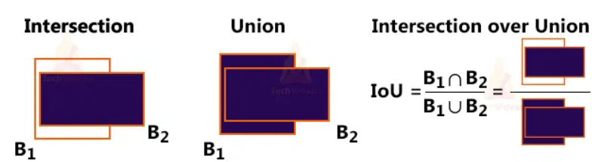
methodology
YOLO works mainly using these techniques
1. Residual Blocks – Basically, it divides an image into NxN grids.
2. Bounding Box regression – Each grid cell is sent to the model. Then YOLO determines the probability of the cell contains a
certain class and the class with the maximum probability is chosen.
3. Intersection Over Union (IOU) – IOU is a metric that evaluates intersection between the predicted bounding box and the
ground truth bounding box. A Non-max suppression technique is applied to eliminate the bounding boxes that are very close
by performing the IOU with the one having the highest class probability among them.

Slide 8
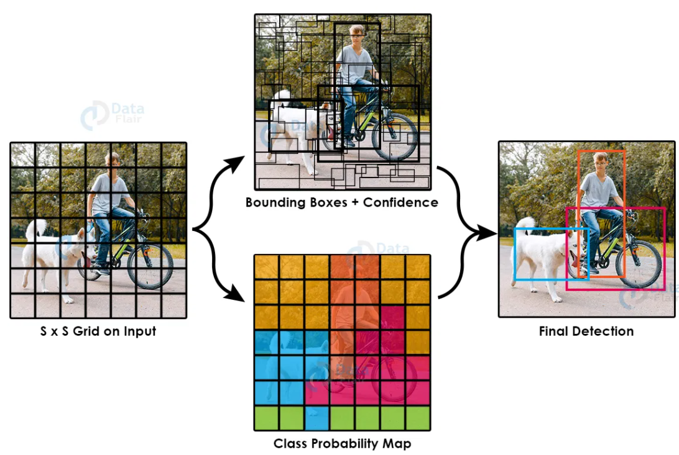
methodology
combination of these 3 techniques.

Slide 9
methodology
YOLO ARCHITECTURE
YOLO v3 uses a variant of Dark-net, which originally has 53 layer network trained on Image-net. This is used for feature
extraction.
For the task of detection, 53 more layers are stacked onto it, giving us a 106 layer fully convolutional underlying architecture for
YOLO v3.
In YOLO v3, the detection is done by applying 1 x 1 detection kernels on feature maps of three different sizes at three different
places in the network.
The shape of detection kernel is 1 x 1 x (B x (5 + C)). Here B is the number of bounding boxes a cell on the feature map
can predict, '5' is for the 4 bounding box attributes and one object confidence and C is the no. of classes.
YOLO v3 uses binary cross-entropy for calculating the classification loss for each label while object confidence and class
predictions are predicted through logistic regression.

Slide 10
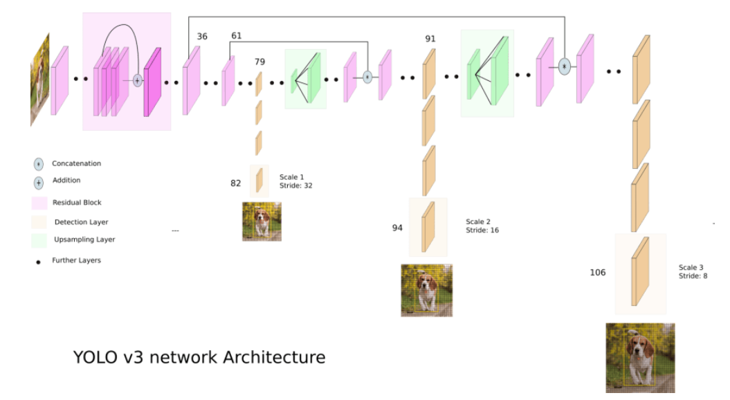
methodology
YOLO ARCHITECTURE

Slide 11
methodology
The output is a list of bounding boxes along with the recognized classes. Each bounding box is represented by 6 numbers
(pc, bx, by, bh, bw, c).
Finally, we do the IOU (Intersection over Union) and Non-Max Suppression to avoid selecting overlapping boxes.
Darknet-53 mainly composed of 3 x 3 and 1 x 1 filters with skip connections like the residual network in Res-Net.
Convolution layer is used to convolve multiple filters on the images and produces multiple feature maps.
we’ll detect and classify cars, HMV ( Heavy Motor Vehicle) , LMV (Light Motor Vehicle) on the road.

Slide 12
methodology
Vehicle tracking
The tracker basically uses the Euclidean distance concept to keep track of an object. It calculates the difference between two
center points of an object in the current frame versus the previous frame, and if the distance is less than the threshold distance then
it confirms that the object is the same object of the previous frame.
YOLOv3 is trained on the COCO dataset, so we read the file that contains all the class names and store the names in a list.
The COCO dataset contains 80 different classes.
We need to detect only cars, motorbikes, buses, and trucks for this project, that’s why we only cared about them from the
Coco dataset.

Slide 13
methodology
YOLO sometimes gives multiple bounding boxes for a single object, so we have to reduce the number of detection boxes and
have to take the best detection box for each class.
For counting we take an entry and exit cross-lines, whenever a vehicle enters we gave unique id to it and add it to our vehicle
Set and when it crosses the exit line we remove that id from the set and increase the count of exited vehicles.
After that we draw the counting texts on the frame .
We can perform this on static images also to detect the number of vehicles that are present in that image.

Slide 14
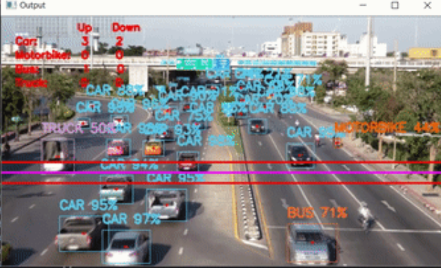
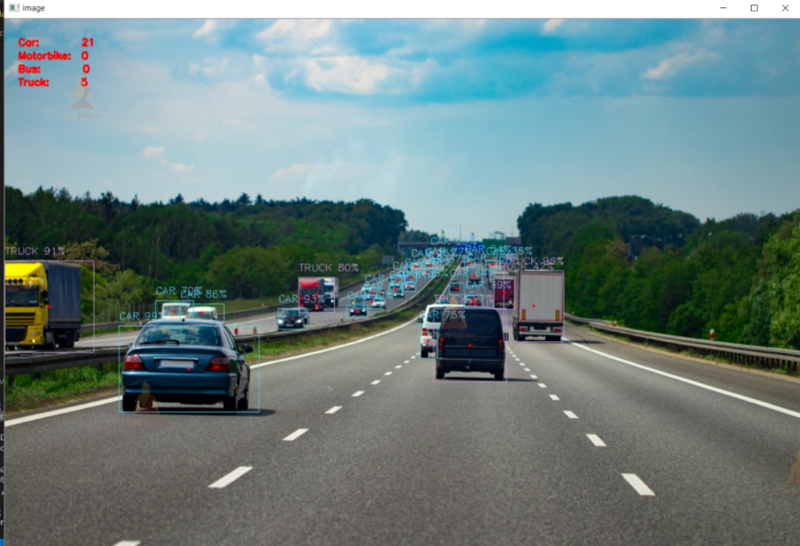
Results and discussions
We have selected YOLO because of its speed and accuracy which is more important for real time processing because YOLO
Only looks into the data once.
YOLO can process images at 30fps and the overall precession i.e. model accuracy is nearly 87.5%.

Slide 15
conclusion
Initially we tried to do this project with motion based algorithms but later on we found that YOLO is far better and faster than
Any of those algorithms. There are few problems in this approach of tracking using Euclidean distance because if the vehicle
Moves so fast this system may count the same vehicle twice.
But any way with limited speed this was able to bring the results with high accuracy and we learnt about deep neural networks
and some advanced computer vision technologies also by doing this.
As this performs well in real time we can use this in cameras, traffic cameras, cctv etc.

Slide 16
for giving us this wonderful opportunity, we learnt a lot
thank you sir

