Slide 1
DESIGN AND VERIFICATION OF ASYNCHRONOUS FIFO
SESSION 2 - TEAM 5
Achyuth Krishna Chepuri (achyuthc@pdx.edu)
Amrutha Regalla (regalla@pdx.edu)
Sai Sri Harsha Atmakuri (atmakuri@pdx.edu)
Sathwik Reddy Madireddy (sathwik@pdx.edu)
June 11, 2024

Slide 2




TEAM INTRODUCTIONS
Achyuth Krishna
Sathwik Reddy Madireddy
Amrutha Regalla
Sai Sri Harsha Atmakuri

Slide 3
PROJECT INTRODUCTION
Why Asynchronous FIFO?
What is CDC(Clock Domain Crossing)?
Metastability
Synchronizers
UVM Verification environment

Slide 4
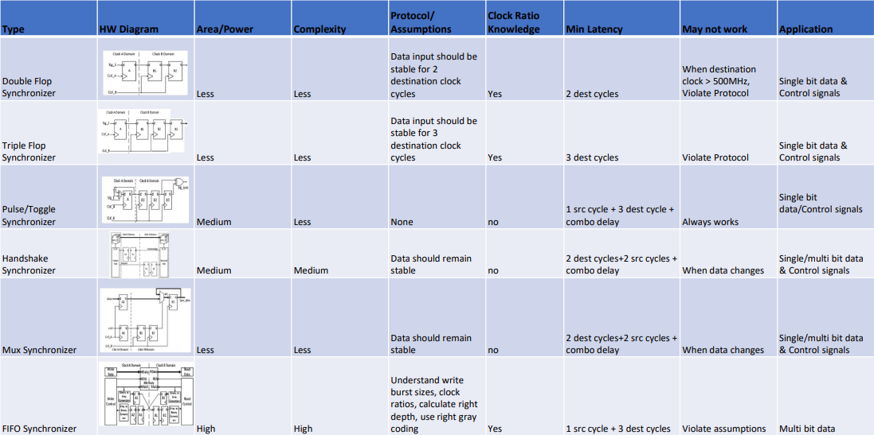
CDC SYNCHRONISERS

Slide 5
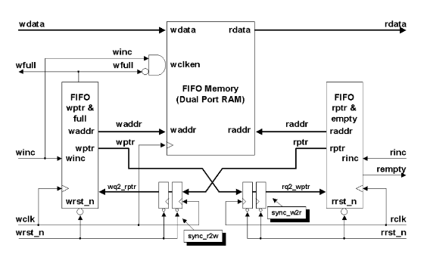
ASYNCHRONOUS FIFO – DESIGN IMPLEMENTATION

Slide 6
Design Implementation:
Use of Gray code Counters
1 extra bit for implementing full and empty signals
Implementation of half full and half empty signals
Write pointer and read pointer cross the domains through a synchronizer
Write pointer and read pointer point to memory location where the writing of data and reading of data can happen respectively
FIFO is full when both write pointer and read pointer are equal and when the write pointer has wrapped around and caught up to read pointer
FIFO is empty when read and write pointers are both equal

Slide 7
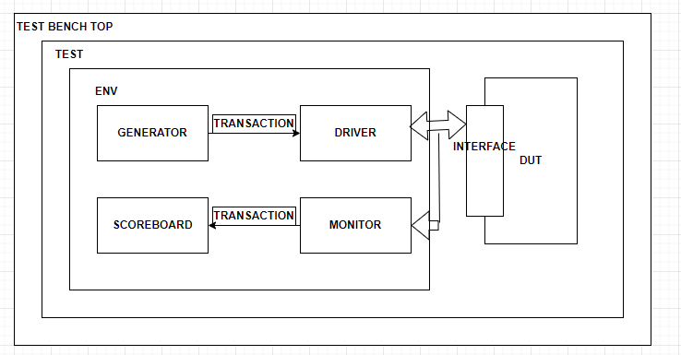
SV TEST BENCH

Slide 8
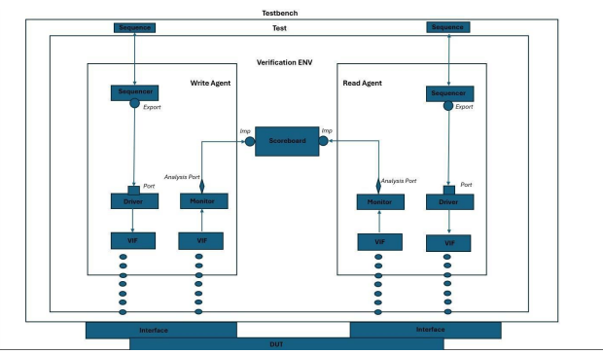
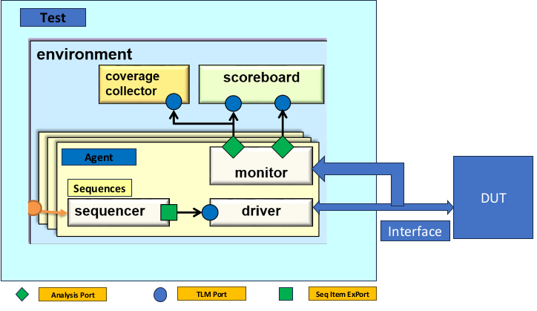
UVM ENVIRONMENT

Slide 9
UVM COMPONENTS:
Sequence item: Randomization of all inputs occur in sequence and sent to driver through sequence.
Sequencer: Sequencer manages the generation and sequencing of stimulus . Build and connect phases are used in the sequencer to connect to driver and pass items from the sequencer to driver.
Driver : Driver is responsible for converting transaction level stimuli into signals and driving the actual interface.
Monitor: Monitor continuously gathers data from DUT and sends it to score boar. Monitor is connected to the driver in build phase using `uvm_config_db to ensure proper connection
Agent: Agent consists of driver, monitor and sequencer.
Scoreboard: Validates the generated data.

Slide 10
UVM ENVIRONMENT
Testbench architecture used will include:
• Testbench Top
o Highest level of the testbench Hierarchy
o Contains Environment instantiation and configuration
o instantiates the DUT and the test sequence
• Environment
o Contains the agents and components for driving stimulus and checking DUT responses
o Instantiates the agents
• Agents (write and read)
o Responsible for interfacing with DUT interface
o Contains components to drive stimulus and collect responses
▪ Agent Sequencer
• Generates sequence of transactions
▪ Agent Driver
• Drives the stimulus to the DUT
▪ Agent Monitor
• Monitors signals on the interface of the DUT
• Collects data for analysis and scoreboard
• Scoreboard
o Compares expected results with actual results from DUT
o Raises error flags on data mismatch
• Sequences
o Contains sequence of transactions that represent specific test scenarios
o Sequence Item represents a single traction (Data packet)
▪ Contains information for driving and checking
▪ Each test contains separate sequence

Slide 11
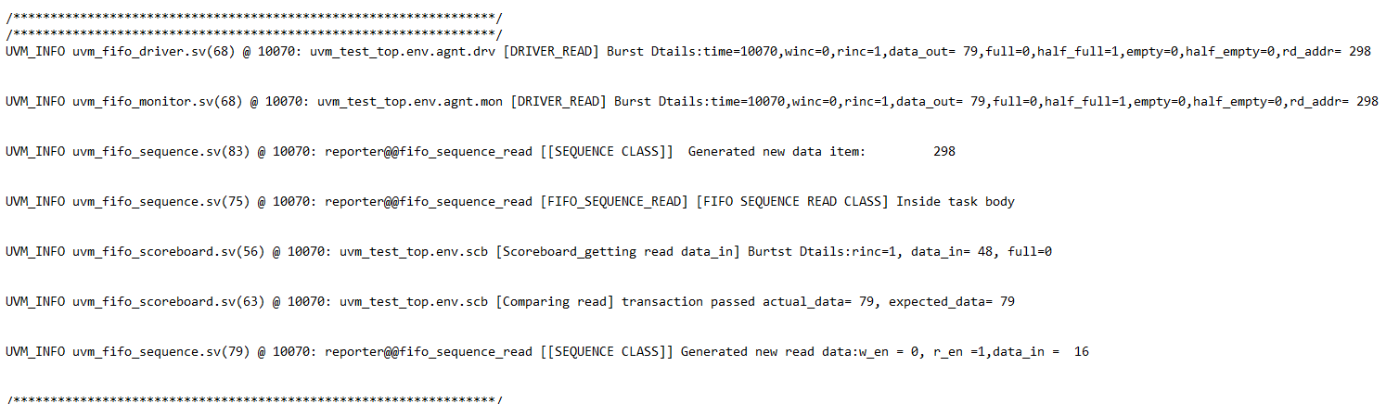
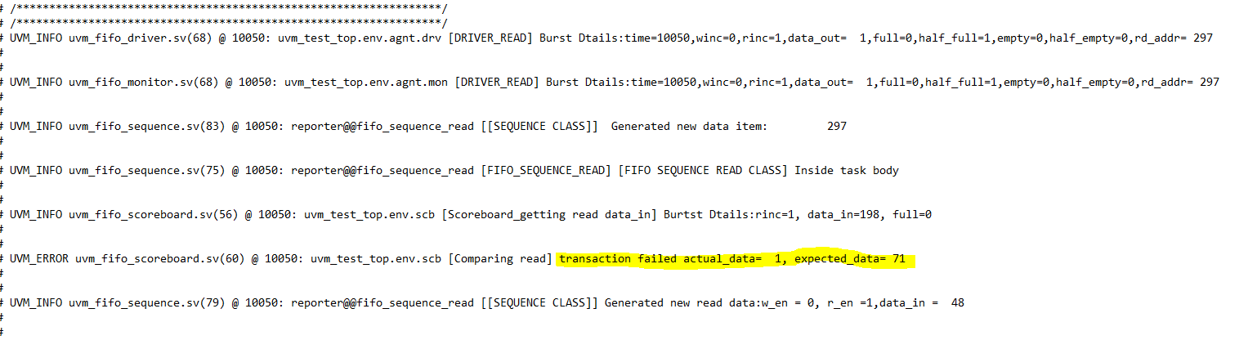
SIMULATION RESULTS:
Error Injection:

Slide 12
CHALLENGES FACED:
Extensively examined the entire testbench, found the incorrect connection between
the classes, and fixed the problem by setting up the correct connection between
the components
Due to additional delays in a few testbench components, the wrong values for the
read address increment were found. These were fixed by cutting the delay and verifying
the correct flow. Fixed testbench and design connectivity problems to achieve both full and
empty situations. This was done by carefully checking the interface connection, noticing
differences in received values in the transcript, and then fixing the problem by deleting ‘
clocking sections.
Determined which prior values were updated in the monitor for each of the two read
operations that were carried out, and fixed the problem by supplying the identical delays
in the monitor and driver.
Race issues between read and write pointers were caused by distinct values propagating
from data_in to data_out, which was found and fixed by carefully examining and changing
the code in both the design and testbench.
Found and fixed the erroneous reset value that was assigned to the top testbench of the
UVM testbench verification hierarchy.

Slide 13
REFERENCES:
Venkatesh Patil-“ECE-593-Lecture Slides”.
https://verificationguide.com/uvm/uvm-testbench-architecture/
https://www.chipverify.com/
https://vlsiverify.com/verilog/verilog-codes/asynchronous-fifo/
Clifford E. Cummings, Sunburst Design, “Simulation and Synthesis Techniques for Asynchronous FIFO Design” http://www.sunburst-design.com/papers/CummingsSNUG2002SJ_FIFO1.pdf
https://hardwaregeeksblog.files.wordpress.com/2016/12/fifodepthcalculationmadeeasy2.pdf

Slide 14
GIT HUB LINK
https://github.com/krishnaachyuth/AsynchronousFIFO

Slide 15
THANK YOU

