Slide 1
FINAL PROJECT – ECE 571
TEAM AMIGOS
Achyuth Krishna Chepuri (952279119)
Sai Sri Harsha Atmakuri (932141135)
Sathwik Reddy Madireddy (920582851)
March 19, 2024

Slide 2
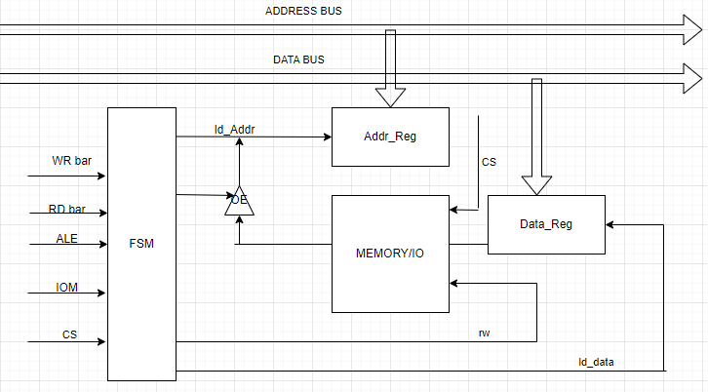
SYSTEM BLOCK DIAGRAM

Slide 3
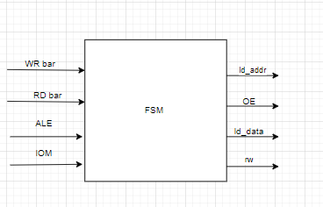
FSM BLACK BOX

Slide 4
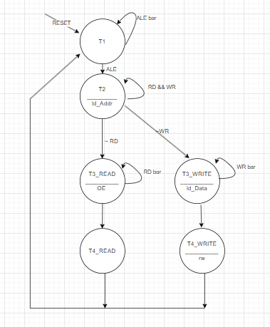
FSM

Slide 5
GIT HUB LINK
https://github.com/krishnaachyuth/Interface-Memory-to-8088/tree/main

Slide 6
THANK YOU

