Slide 1
CMU Rental Hub – User Interface BIS 698 Information Systems Project
By Group - 9
Krishna Mohan Reddy Ailuri
Himabindu Mandem
Sai Prasanna Goduguluri
Sainikhil Reddy Pannala
Prahlada Reddy Kasani

Slide 2
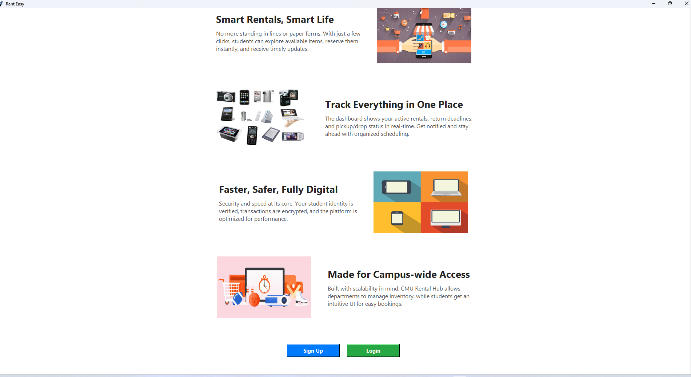
Home Page

Slide 3
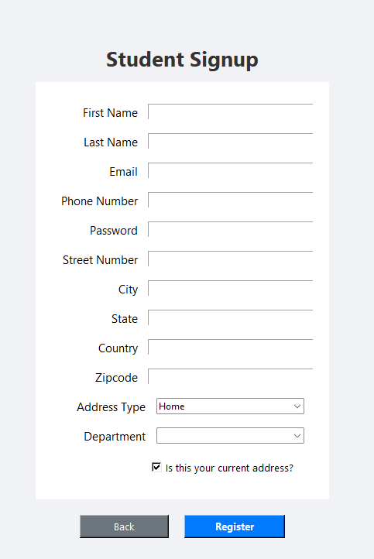
Student Signup Page

Slide 4
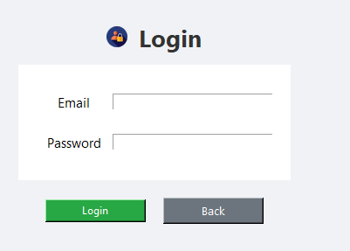
Login Page

Slide 5
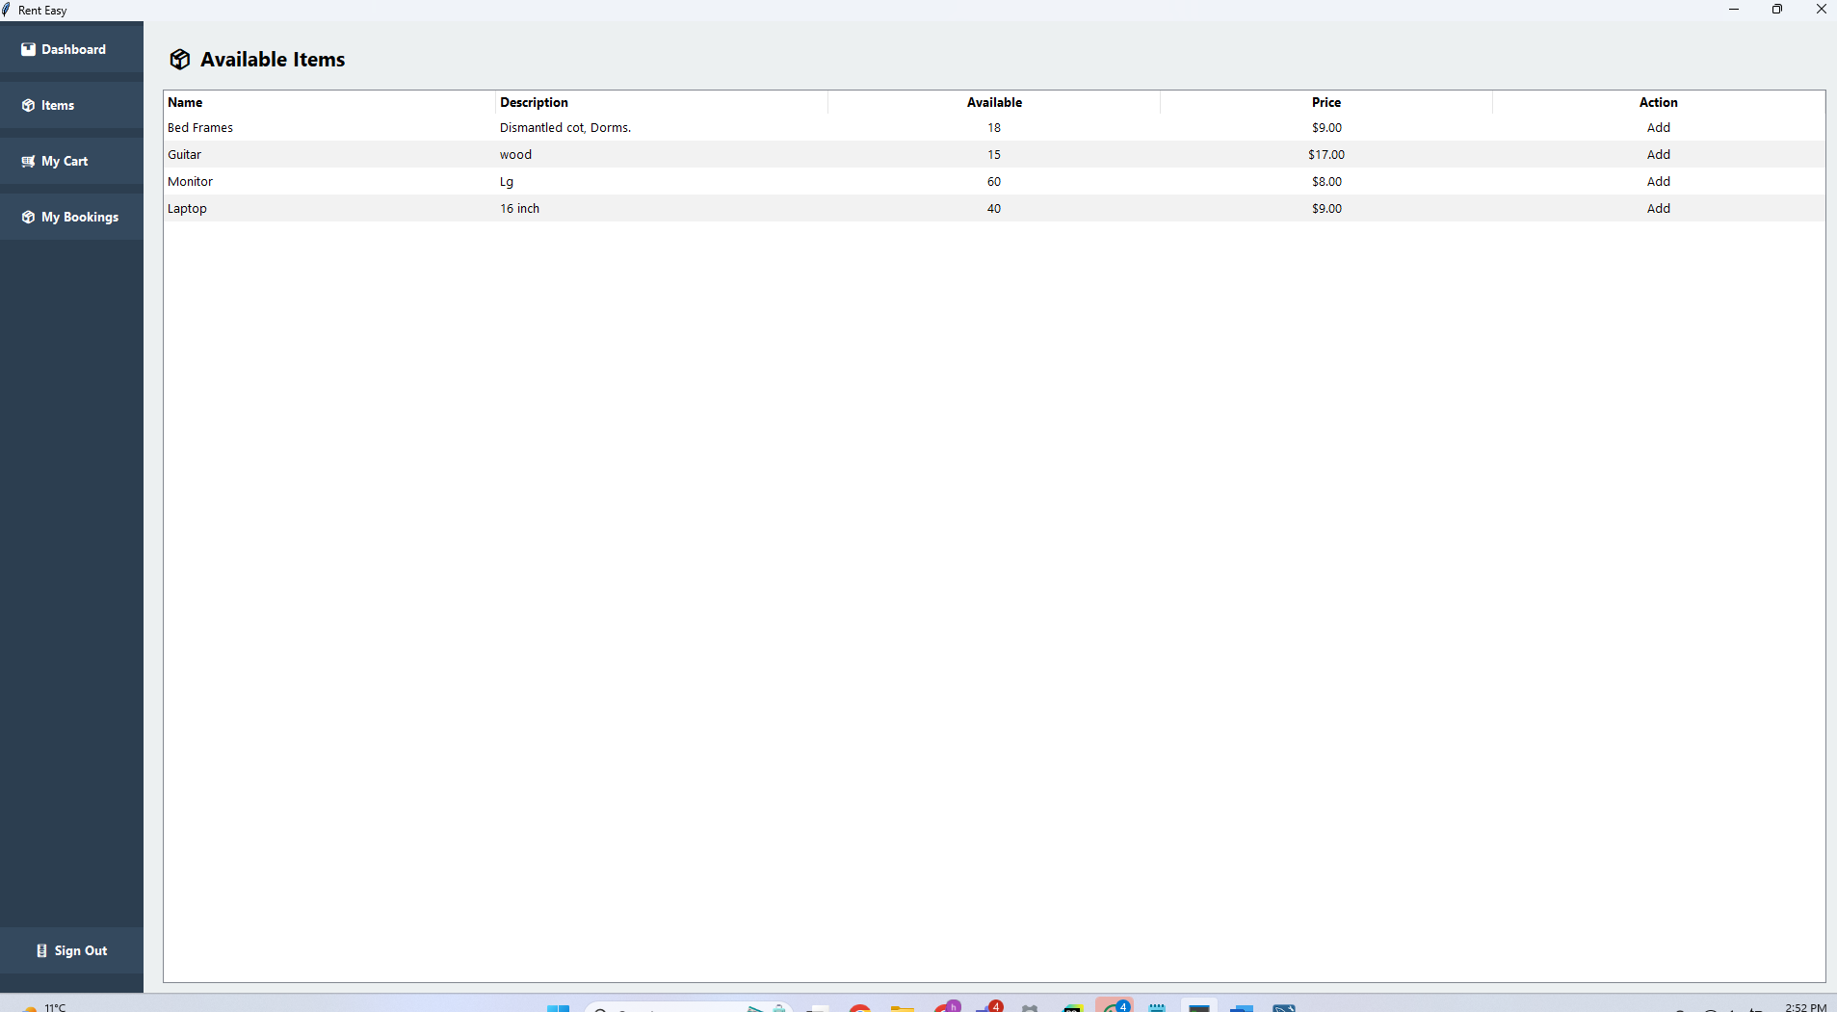
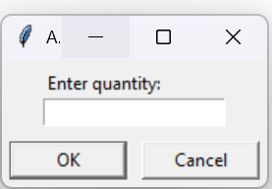
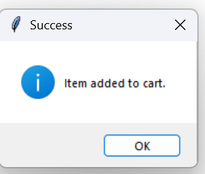
Available Items – Student View

Slide 6
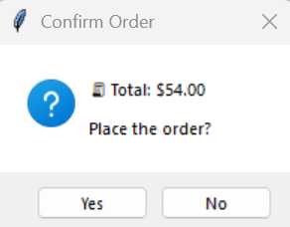
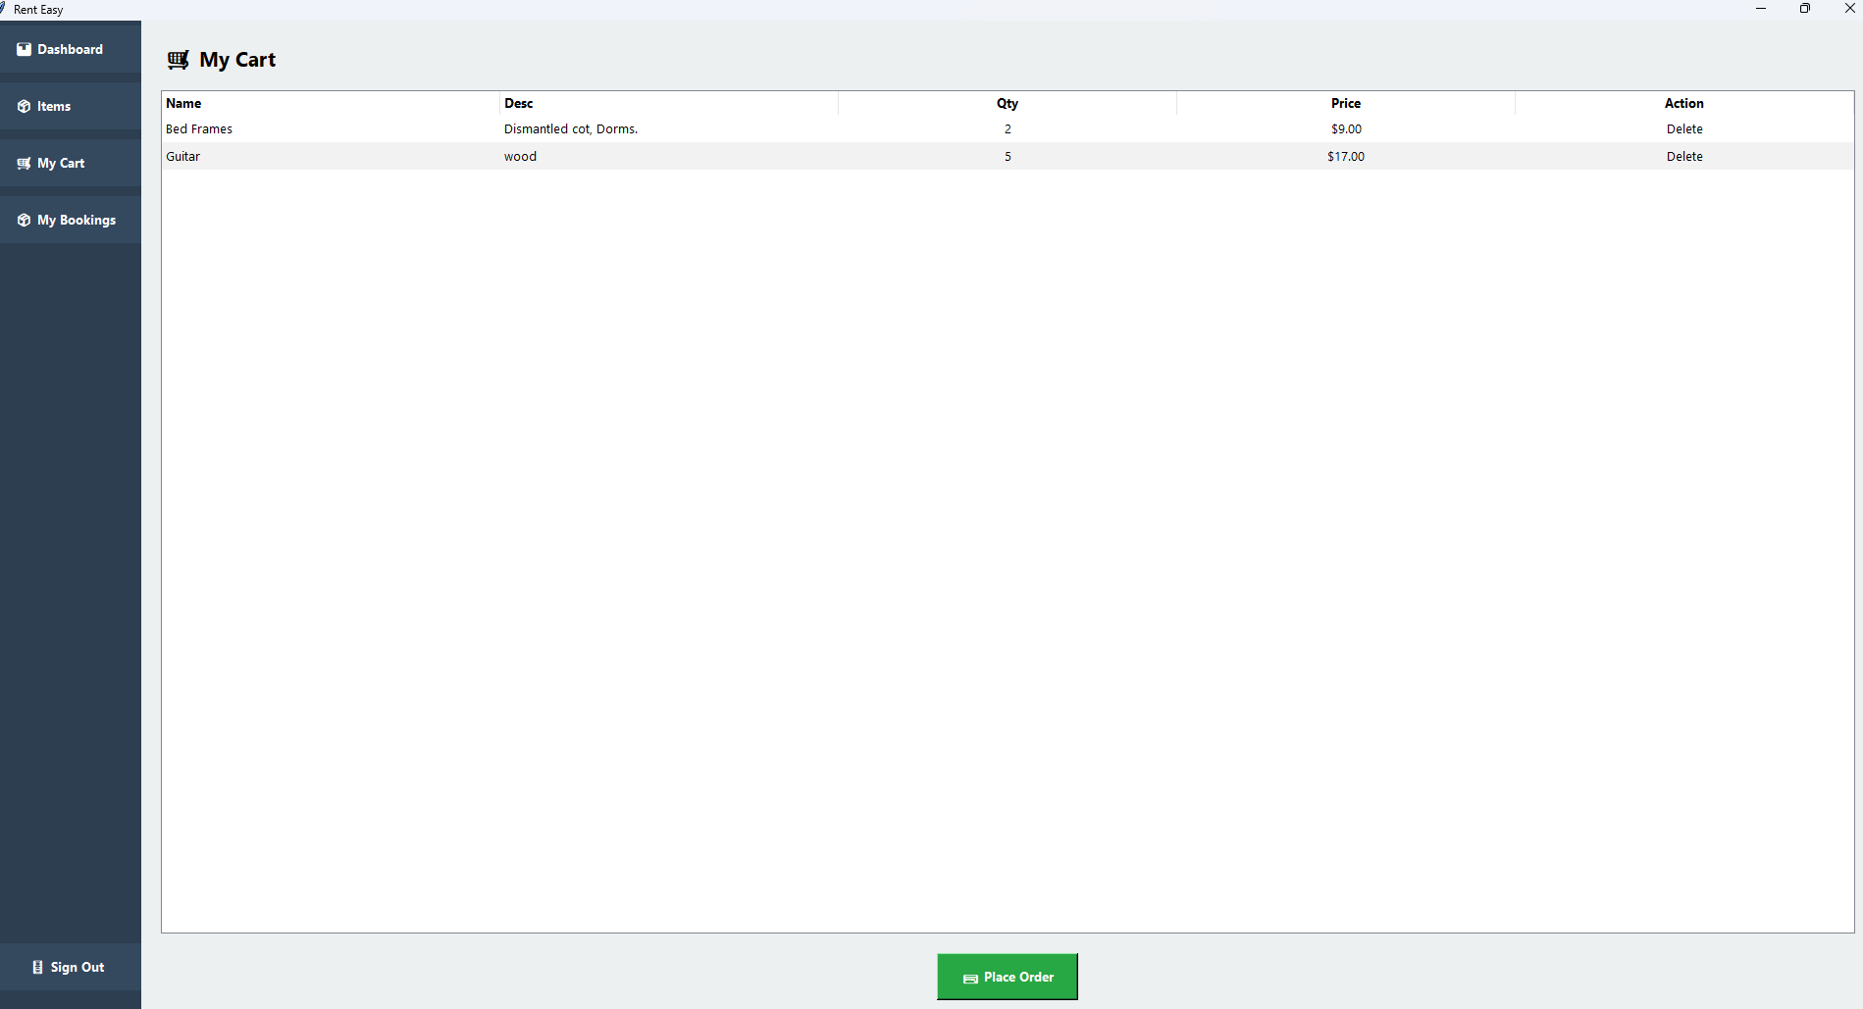
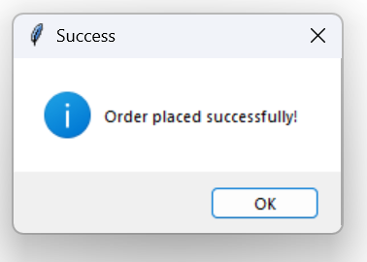
My Cart Page – Student View

Slide 7
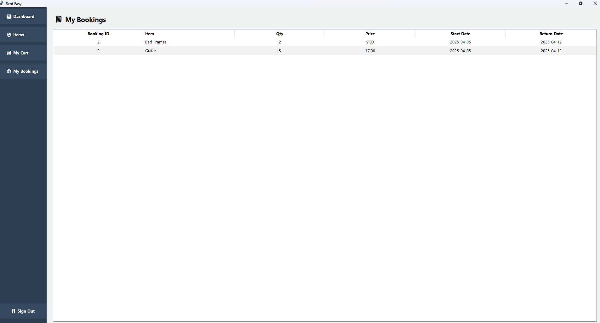
My Bookings Page – Student View

Slide 8
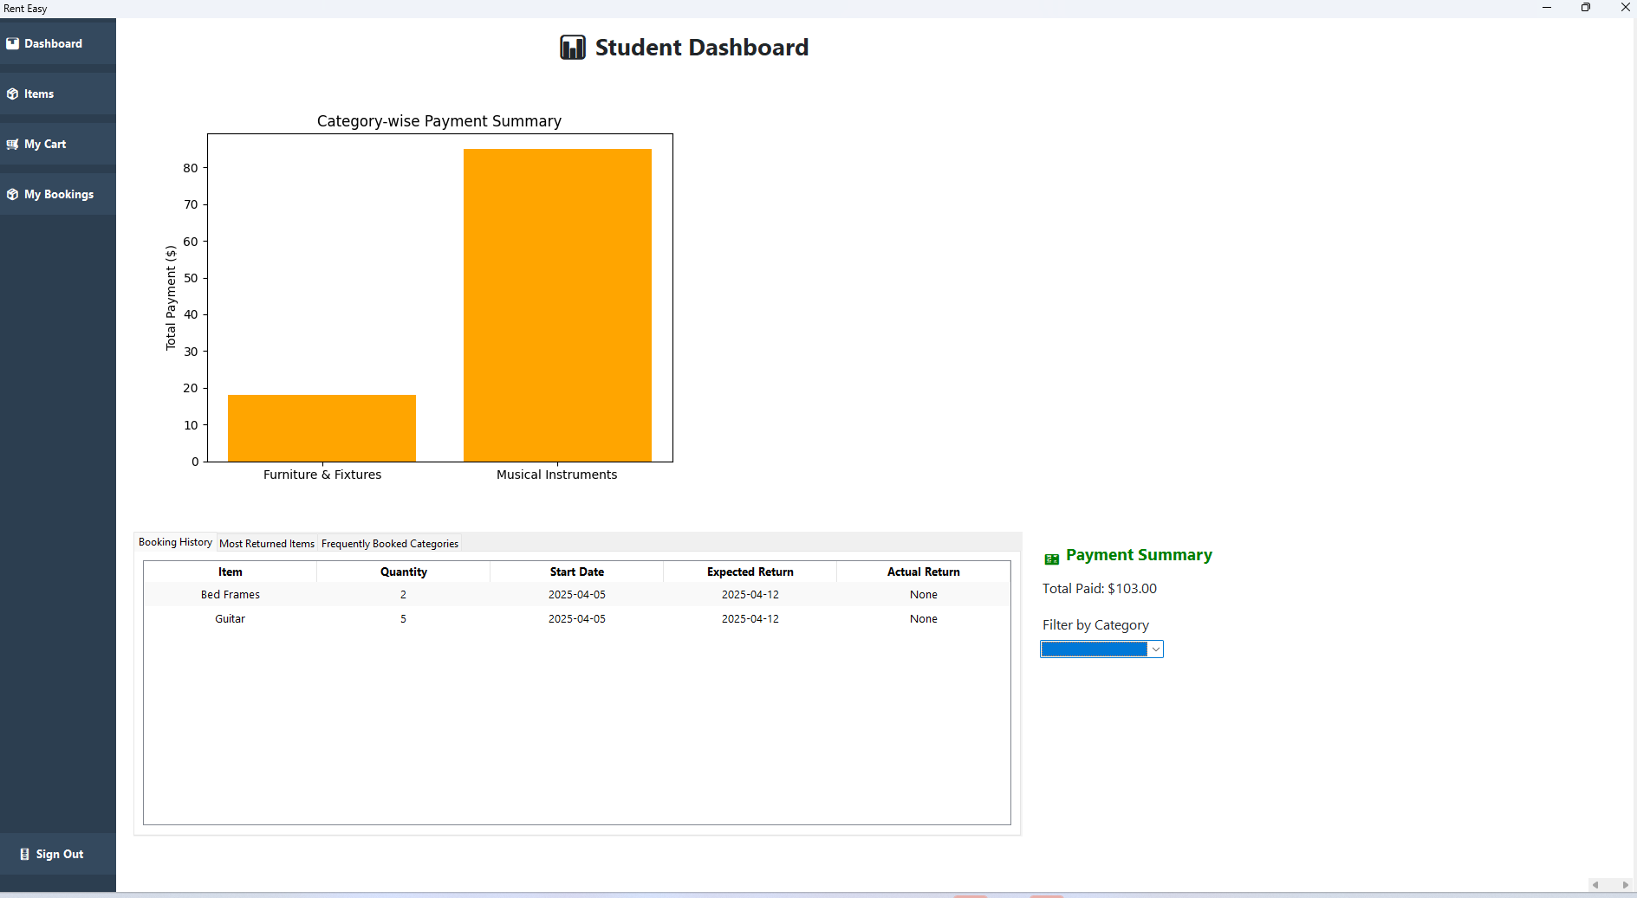
Student Dashboard – Student View

Slide 9
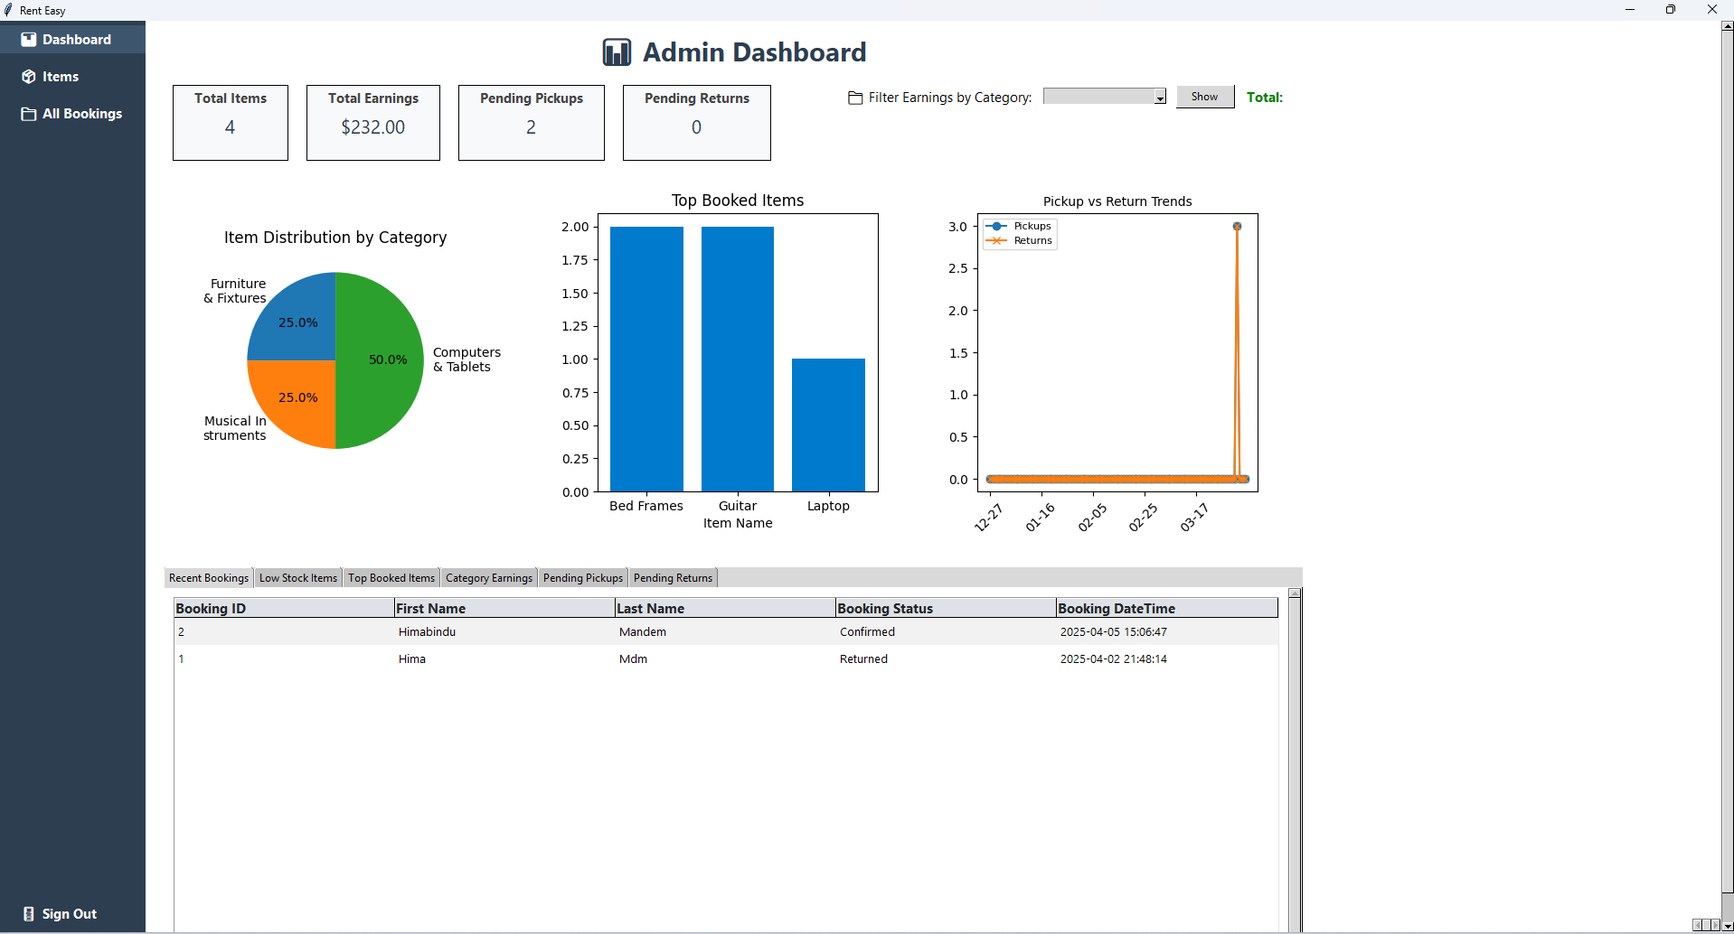
Admin Dashboard – Overview and Insights

Slide 10
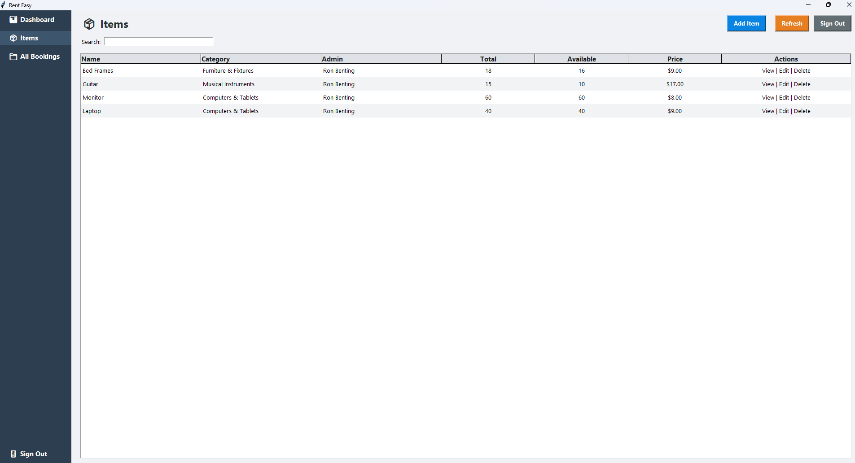
Items Management Page -Admin View

Slide 11
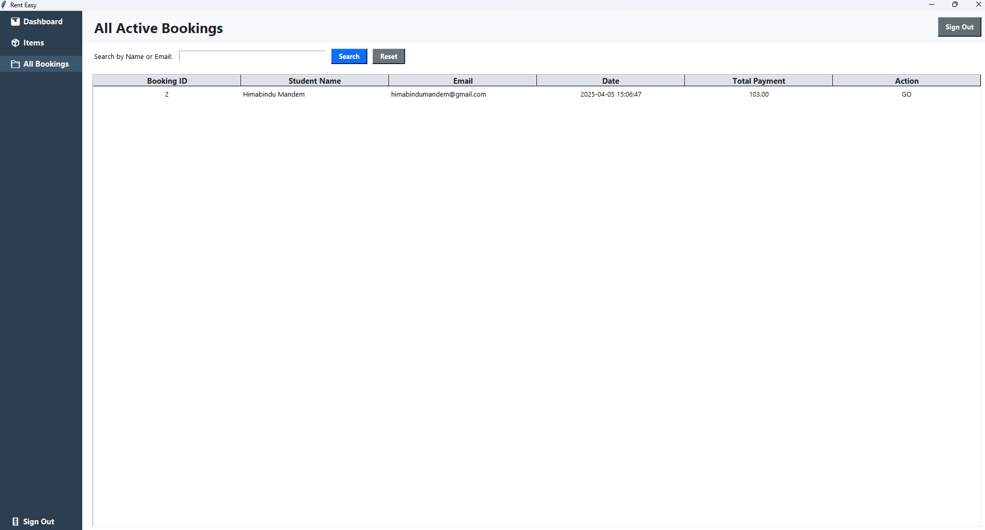
All Booking Page – Admin View

