Slide 1
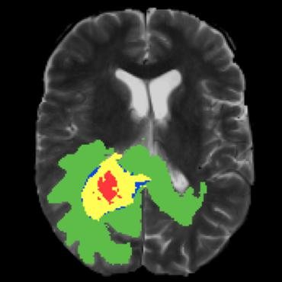
Brain Tumor Segmentation
August 16, 2023
By:
Maramreddy Krishna Ananda Reddy - cse200001042
Mudavath Bhanu Prakash - cse200001048
BTP Superviser: Dr. Surya Prakash

Slide 2
Contents
Abstract
Introduction
Dataset
Brats2020
Different Modalities
3D Image Pre-Processing
Model
U-Net
3D U-Net
V-Net
Dice Loss function
References

Slide 3
Introduction
Gliomas are tumor that affect the Central Nervous System.
Prognosis of subjects with Gliomas are low (< 15 months).
MR is preferred technique due to non-ionising, non-invasive and good spatial and temporal resolution
Manual segmentation - time consuming and introduces inter rater variabilitv.
Various MR sequence, provide complimentary information about the lesion in the volume.
FLAIR, T2, T1 post contrast sequence are often used MR sequence.
Notes:
Affects CNS, patients are typically monitored by MRI, magnetic resonance imaging
Poor prognosis, survival rate is less than 2 years. Doctors generally use size of tumor as a parameter to see whether the tumor is growing or responding to treatment
“IMAGE VOLUME”
In MRI, Multiple image volumes are acquired called sequence
Each sequence is obtained by certain technique by exciting magnetic spins in human body, each of them gives raise to separate grey-scale contrast
Generally each sequence is of size 256x256x100 where 100 is no.of slices

Slide 4
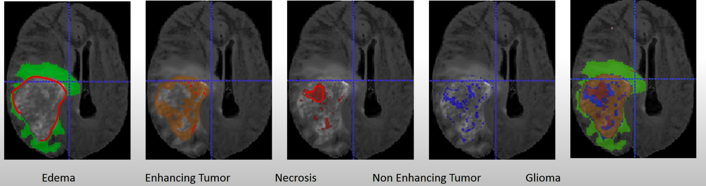
Constituents of Gliomas
Constituents of gliomas are :
Edema: Collection of fluid or water. Best seen in FLAIR and T2 weighted sequence. Fingerlike projection.
Necrosis: Accumulation of dead cells. Best seen in T1 post contrast sequence.
Enhancing Tumor: Indicate breakdown of blood brain barrier. Seen in T1c post contrast sequence.
Non Enhancing: Regions in region that are neither edema, necrosis or enhancing tumor.

Slide 5
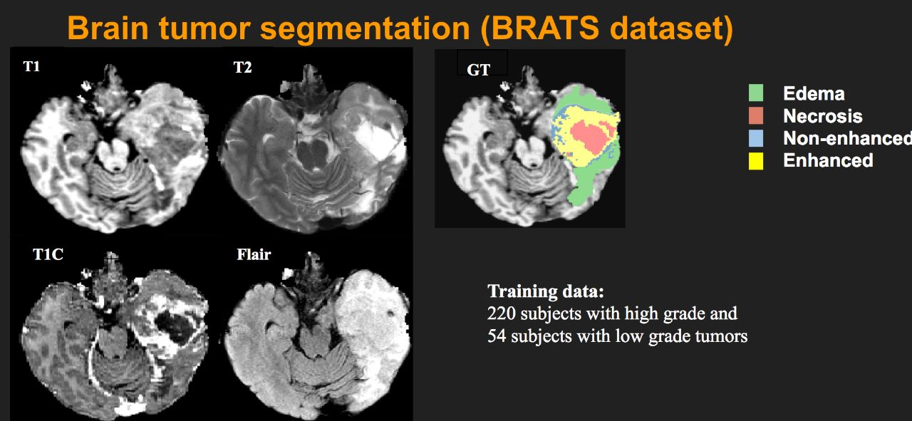
BraTS 2020 Dataset
BraTS dataset link : https://www.kaggle.com/datasets/awsaf49/brats20-dataset-training-validation
Multi-centric, Publicly available
Composed of data from both low (n=75) and high grade glioma (n=210).
Each patient volume comprises of
Fluid Attenuated Inversion Recovery (FLAIR)
T1 weighted sequences
T2 weighted sequence
T1 post contrast sequence
Pixel Level segmentation mask
Each MR sequence is skull stripped, registered and resampled to have isotropic resolution (1 mm°). Dimension of dataset is 240 x 240 ×155. ( Sagittal, Coronal , Axial)
Notes:
Multi centric: varies from hospital yo hospital and scanner to scaner so this data generalises well

Slide 6
Different Modalities
Different modalities in BraTS 2020 dataset and their significance
FLAIR (Fluid Attenuated Inversion Recovery): FLAIR images are excellent at highlighting areas of edema, inflammation, and necrosis around tumors. They help in identifying regions of brain tissue affected by tumor growth.
T1 (T1-weighted): T1 images provide high-resolution anatomical details and help in visualizing the structure of brain tissues. They are useful for identifying the tumor's location and size.
T1ce (Contrast-enhanced T1-weighted): T1ce images highlight regions of active tumor growth and angiogenesis. They provide insights into the most aggressive parts of the tumor.
T2 (T2-weighted): T2 images are sensitive to edema, cysts, and tumor-invaded regions. They help in identifying the extent of peritumoral edema and the tumor's boundaries.
Each modality emphasizes different tissue properties, resulting in varying contrasts between different types of tissues and abnormalities. The combination of modalities helps define tumor boundaries more accurately, leading to better segmentation and treatment planning.

Slide 7
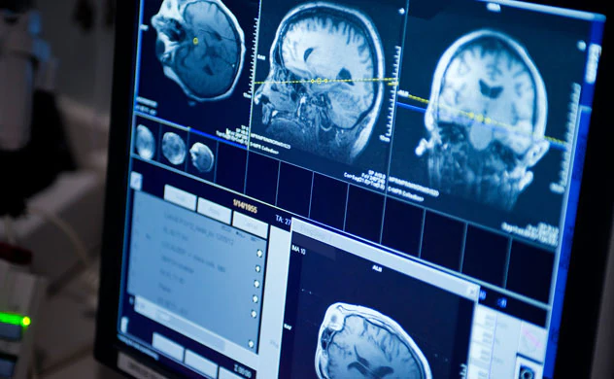
Challenges in segmenting Brain tumor Dataset
Some tumors such as meningiomas can be easily segmented, others like gliomas and glioblastomas are much more difficult to localize. These tumors (together with their surrounding edema) are often diffused, poorly contrasted, and extend tentacle-like structures that make them difficult to segment.
Another fundamental difficulty with segmenting brain tumors is that they can appear anywhere in the brain, in almost any shape and size.
Furthermore, unlike images derived from X-ray computed tomography (CT) scans, the scale of voxel values in MR images is not standardized. Depending on the type of MR machine used and the acquisition protocol, the same tumorous cells may end up having drastically different grayscale values when pictured in different hospitals

Slide 8
Pre-processing
This preprocessing pipeline prepares the medical image data for training machine learning models, enabling accurate and robust brain tumor segmentation.
The main steps involved in this are:
Loading Images and Masks:
Iterate through the list of image filenames (e.g., T2-weighted, T1ce, FLAIR).
Load each image using the Nibabel library to obtain the raw image data.
Perform the same step for the corresponding mask.
Initially the dataset contains different modularity images with .nii extension
Data Scaling:
Reshape the 3D image volume to a 2D matrix to apply scaling.
Apply the scaler to normalize the intensity values in the range [0, 1].
Reshape the normalized data back to the original 3D shape.
Notes:
the process of temporarily reshaping a 3D image volume to a 2D matrix for scaling and then reshaping it back to its original 3D shape is a technique used to ensure that the scaling operation is applied consistently across the entire image volum

Slide 9
Pre-processing
Combining Modalities:
Stack the preprocessed images (FLAIR, T1ce, T2) along the fourth dimension to create a combined image volume.
This produces a 4D tensor with modalities as channels.
Mask Adjustment:
Load the mask data and convert it to unsigned 8-bit integers (uint8).
Modify the mask to reassign value 4 to 3, aligning classes for consistency.
Volume Cropping:
Crop both the combined image volume and the mask to focus on the region of interest.
This cropping step helps reduce unnecessary background data.
Initially 240x240x155 -> to 128x128x128
Data Validation:
Calculate the percentage of useful volume that contains non-zero labels in the mask.
If the useful volume percentage exceeds a threshold (e.g., 1%), proceed with saving the data.
If the percentage is too low, consider the image as "useless."

Slide 10
Pre-processing
One-Hot Encoding:
Convert the modified mask into one-hot encoded format, creating a categorical representation.
This step is essential for segmentation tasks with multiple classes.
Saving Processed Data In Numpys:
If the image contains a sufficient amount of relevant information, save the preprocessed combined image and mask data.
Use unique filenames to differentiate between processed images and masks.
Summary: Iterate through all images in the dataset, applying these preprocessing steps. By combining modalities and adjusting masks, the data becomes ready for training machine learning models.
Quality Control: Carefully assessing and preprocessing data ensures that only relevant and usable data are fed into machine learning algorithms. Monitoring useful volume percentages helps ensure the effectiveness of the preprocessing pipeline.

Slide 11
Smart View of Image Pre-Processing
Stack the 3D images along 4th dimension.(FLAIR,T1ce,T2)stacked format
Removing the useless image based on threshold of useful volume.
Fetch data using Nibabel(loading .nii files)
Data loading
Normalization
Combining Modalities
Volume Cropping
Data validation
Storing in Numpys
Normalizing the intensity values in the range[0,1].
Cropping image to consider only on region of interest.
Storing the preprocessed data in numpy files.

Slide 12
3D U-Net Architecture
Overview:
The 3D U-Net is an extension of the U-Net architecture designed for 3D medical image segmentation tasks.
It's particularly well-suited for segmenting volumetric medical images such as CT scans and MRI volumes.
The architecture is named after its "U" shape due to its contracting and expansive paths.
3D-Unet Architecture can be breakdown in multiple Sub parts:
Contracting Path
Bottleneck Layer
Expansive Path
Skip Connections
Output Layer

Slide 13
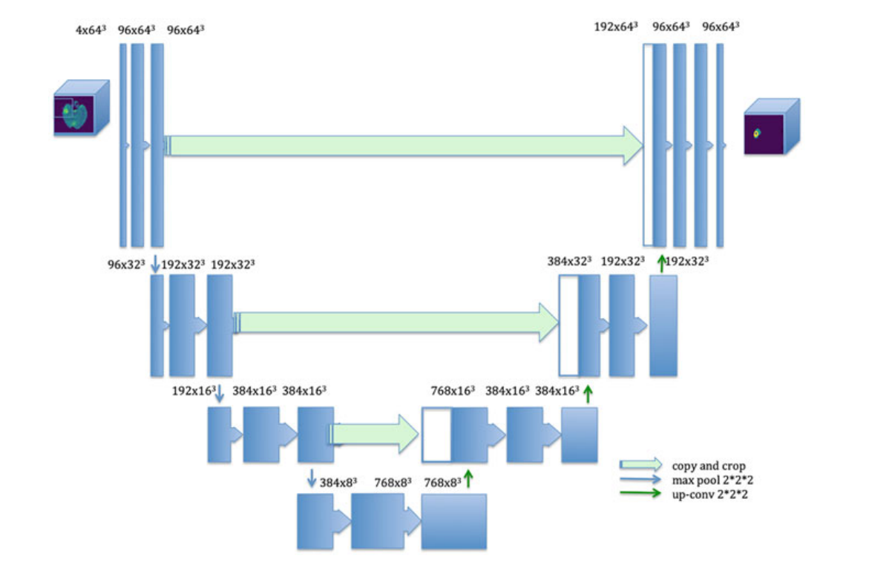
3D Unet Model Architecture:

Slide 14
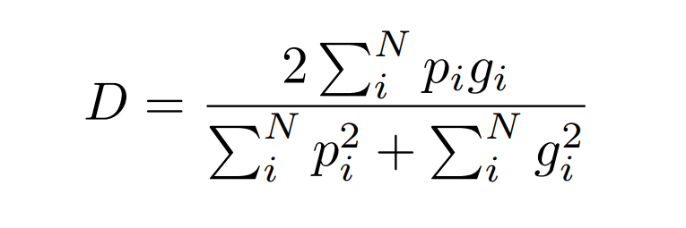
Dice Loss
Dice loss, also known as the Sørensen-Dice coefficient, measures the similarity between the predicted segmentation masks and the ground truth masks. It is particularly useful for imbalanced datasets where the class of interest (e.g., tumor regions) might be small compared to the background class.
Dice Coefficient: The Dice coefficient for a single class is computed as:
where the sums run over the N voxels, of the predicted binary segmentation volume pi ∈ P and the ground truth binary volume gi ∈ G.

Slide 15

Dice Loss
Dice loss: The Dice loss is derived from the Dice coefficient and is used as a loss function to train the model. The goal is to maximize the Dice coefficient, which means minimizing the Dice loss.
The Dice loss for multiple classes (e.g., background, edema, non-enhancing tumor, enhancing tumor) is computed as the inverse of the average Dice coefficient for all classes
where N is the number of classes and Dice i ​is the Dice coefficient for class i.

Slide 16
References
Havaei M, Davy A, Warde-Farley D, Biard A, Courville A, Bengio Y, Pal C, Jodoin PM, Larochelle H. Brain tumor segmentation with Deep Neural Networks. Med Image Anal. 2017 Jan;35:18-31. doi: 10.1016/j.media.2016.05.004. Epub 2016 May 19. PMID: 27310171.
Na, X., Ma, L., Milanova, M., Yang, M.Q. (2021). Brain Tumor Segmentation Using Deep Neural Networks and Survival Prediction. In: Arabnia, H.R., Ferens, K., de la Fuente, D., Kozerenko, E.B., Olivas Varela, J.A., Tinetti, F.G. (eds) Advances in Artificial Intelligence and Applied Cognitive Computing. Transactions on Computational Science and Computational Intelligence. Springer, Cham. https://doi.org/10.1007/978-3-030-70296-0_7
V-Net: Fully Convolutional Neural Networks for Volumetric Medical Image Segmentation Fausto Milletari, Nassir Navab, Seyed-Ahmad Ahmadi
Segmentation of Brain Tumor Tissues with Convolutional Neural Networks Darko Zikic1 , Yani Ioannou, Matthew Brown, and Antonio Criminisi

Slide 17
Thank you

