Slide 1

MLC Capstone Project - Model Building
By Krishnabansuri K

Slide 2
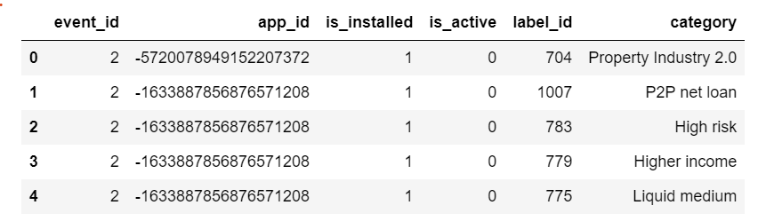
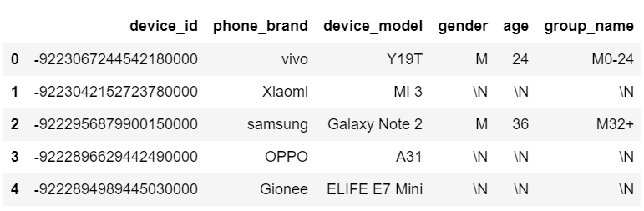
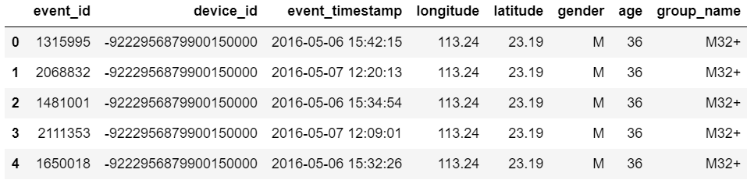
Model Building
Top five rows of the data set at the beginning of the analysis

Slide 3
Model Building
List of data cleaning techniques applied such as missing value treatment, etc.
Across all the 3 data sets, app data, events and non-events data, determined the % of missing values and retained columns where missing values is <40%
Events data that have latitude and longitude between -1 and 1 and equals 0 are eliminated as they have no importance
Converted gender data (M, F) to 1 and 2 respectively
Replaced any special characters in Gender and Age which are the target variables with 0 or median value

Slide 4
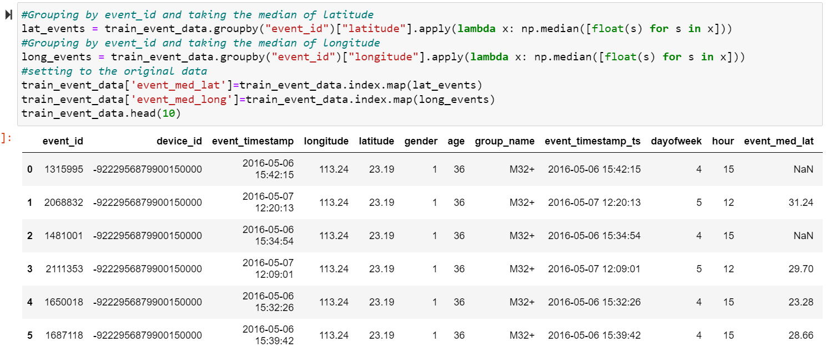
Model Building
Feature engineering techniques that were used along with proper reasoning to support why the technique was used
Created features for such as Median Latitude and Median Longitude for different event ids

Slide 5
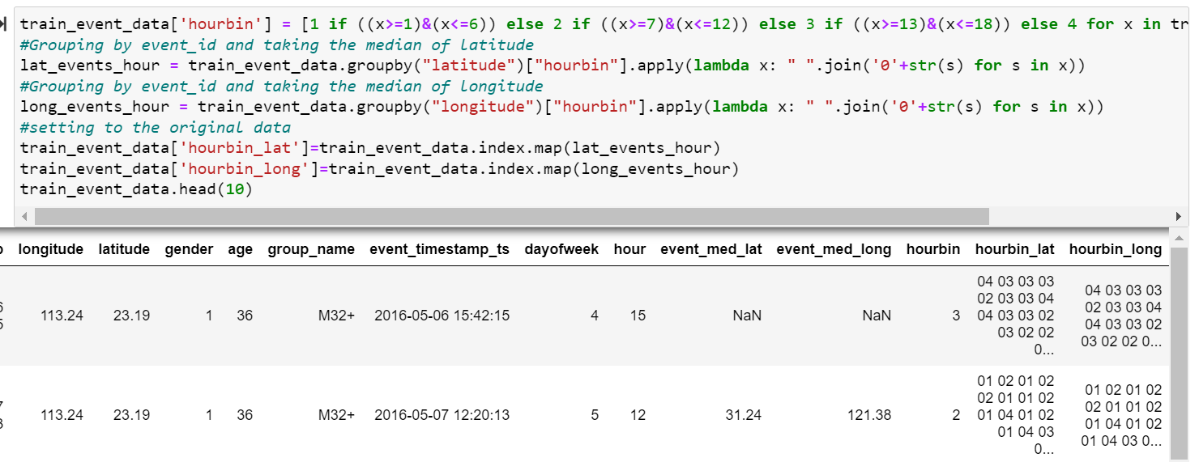
Model Building
Feature engineering techniques that were used along with proper reasoning to support why the technique was used
Used information related to the location of the users (latitude and longitude data) to create features representing changes in the latitude and longitude details at different times of the day

Slide 6
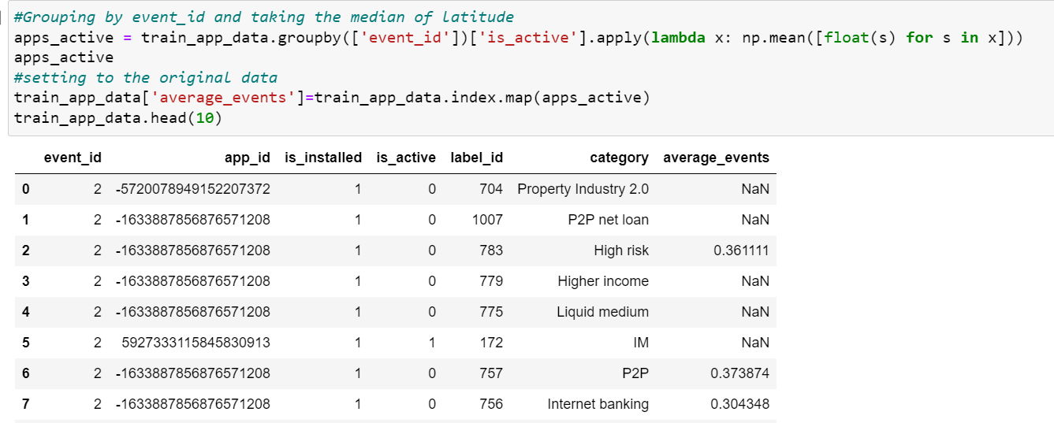
Model Building
Feature engineering techniques that were used along with proper reasoning to support why the technique was used
Created a feature called Average Events, which can give you an estimate of how long the users' mobile phones are active.

Slide 7
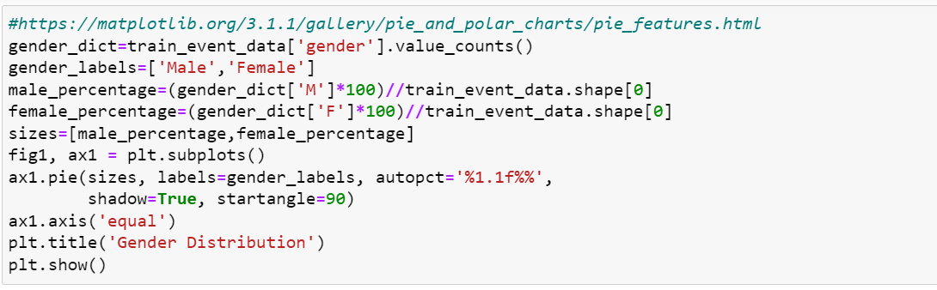
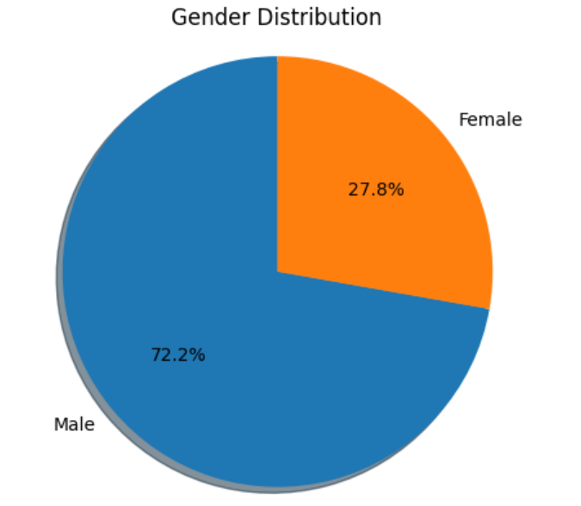
Model Building
Outputs to the various EDA and Visualisation codes along with the corresponding results and the insights gathered from each EDA and visualisation
Plot appropriate graphs representing the distribution of age and gender in the data set [univariate]

Slide 8
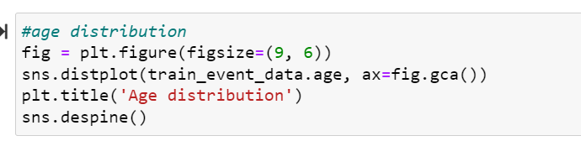
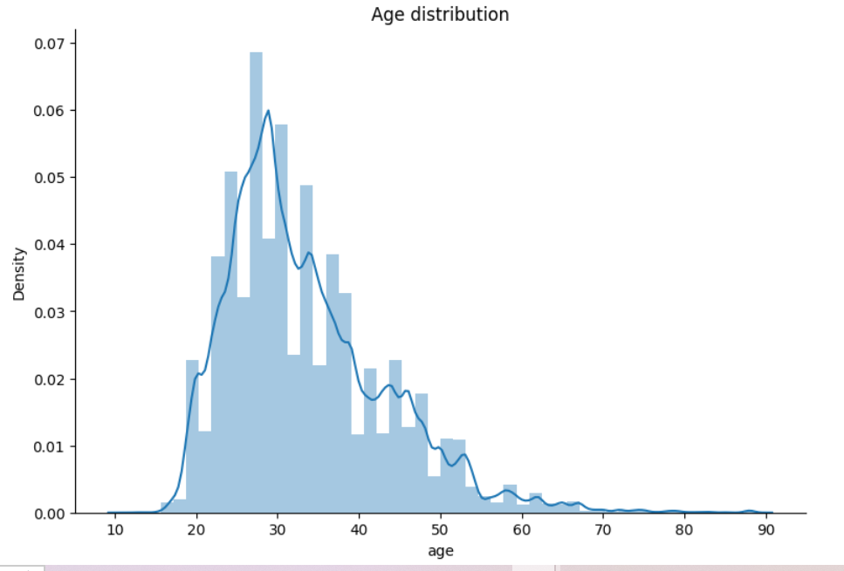
Model Building
Outputs to the various EDA and Visualisation codes along with the corresponding results and the insights gathered from each EDA and visualisation
Plot appropriate graphs representing the distribution of age and gender in the data set [univariate]

Slide 9
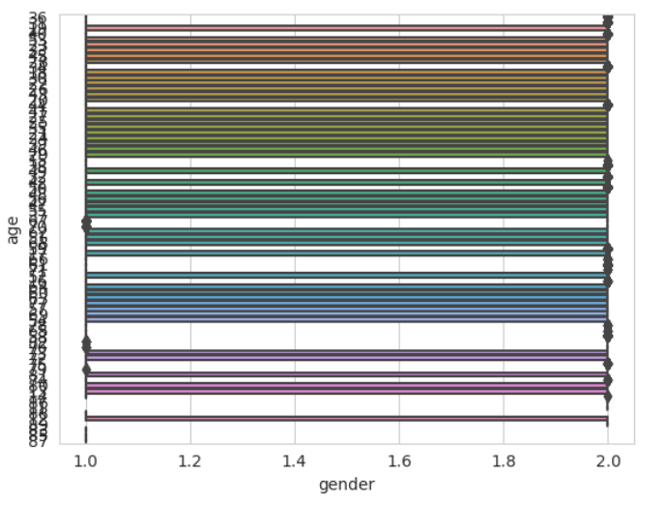

Model Building
Outputs to the various EDA and Visualisation codes along with the corresponding results and the insights gathered from each EDA and visualisation
Boxplot analysis for gender and age [bivariate].

Slide 10
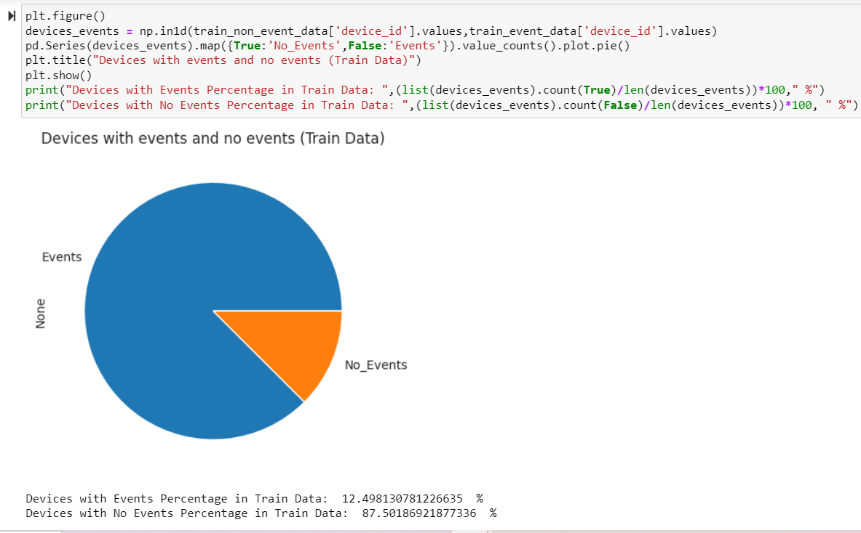
Model Building
Outputs to the various EDA and Visualisation codes along with the corresponding results and the insights gathered from each EDA and visualisation
Plot the percentage of the device_ids with and without event data.

Slide 11
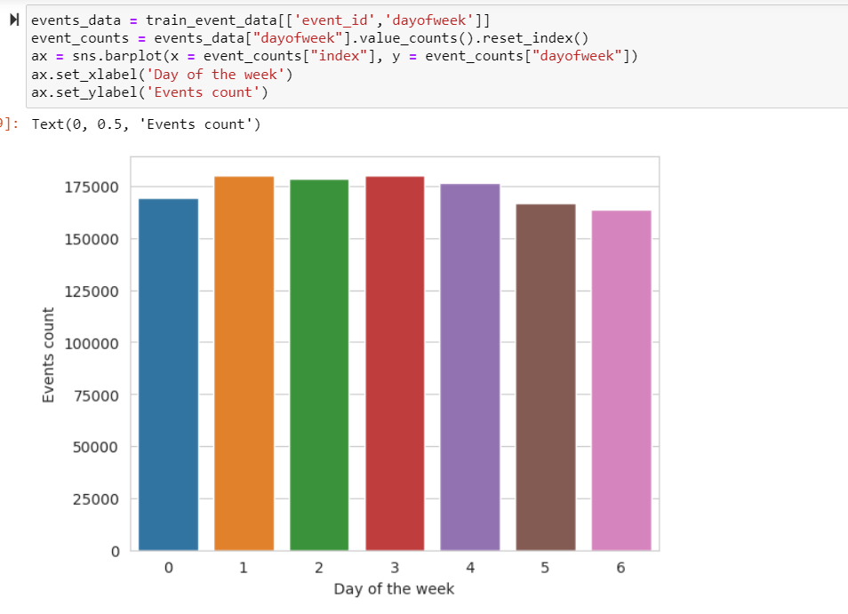
Model Building
Outputs to the various EDA and Visualisation codes along with the corresponding results and the insights gathered from each EDA and visualisation
Plot a graph representing the distribution of events over different days of a week.

Slide 12
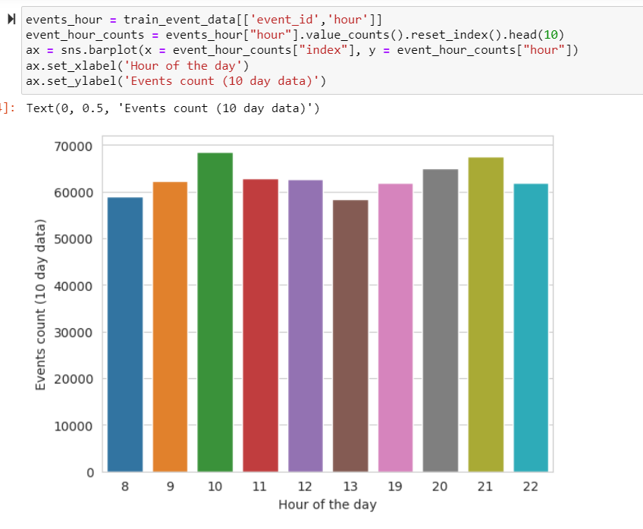
Model Building
Outputs to the various EDA and Visualisation codes along with the corresponding results and the insights gathered from each EDA and visualisation
Plot a graph representing the distribution of events per hour [for one-week data].

Slide 13
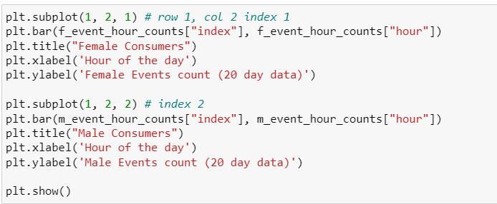
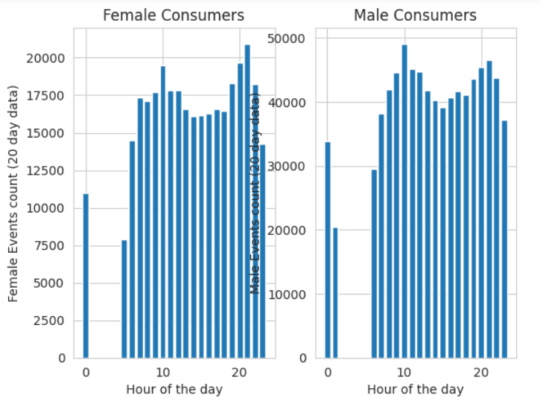
Model Building
Outputs to the various EDA and Visualisation codes along with the corresponding results and the insights gathered from each EDA and visualisation
The difference in the distribution of events per hour for Male and Female consumers. [Show the difference using an appropriate chart for one-week data.]

Slide 14
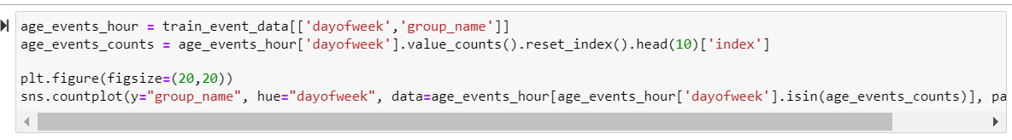
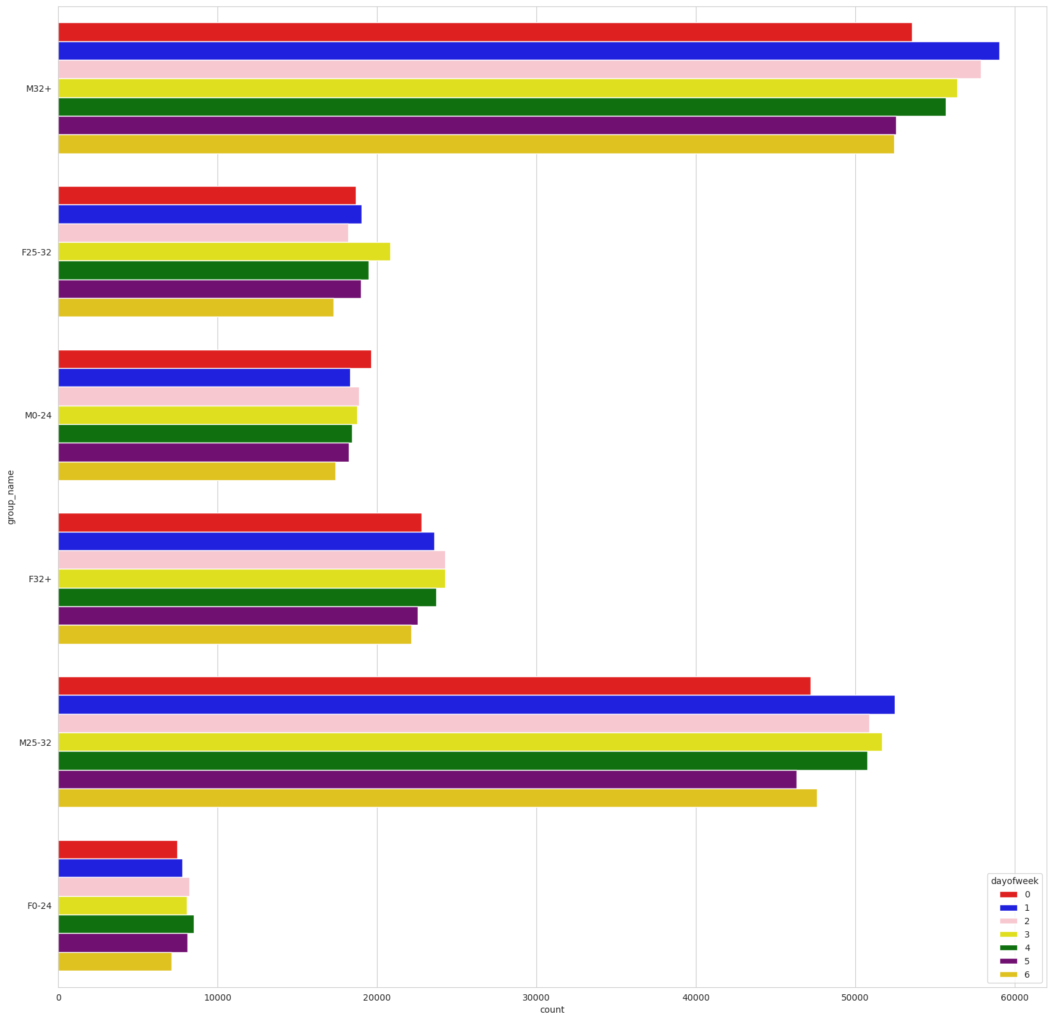
Model Building
Outputs to the various EDA and Visualisation codes along with the corresponding results and the insights gathered from each EDA and visualisation
Is there any difference in the distribution of Events for different Age Groups over different days of the week? [Consider the following age groups: 0–24, 25–32, 33–45, and 46+]

Slide 15
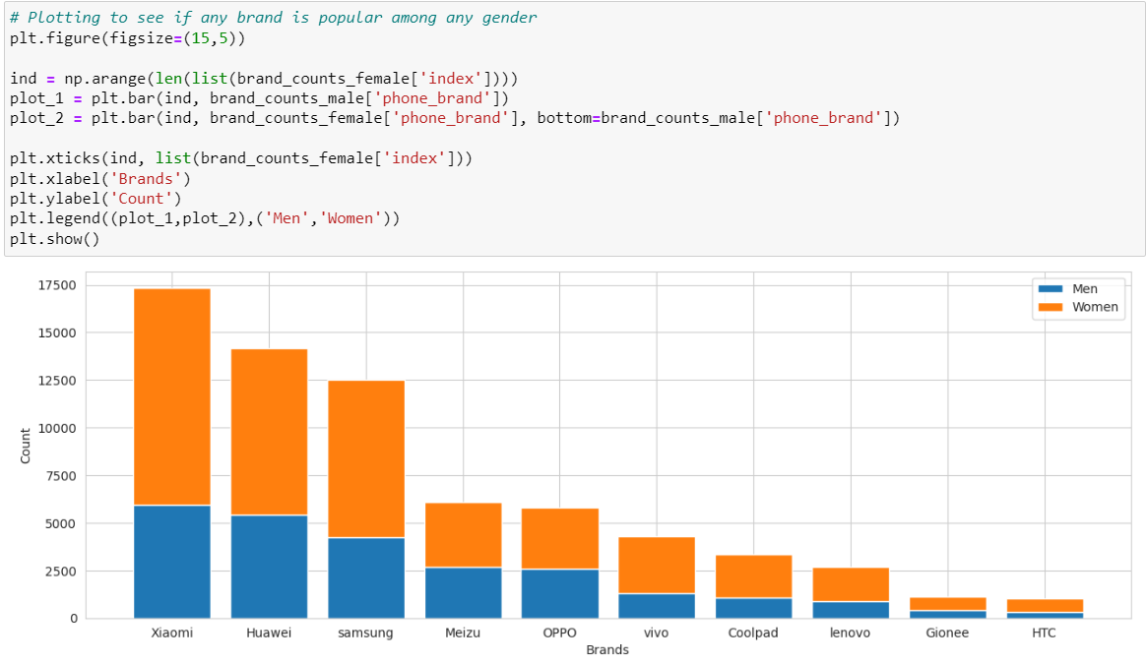
Model Building
Outputs to the various EDA and Visualisation codes along with the corresponding results and the insights gathered from each EDA and visualisation
Stacked bar chart for the top 10 mobile brands across male and female consumers.

Slide 16
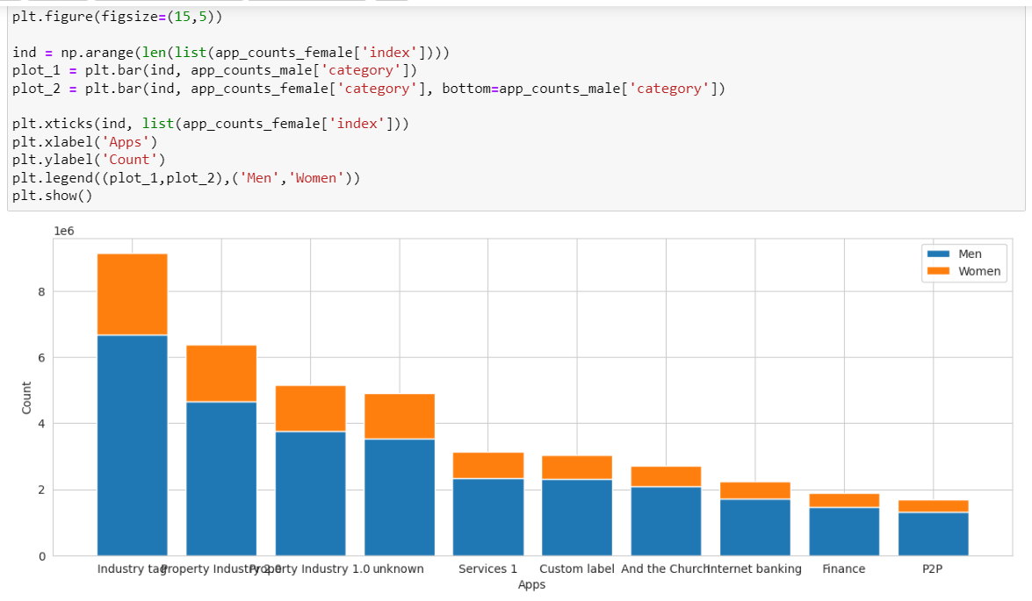
Model Building
Outputs to the various EDA and Visualisation codes along with the corresponding results and the insights gathered from each EDA and visualisation
Prepare a chart representing the ten frequently used applications and their respective male and female percentage.

Slide 17
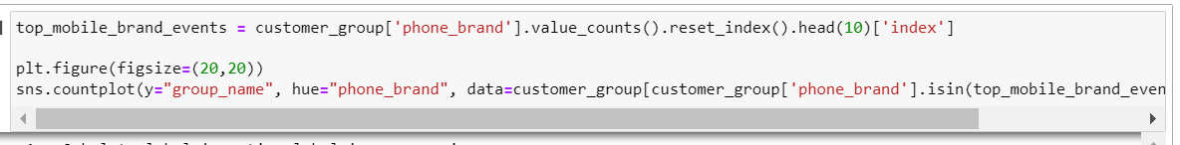
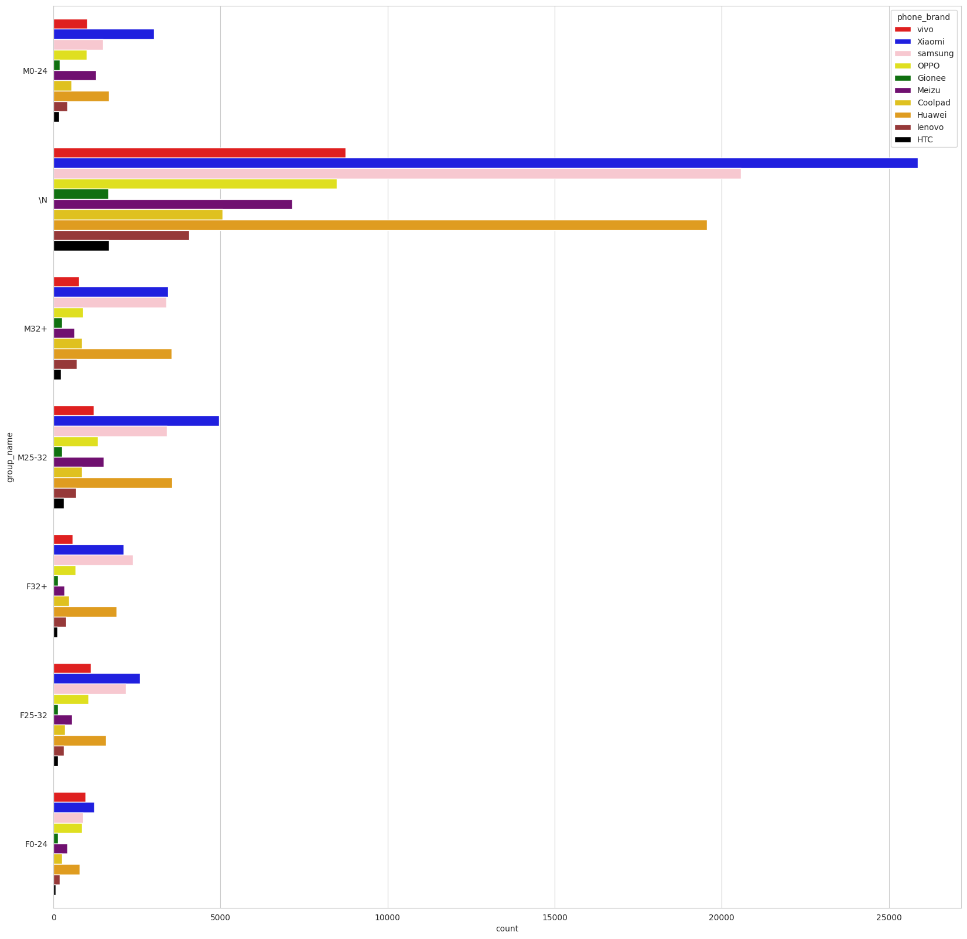
Model Building
Outputs to the various EDA and Visualisation codes along with the corresponding results and the insights gathered from each EDA and visualisation
List the top 10 mobile phone brands bought by customers by age groups. [Consider the following age groups: 0–24, 25–32, 33–45, and 46+]

Slide 18
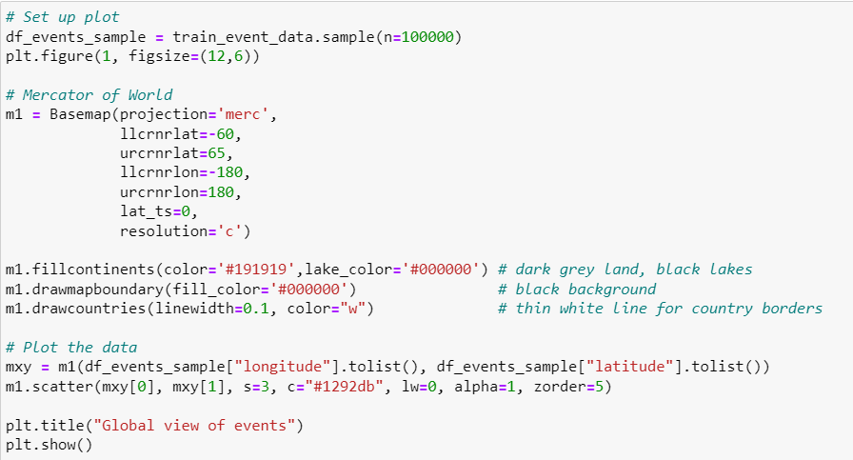
Model Building
Geospatial visualisations along with the insights gathered from this visualisation
Plot the visualisation plot for a sample of 1 lakh data points.

Slide 19
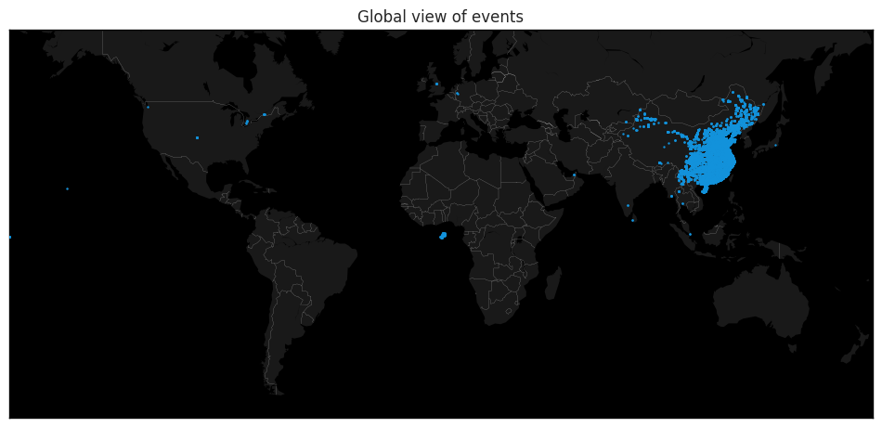
Model Building
Geospatial visualisations along with the insights gathered from this visualisation
Plot the visualisation plot for a sample of 1 lakh data points.

Slide 20
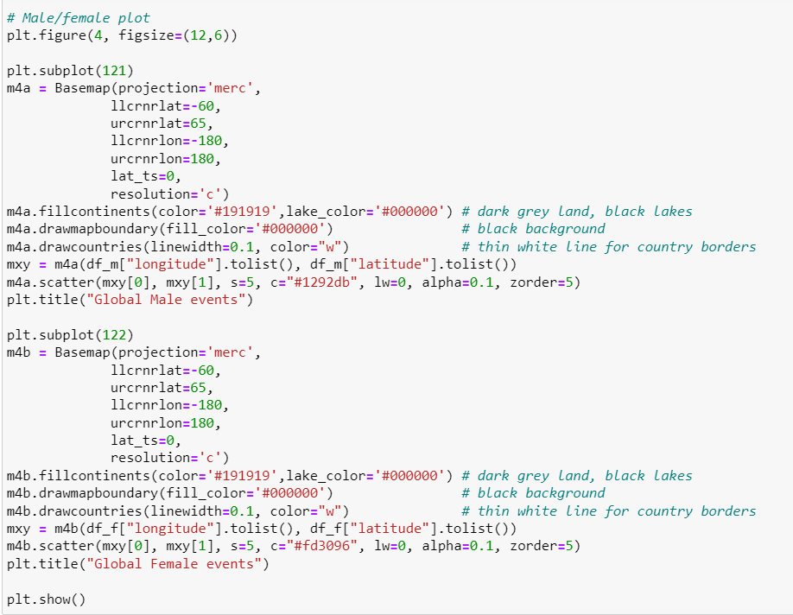
Model Building
Geospatial visualisations along with the insights gathered from this visualisation
Compare the event visualisation plots based on the users' gender information. [This can be done on the sample of 1 lakh data points.]

Slide 21
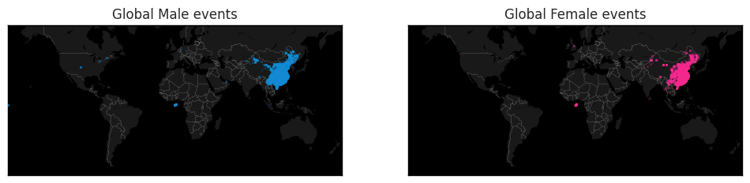
Model Building
Geospatial visualisations along with the insights gathered from this visualisation
Compare the event visualisation plots based on the users' gender information. [This can be done on the sample of 1 lakh data points.]

Slide 22
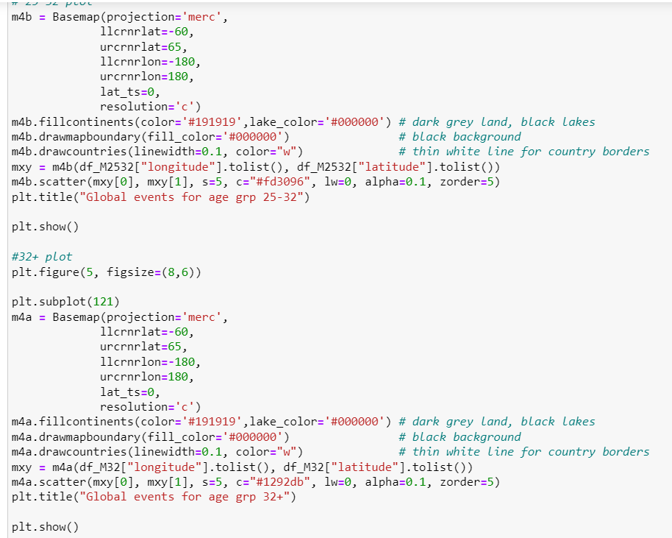
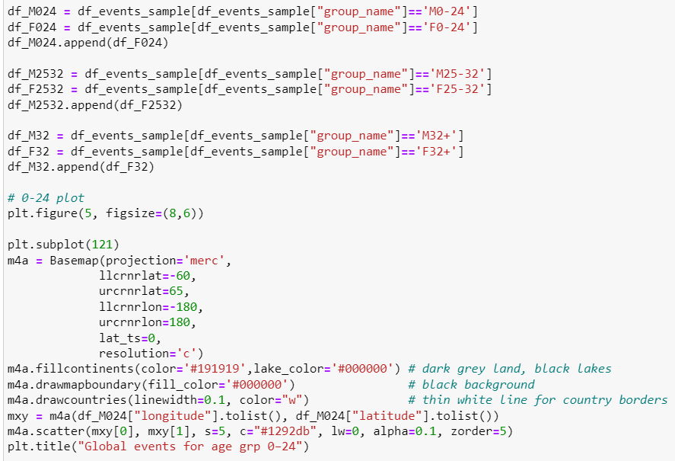
Model Building
Geospatial visualisations along with the insights gathered from this visualisation
Compare the event visualisation plots based on the following age groups:
a) 0–24
b) 25–32
c) 32+

Slide 23
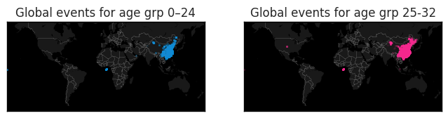
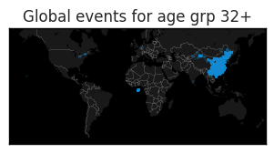
Model Building
Geospatial visualisations along with the insights gathered from this visualisation
Compare the event visualisation plots based on the following age groups:
a) 0–24
b) 25–32
c) 32+

Slide 24
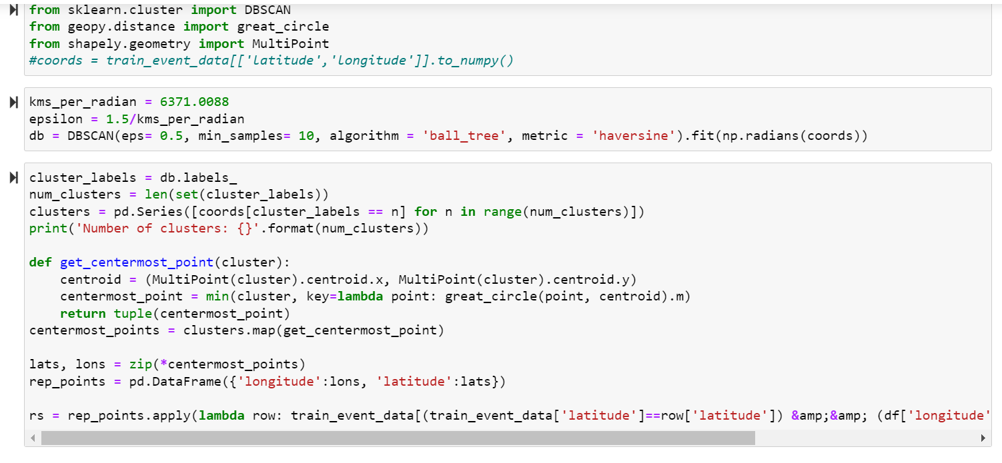
Model Building
Results interpreting the clusters formed as part of DBSCAN Clustering and how the cluster information is being used
Used DBSCAN clustering to reduce the events data based on lat and long. Code for the same

Slide 25
Model Building
A brief summary of any additional subtask that was performed and may have improved the data cleaning and feature generation step
I have applied following methods for data cleaning and feature generation
Convert categorical data to numerical data
one hot/label encoding from pandas
csr matrix from scipy - sparse matrix

Slide 26
Model Building
All the data preparation steps that were used before applying the ML algorithm
Got rid of duplicate device ids in non events data
Encoding the brands using LabelEncoder
Concatenating Phone Brand and Model and encoding the same
Encoding the device models using LabelEncoder same way as done for Brands
Dropping columns timestamp, timestamp_ts, phone_brand, device_model, group_name
Read the test and train data and divide the data for events and without events
Checking and extracting the Device Ids which have Event Details for Train Data
Setting device_id as index for Train, Test Data
Created columns trainrow, testrow in Train and Test Data to indicate which row a particular device belongs to and this will be useful in our One-hot encoded Sparse Matrix Creation, in which we will specify number of rows in the sparse matrix
Getting the csr matrix from the encoded columns for events data and non-events data
Stacking all the features together for GENDER/AGE analysis ---- WITH EVENTS

Slide 27
Model Building
All the data preparation steps that were used before applying the ML algorithm
Stacking all the features together - GENDER/AGE analysis WITHOUT EVENTS
Stacking all the features together for GENDER/AGE analysis WITH EVENTS
Saving Data without Events for GENDER and AGE prediction
Saving Devices with Events for GENDER and AGE prediction

Slide 28
Model Building
Documentation of all the machine learning models that were built along with the respective parameters that were used (e.g., DBSCAN, XGBoost, Random Forest, GridSearchCV, etc.)
Segregated the data that is data that has event data and that doesn't have event data
Scenario 1: latitude-longitude data, application id data, event data and devices data
Scenario 2: only have the mobile phone, brand and device data available.
Gender and Age Prediction
Gender - scenario1
used logistic regression, XGboost classifier with GridSearchCV, Randomforest classifier and finally used StackingCVClassifier
Age - scenario1
used linear regression, XGBoost regressor with GridsearchCV, Randomforest regressor and finally used stackingCVregressor
The same set of models were applied for scenario 2 also

Slide 29
Model Building
The reason for using regression or classification for age prediction
When Age was classified there were quite a lot of bins. Classification could have been adopted if the bins were limited. Since the bins were quite a lot, regression was adopted.

Slide 30

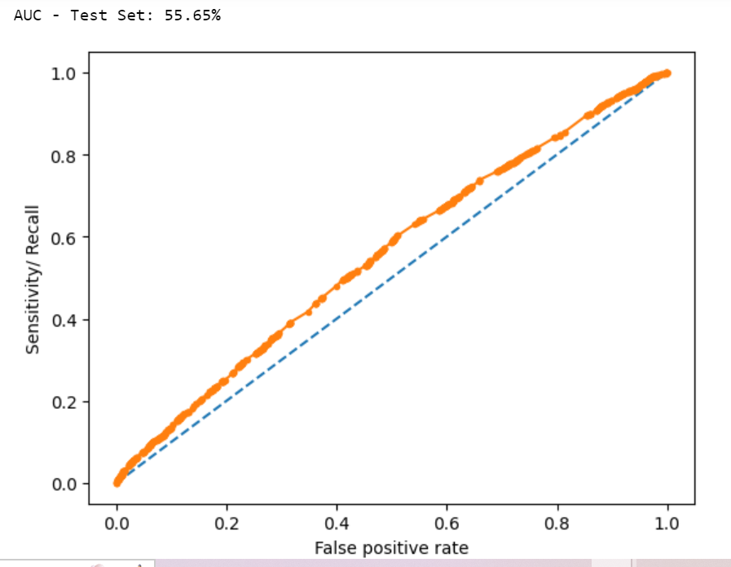
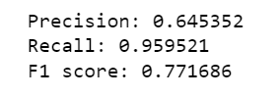
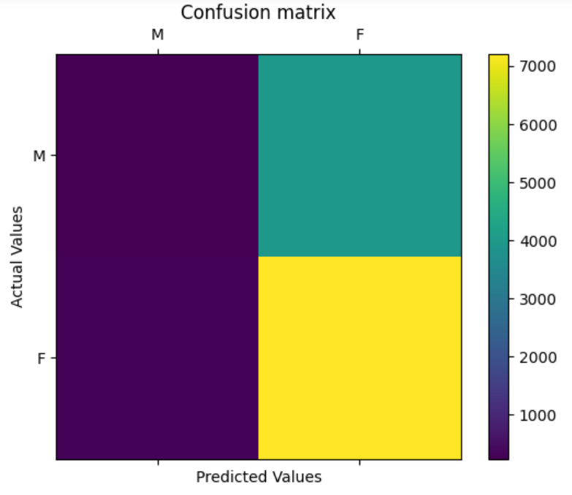
Model Building
The outcomes of the evaluation metrics (results for both Scenario 1 and Scenario 2 must be shown separately).
Model Evaluation for Gender prediction without events

Slide 31
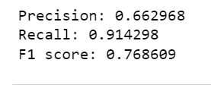

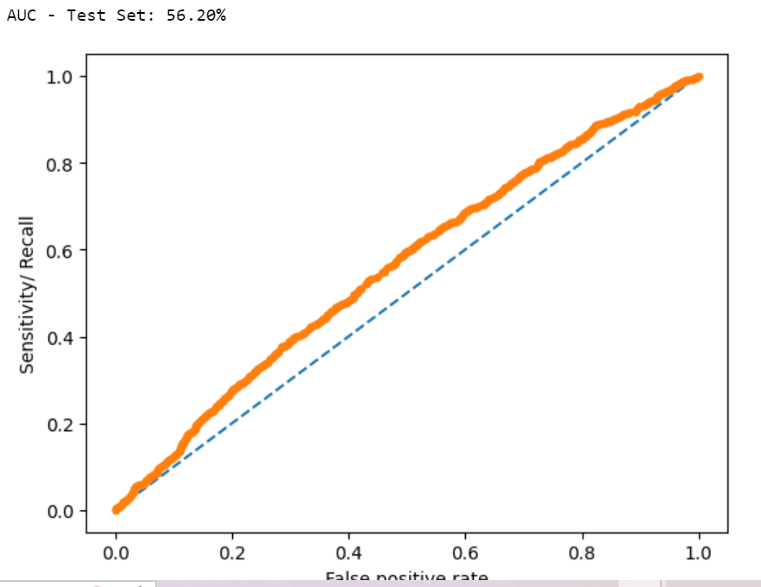
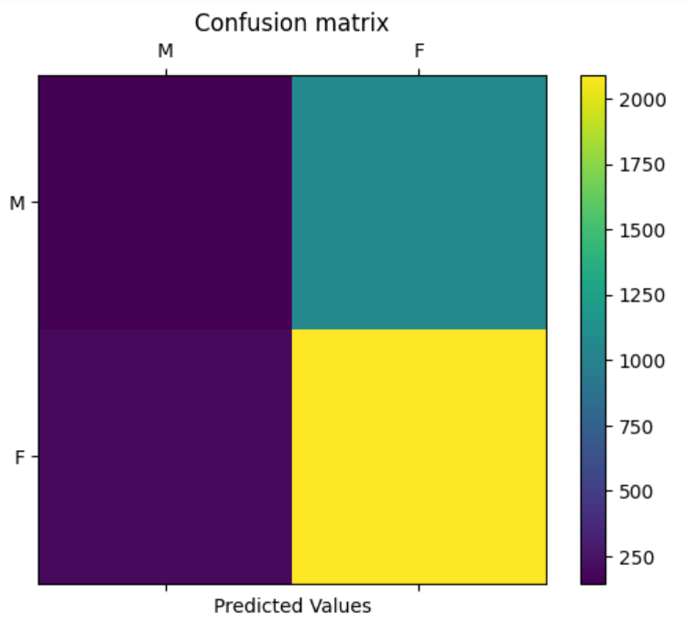
Model Building
The outcomes of the evaluation metrics (results for both Scenario 1 and Scenario 2 must be shown separately).
Model Evaluation for Gender prediction with events

Slide 32
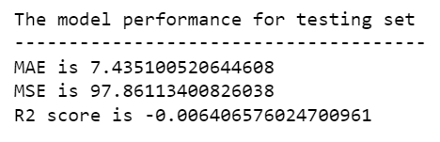
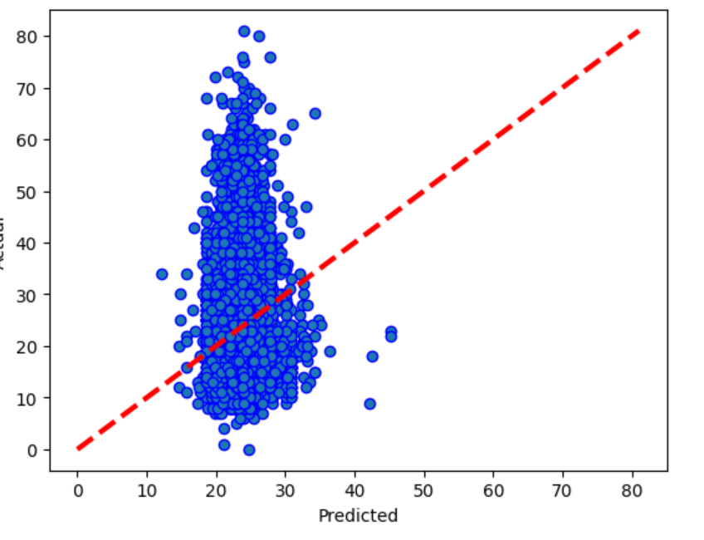
Model Building
The outcomes of the evaluation metrics (results for both Scenario 1 and Scenario 2 must be shown separately).
Model Evaluation for Age prediction without events

Slide 33
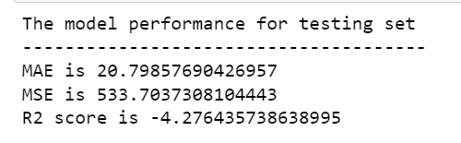
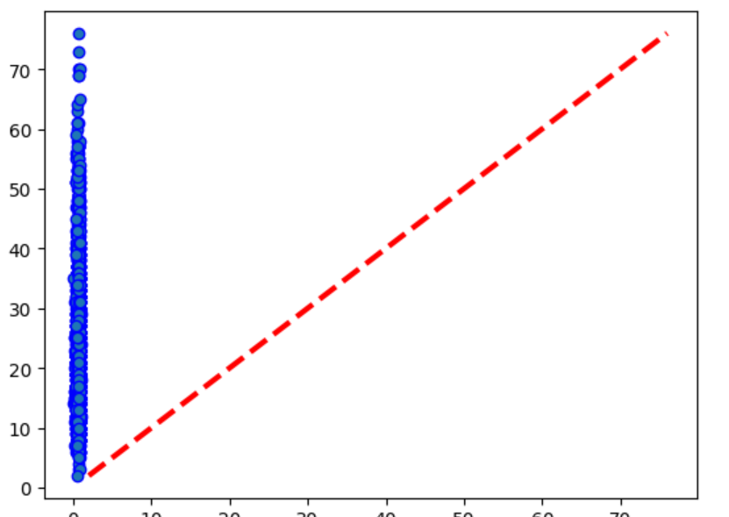
Model Building
The outcomes of the evaluation metrics (results for both Scenario 1 and Scenario 2 must be shown separately).
Model Evaluation for Age prediction with events

