Slide 1

MLC Capstone Project - Model Deployment
By Krishnabansuri K

Slide 2
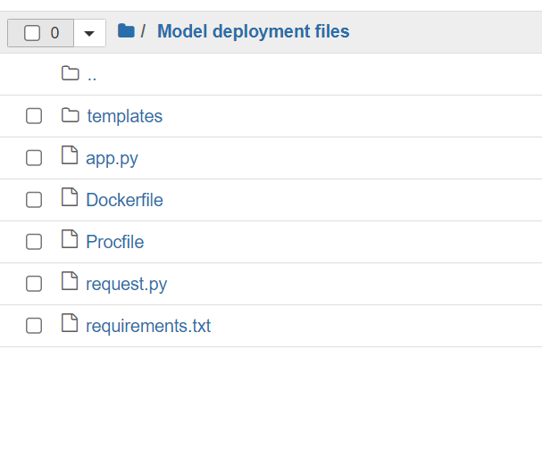
Commands used for deploying the flask application on the ec2 instance
Created following files on ec2 instance in a folder called Model Deployment files
index.html has the html page for us to predict the age and gender for 50 device ids
App.py has the implementation of 2 services using Flask, / and /predict. Predict gives the predictions for the 50 device ids
Docker file contains the commands to create the image
Following commands are used to create an image on ec2 instance

Slide 3
Commands used for deploying the flask application on the ec2 instance
To install docker on EC2:
sudo amazon-linux-extras install docker
sudo yum install docker
start to docker service
sudo service docker start
change the user permissions
sudo usermod -a -G docker ec2-user
sudo chmod 666 /var/run/docker.sock
#build docker image
docker build -t agegenderprediction .
Run the docker container
docker run -p 5000:5000 agegenderprediction
This command will give a public URL with which we can access the flask app

Slide 4
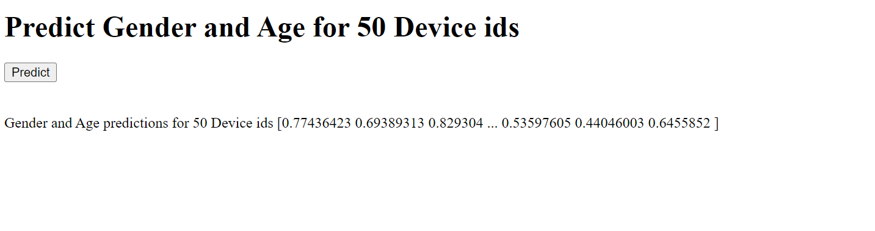
The screenshot of the final output for predicting the campaigns for the 50 customers

