Slide 1







Tech Survey Analytics: Visualizing Programming Trends, Demographics, and Technology Preferences
KRISHNABHARATHY MANIKANDAN
08.04.2024
This Photo by Unknown Author is licensed under CC BY-NC-ND

Slide 2



OUTLINE
Executive Summary
Introduction
Methodology
Results
Visualization – Charts
Dashboard
Discussion
Findings & Implications
Conclusion
Appendix

Slide 3

EXECUTIVE SUMMARY
To programming languages in demand:
JavaScript, HTML/CSS, SQL, Bash/Shell/PowerShell, Python
Top database skills in demand:
My SQL, Microsoft SQL Server, Postgre SQL, SQLite, MongoDB
Popular platforms:
Windows, Linux, Docker, AWS, Slack
Popular Web Frames:
jQuery, Angular/Angular.js, React.js, ASP.NET, Express
Future Technology Trend:
Python takes the third row, followed by SQL and TypeScript
Redis and Elasticsearch also place in Top 5
Android is in the Top 5 demanded platforms, the rest remains
React.js takes the first row and Vue.js is the latest addition as the last

Slide 4

INTRODUCTION
Objective: Analyzing the Patterns and Trends in Technology Jobs
Purpose of the Analysis:
To comprehend the current and future job demands in the technology field.
Identifying the leading programming languages in high demand.
Recognizing the top databases sought after in the industry.
Evaluating the popularity of Integrated Development Environments (IDEs).
Target Audience: Individuals aspiring to pursue careers in the technical field and professionals working in IT departments

Slide 5

METHODOLOGY
Sources of Data Collection:
Stack Overflow Developer 2019 Survey
GitHub Job Postings
Programming Languages Annual Salary
Data Exploration
Data Cleaning
Data Visualization
Presentation

Slide 6
RESULTS
Python overtakes Java, becoming the 5th most preferred
language with significant growth. It stands as the fastestgrowing
major programming language.
JavaScript remains the most used programming language.
jQuery is the most widely used among web frameworks,
with React.js surpassing Angular in developer usage this
year.
Globally, men represent approximately 90% of respondents,
with higher female representation among students than
professional developers in regions like the US, India, and the
UK.
Around 3/4 of professional developers globally hold at least
a bachelor's degree, aligning with past findings.
3/4 of survey respondents in professional developer roles
are under 35 years old.

Slide 7
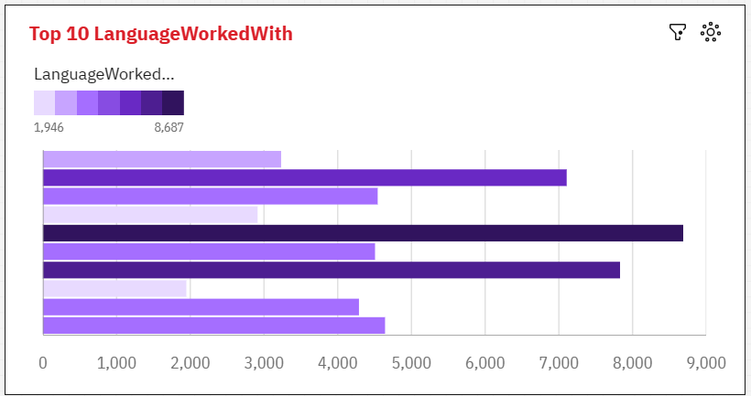
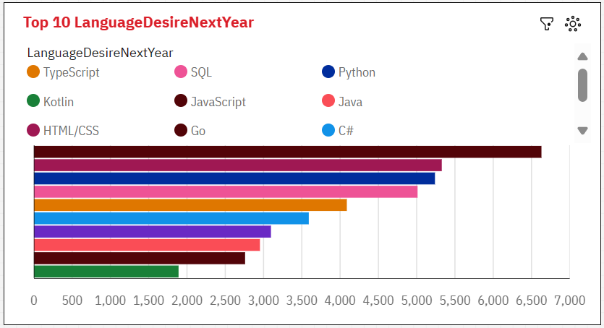
PROGRAMMING LANGUAGE TRENDS
CURRENT YEAR
NEXT YEAR

Slide 8
PROGRAMMING LANGUAGE TRENDS - FINDINGS & IMPLICATIONS
Findings
JavaScript, HTML/CSS, and SQL are the top three programming languages for this year.
Python and TypeScript are expected to gain popularity in the coming year.
PowerShell will experience a decline in demand in the next year.
Implications
Web development continues to be in high demand, reinforcing the importance of JavaScript, HTML/CSS, and SQL skills.
Companies still rely on SQL for managing Big Data technologies.
With the increasing demand for AI and ML, Python remains the best choice for those looking to specialize in these fields.

Slide 9
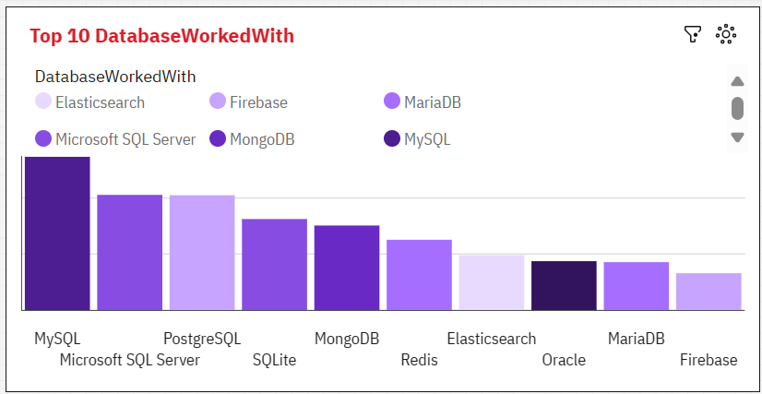
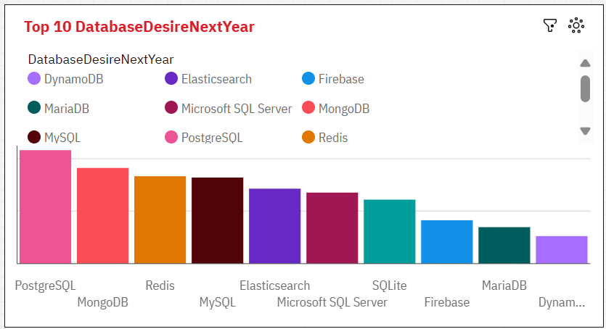
DATABASE TRENDS
Current Year
Next Year

Slide 10
DATABASE TRENDS - FINDINGS & IMPLICATIONS
Findings
MySQL is the most popular database.
Microsoft SQL closely follows as the second most popular choice.
MongoDB and Redis are emerging as favorites among users.
Elasticsearch is a newcomer gaining attention.
Implications
Open-source databases continue to be the preferred choice for companies, with MySQL leading the way.
NoSQL databases like MongoDB and Redis will have a significant impact on storing non-relational data.
Redis's support for abstract data types offers versatility and flexibility in data storage.
Elasticsearch provides pre-tuned search capabilities for websites, apps, and ecommerce stores, enhancing user experience and efficiency in data retrieval.

Slide 11

DASHBOARD
You can find the Dashboard link below:
https://github.com/krishnabharathy/Capstone-Project/blob/main/Building%20a%20dashboard%20with%20IBM%20Cognos%20Analytics.pdf

Slide 12
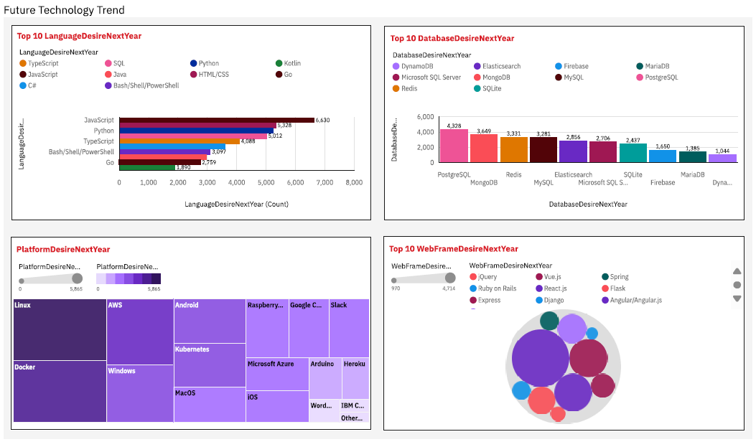
FUTURE TECHNOLOGY TREND DASHBOARD

Slide 13
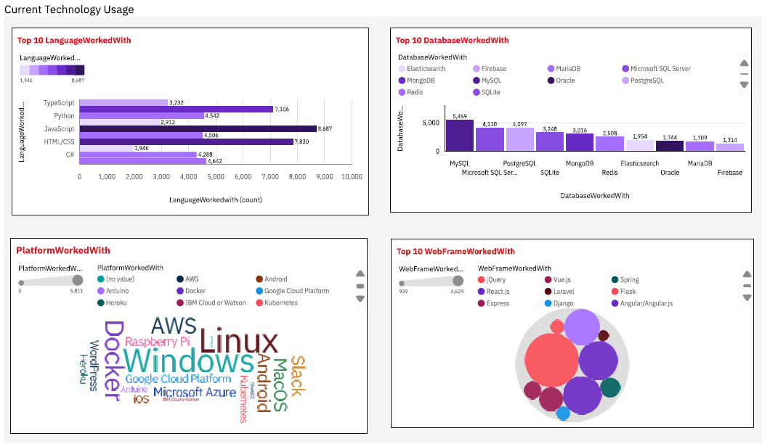
CURRENT TECHNOLOGY USAGE DASHBOARD

Slide 14
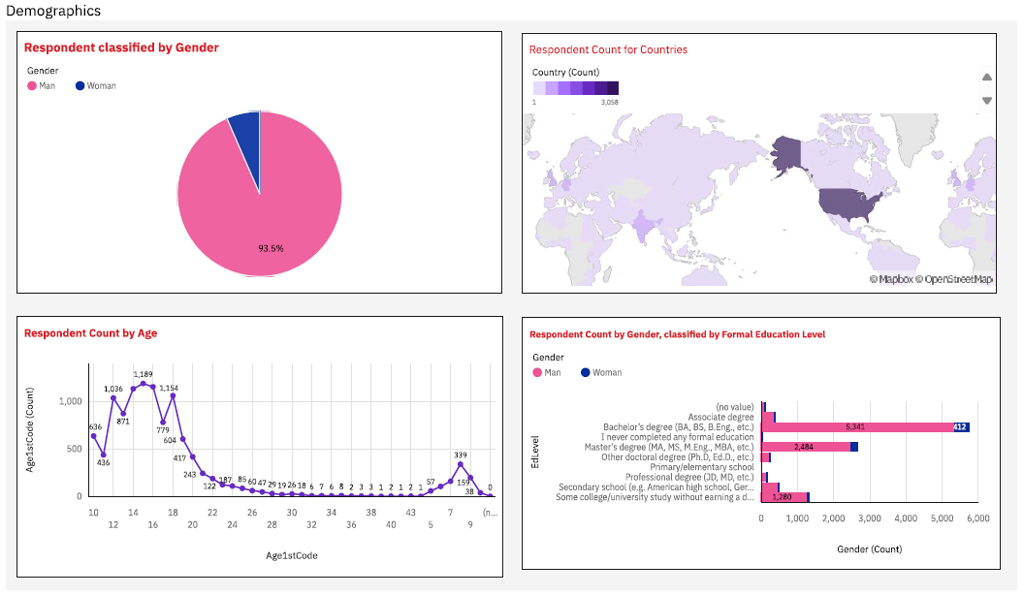
DEMOGRAPHICS

Slide 15
DISCUSSION
The dominance of JavaScript and HTML/CSS and the adoption of MySQL as the leading database management system
Highlights the central role of web development in the programming landscape
Opens up discussions on the significance of client-side scripting and styling, trends in web development frameworks, and the evolving nature of web technologies

Slide 16
OVERALL FINDINGS & IMPLICATIONS
Findings
Technology rapidly evolves each year.
Technology concentration in countries like USA and India.
Gender gap persists in technology jobs.
Growing popularity of platforms like Docker and AWS.
Implications
Companies must be adaptable to cope with fast-paced technological changes.
Efforts needed to distribute technology advancements to less developed countries.
Gender disparity influences job hiring practices.
A shift towards faster app deployments and increased reliance on cloud services in the future.

Slide 17

CONCLUSION
The findings underscore the dynamic nature of the programming landscape and the critical role of technology in driving innovation across industries.
As developers navigate this ever-changing terrain,
a keen understanding of diverse programming languages
database systems becomes essential to meet the demands of modern applications
ensure optimal outcomes in software development projects.

Slide 18

APPENDIX
Job Postings Chart
Popular Languages Chart

Slide 19
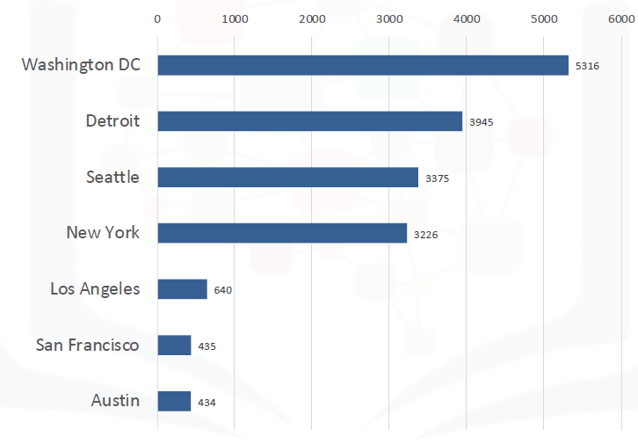
JOB POSTINGS

Slide 20
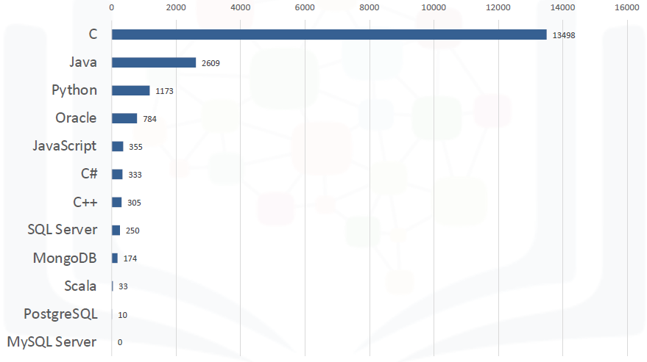
POPULAR LANGUAGES

