Slide 1
Customer Segmentation using K-Means
A.D. Patel Institute of Technology
The Charutar Vidya Mandal (CVM) University
Data Science Project
Prepared By:
Krishna Bhavsar (12302120601035)
Punit Kaka (12302120601051)
Pratham Vyas (12302120601049)

Slide 2
Index
Introduction
Problem Statement
Dataset Description
Tools Used
K-Means Clustering
Choosing K: Elbow & Silhouette
Customer Groups
Output: Cluster Chart
Marketing Strategies
Dashboard & Predict a Customer
Conclusion & Future Scope

Slide 3
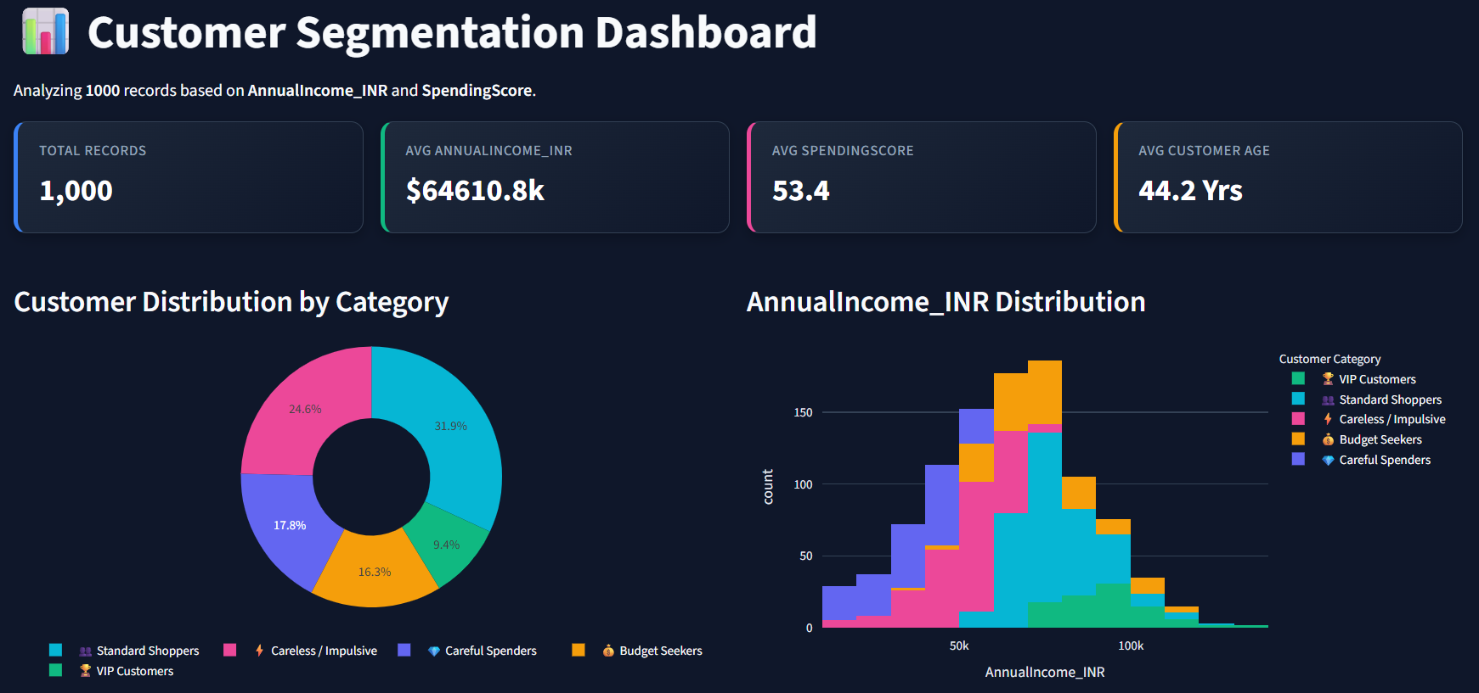
Introduction
Customer segmentation means putting similar customers in the same group.
Each group can then get its own offer, instead of one offer for everyone.
K-Means is a simple method that sorts customers into K groups by how close they are to each other.
This project groups 1,000 customers using their Annual Income and Spending Score.
Dashboard overview from our project

Slide 4
Problem Statement
Problem: A shop has many customers, but sending the same offer to everyone wastes money and misses the best customers.
Objectives:
Group customers who behave alike.
Give each group an easy name.
Suggest the best offer for each group.
Build a dashboard that anyone can use.
Our answer: customer segmentation. We split customers into groups with K-Means, then treat each group differently.

Slide 5
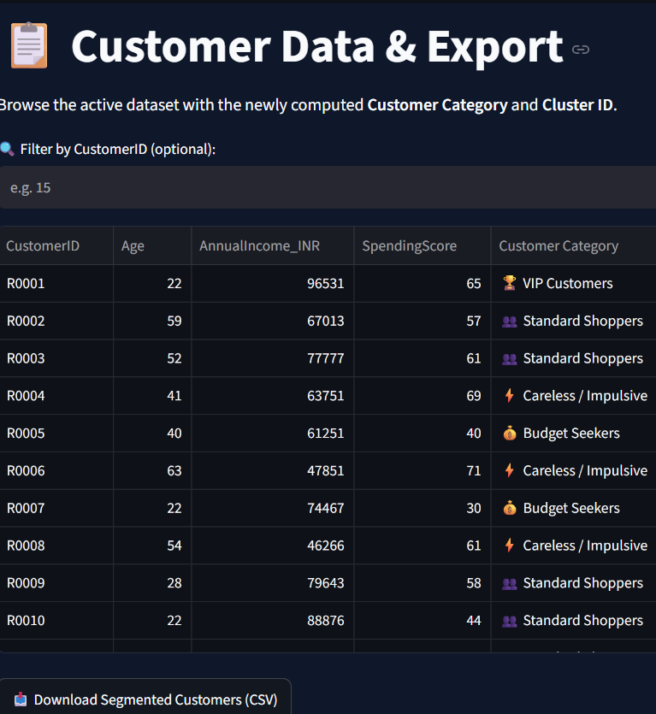
Dataset Description
1,000
₹64,610
53.4
44.2 yrs
customers
average yearly income
average spending score
average age
Data: a customer CSV file with 1,000 rows. You can also upload your own file.
Columns: Customer ID, Age, Annual Income (₹), Spending Score.
Spending Score: a number from 1 to 100. Higher means the customer spends more.
Used for groups: Annual Income and Spending Score. Other columns can be chosen in the dashboard.
Output: every customer gets a group name and a cluster number.
Customer table in the dashboard

Slide 6
Tools Used
1
Python
2
Pandas
3
Scikit-learn
Main programming language for the whole project.
Loads the customer file and works with the data table.
Runs the K-Means model and the Silhouette score.
4
Plotly
5
Streamlit
6
CSV file
Makes interactive charts. Hover to see details.
Turns the Python code into a web dashboard.
Customer data goes in, the grouped result comes out for download.

Slide 7
K-Means Clustering
How the algorithm works
Pick K centre points to start.
Each customer joins the nearest centre.
Move each centre to the middle of its group.
Repeat steps 2 and 3 until nothing changes.
Real-life example: sorting students into teams, where each student joins the team whose captain is nearest.
Our setup
Features: Annual Income, Spending Score
Tool: K-Means from Scikit-learn
Clusters (K): chosen with a slider in the dashboard
Checks: Elbow method and Silhouette score
Result: 5 named customer groups

Slide 8
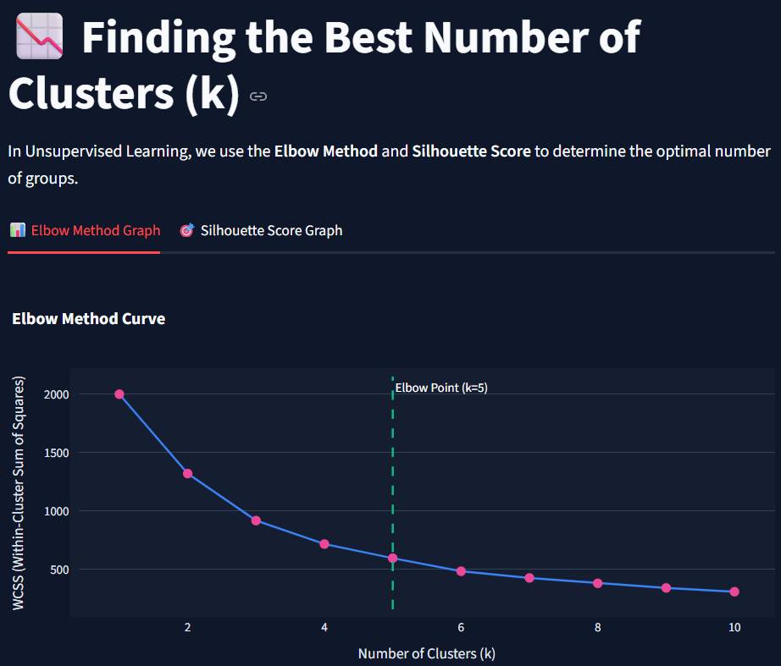
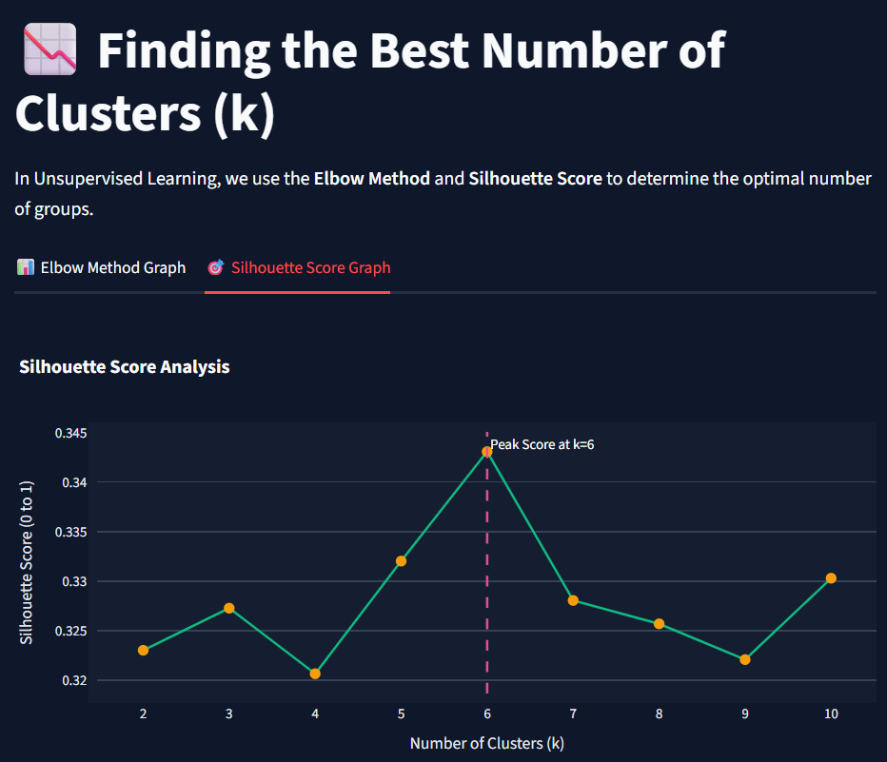
Choosing K: Elbow & Silhouette
Elbow chart: error falls as groups increase
Silhouette chart: how clear the groups are
Elbow: more groups means less error, but after a point it helps very little. The bend (elbow) of the curve is a good K.
Silhouette: a higher score means clearer groups. In our chart the score peaks at K = 6 (about 0.34).
Easy scale: close to 1 is very good, near 0 means groups overlap, below 0 means a wrong group.

Slide 9
Customer Groups
# | Segment | Income | Spending | Who they are
1 | VIP Customers | High | High | Best customers who love quality
2 | Careful Spenders | High | Low | Check reviews before buying
3 | Careless / Impulsive | Low | High | Buy quickly on offers and new items
4 | Budget Seekers | Low | Low | Look for the lowest price
5 | Standard Shoppers | Middle | Middle | Steady, regular buyers
Insight: each group needs a different message. High spenders get VIP care, careful buyers need proof of value, and budget shoppers respond to discounts.

Slide 10
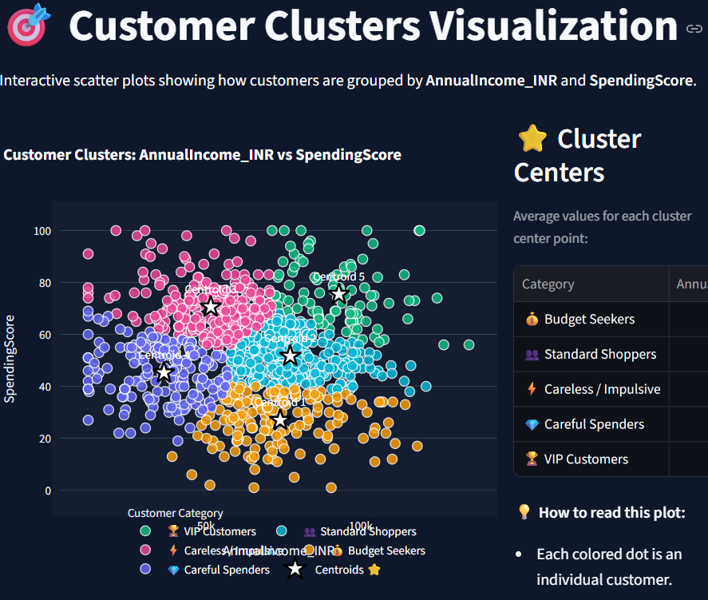
Output: Cluster Chart
Observations
Each dot is one customer.
Dots close together belong to the same group.
The white stars mark the centre of each group.
Hover over a dot to see that customer’s details.
A new customer joins the group with the nearest centre.
Customer clusters: Annual Income vs Spending Score

Slide 11
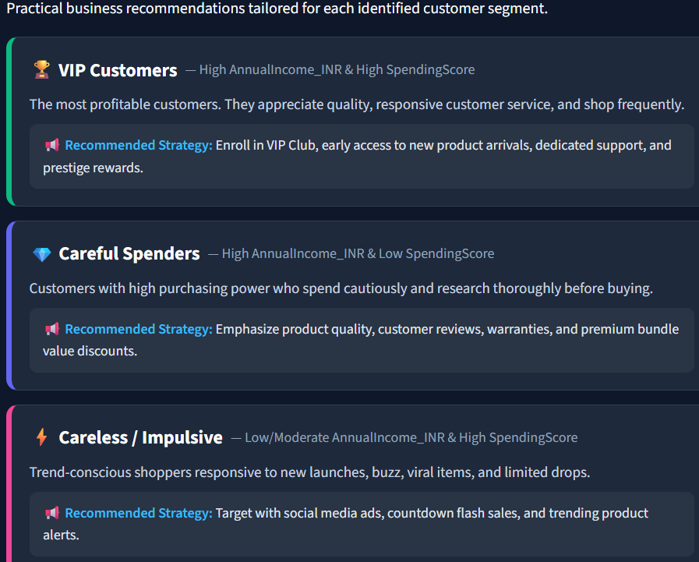
Marketing Strategies
VIP Customers: VIP club, early access to new products, special support.
Careful Spenders: show reviews, warranties and value discounts.
Careless / Impulsive: flash sales, countdown deals, trending items.
Budget Seekers: low-price deals and discount coupons.
Standard Shoppers: loyalty points and seasonal discount emails.
Strategies page in the dashboard

Slide 12
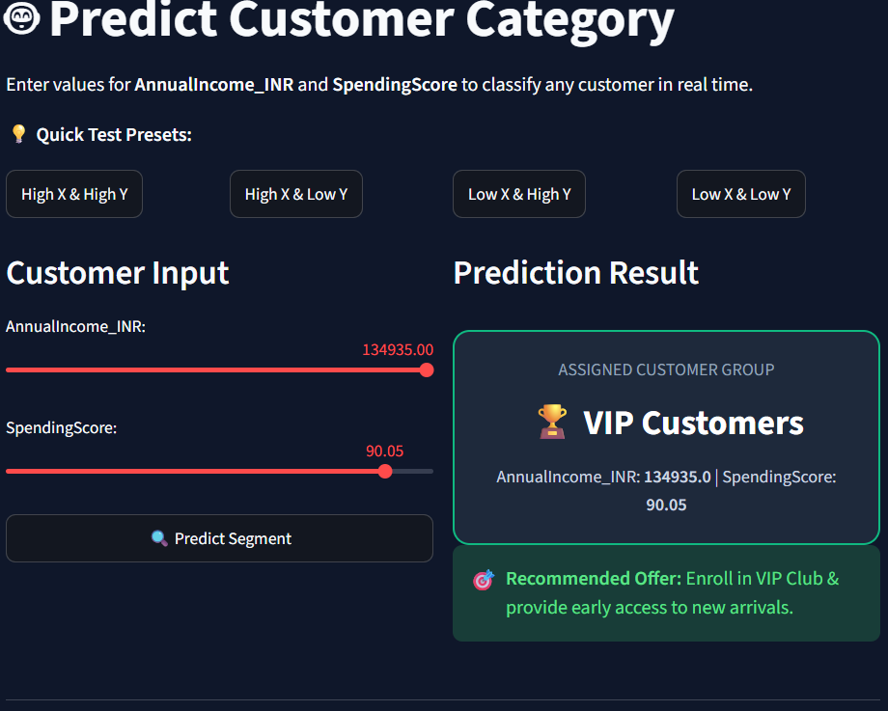
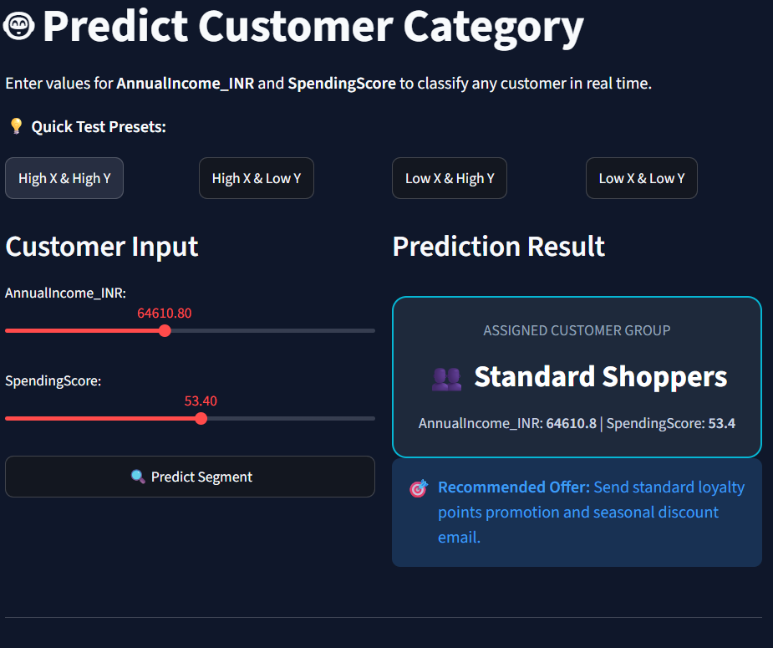
Dashboard & Predict a Customer
Average income + spending: Standard Shoppers
High income + high spending: VIP Customers

Slide 13
Conclusion & Future Scope
Conclusion
K-Means grouped 1,000 customers into 5 easy-to-understand segments.
Elbow and Silhouette checks help pick a good K.
Each group gets its own marketing idea, which saves advertising money.
The dashboard is easy: sliders, charts, CSV upload and download.
Future Scope
Add more features such as age.
Use real shop data.
Try other methods, for example DBSCAN.
Put the app online for everyone.

Slide 14
Thank You!

