Slide 1
Secure Data Hiding in Image Using Steganography
CAPSTONE PROJECT
Presented By: KRISHNA BOGANA
Student Name : KRISHNA BOGANA
College Name & Department : Vignan’s Institute Of Information Technology & CSE

Slide 2
OUTLINE
Problem Statement
Technology used
Wow factor
End users
Result
Conclusion
Git-hub Link
Future scope

Slide 3
Problem Statement
In an era of increasing data security concerns, traditional encryption methods often attract unwanted attention. Steganography offers a covert way to conceal messages within digital images without visible alterations. This project leverages OpenCV to develop a secure image-based steganography system that embeds and retrieves secret text using password protection, ensuring confidential communication while preserving image integrity.

Slide 4
Technology used
OpenCV – Image Processing – Provides read and write functions to images in different formats. Allows direct pixel manipulation, which is crucial for hiding and extracting secret messages.
NumPy – Efficient Array Handling - OpenCV loads images as NumPy arrays, allowing easy access to RGB pixel values. Fast and efficient mathematical operations on pixel values.
JSON – Secure Metadata Storage - JSON is lightweight and human-readable, making it easy to store and retrieve encryption-related data.
Base64 – Secure Password Encoding - converts password into an encoded format, preventing direct exposure in plaintext. Ensures compatibility with JSON.
Python - Easy-to-use and widely supported for image processing and cryptography applications. Extensive libraries for handling images, encryption, and data storage.
Compatibility : OS – Windows, Linux, macOS
Processor – Intel Core i3 or above
RAM – Atleast 2GB
Python version – 3.7+

Slide 5
Wow factors
Unlike traditional encryption, where the message is clearly visible in ciphertext, steganography hides the message inside an image's pixels, making it nearly undetectable. No one suspects an innocent-looking image contains a secret!
The hidden message cannot be extracted without the correct password, adding an extra layer of security. Even if someone suspects steganography, they still need the correct key to decode it.
Instead of storing passwords as plaintext, it uses Base64 encoding before saving them in JSON. This ensures that the password isn't stored in an easily readable format.
The project supports JPG, PNG, BMP, and more, making it versatile for different use cases. Using PNG is recommended for lossless encryption.

Slide 6
End users
Cybersecurity Professionals & Ethical Hackers
Journalists & Whistleblowers
Intelligence & Law Enforcement Agencies
Software Developers & Security Enthusiasts
Digital Forensics Experts
Users who concerned about Privacy

Slide 7
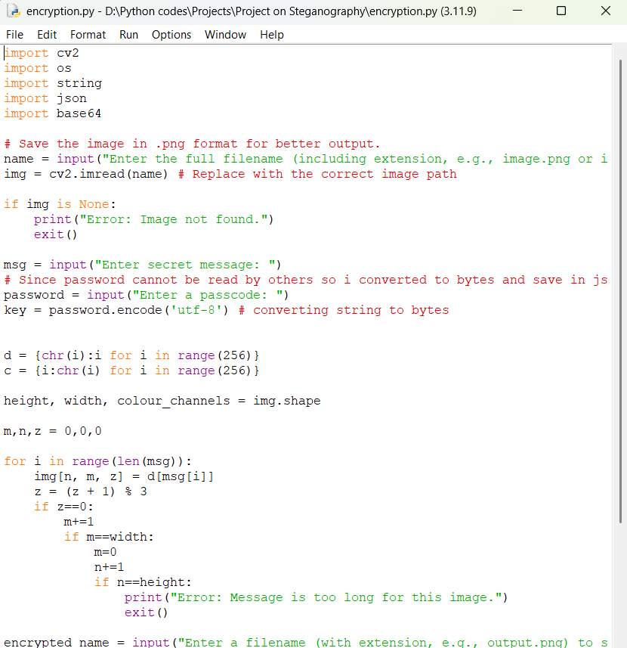
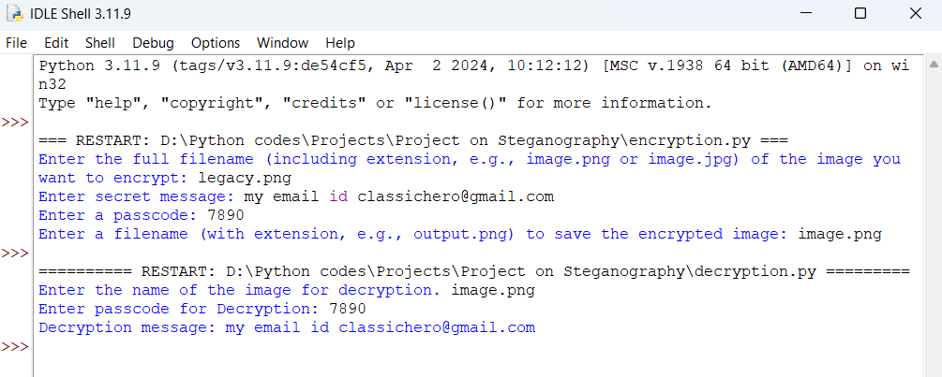
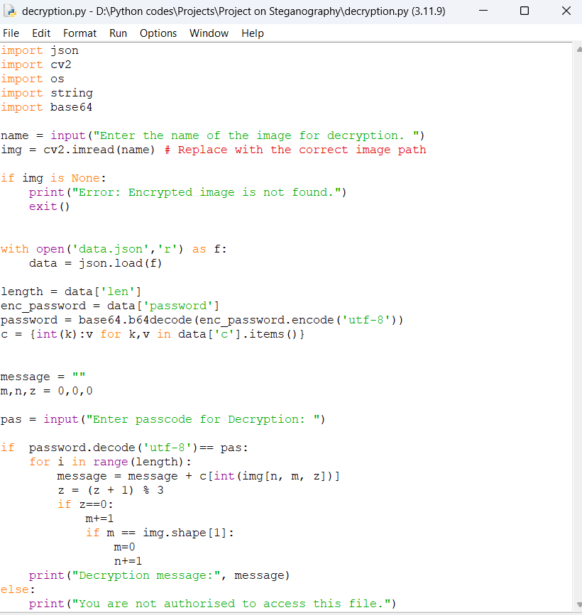
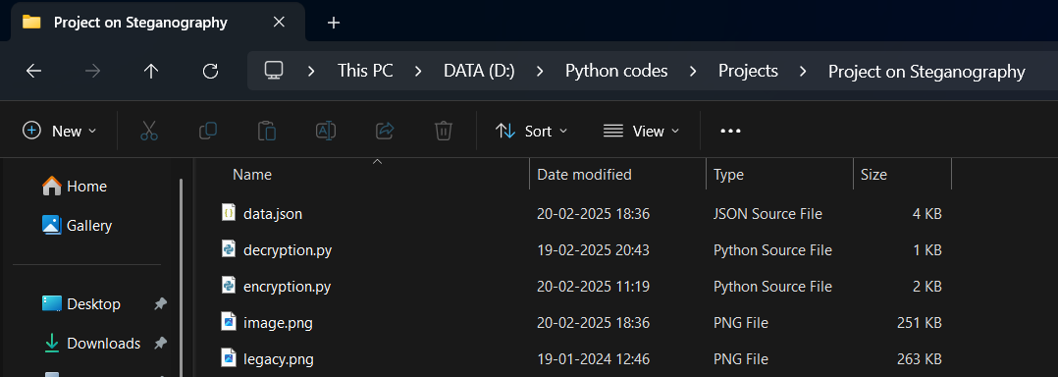
Results

Slide 8
Conclusion
This steganography project effectively illustrates how to use OpenCV to conceal messages within pictures in a safe and discrete manner. The technology allows for the communication of private information without compromising the visual integrity of the image by encoding text into pixel values. By combining Base64 encoding with password protection, security is improved and only authorized users may access the concealed content. Steganography is a useful tool for users who are concerned about their privacy because of this project's demonstration of its effectiveness in digital forensics, cybersecurity, and private communication. Stronger encryption, support for audio/video steganography, or a GUI-based solution to increase security and usability are possible future developments.

Slide 9
GitHub Link
https://github.com/krishnabogana/Steganography-project.git

Slide 10
Future scope(optional)
Enhanced Security with Encryption: Integrating advanced encryption techniques like AES or RSA before embedding the message will ensure that even if the hidden data is extracted, it remains unreadable without the correct decryption key.
Support for Audio and Video Steganography: Expanding beyond images to support audio and video steganography would make hidden communication more discreet and significantly harder to detect.
Optimization of LSB Steganography: Improve the efficiency of the LSB algorithm by using techniques like adaptive LSB or randomized bit embedding to make the hidden message more resistant to detection.
User-Friendly GUI and Cloud Integration: Developing a Graphical User Interface (GUI) using Tkinter or PyQt will allow users to encrypt and decrypt messages effortlessly, while a cloud-based platform can enable secure image sharing with end-to-end encryption.
Integration with Secure Messaging Apps: Embedding this technique into messaging applications will allow users to send hidden messages within images, making private communication more secure and resistant to surveillance.

Slide 11
THANK YOU

