Slide 1









NEPALI DOCUMENT DIGITIZATION
TEAM ZETA
Members
Krishna Bahadur Ojha
Krishna Rauniyar
Jagadish Khadka
Pradip Oli

Slide 2
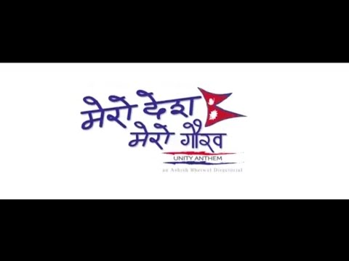

How fast can you digitize this?

Slide 3
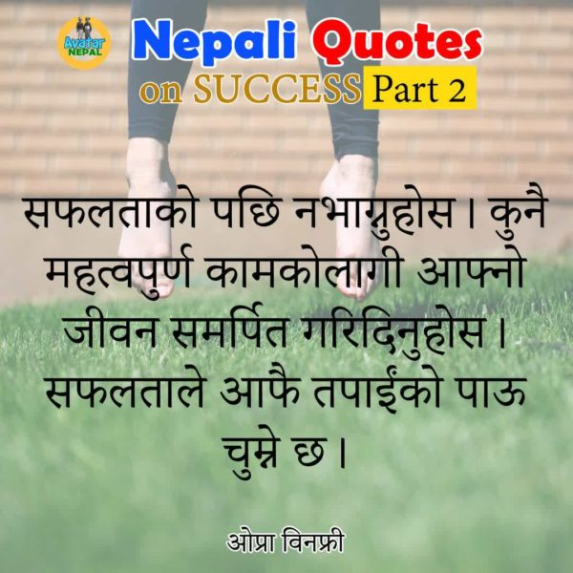
And How about this?

Slide 4


WHY??
Go Green, GO Paperless & Save The Planet
Data Security-The Need of the Hour
Unlimited Backup & Disaster Recovery
Make your Data Instantly Accessible

Slide 5
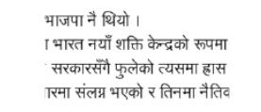



Nepali Document Digitization
Illustration of Segmentation Process
For each word, top zone, core zone and bottom zone is identified
Multi lines into Individual lines and each words segmented from that line
Top and bottom modifiers are removed also header line is removed

Slide 6
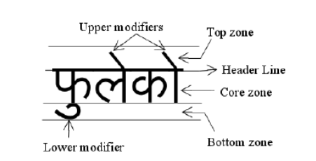


Nepali Document Digitization
Individual characters are extracted based on segmented lines
Finally, CNN model is used for feature extraction and recognition

Slide 7
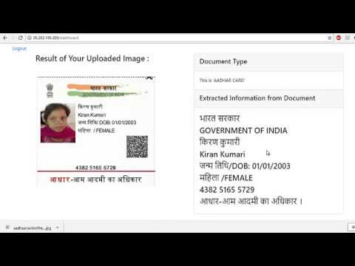
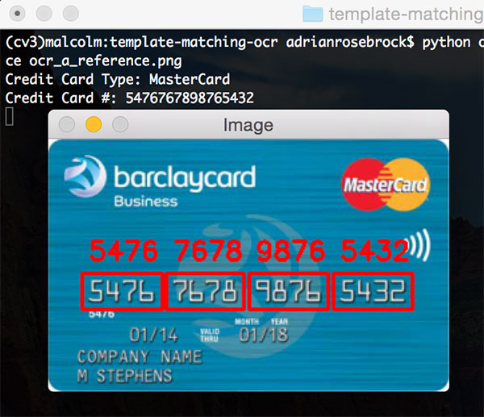
Applications

Slide 8
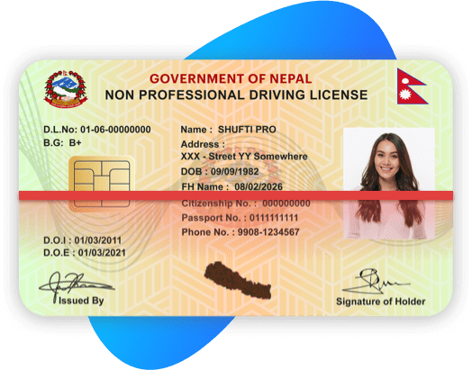
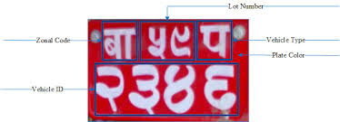
Applications
Banks
Government Organizations
Education

Slide 9
Economy
Education
FOR NEPAL
Tourism
Technical

Slide 10
Thank You !

