Slide 1
Intel Vtune Assignment
CS 232 Lab-5
Logic Design and Computer Architecture Lab

Slide 2
Team
Nagasai Saketh Naidu (210050103)
Gorle Krishna Chaitanya (210050057)
Gangisetty Krishna Sai Kusal (210050051)

Slide 3
PART - 1

Slide 4
Profiling Output
Performance Analysis
Hotspot Detection
IPC | 0.199
Bad Speculation | 0.5%
Logic Core Utilization | 77.9%
Top hotspot function | multiply1
Percentage of CPU time | 100%
Microarchitecture Exploration
Number of Instructions retired | 70,099,200,000
Average CPU frequency | 1.3 GHz
Effective logical core utilization | 94.8%

Slide 5
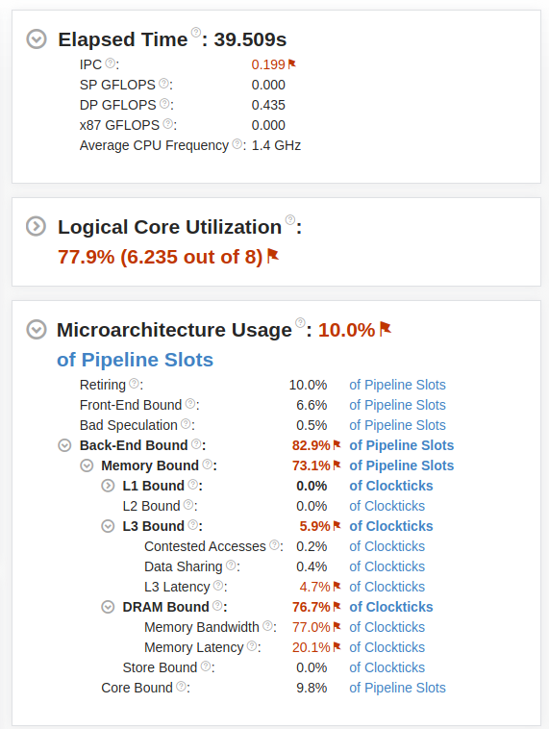
Performance Analysis

Slide 6
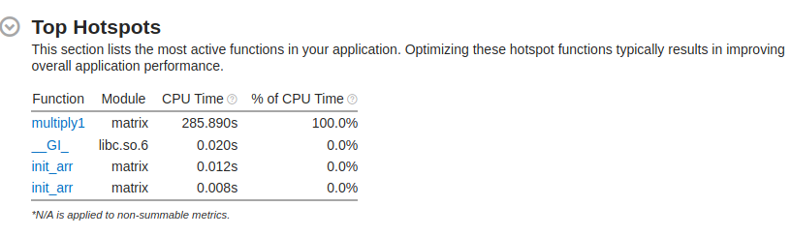
Hotspot Analysis

Slide 7
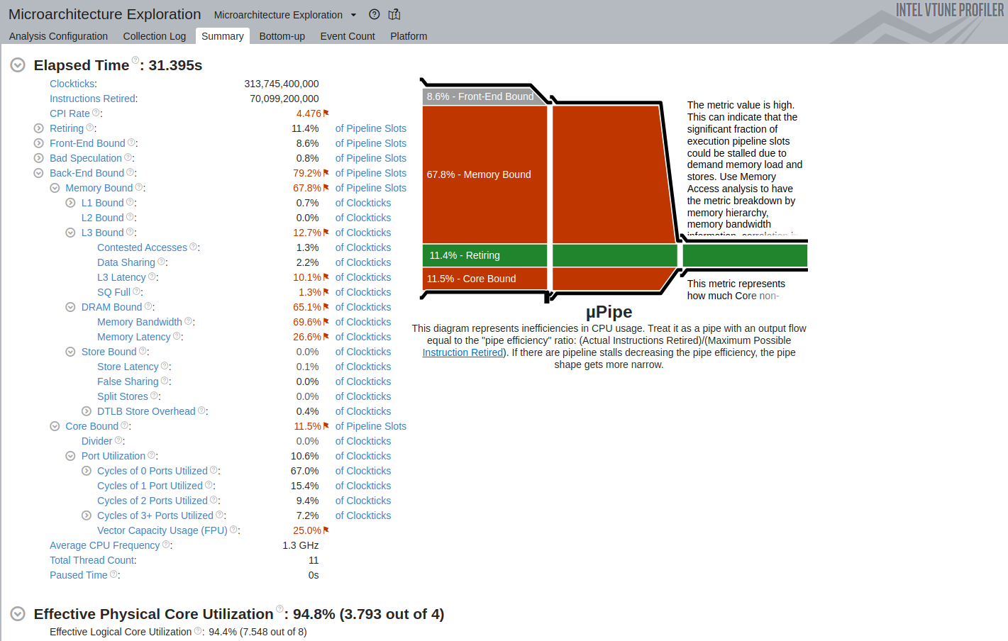
Microarchitecture Exploration

Slide 8
PART - 2

Slide 9
Optimization 1
Hotspot analysis suggests my_strlen() is the hotspot, so the number of function calls have been reduced. And subfunction CalculateCRC is eliminated.

Slide 10
Optimization 2
Next Decrypt is the hotspot. The two while loops were replaced by a single for loop(because it is faster than while loop), for better memory accesses, with respect to cache utilization.

Slide 11
Optimization 3
perf_int is less than or equal to 15. Hence
(prf_int+1) >> 4 is either 1 or 0. In case it is 0, mask is 15 , perf_int & mask is perf_int. In case it is 1, then we have to consider the mask.

Slide 12
Optimization 4
Instead of calculating I%length in every itertion, we can just use another variable j, increment it and reset to 0 each time I touches len.

Slide 13
Optimization 5
We can further speed it up by implementing parallelism, running execution for 4 indices in one iteration (Assuming length and maximum size are a multiple of 4). And minor changes like replacing while loops with for.

Slide 14
Stage | Avg Passwords per sec
Unoptimized | 120
Optimization 1 | 3000
Optimization 2 | 3500
Optimization 3 | 4400
Optimization 4 | 5600
Optimization 5 | 8200

Slide 15
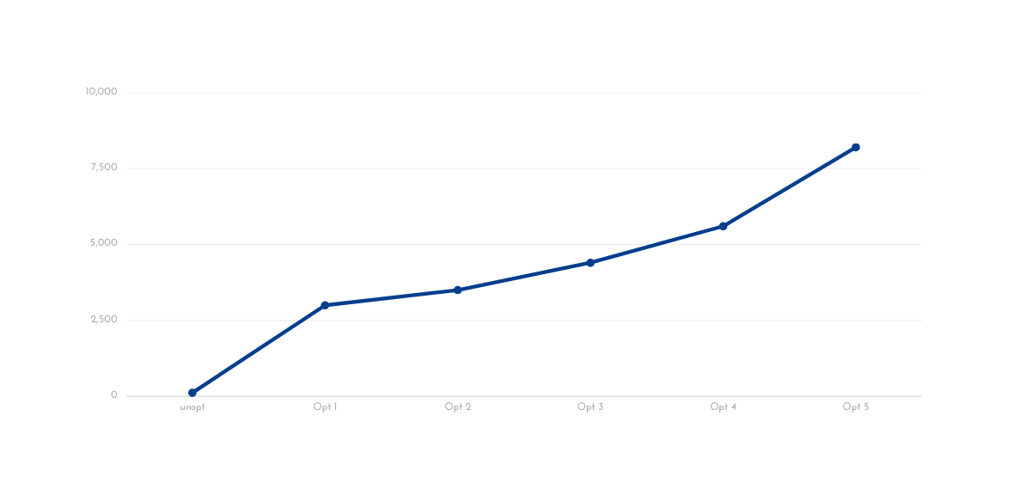
Plot of passwords per second

