Slide 1


ZEROTH REVIEW
VEHICLE ACCIDENT PREVENTION IN
MOUNTAIN ROADS
TEAM MEMBERS : GUIDED BY
A.Adhithyan (927621BME302) DR.M. Loganathan
Krishna Charan (927621BME313) Professor
V.Vinoth (927621BME339) Dept of mechanical engineering
M. Kumarasamy college of Engg

Slide 2
Abstract
This study proposes an accident prevention road safety model that uses infrared sensors and light control to improve road safety on mountain roads.
The proposed model aims to detect potential hazards on the road and control traffic lights accordingly to prevent accidents. Infrared sensors are used to detect the presence of vehicles and pedestrians, and traffic lights are controlled based on data collected by the sensor.
A warning mechanism is also included to warn the driver of potential dangers on the road. The effectiveness of the proposed model is evaluated by simulation and the results show that the number of accidents is significantly reduced and road safety is improved on mountainous roads.
Integrating infrared sensor technology and light control into traffic safety systems can greatly improve the safety of road users, especially in harsh environments such as mountain roads

Slide 3
Introduction
Mountain roads are known for their rugged terrain, limited visibility and adverse weather conditions that pose many risks to vehicle drivers.
Mountain road accidents can result in serious injury and death due to difficulty in accessing medical assistance and rough terrain.
Therefore, a crash prevention system for mountain roads is very important to improve road safety and reduce the number of accidents.
This study proposes an accident prevention system for mountain roads using infrared sensors to improve road safety.
The system consists of a network of infrared sensors installed along the road to detect the presence of vehicles and pedestrians.
Sensors send real-time data to a central control unit to analyze the data and generate alerts to warn drivers of potential hazards on the road.

Slide 4
Working
IR Sensors will be placed at strategic locations along mountain roads, and they will detect the presence of oncoming vehicles.
The sensors will send data to the control unit, which will analyze the incoming data.
If the control unit detects an oncoming vehicle, it will trigger an alert system.
The alert system will then notify drivers of the oncoming vehicle by flashing lights and emitting an audible alarm

Slide 5
Components required:
Arduino
Led
LCD display
Switch
Transformer/Adapters
Rectifier
Sensors
Buzzer

Slide 6
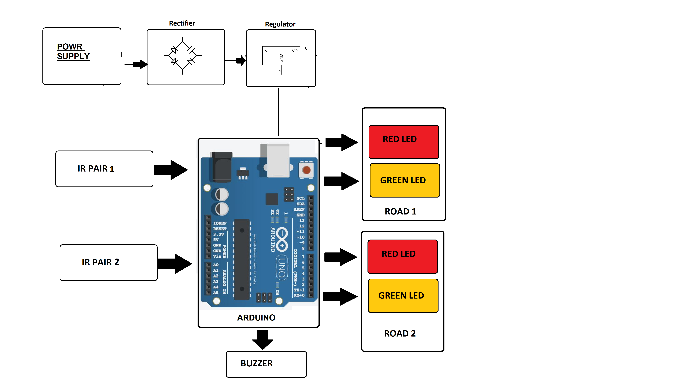
Block diagram

Slide 7
IR Sensors: The IR sensors are used to detect the presence of vehicles on mountain roads. The sensors are placed at strategic locations on the road and are connected to the microcontroller. The IR sensors emit infrared light and measure the amount of light that is reflected back. When a vehicle passes by, it reflects more light back to the sensor, indicating the presence of a vehicle. The data from the sensors is then processed by the microcontroller.
Microcontroller: The microcontroller is responsible for processing the data from the IR sensors and triggering the warning system. The microcontroller receives the data from the sensors and analyzes it to determine if a vehicle is present on the road. If a vehicle is detected, the microcontroller triggers the warning system, which consists of a red light and a beep buzzer. The microcontroller also logs the data from the sensors, which can be used for further analysis.
Warning System: The warning system consists of a red light and a beep buzzer that warn the driver of any danger on the road. The warning system is triggered by the microcontroller when a vehicle is detected on the road. The red light flashes to alert the driver, and the beep buzzer sounds to grab the driver's attention.

Slide 8
Arduino:- Arduino is an open-source electronics platform based on easy-to-use hardware and software. Arduino boards are able to read inputs - light on a sensor, a finger on a button, or a Twitter message - and turn it into an output - activating a motor, turning on an LED, publishing something online.
Switch:- Switch is a transition state which can be either off or on or we can change connection system here we use electronic or mechanical switch to disconnect and connect motor from supply.
Transformer/Adapter:- Here we use transformer/adapter to increase voltage gain on produce or generate output. We need to amplify voltage because output is not enough to transmit to a long distance.
Rectifier:- A rectifier is an electrical device that convert alternating current, which periodically reverses direction, to direct current, which flows in only one direction.

Slide 9
Advantages
The purpose of this project is to reduce the number of accidents at mountain roads.
This system is also useful for animal sensing and save their lives.
With the help of this system people can drive in day and night to be carefully.
With the help of this system we can save thousands of lives in curved road.

Slide 10
FUTURE SCOPE:- The scope of this system is to prevents the lives of people in future. By addind a camera , we can make this system better which will give us the photograph of accident place. We can add GPS also for tracking the location of accident vehicle. By using these technologies we can make the safe environment for people and animals. We can decrease the number of accident occurs at mountain roads, curved road.

Slide 11
Conclusion
We believe that our project will be beneficial for various purposes and hence our efforts will be fruitful and our proposed system can save thousands of human lives
Accident prevention road safety model with light control using IR sensors in mountain roads is a promising approach for enhancing road safety. The literature review highlights the effectiveness of IR sensors in detecting potential hazards in low visibility conditions and alerting drivers in real-time. The proposed model utilizes IR sensors to detect the presence of vehicles and pedestrians and controls the traffic lights accordingly to prevent accidents

Slide 12


