Slide 1
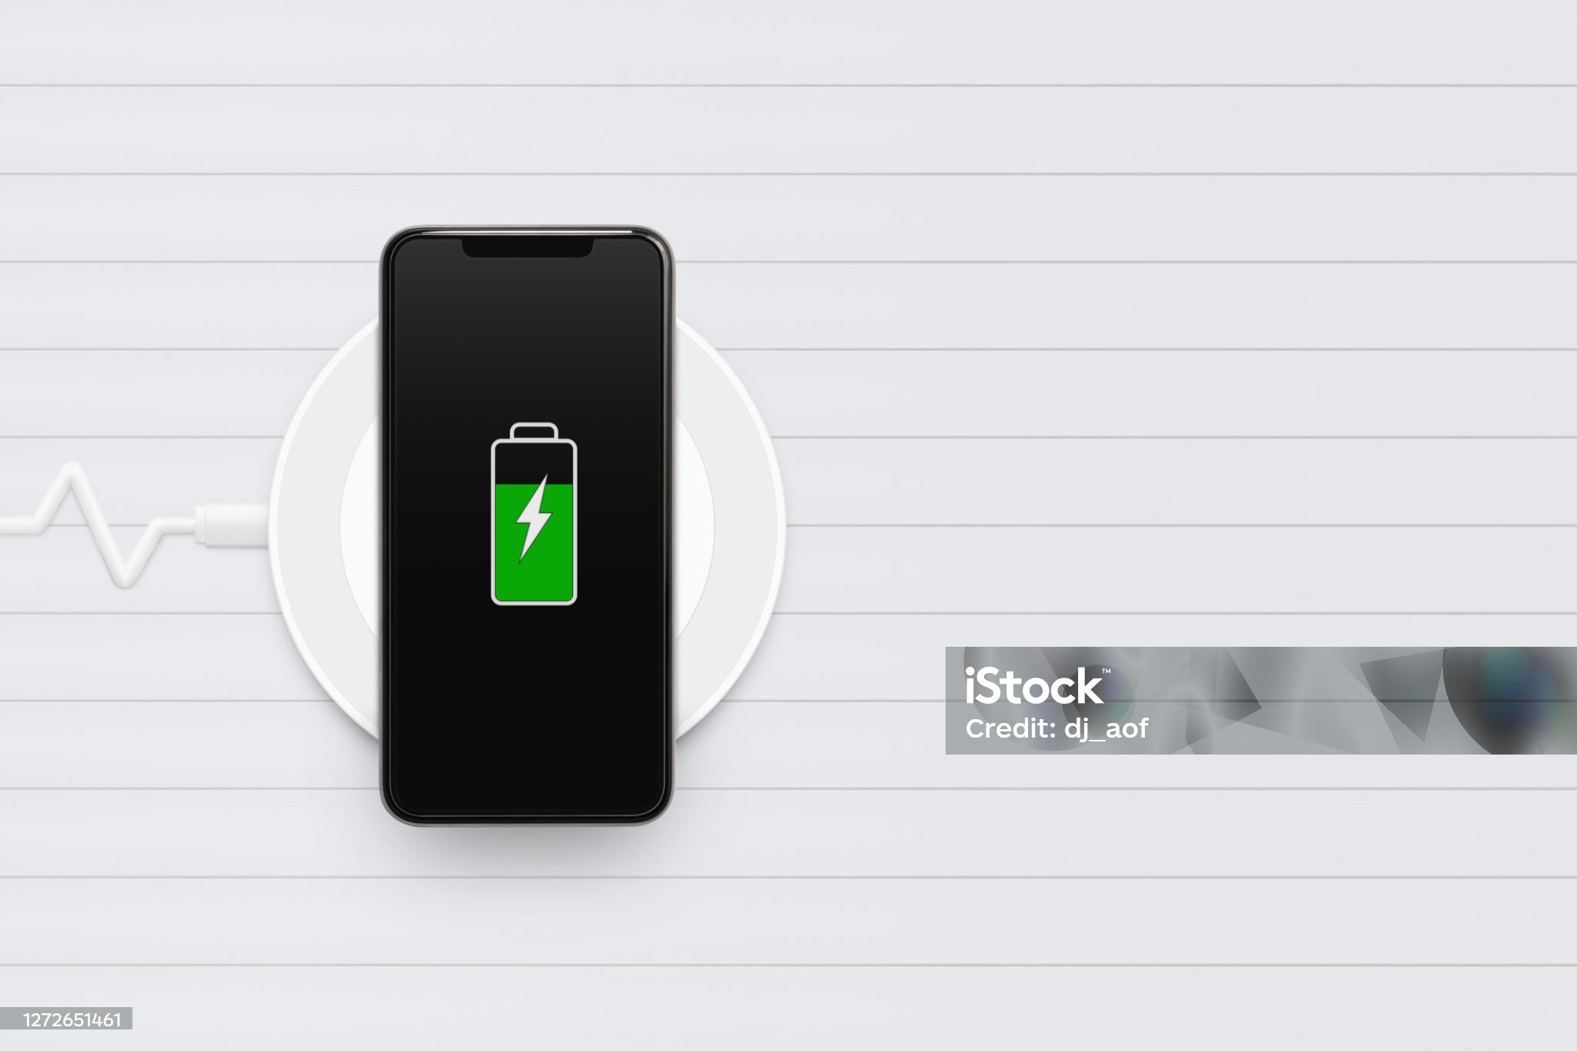

Smartphone Battery Failure Analysis
Understanding Causes and Solutions
TEAM : - NEXGEN

Slide 2
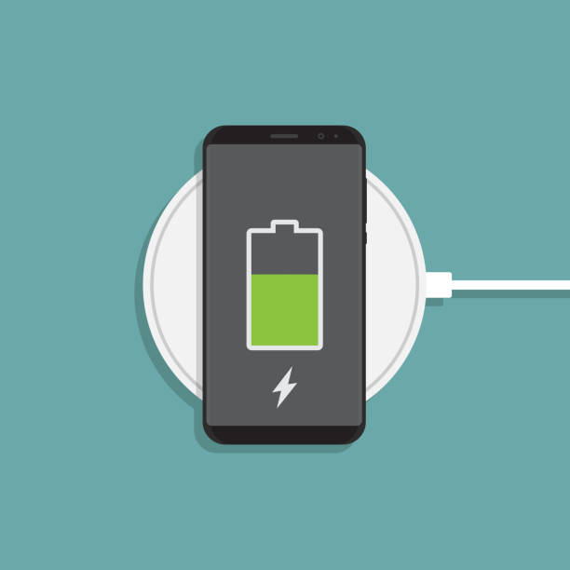
Introduction to Smartphone Battery Failure Analysis:-
Smartphone batteries are essential for the functionality of our devices, but they can sometimes fail, causing inconvenience and potential safety hazards. This analysis aims to understand why these failures happen and how we can prevent them.
Objective: To identify the causes of smartphone battery failures and propose solutions to improve battery reliability and safety.
Scope: Focus on lithium-ion batteries, commonly used in smartphones, and explore factors like manufacturing defects, improper usage, and environmental conditions.

Slide 3
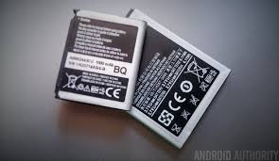
Lithium-Ion Battery:
What is it? A lithium-ion (Li-ion) battery is a rechargeable battery commonly used in smartphones, laptops, and electric vehicles due to its high energy density and long lifespan.
Key Components:
Anode: Stores lithium ions.
Cathode: Releases lithium ions.
Electrolyte: Allows ion movement.
Separator: Prevents short circuits
How It Works: Lithium ions move between the anode and cathode to generate electricity.

Slide 4


Advantages:
High Energy Density: Stores more energy per unit weight.
Long Cycle Life: Can be recharged many times.
Low Self-Discharge: Retains charge well when not in use.
Applications:
Consumer Electronics: Smartphones, laptops, tablets.
Electric Vehicles: Cars, bikes, scooters.
Grid Storage: Renewable energy storage solutions.
TEAM:-NEXGEN

Slide 5

Challenges:
Safety Concerns: Risk of overheating and fire if damaged or improperly handled.
Cost: Higher initial cost compared to some other battery types.
Environmental Impact: Requires proper recycling to mitigate environmental harm.
Lithium-ion batteries have revolutionized the way we use and store energy, making them a cornerstone of modern technology
TEAM:-NEXGEN

Slide 6

Identifying the Problem
Data Collection: Gather data on battery performance, usage patterns, charging cycles, and failure incidents. This can include:
Battery health reports
User complaints and feedback
Diagnostic logs from smartphones
Data Analysis: Analyze the collected data to identify common patterns and root causes of battery failures. Look for:
Trends in battery degradation over time
Correlation between usage patterns and battery life
Specific conditions that lead to battery failure (e.g., overcharging, high temperatures)

Slide 7

Fixing the Product:-
Design Improvements:
Battery Technology: Consider using more advanced battery technologies like lithium-polymer or solid-state batteries that offer better performance and safety.
Thermal Management: Implement better thermal management systems to prevent overheating, which can degrade battery life.
Software Optimization:
Power Management: Optimize the smartphone’s power management system to reduce unnecessary battery drain. This can include features like adaptive brightness, background app management, and power-saving modes.
Charging Algorithms: Develop smarter charging algorithms that prevent overcharging and optimize charging cycles to extend battery life.
User Education:
Best Practices: Educate users on best practices for battery maintenance, such as avoiding extreme temperatures, not letting the battery drain completely, and using original chargers.
Usage Alerts: Implement alerts that notify users when their battery is being subjected to conditions that could lead to failure (e.g., high temperatures, excessive charging).

Slide 8
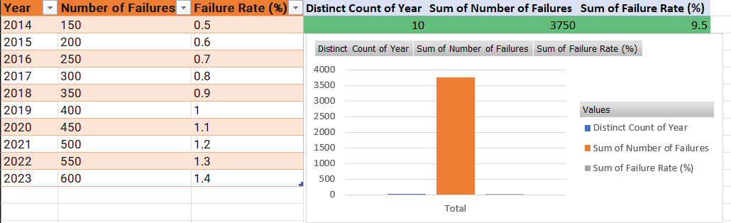

TEAM:-NEXGEN

