Slide 1


Sarvajanik Education Society
KP Human Sarvajanik College of Commerce & Computer Applications, Surat.
Bachelor of Computer Applications
Academic Year: 2026– 27
A Presentation On
“BuildAdvisor – AI-Powered PC Build Recommender for Gamers”
Presented By
<Member 1 Name>(En. No.)
<Member 2 Name> (En. No.)
<Member 3 Name> (En No.)
B.C.A. v Sem.
Under the Guidance of
<Mentor Name>

Slide 2
Agenda
Abstract
Objective
System Description (Technology Used)
Diagrams (Use Case, Activity, Sequence, DFD)
Data Dictionary
E-R Diagram
System Architecture
Project UI
Testing
Advantages
Limitations
Future Enhancement
References

Slide 3
Abstract
BuildAdvisor is an AI-powered web application that recommends a complete, compatible gaming PC within a user’s budget.
The user enters only a budget, target game and resolution; the system selects seven parts (CPU, GPU, motherboard, RAM, storage, PSU, case).
Every build is checked for socket, RAM type, PSU wattage and case fit, priced across retailers and given an estimated FPS.
The Google Gemini API explains the build in plain language, with a local fallback if the API is unavailable.
Existing PC owners get upgrade advice; builds can be saved, shared and rated. Built with Streamlit, Flask and SQLite.

Slide 4
Objective
Help first-time builders buy a balanced, compatible PC without technical knowledge.
Recommend builds tailored to budget, game and resolution, not budget alone.
Prevent incompatible purchases through automatic compatibility checks and part substitution.
Show realistic FPS estimates and the lowest retailer prices.
Explain every recommendation in simple language using generative AI.
Suggest cost-effective upgrades for existing PCs instead of a full rebuild.
Keep working gracefully when external services (Gemini, pricing) fail.

Slide 5
System Description
Category | Details
Frontend | Streamlit (Python) with custom dark theme – app.py, ui.py
Backend | Flask REST API – backend.py; business logic – logic.py
Database | SQLite (7 tables) – db.py; portable to MySQL
AI Service | Google Gemini API (gemini-2.5-flash) – ai.py
Pricing | requests + BeautifulSoup scraping with cache – pricing.py
Configuration | .env business rules (BUILDADVISOR_*) – config.py
Software Requirement | Python 3.x, pip packages from requirements.txt, modern web browser, VS Code
Hardware Requirement | Intel i3 / Ryzen 3 or above, 4 GB RAM (8 GB recommended), 500 MB disk, internet connection
Operating System | Windows 10/11, Linux or macOS

Slide 6
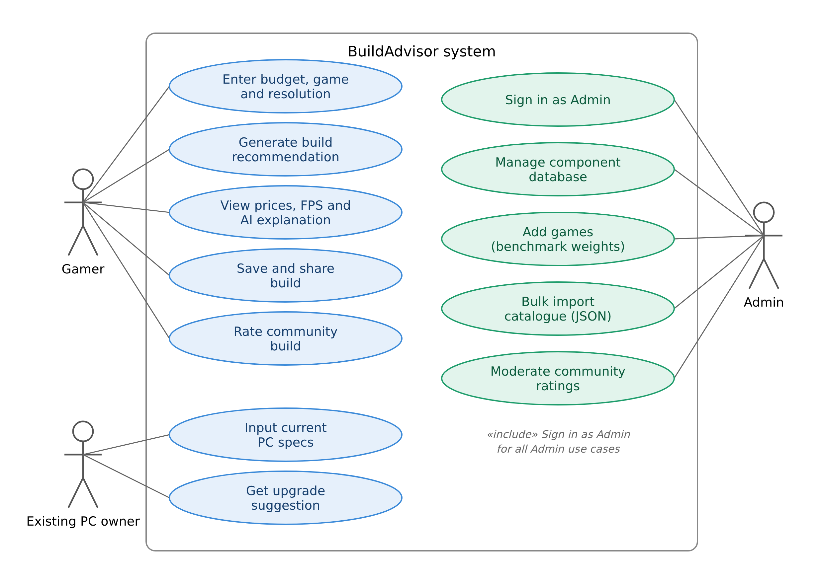
Use Case Diagram

Slide 7
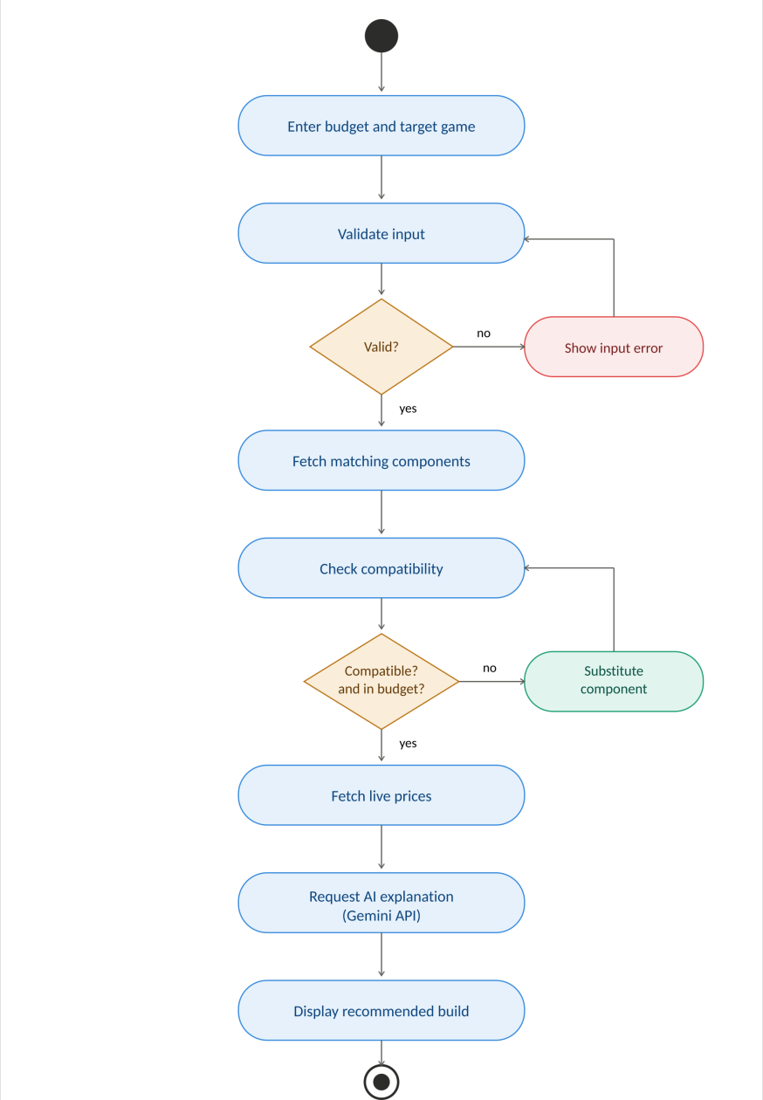
Activity Diagram (Build Generation)

Slide 8
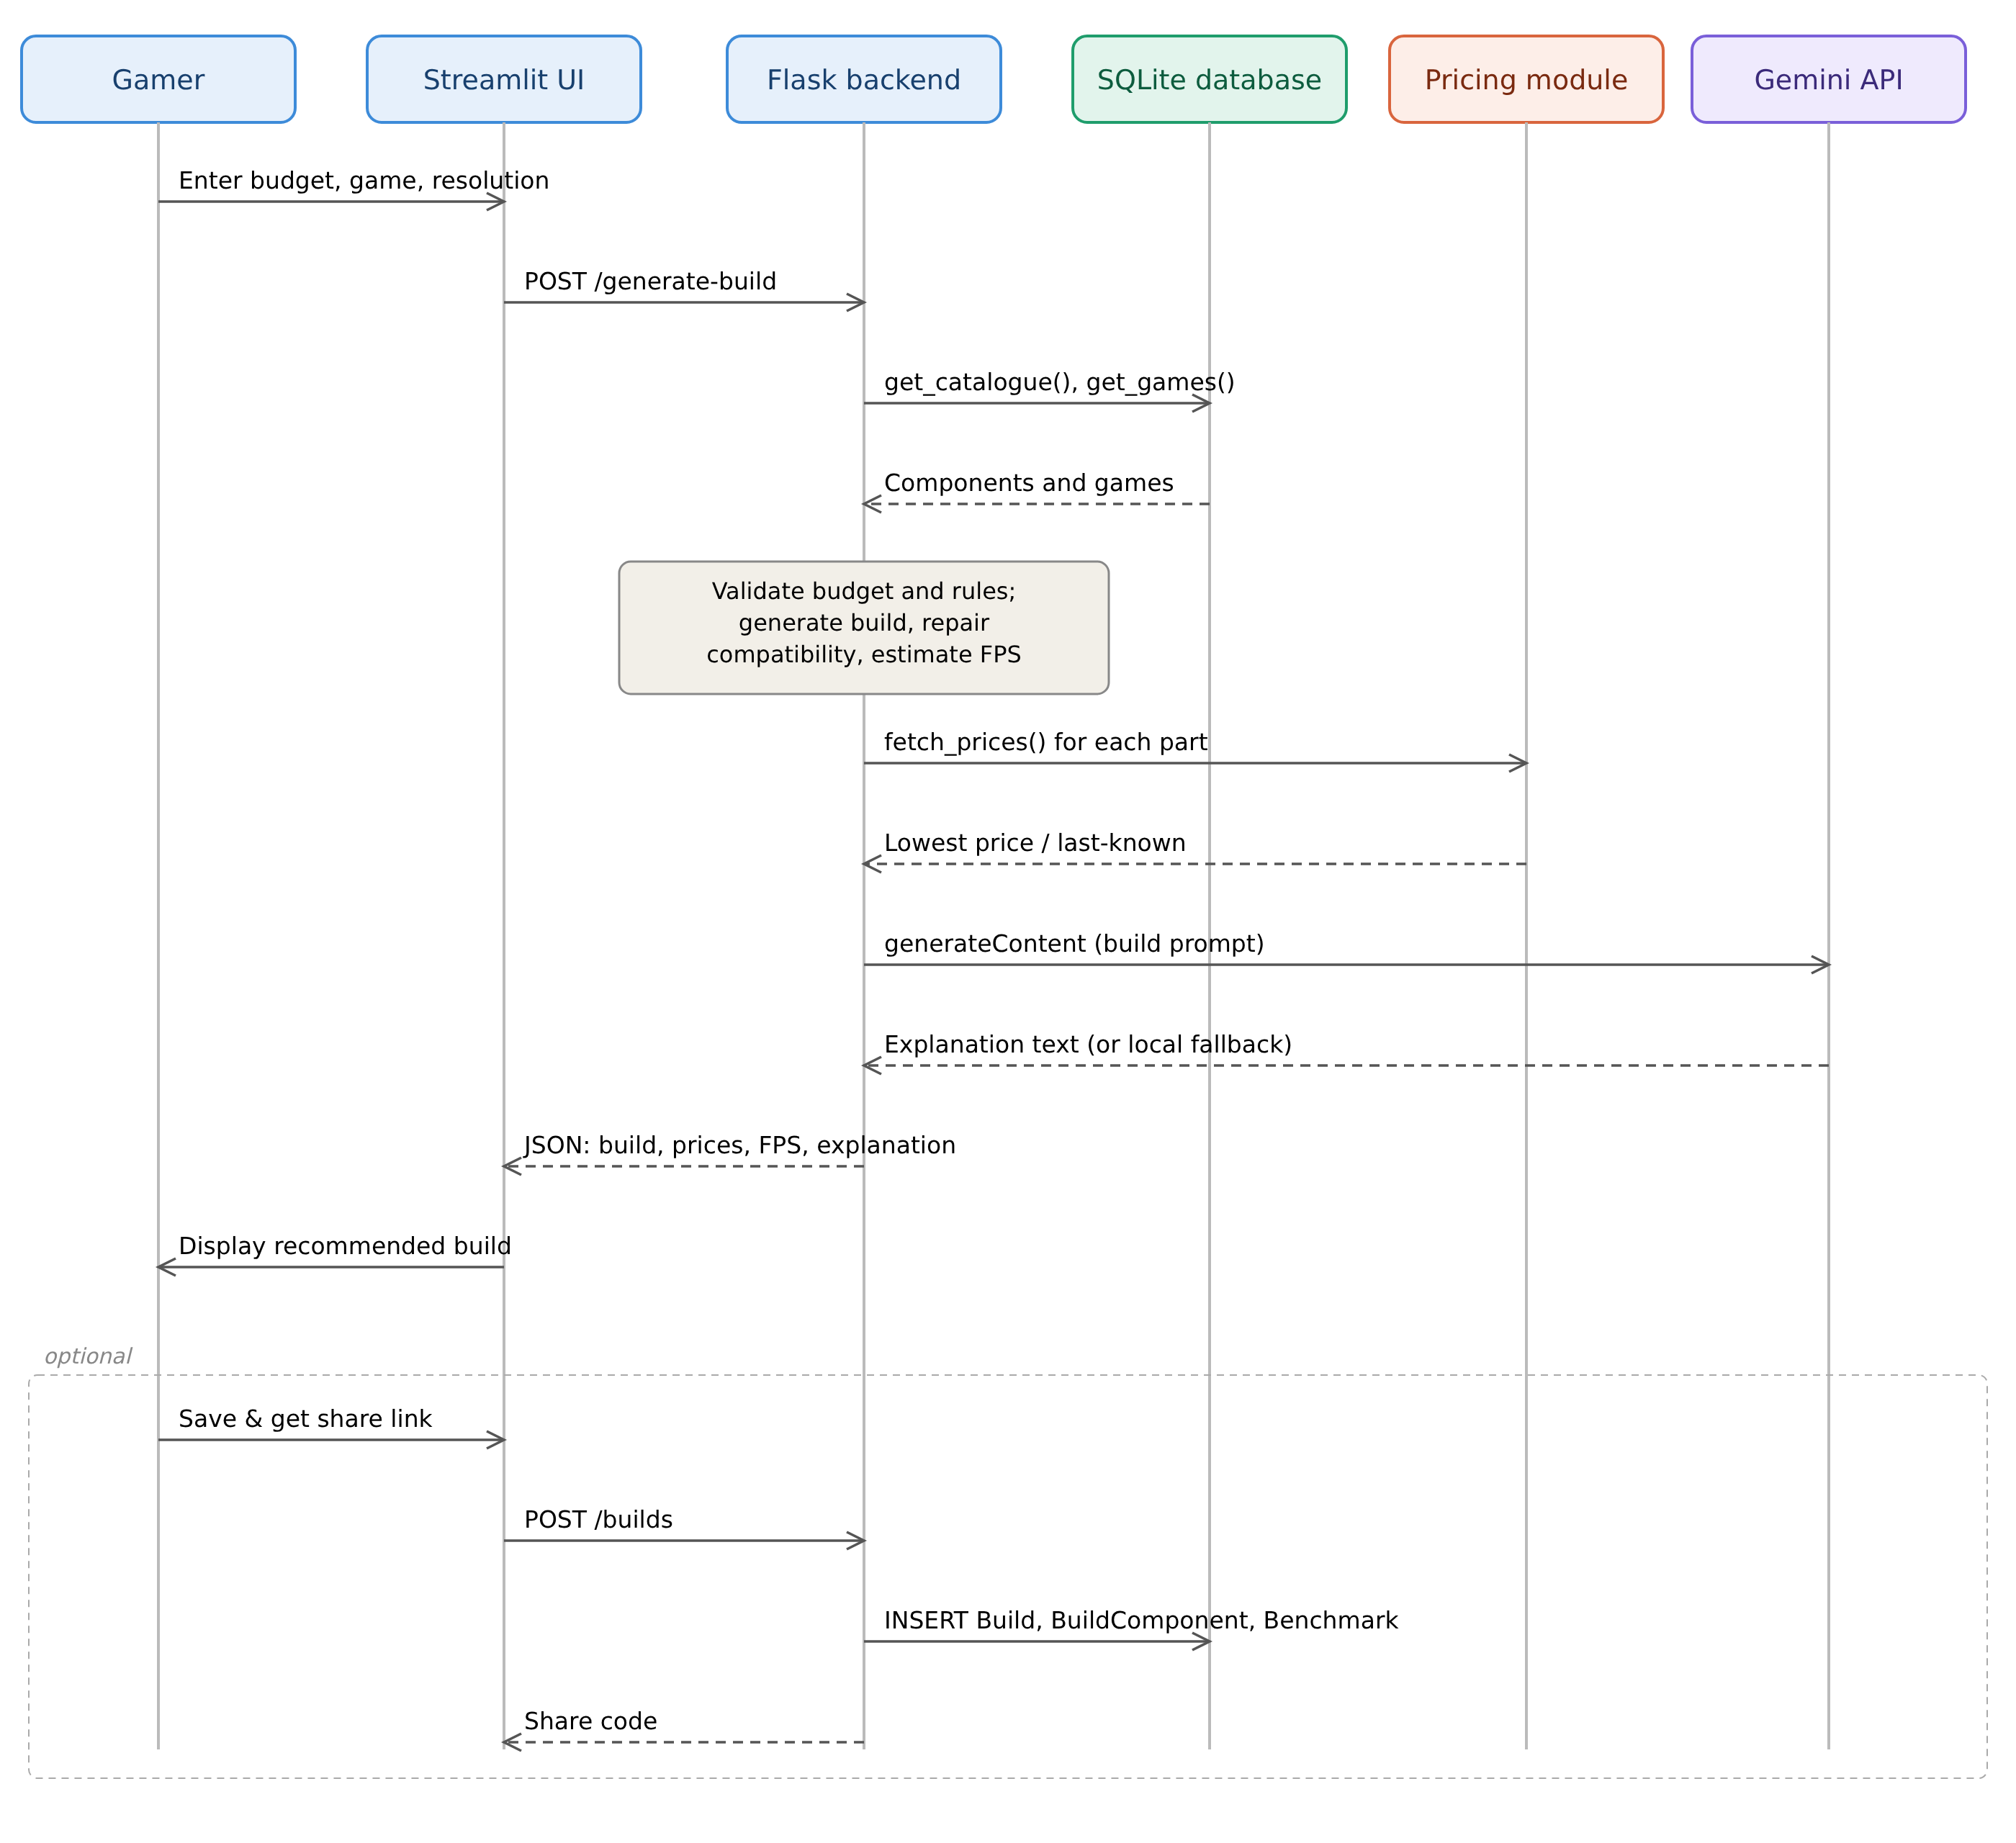
Sequence Diagram (Generate & Save Build)

Slide 9
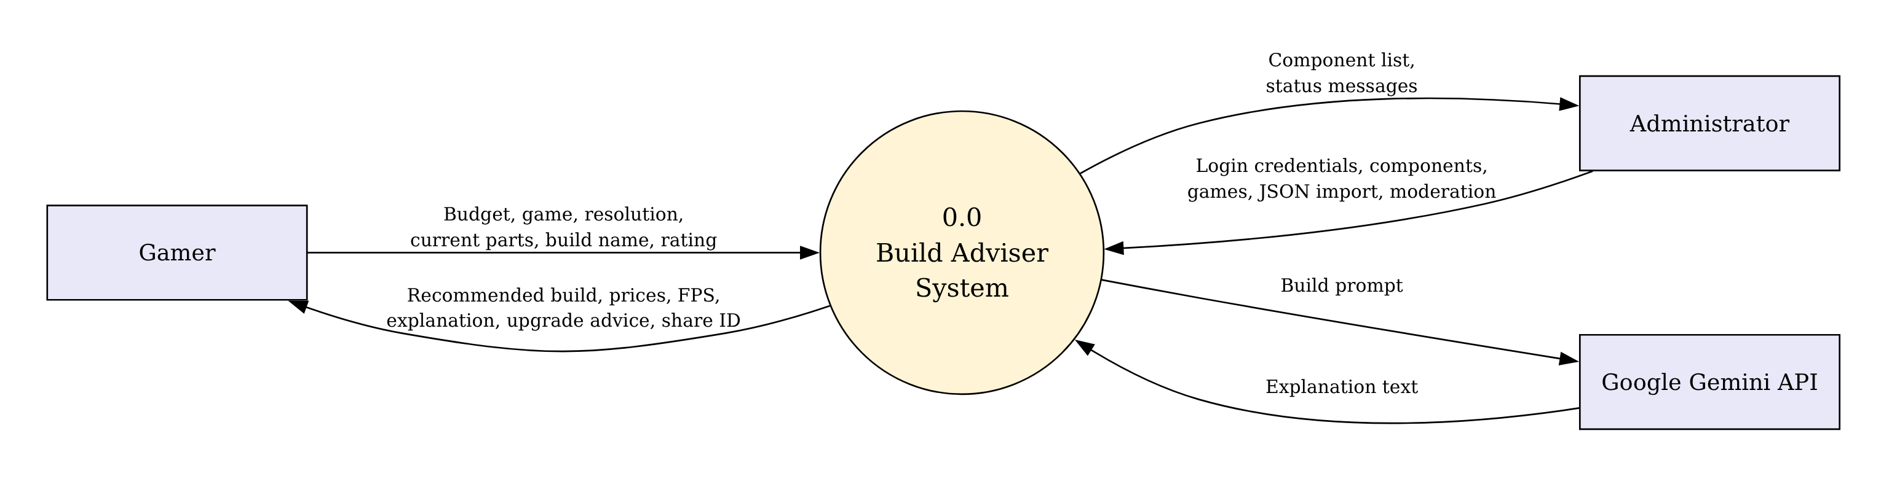
DFD Level 0 (Context Diagram)
BuildAdvisor shown as a single process exchanging data with the Gamer, the Administrator and the Google Gemini API.

Slide 10
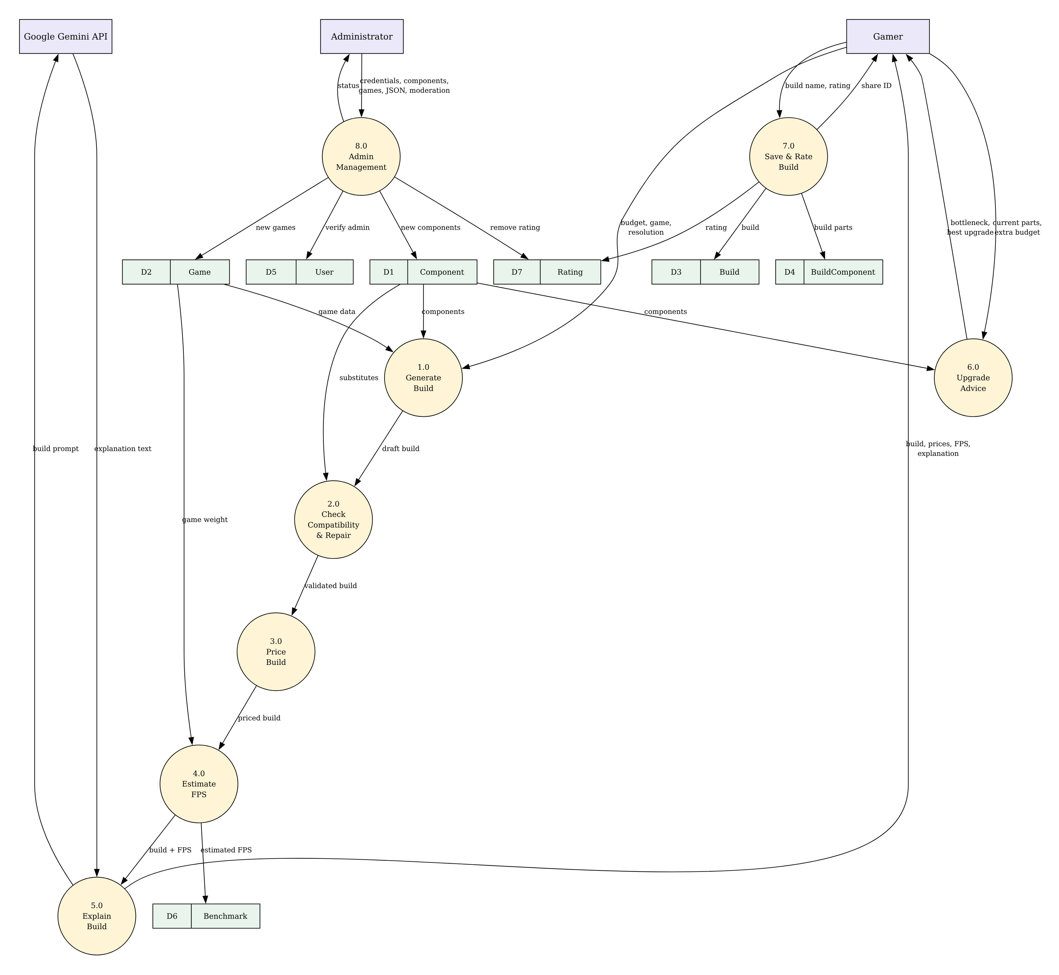
DFD Level 1

Slide 11
Data Dictionary (1/2)
Table | Field | Type | Description
User | user_id | INTEGER (PK) | Unique user id
User | name / email | TEXT | User details
User | role | TEXT | Gamer, PC owner or Admin
Component | component_id | TEXT (PK) | Unique component code
Component | type | TEXT | CPU, GPU, RAM, etc.
Component | name / price | TEXT / INTEGER | Product name, price in ₹
Component | tier | TEXT | entry / mid / high
Component | specs | TEXT (JSON) | socket, tdp, ram_type, wattage, score…
Game | game_id | TEXT (PK) | Unique game code
Game | name / weight | TEXT / REAL | Title and FPS difficulty
Game | cpu_bound | INTEGER | 1 if CPU-heavy game

Slide 12
Data Dictionary (2/2)
Table | Field | Type | Description
Build | build_id | INTEGER (PK) | Unique build id
Build | share_code | TEXT (Unique) | 10-char share code
Build | user_id | INTEGER (FK) | Owner of build
Build | name / game | TEXT | Build name, target game
Build | total_price | INTEGER | Total in ₹
Build | created_at | TEXT | Save time
BuildComponent | build_id, component_id | PK + FK | Links builds to parts
Benchmark | build_id, game_id | PK + FK | Build–game pair
Benchmark | estimated_fps | INTEGER | Estimated FPS
Rating | rating_id | INTEGER (PK) | Unique rating id
Rating | build_id / score / comment | FK / INT / TEXT | Rating 1–5 with comment

Slide 13
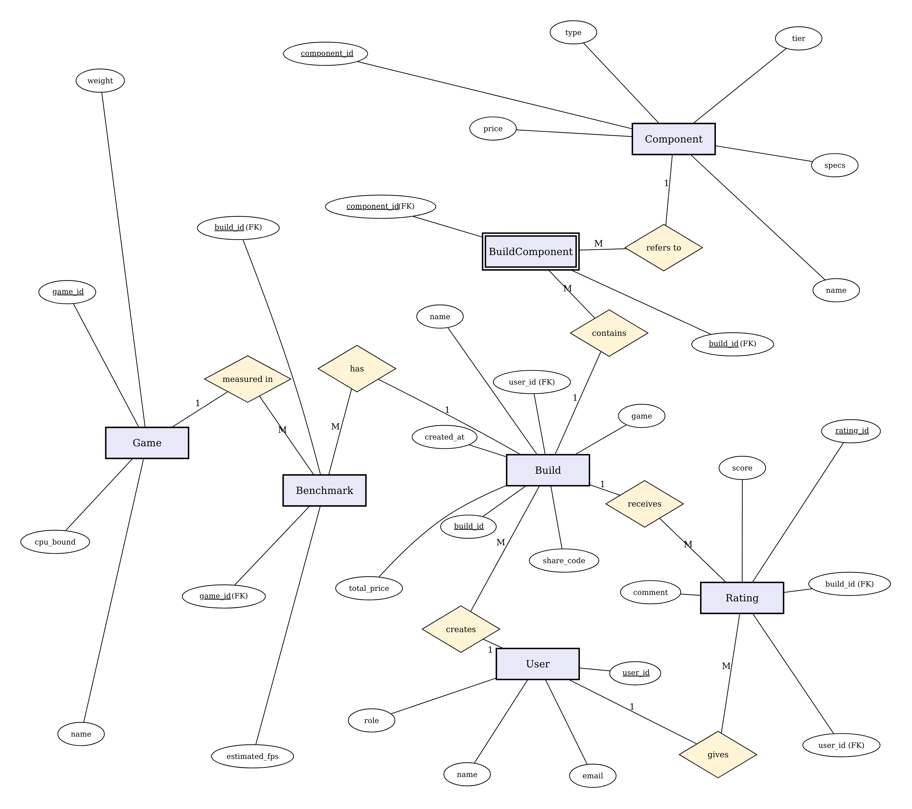
E-R Diagram

Slide 14
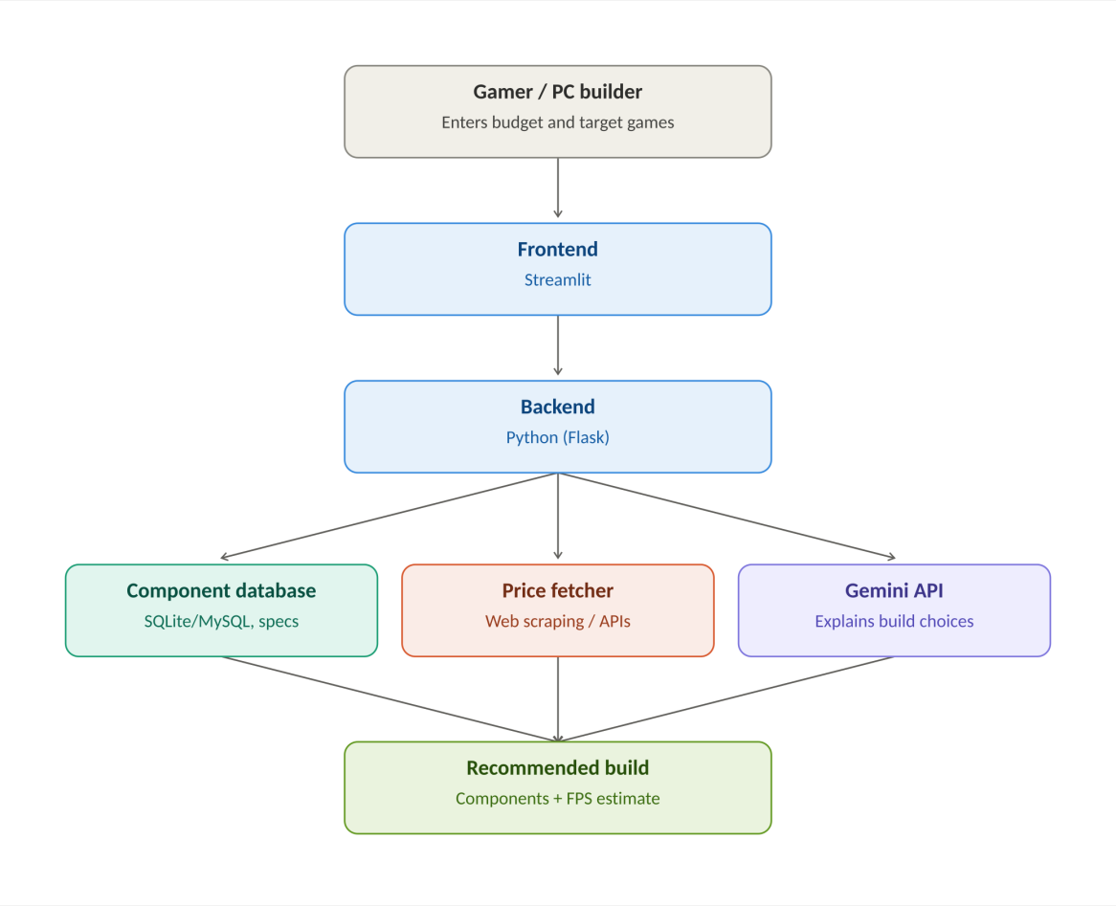
System Architecture

Slide 15
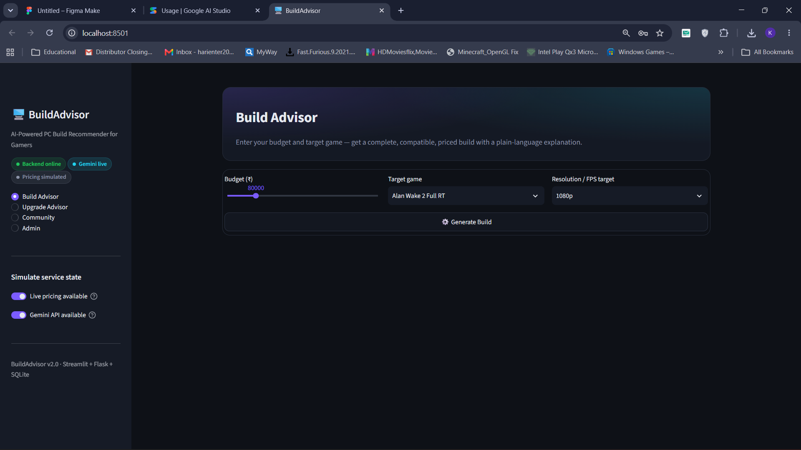
Project UI
Build Advisor – Home Screen

Slide 16
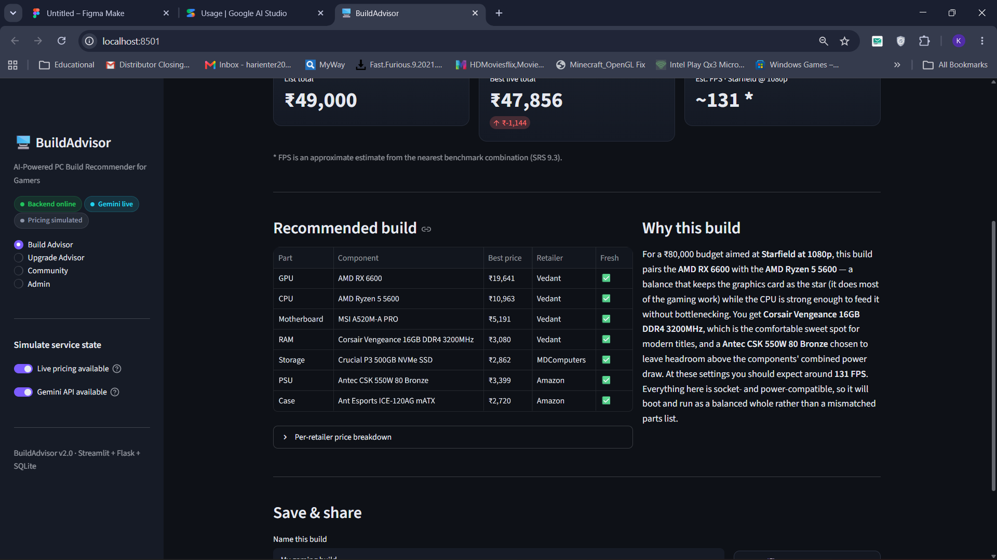
Project UI
Recommended Build with AI Explanation

Slide 17
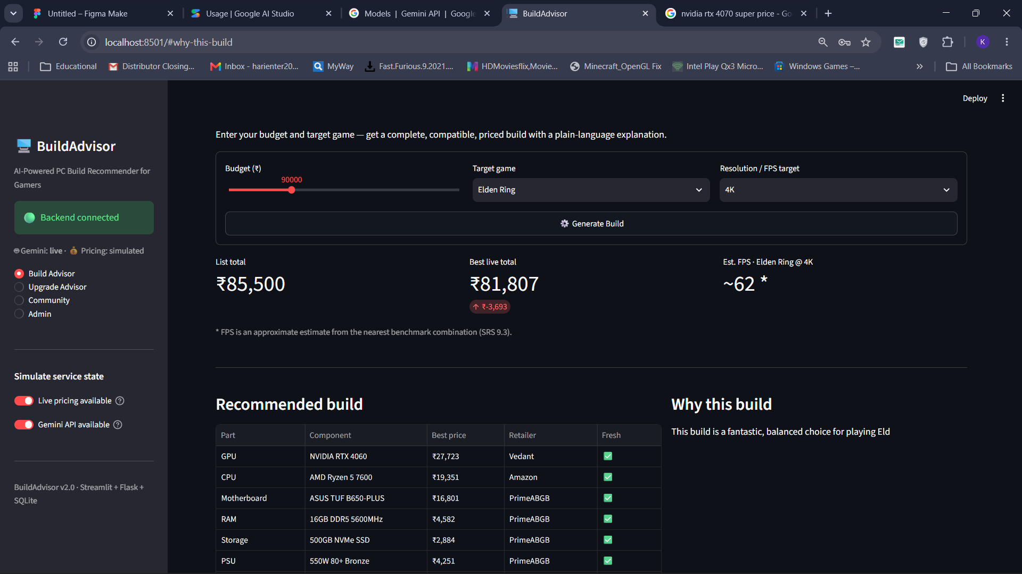
Project UI
Build Result for a 4K Target

Slide 18
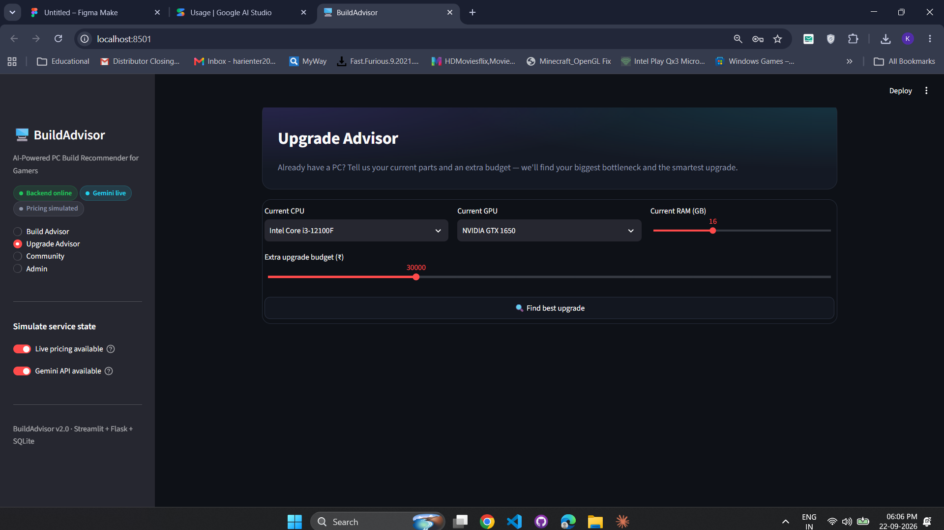
Project UI
Upgrade Advisor

Slide 19
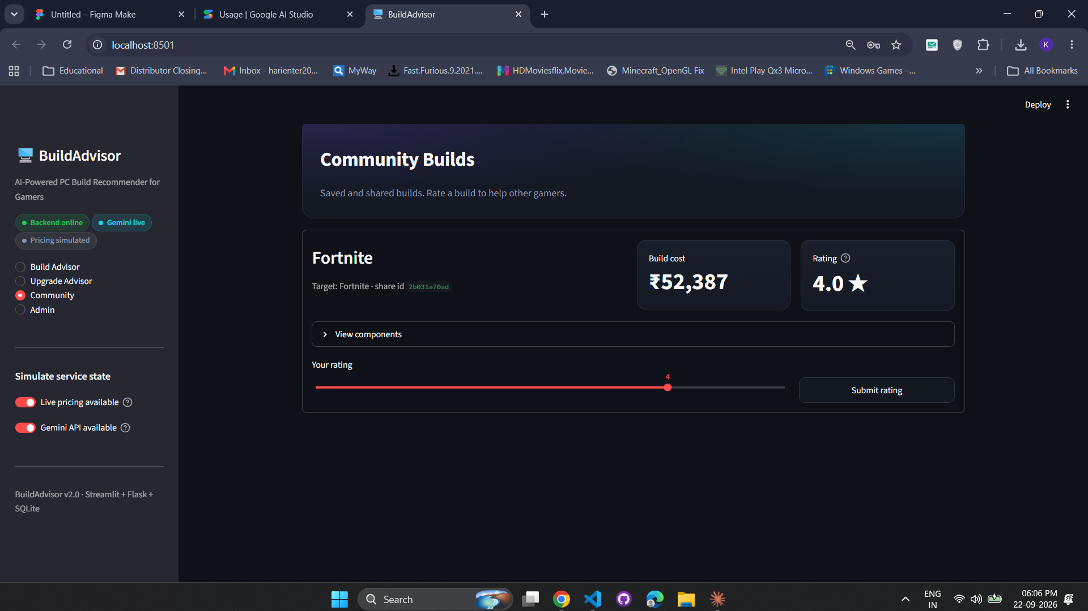
Project UI
Community Builds

Slide 20
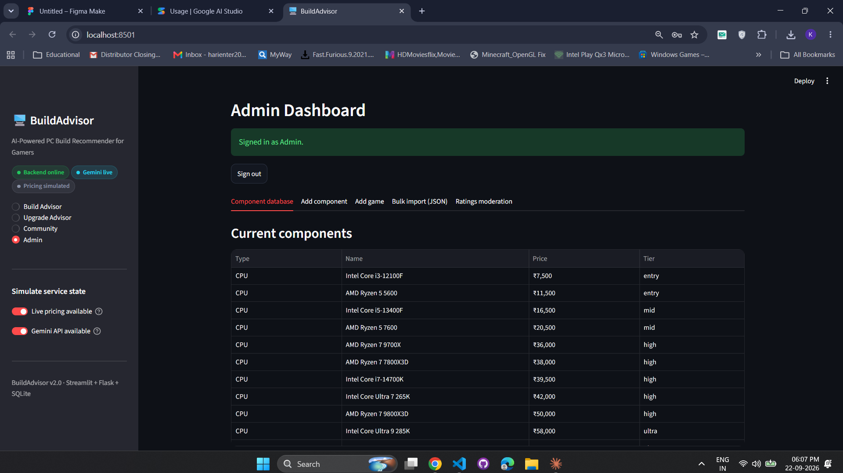
Project UI
Admin Dashboard

Slide 21
Testing – Summary
ID | Test Case | Expected Result | Status
TC01 | Mid-range build (₹80,000, Starfield, 1080p) | Compatible build within budget | Pass
TC02 | 4K target (₹90,000, Elden Ring) | Stronger GPU, lower FPS | Pass
TC07 | Gemini API unavailable | Build shown with fallback notice | Pass
TC08 | Live pricing unavailable | Last-known prices with note | Pass
TC09 | Upgrade Advisor | GPU bottleneck, RTX 4060 suggested | Pass
TC10 | Save and share build | Share link generated | Pass
TC12 | Admin wrong password | Access denied | Pass
TC14 | Backend server offline | Clear offline message, no crash | Pass

Slide 22
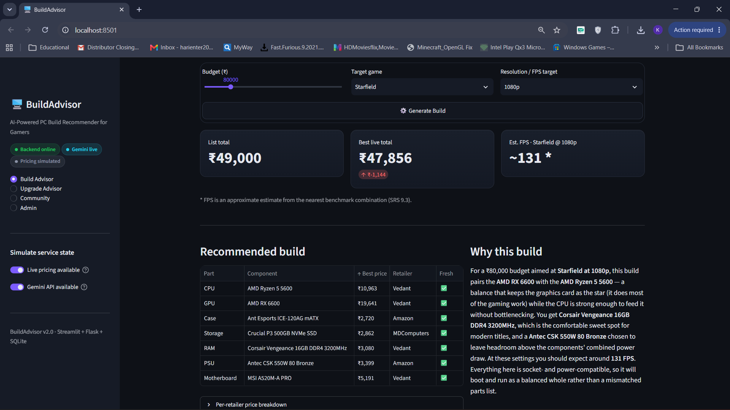
Testing
TC01 – Generate a build for a mid-range budget

Slide 23
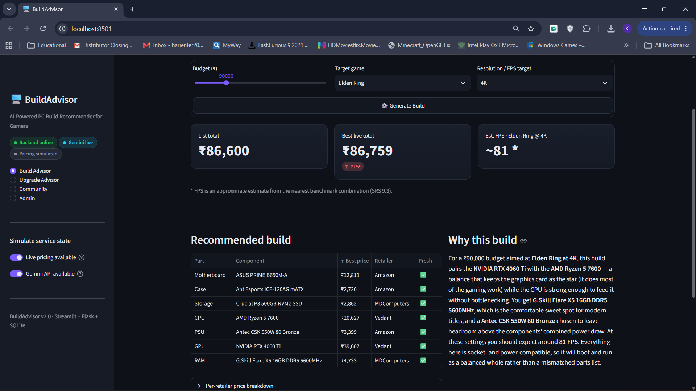
Testing
TC02 – Build for a 4K resolution target

Slide 24
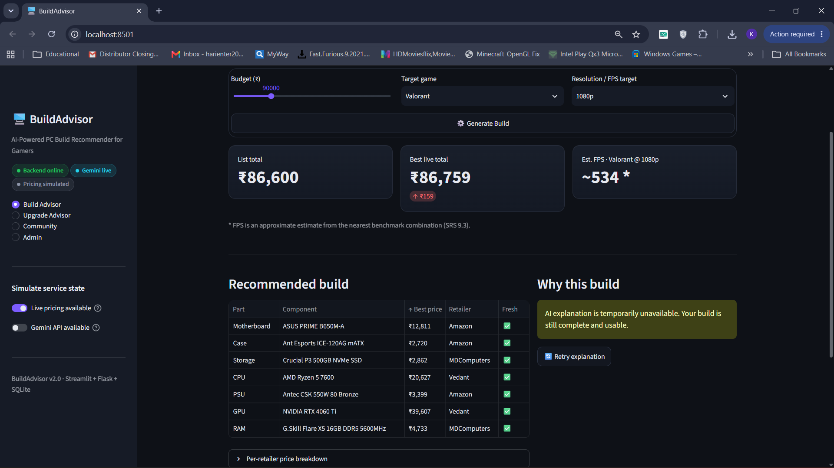
Testing
TC07 – Gemini API unavailable (graceful fallback)

Slide 25
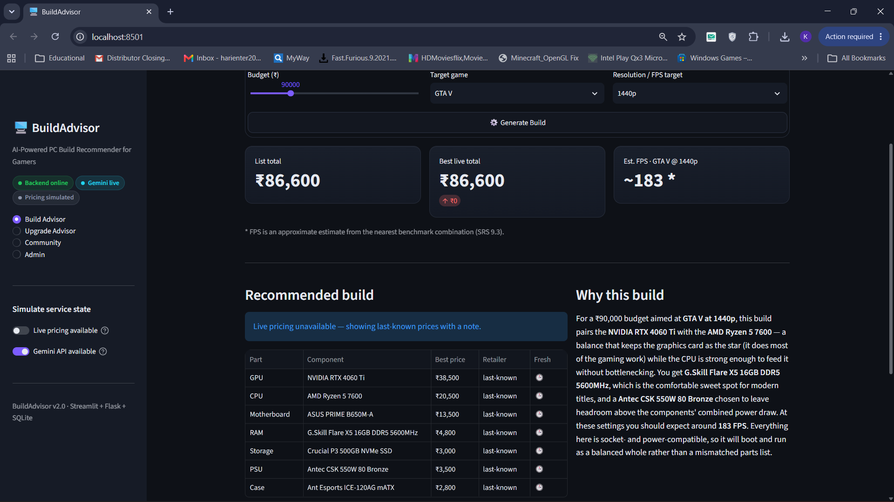
Testing
TC08 – Live pricing unavailable

Slide 26
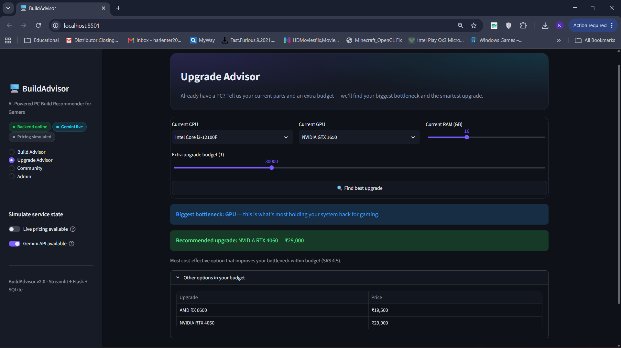
Testing
TC09 – Upgrade Advisor finds the bottleneck

Slide 27
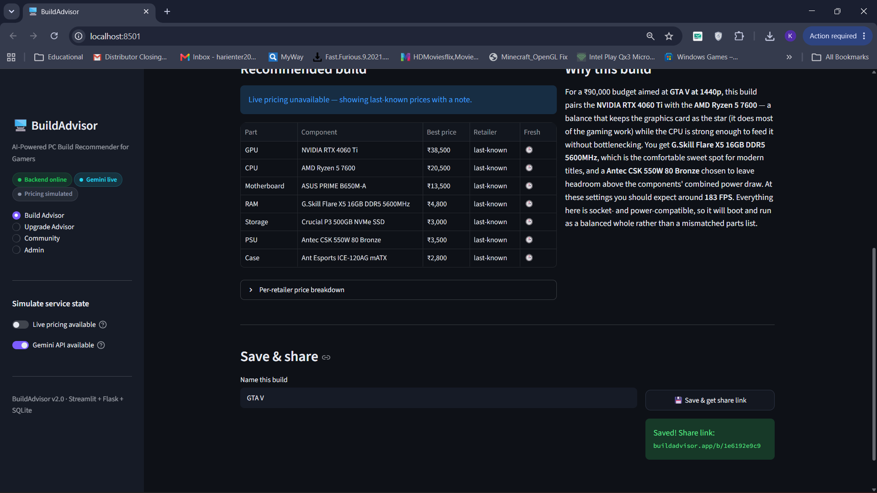
Testing
TC10 – Save and share a build

Slide 28
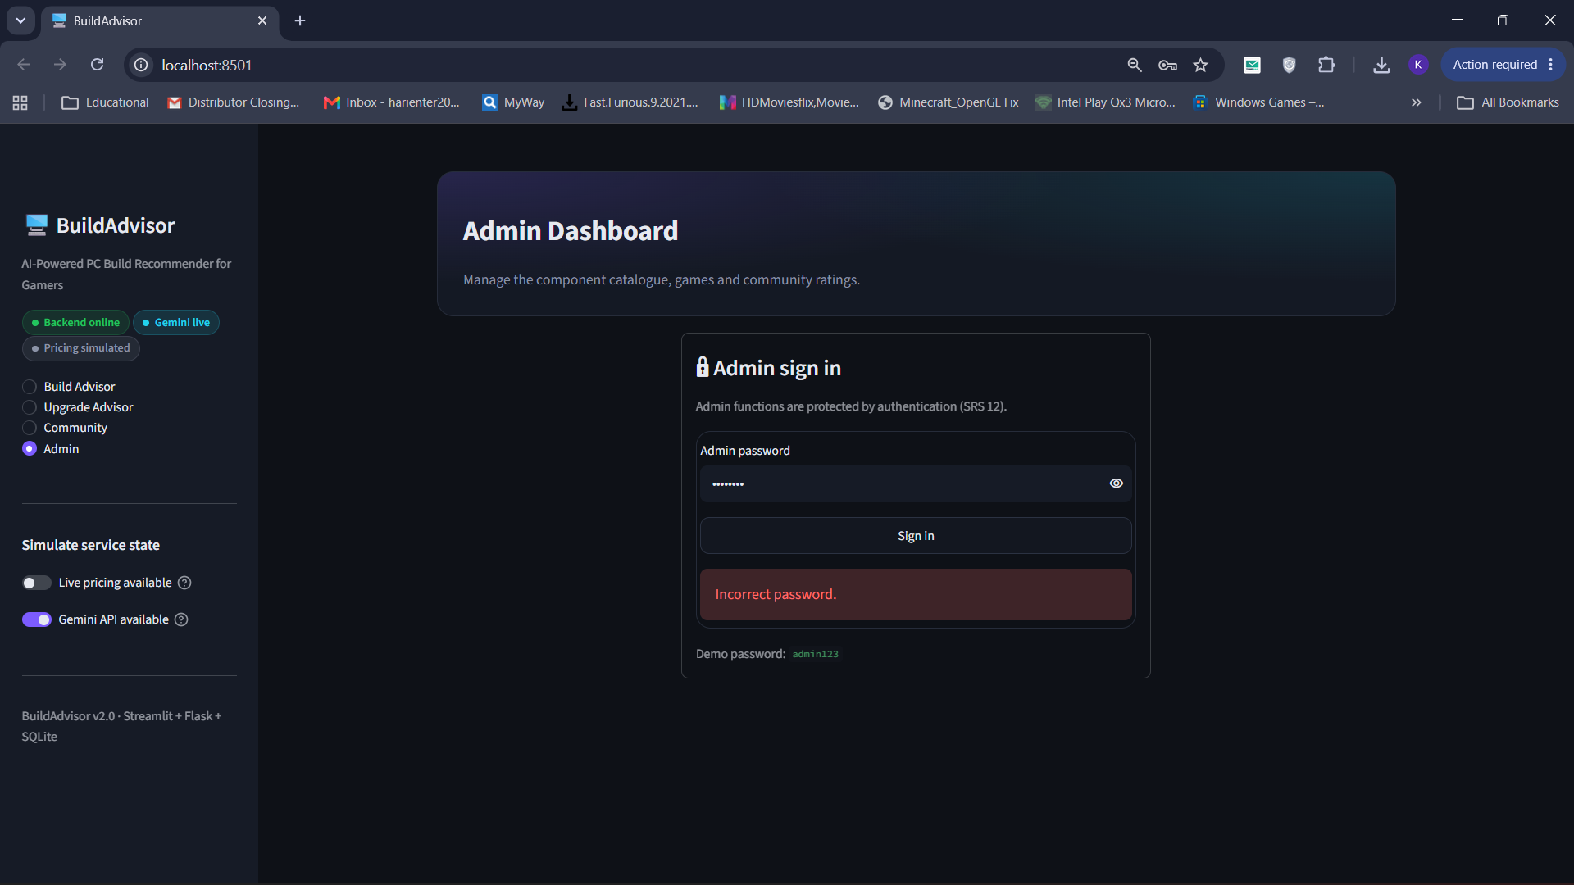
Testing
TC12 – Admin login with incorrect password

Slide 29
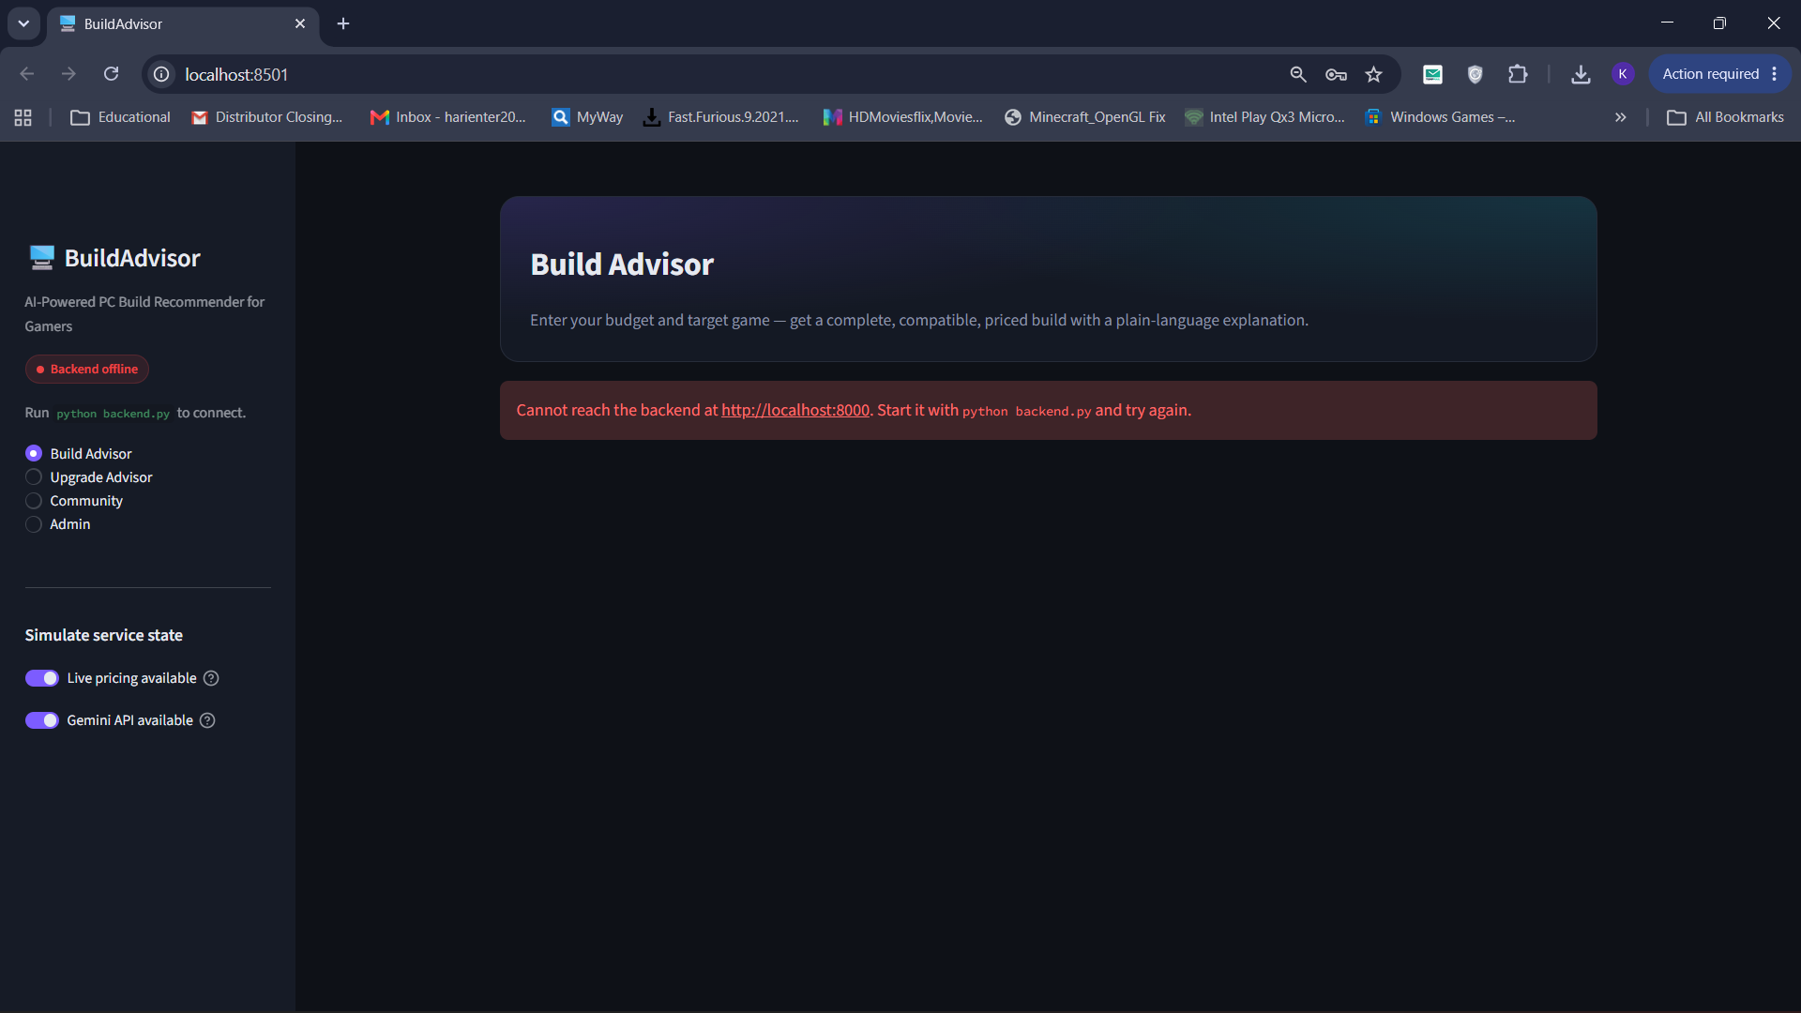
Testing
TC14 – Backend server offline

Slide 30
Advantages
Only three inputs needed: budget, game and resolution.
Automatic compatibility checks: socket, RAM type, PSU headroom and case fit.
Plain-language AI explanations for beginners.
Graceful fallback when Gemini or live pricing is unavailable.
Multi-retailer price comparison saves money.
Upgrade Advisor extends the life of existing PCs.
Business rules configurable through .env without code changes.
Modular three-tier design that is easy to maintain.

Slide 31
Limitations
Catalogue currently has only 35 components and 13 games.
FPS values are estimates from a score model, not measured benchmarks.
Live price scraping is optional and can break if retailer pages change.
AI explanations need internet and are subject to Gemini rate limits.
SQLite is not suited for many concurrent users.
No user registration yet; only the Admin signs in.
Peripherals such as monitors and coolers are not recommended.

Slide 32
Future Enhancement
Add more components (coolers, monitors) and more games.
Use real benchmark data for accurate FPS.
Reliable live pricing with price-drop alerts.
User registration, login and personal build history.
Support for laptops, pre-builts, streaming and editing workloads.
Move to PostgreSQL and deploy on the cloud.
Gemini-powered chat assistant for follow-up questions.

Slide 33
References
https://docs.streamlit.io
https://flask.palletsprojects.com
https://www.sqlite.org/docs.html
https://ai.google.dev/gemini-api/docs
https://docs.python.org/3
https://www.crummy.com/software/BeautifulSoup/bs4/doc
https://pcpartpicker.com

Slide 34
Thank You

