Slide 1


Sarvajanik Education Society
KP Human Sarvajanik College of Commerce & Computer Applications, Surat.
Bachelor of Computer Applications
Academic Year: 2026– 27
A Presentation On
“<Project Name>”
Presented By
<Member 1 Name>(En. No.)
<Member 2 Name> (En. No.)
<Member 3 Name> (En No.)
B.C.A. v Sem.
Under the Guidance of
<Mentor Name>

Slide 2
Agenda
Abstract
Objective
System Description (Technology Used)
Diagram (Use Case Diagram, Activity Diagram)
Data Dictionary
E-R Diagram
Project UI
Testing
Advantages
Limitations
References
Future Enhancement

Slide 3
Abstract

Slide 4
Objective

Slide 5
System Description
Software Requirement
Hardware requirements
Operating System

Slide 6
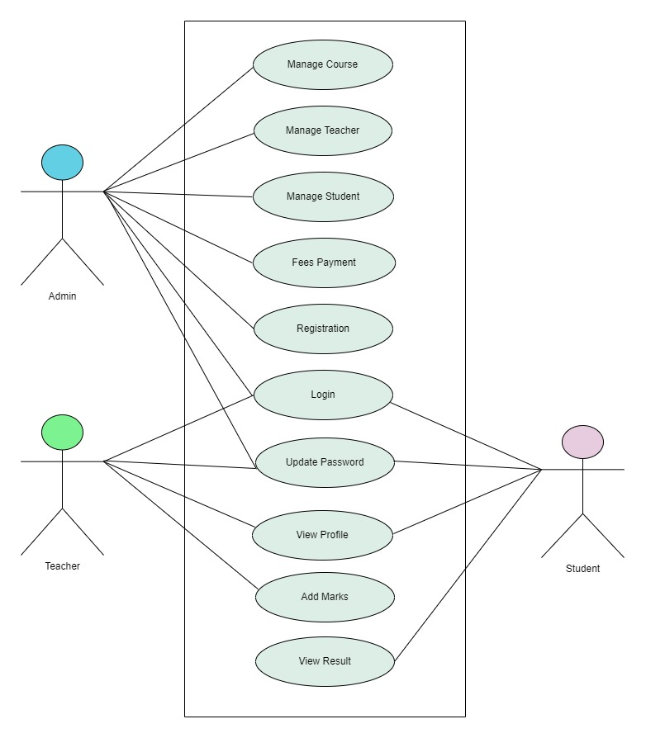
Use Case Diagram

Slide 7
Activity Diagram (Login)

Slide 8
Activity Diagram (Registration)

Slide 9
Data Dictionary

Slide 10
E-R Diagram

Slide 11
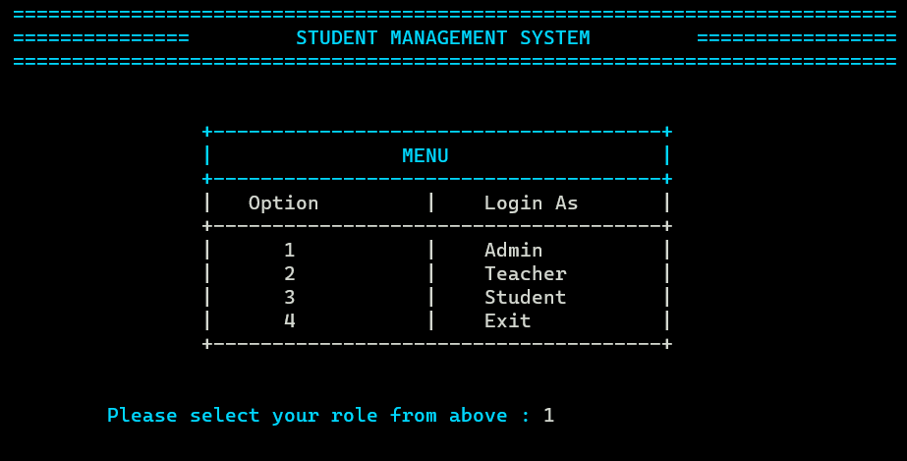
Project UI

Slide 12
Testing

Slide 13
Advantages

Slide 14
Limitations

Slide 15
Future Enhancement

Slide 16
References
https://www.cprogramming.com/
https://www.w3schools.com/c/index.php
https://www.geeksforgeeks.org/c-programming-language/

Slide 17
Thank You

