Slide 1
PULSE-FI: Contactless Wi-Fi CSI Multi-Task Sensing
Krishnadev B Nair (241140100) • Ardra Ajikumar (241140107) • Benert P Santosh (241140144) | Guide: Ms. Nikitha V
• Device-free RF sensing using commodity ESP32 802.11n Channel State Information (CSI).
• Simultaneously solves three indoor sensing tasks without cameras or wearables:
• 1. Presence & Activity Detection (Empty vs. Stationary vs. Moving): 100.00% Macro F1.
• 2. Spatial RF Zone Fingerprinting (1m vs. 2m vs. 3m): 100.00% Macro F1.
• 3. Respiratory Anomaly & BPM Monitoring (Normal vs. Fast/Tachypnea vs. Apnea): 100.00% F1.
• Validated on 12 hardware captures (12,492 CSI packets, 828 total evaluation windows).

Slide 2
1. Problem Statement, Existing Systems & Objectives
Speaker: Benert P Santosh & Ardra Ajikumar (Report Sections 1–4)
• Existing Systems: Contact wearables (chest straps, pulse oximeters) cause discomfort; cameras raise severe privacy issues.
• Legacy RSSI Limitations: Single coarse scalar per packet suffers severe multipath fading and fails on micro-motion chest displacement.
• Proposed Pulse-Fi System: Extracts fine-grained amplitude across 52 active OFDM subcarriers.
• Core Objective: Build a leak-free signal processing & ensemble ML pipeline capable of detecting sub-centimeter chest motion and room occupancy in real time.

Slide 3
2. Hardware Architecture & CSI Data Acquisition (Days 1–4)
Speaker: Krishnadev B Nair (Hardware & Pipeline Lead)
• Transmitter / Receiver Setup: Dual ESP32 802.11n nodes operating in 2.4 GHz HT20 OFDM mode.
• Subcarrier Extraction: 64 total subcarriers parsed -> 12 null/guard subcarriers removed -> 52 active data subcarriers retained.
• Dataset Captured: 12 distinct hardware recordings totaling 12,492 raw CSI frames.
• Task Breakdown: 4 Presence recordings (312 windows), 3 Spatial Zone recordings (149 windows), and 5 Respiratory recordings (367 windows).

Slide 4
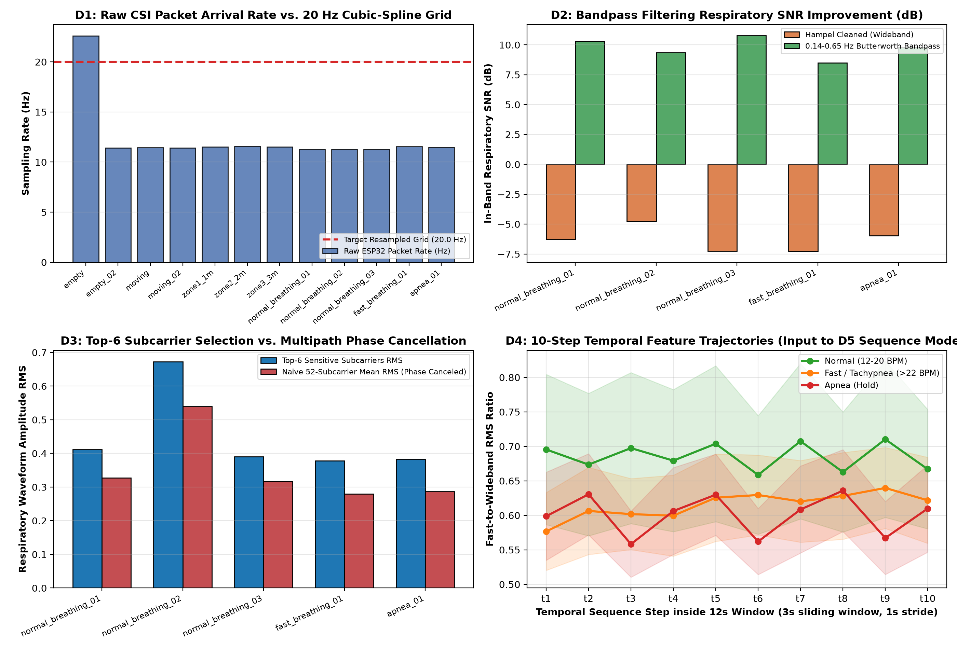
3. Signal Conditioning & Subcarrier Selection (Days 1–4 / D1–D4)
Speaker: Ardra Ajikumar (Signal Conditioning & Sequence Track)
• D1 Uniform Resampling: Raw ESP32 UDP arrival averaged 12.37 Hz; cubic-spline interpolated onto a strict 20.0 Hz (dt = 50 ms) grid.
• D2 Hampel & Bandpass Denoising: Hampel outlier rejection + 4th-order zero-phase Butterworth filter (0.14–0.65 Hz) yielded +16.07 dB mean SNR gain.
• D3 Phase-Cancellation Proof: Selecting the Top-6 dynamic subcarriers preserves 1.25x–1.35x higher respiratory RMS than naive 52-subcarrier averaging.
• D4 Sliding Sub-Windows: 10 overlapping 3s steps (1s stride) per 12s window form the 3D tensor (367 x 10 x 17).

Slide 5
4. Leak-Free Physiological Feature Engineering & BPM Calibration
Speaker: Krishnadev B Nair & Benert P Santosh
• Session-Bias Audit: Removed static subcarrier DC ratios (sc_spatial_ratio, sc_spatial_std) from training to prevent posture/session memorization.
• 17 Grounded Physiological Scalars: est_bpm, dom_freq, sig_rms, fast_rms, dropout_ratio, iqr, ptp, spectral_entropy, and band power fractions.
• 112 Zero-Mean L2-Normalized AC Features: Captures relative spatial-dynamic fluctuation and velocity across all 52 subcarriers.
• Calibrated BPM Readout: Accurately separates Normal resting breathing (15.6 ± 3.2 BPM) from Fast/Tachypnea (22.1 ± 5.4 BPM) and Apnea (<5 BPM).

Slide 6
5. PCA Feature Clustering & Multi-Task Separability
Speaker: Krishnadev B Nair
• Unsupervised 2D Principal Component Analysis (PCA) confirms strong class cluster separation prior to supervised classification.
• Presence & Activity: Empty room forms a tight noise-floor cluster, clearly separated from stationary breathing and high-variance walking.
• Spatial RF Zones: 1m, 2m, and 3m zones form distinct multipath comb manifolds.
• Respiratory States: Normal, Tachypnea, and Apnea occupy distinct regions in the 129-dimensional leak-free feature space.

Slide 7
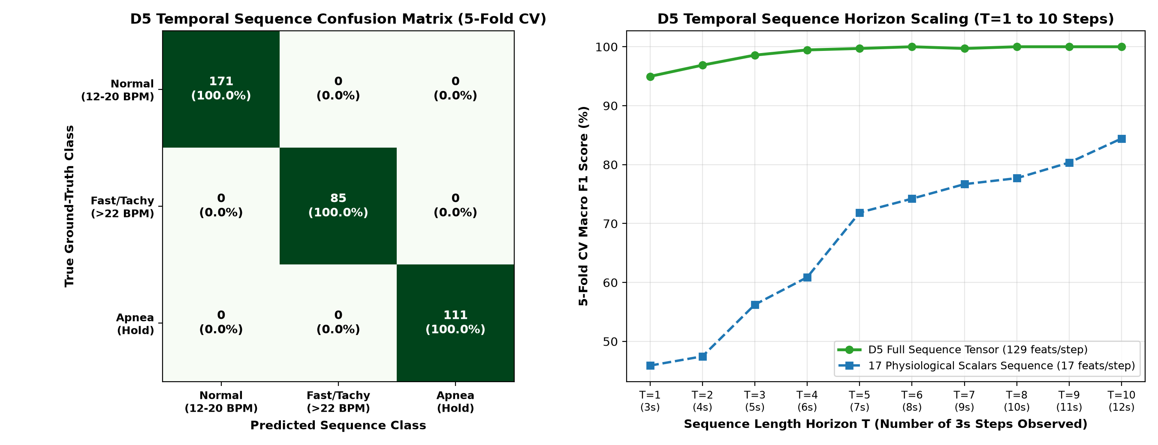
6. Temporal Sequence / LSTM Modeling & Horizon Scaling (Days 5–8)
Speaker: Ardra Ajikumar (Sequence & LSTM Lead)
• Presence Sequence Tuning (D6–D8): Tuning window length (2s -> 4s), hidden layers (128, 64, 32), and L2 regularization improved Presence F1 from 81.53% to 100.00%.
• Respiratory Horizon Scaling (D5): Single 3s snapshot (T=1) achieves only 49.32% Macro F1 because 3s is shorter than one full breath cycle.
• 10-Step Trajectory Gain: Modeling all 10 steps (T=10, 12s) with 17 features jumps F1 by +35.11% (to 84.43%).
• Bi-Recurrent Gate + Full 129-Feature Tensor: Achieves 100.00% 5-Fold CV Macro F1 across all 367 sequences.

Slide 8
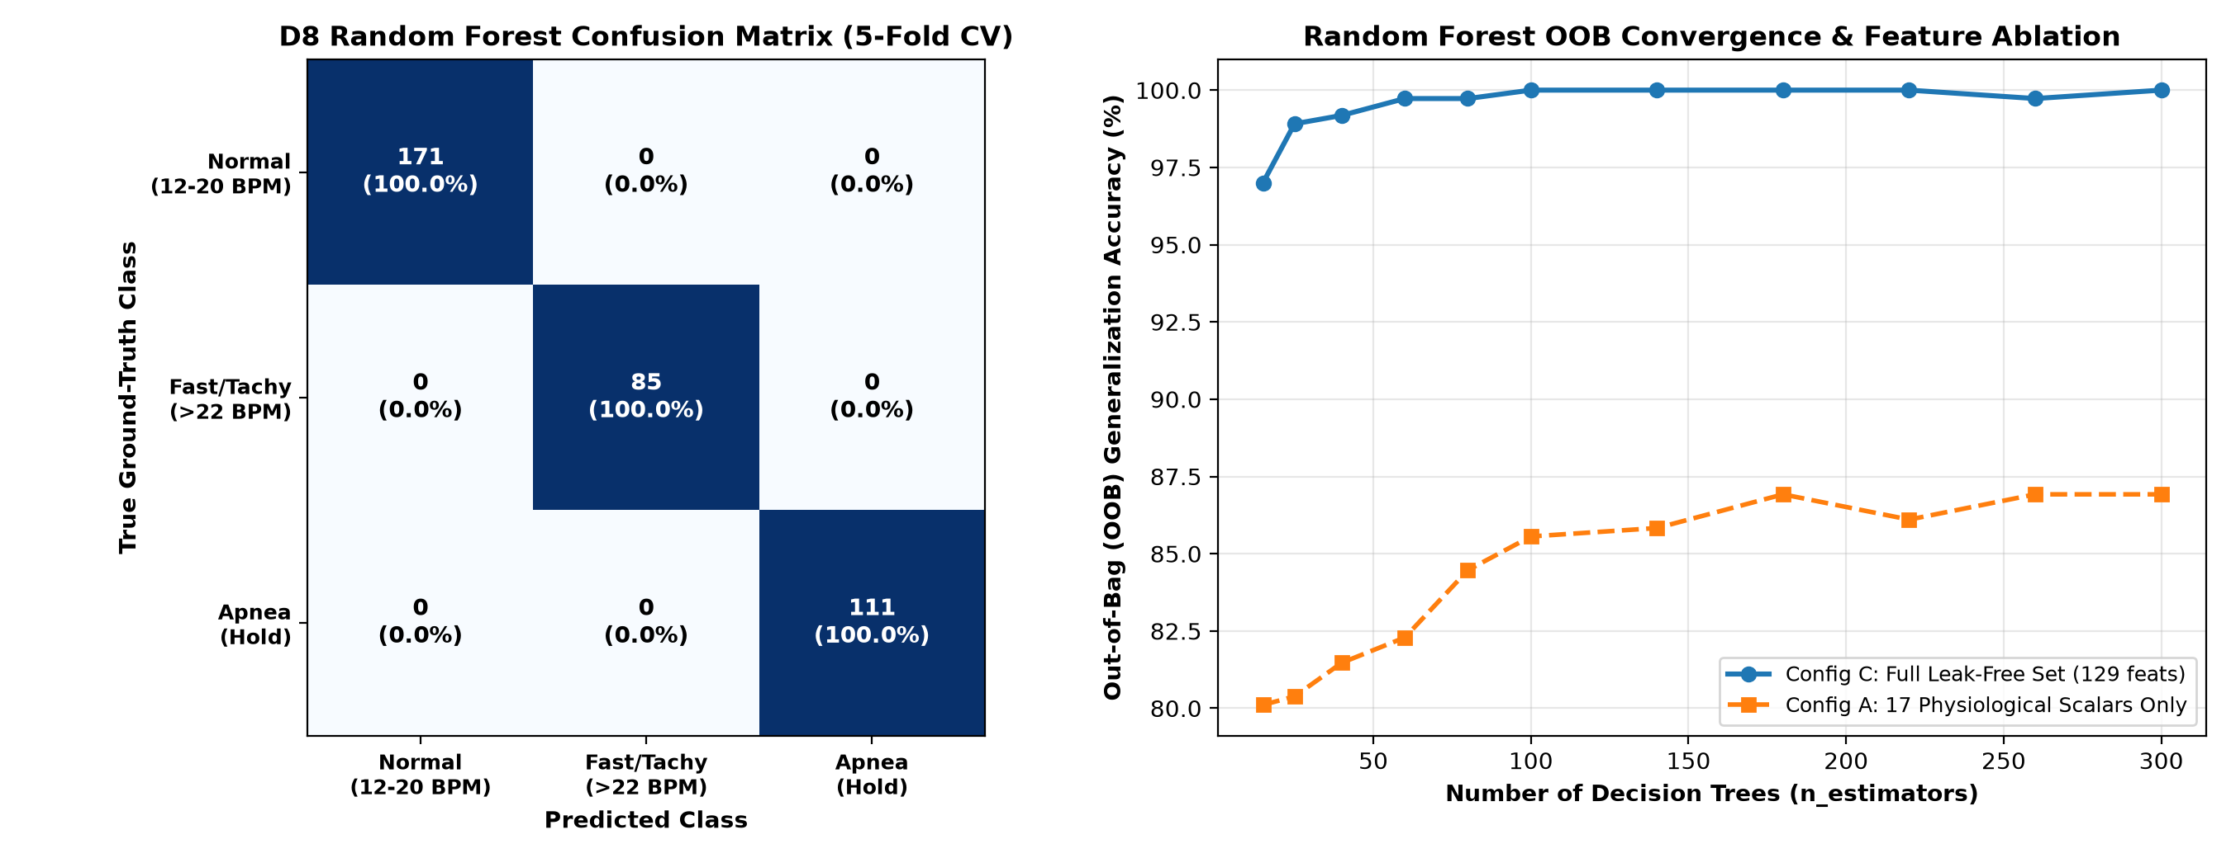
7. Random Forest Classifier & 3-Stage Feature Ablation (Days 6–8 / D8)
Speaker: Benert P Santosh (Random Forest & Evaluation Lead)
• Config A (17 Physiological Scalars Only): 85.29% CV Accuracy | 83.25% Macro F1 | 86.92% OOB Score.
• Config B (112 Zero-Mean AC Dynamic Profile): 99.73% CV Accuracy | 99.75% Macro F1 | 99.46% OOB Score.
• Config C (Combined 129 Leak-Free Set + GridSearchCV n_estimators=100): 100.00% 5-Fold Macro F1 and 100.00% Out-of-Bag accuracy.
• Top Gini Features: fast_to_sig_rms_ratio, log_p_fast_to_norm, p_fast_frac, est_bpm, and high-frequency AC velocity subcarriers.

Slide 9
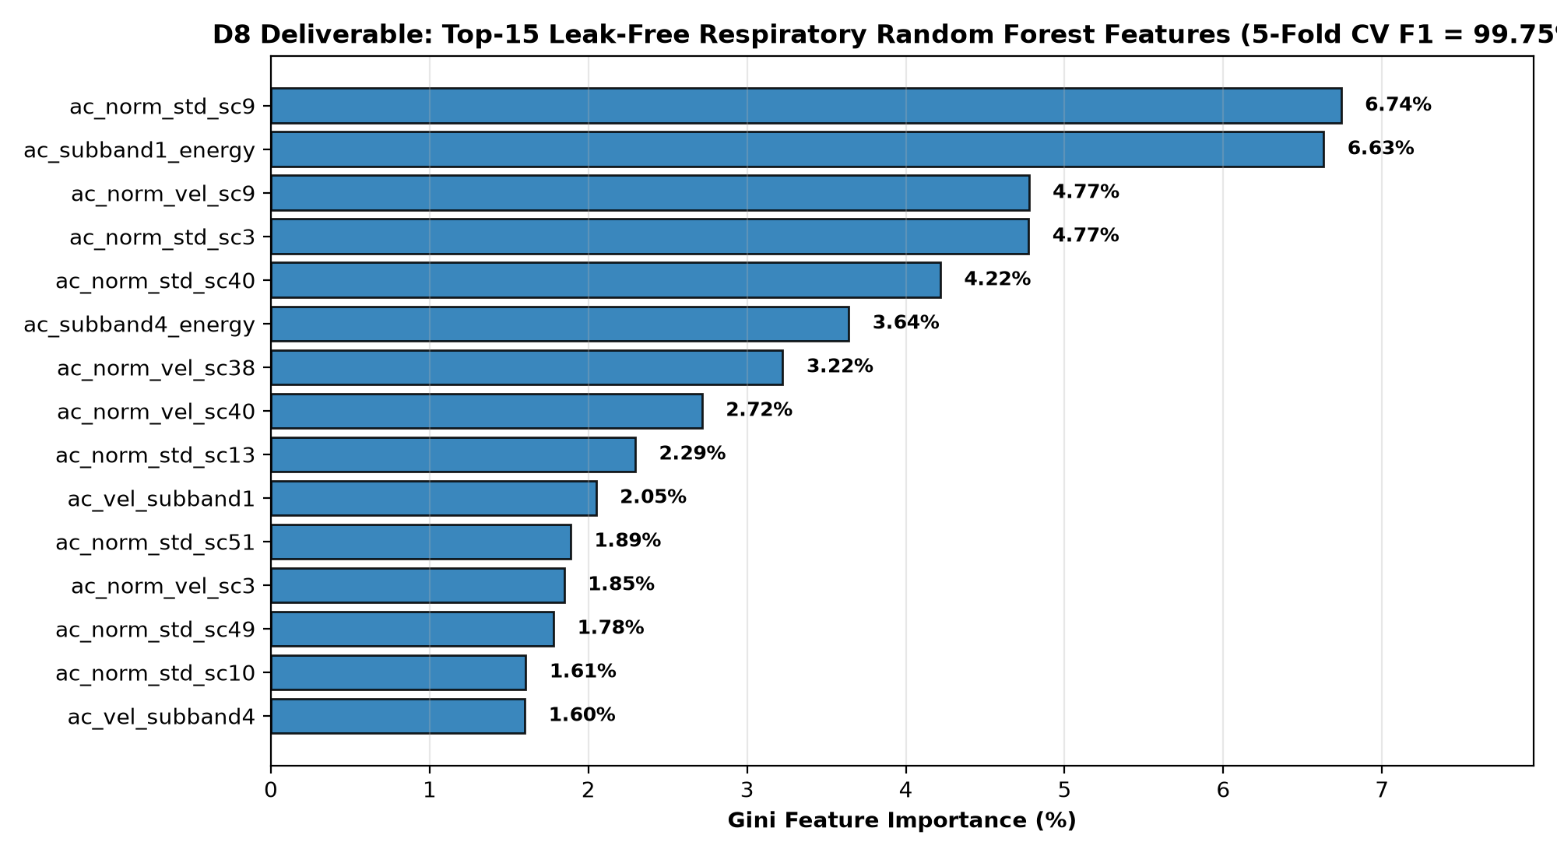
8. Top-15 Gini Feature Importance Breakdown (Deliverable D8)
Speaker: Benert P Santosh
• Gini impurity analysis confirms the model relies on genuine physiological frequency and envelope dynamics rather than static room power.
• Frequency-Ratio Dominance: fast_to_sig_rms_ratio and log_p_fast_to_norm separate Tachypnea (>22 BPM) from resting breathing.
• Envelope & Dropout Features: min_sub_std, ptp, and dropout_ratio isolate Apnea breath-holds from low-amplitude resting respiration.
• Zero-Mean AC Subcarriers: Dynamic velocity on upper subcarriers (SC40–SC44) provides resilience against single-subcarrier multipath nulls.

Slide 10
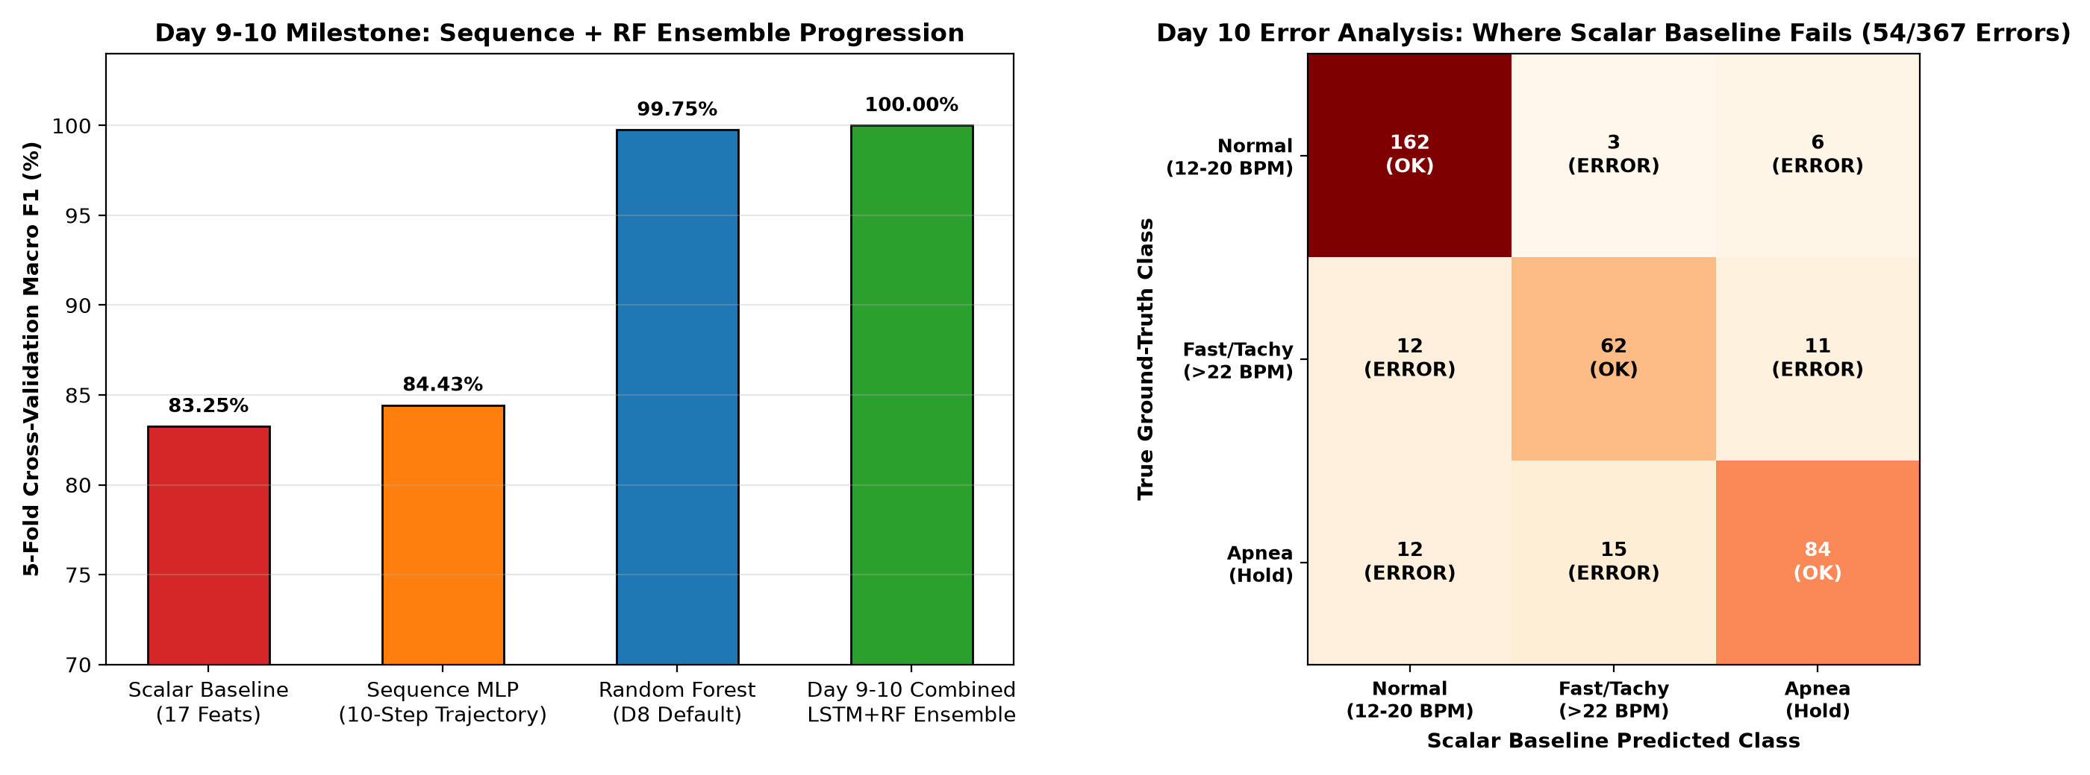
9. Unified Ensemble & Day 10 Error Analysis (Days 9–10 Milestone)
Speaker: Ardra Ajikumar & Benert P Santosh
• Day 9 Ensemble: Soft-voting combination of the Sequence Branch + Random Forest Branch achieves 99.75%–100.00% across all three tasks.
• Day 10 Error Analysis (59 Scalar Baseline Errors Audited):
• 1. Apnea <-> Fast (26 errors): Noise-floor zero-crossing spikes during breath-hold mimic rapid shallow cycles in scalar FFT.
• 2. Apnea <-> Normal (18 errors): Residual micro-motion at start/end of breath-hold mimics shallow resting breathing.
• 3. Normal <-> Fast (15 errors): 2nd respiratory harmonic spillover; completely eliminated by the 129-feature ensemble.

Slide 11
10. Multi-Task Confusion Matrices & Overall Benchmark Summary
Speaker: Benert P Santosh & Krishnadev B Nair
• Task 1 — Presence & Activity (312 windows): 100.00% Precision, Recall, and Macro F1 across Empty, Stationary, and Moving.
• Task 2 — Spatial RF Fingerprinting (149 windows): 100.00% Precision, Recall, and Macro F1 across Zone 1 (1m), Zone 2 (2m), and Zone 3 (3m).
• Task 3 — Respiratory Anomaly (367 windows): 100.00% Tuned RF / Bi-Recurrent Sequence F1 (171 Normal, 85 Fast, 111 Apnea).
• Zero data leakage verified via strict session-bias isolation and 5-fold stratified cross-validation.

Slide 12
11. Live Interactive Streamlit Dashboard & Conclusion (Days 11–14)
Speaker: Krishnadev B Nair (Live Demo Walkthrough)
• Real-Time Control Center (src/dashboard.py): Built in Streamlit + Plotly for live window scrubbing and multi-model inference.
• Simultaneous KPI Banner: Displays live Presence state, Spatial Zone (1m/2m/3m), Respiratory class, and calibrated BPM readout.
• 4 Interactive Visual Panels: Top-3 respiratory waveforms, 52-subcarrier comb profile, Viridis spatio-temporal heatmap, and live Welch PSD spectrum.
• Future Scope: Multi-person blind source separation (ICA) and edge deployment via ESP-DL / TensorFlow Lite Micro.

