Slide 1

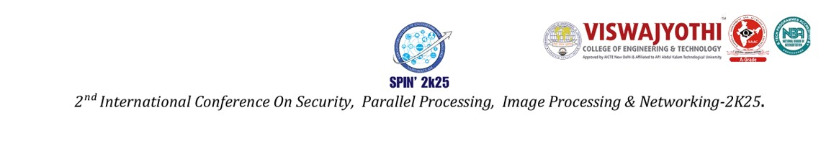
Paper ID: SPIN2K25_30
CAMPUS VIEW
Guided By:
Mr. Andrews Jose
Asst.prof CSE Dept
By,
Alan Shaji
Aniruddh Ajay
Krishnadev P Melevila
Robin George
SPIN conference 2k25
1

Slide 2


INTRODUCTION
What is Campus View?
A software tool for educational accreditation processes.
Helps in assessing course and program outcomes efficiently.
Why Accreditation Matters?:
Ensures academic quality and continuous improvement.
Essential for institutional recognition by NAAC/NBA.
Role of Automation in Accreditation
Reduces manual workload for faculty.
Provides accurate and data-driven insights.
SPIN conference 2k25
2

Slide 3
PROBLEM STATEMENT
Challenges in Accreditation Process:
Manual calculation of CO-PO attainment is time-consuming.
Difficulty in identifying weak and bright students.
Gathering and analyzing student feedback is complex.
Need for a structured, automated approach to Criterion 2 inputs.
Existing System Limitations:
Spreadsheets and manual computations lead to errors.
Lack of standardized methodology for NAAC/NBA compliance.
No real-time performance tracking of students.
Need for a Solution:
A software-driven approach to streamline accreditation requirements.
SPIN conference 2k25
3

Slide 4

LITERATURE SURVEY
SPIN conference 2k25
4

Slide 5
TITLE | TECHNIQUES | MERITS | DEMERITS
A Case Study on the Assessment of Program Quality through CO-PO Mapping and its Attainment | CO-PO Mapping and Attainment Calculation | Provides a structured approach to assess program quality, aiding in continuous improvement. | Implementation can be complex and time-consuming.
Student Performance Analysis using Machine Learning | Machine Learning Algorithms | Offers predictive insights into student performance, enabling early interventions. | Requires large datasets and may face privacy concerns.
Student Performance Prediction Using Machine Learning Algorithms | Decision Trees, Neural Networks, SVM | Identifies key predictors of student success, assisting in targeted support strategies. | Model accuracy varies; may need frequent updates.
SPIN conference 2k25
5

Slide 6
TITLE | TECHNIQUES | MERITS | DEMERITS
A Simple Approach to Calculate CO & PO Attainment Levels by Direct and Indirect Methods | Direct and Indirect Assessment Methods | Simplifies the attainment calculation process, making it more accessible. | May oversimplify complex educational outcomes.
Classification and Prediction of Student Performance Data Using Various Machine Learning Algorithms | Supervised Machine Learning | Enhances accuracy in predicting student outcomes, facilitating personalized learning paths. | Dependent on data quality and algorithm selection.
Predicting Students' Performance Using Machine Learning Algorithms | Socioeconomic Factors and Past Grades Analysis | Considers a holistic view of student performance by including diverse factors. | Data collection can be intrusive; ethical considerations are necessary.
SPIN conference 2k25
6

Slide 7
TITLE | TECHNIQUES | MERITS | DEMERITS
Intelligent CO-PO Attainment Model for Misalignment in Assessing Blended Learning & Instruction | Intelligent Modeling for CO-PO Attainment | Addresses misalignment issues in blended learning environments, improving assessment accuracy. | Implementation may require advanced technical expertise.
Educational Data Mining: Prediction of Students' Academic Performance | Educational Data Mining Techniques | Utilizes data mining to uncover patterns in student performance, aiding in curriculum development. | Potential privacy issues; requires careful data handling.
Attainment of Course Outcome and Programme Outcome: Direct and Indirect Methods | Direct and Indirect Assessment Methods | Provides comprehensive guidelines for CO and PO attainment calculations, ensuring thorough evaluation. | Can be resource-intensive to implement effectively.
SPIN conference 2k25
7

Slide 8
TITLE | TECHNIQUES | MERITS | DEMERITS
Student Performance Prediction and Classification Using Machine Learning | Neural Networks and Classification Algorithms | Demonstrates high accuracy in classifying student performance levels, supporting targeted interventions. | Neural networks can be computationally intensive and require substantial data.
An Empirical Study on Assessment and Attainment Method of Course Outcome and Program Outcome | Empirical Assessment Methods | Offers practical insights into effective assessment strategies for course and program outcomes. | Findings may be context-specific and not universally applicable.
Predicting Students' Performance in Exams Using Machine Learning | Gaussian Naive Bayes, SVM, Random Forest, KNN | Compares multiple algorithms to identify the most effective for exam performance prediction. | Performance varies across algorithms; no one-size-fits-all solution.
SPIN conference 2k25
8

Slide 9
PROPOSED SYSTEM
Primary Goal:
Develop a single application for seamless accreditation support.
Specific Objectives:
Automate CO-PO attainment calculations.
Provide student classification based on performance.
Implement feedback analysis from students and faculty.
Generate structured Criterion 2 reports for NAAC/NBA.
SPIN conference 2k25
9

Slide 10
ARCHITECTURE
SPIN conference 2k25
10

Slide 11
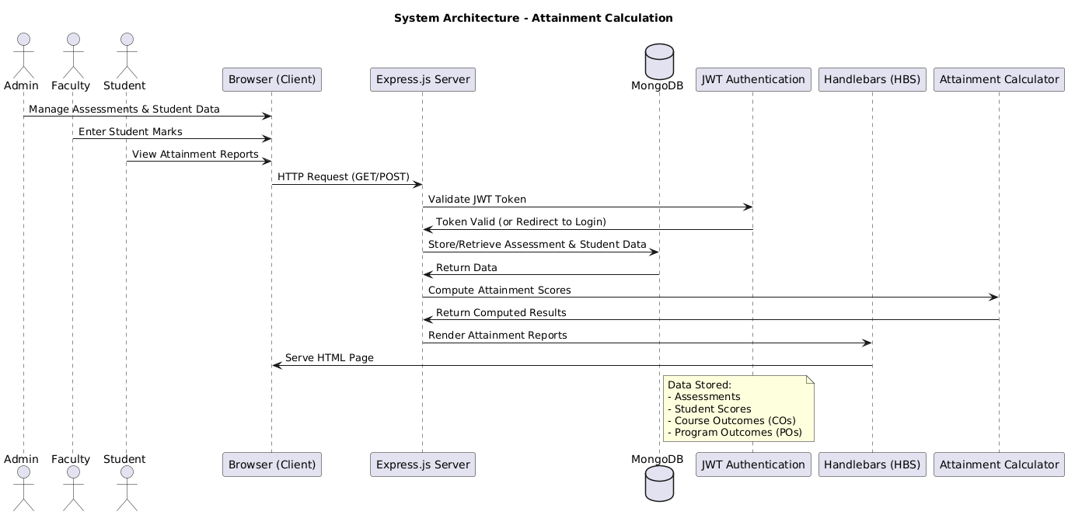
SPIN conference 2k25
11

Slide 12
IMPLEMENTAION DETAILS: DATASETS USED
Requirements:
4GB RAM
Intel Pentium processor
256 GB HDD / SSD recommended
Server : Ubuntu 22.0
Database: MongoDB
Frameworks: Node.Js, HBS
SPIN conference 2k25
14

Slide 13
IMPLEMENTAION DETAILS: ASSOCIATED DATASETS
Primary Datasets:
Student marks & academic records
CO-PO attainment values from previous years
Faculty evaluations and feedback responses
Data Sources
University grading systems
Survey responses from faculty/students
Accreditation reports & previous assessments
SPIN conference 2k25
15

Slide 14
IMPLEMENTAION DETAILS: MODULE DESCRIPTION
Module 1: Assessment tool generation
Allow faculties and admins to create assessment tools
Map each tools to its taxonomy and category
Module 2:Student data input
Add student data by faculty
Add each assessment tool data for each student
Module 3 :CO-PO Attainment Calculation
Uses predefined correlation values (1,2,3)
Fetches student performance data
Calculates attainment percentage
SPIN conference 2k25
16

Slide 15

SCREENSHOTS
SPIN conference 2k25
17

Slide 16
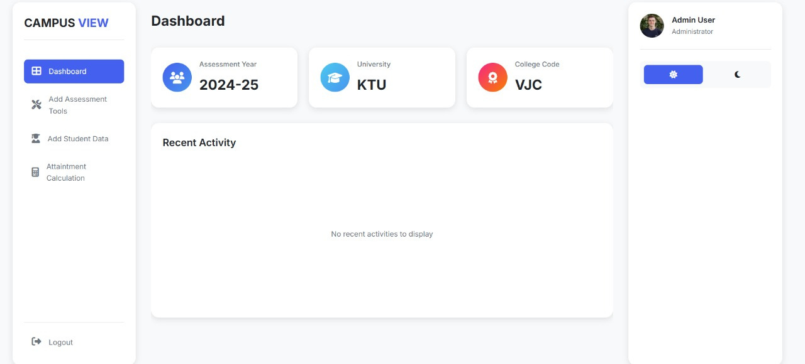
SPIN conference 2k25
18

Slide 17
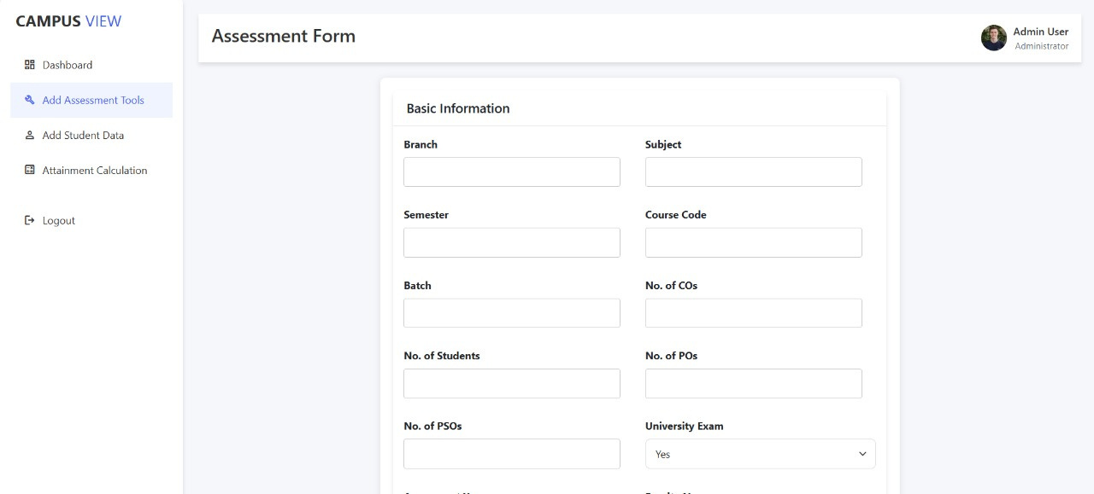
SPIN conference 2k25
19

Slide 18
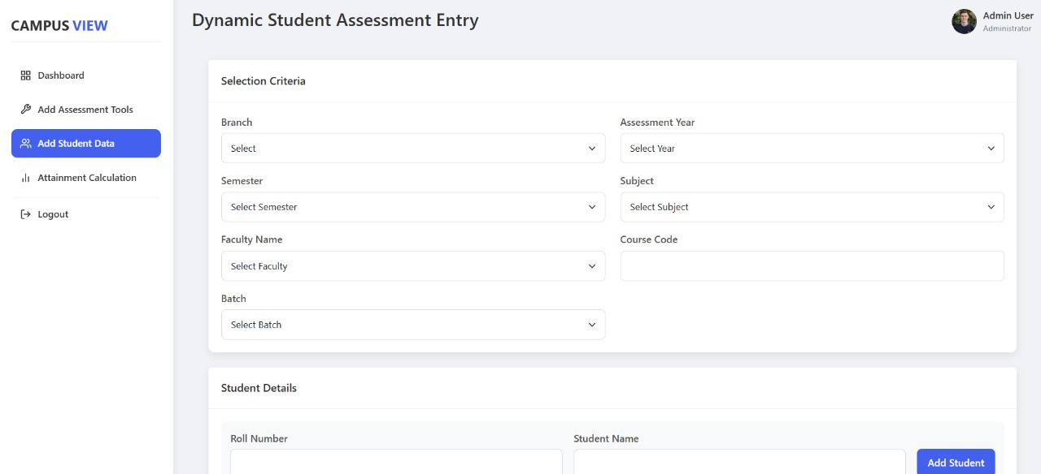
SPIN conference 2k25
20

Slide 19
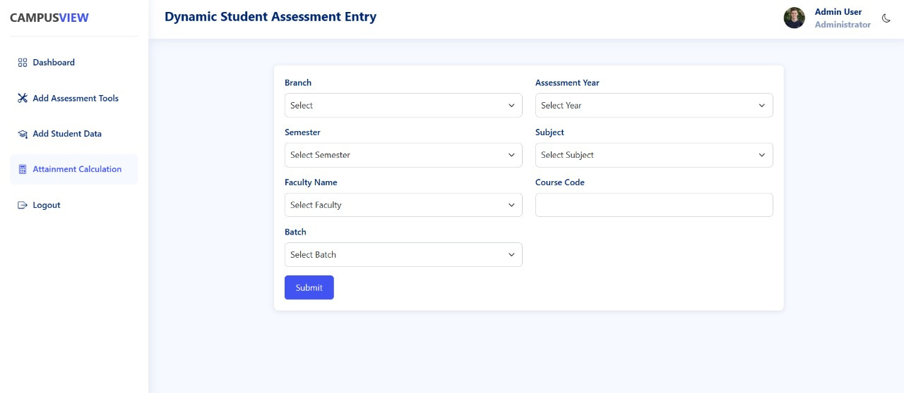
SPIN conference 2k25
21

Slide 20
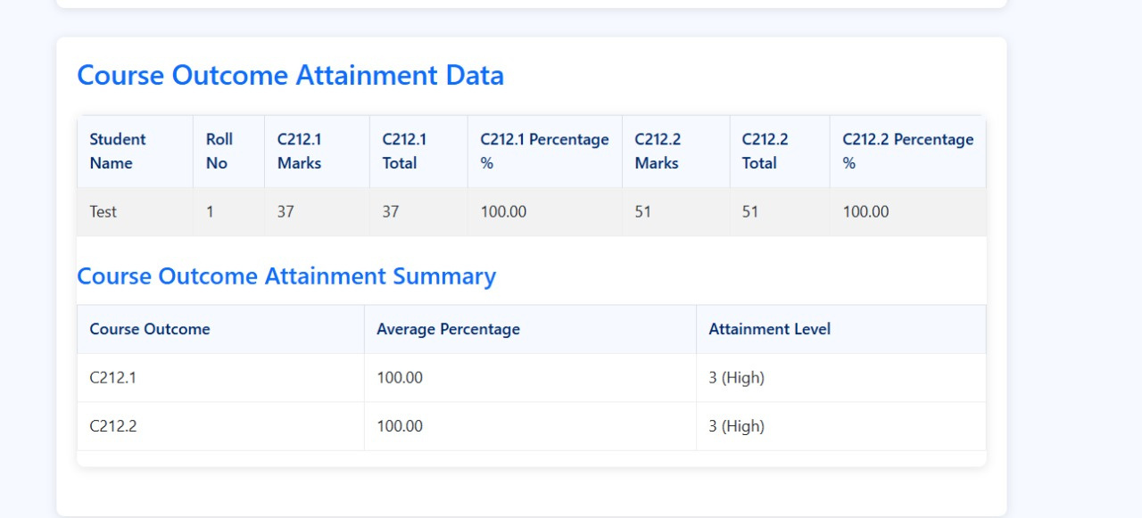
SPIN conference 2k25
22

Slide 21
RESULT
PERFORMANCE ANALYSIS
Comparison with Manual Methods:
Accuracy improvement: ~30-40%.
Time reduction: ~50-60%.
Software Efficiency:
Handles large datasets efficiently.
Macro-based automation speeds up calculation.
Scalability
Can be adapted for multiple departments and institutions.
SPIN conference 2k25
23

Slide 22
CONCLUSION
Campus View automates key accreditation tasks.
Reduces faculty workload and increases accuracy.
Provides actionable insights for academic improvement.
SPIN conference 2k25
24

Slide 23
REFERENCES
https://naac.gov.in/index.php/en/assessment-accreditation
Min Dong, Yongfa Li, Xue Tang, Jingyun Xu, Sheng Bi, and Yi Cai, “Variable Convolution and Pooling Convolutional Neural Network for Text Sentiment Classification,” IEEE Access, 2022.
https://journaleet.in/articles/a-case-study-on-the-assessment-of-program-quality-through-co-po-mapping-and-its-attainment
"A Case Study on the Assessment of Program Quality through CO-PO Mapping and its Attainment" by B. Rajagopal Reddy et al.
SPIN conference 2k25
25

Slide 24
THANK YOU
SPIN conference 2k25
26

