Slide 1

IT
INDIA TODAY
~ KRISHNA DHOLAKIYA
~ KARAN RATHOD

Slide 2
Prescription of Power Point Presentation
1
Group Details.
What Is India Today.
Technologies Used In This Project.
Data Dictionary.
Screen Layouts.
Reference.
Conclusion.
2
3
4
5

Slide 3
MSC IT DATA MANAGEMENT & VISUAL INSIGHT (5 YEAR INTEGRATED )
PROJECT TITLE : INDIA TODAY
GROUP NAME : K&K
GROUP DETAILS
KRISHNA DHOLAKIYA(202126940021) (Back-end)
KARAN RATHOD(202126940103) (Front-end)

Slide 4
What Is India Today ?
India today is an article website.
India today provides news, articles, magazines, weather, live tv.
India today provides national news, state level news, international news.
India today also provide top headlines.

Slide 5
Technology Used In This Project
REACT JS
React JS is a free and open source front end java script library for building user interface based on component.
Component : components are independent and reusable bits of code.
Component used in this project : Header.jsx,
: Signin.jsx,
: Signup.jsx,
: Subscribe.jsx
CSS File used in this project : index.css
: login.css
: sub.css

Slide 6
Technology Used In This Project
NODE JS
Node JS is a cross platform , open source server environment that can be run on Windows, Linux, Unix, MacOS and more.
Node JS is a back-end java script run time environment.
We used Node JS in this project to connect MongoDB for data bases.
Node JS and React JS are connected in this project.
This project is based on Express JS.

Slide 7
Technology Used In This Project
MONGO DB
Mongo DB mongo is a source available cross platform document oriented data base program.
MongoDB is classified as a NoSQL data base program.
MongoDB used JSON documents with optional schemas.
MongoDB is faster and more scalable.
Used of MongoDB in this project : Databases.

Slide 8
Data Dictionary
NUMBER OF TABLES
NO | Table Name.
1 | Sign-Up

Slide 9
Data Dictionary
SIGN-UP
Serial No. | Field Name. | Data Type. | Size. | Constraints. | Description.
1 | Full name | Varchar | (30) | Not null | Store user name
2 | Email.ID | Varchar | (30) | Not null, unique, Primary key | Store user E-mail.ID
3 | Password | Varchar | (30) | Not null | Store user Password
4 | Contact | int | (12) | Not null | Store use contact no

Slide 10
Screen layout

Slide 11
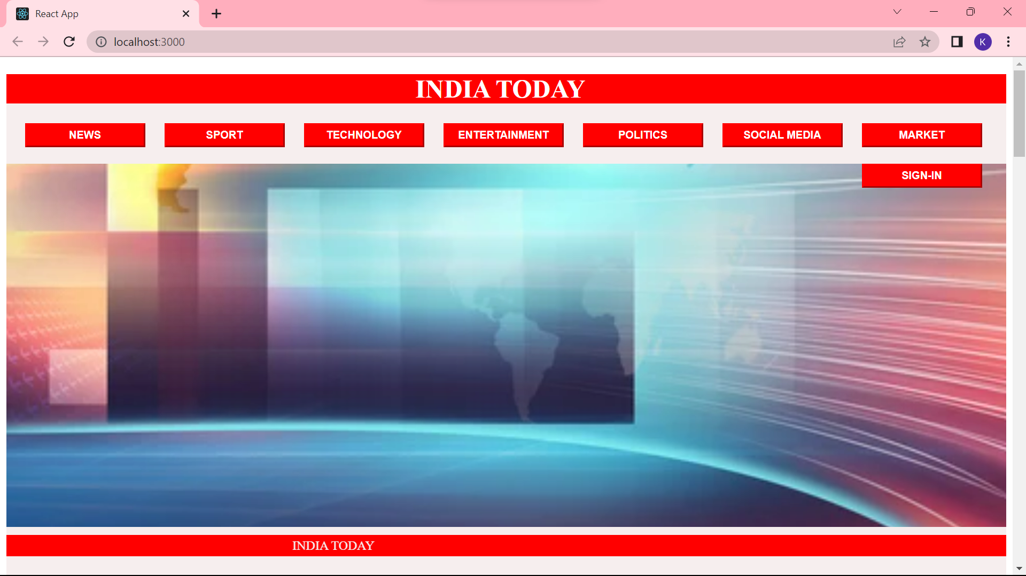
Home page

Slide 12
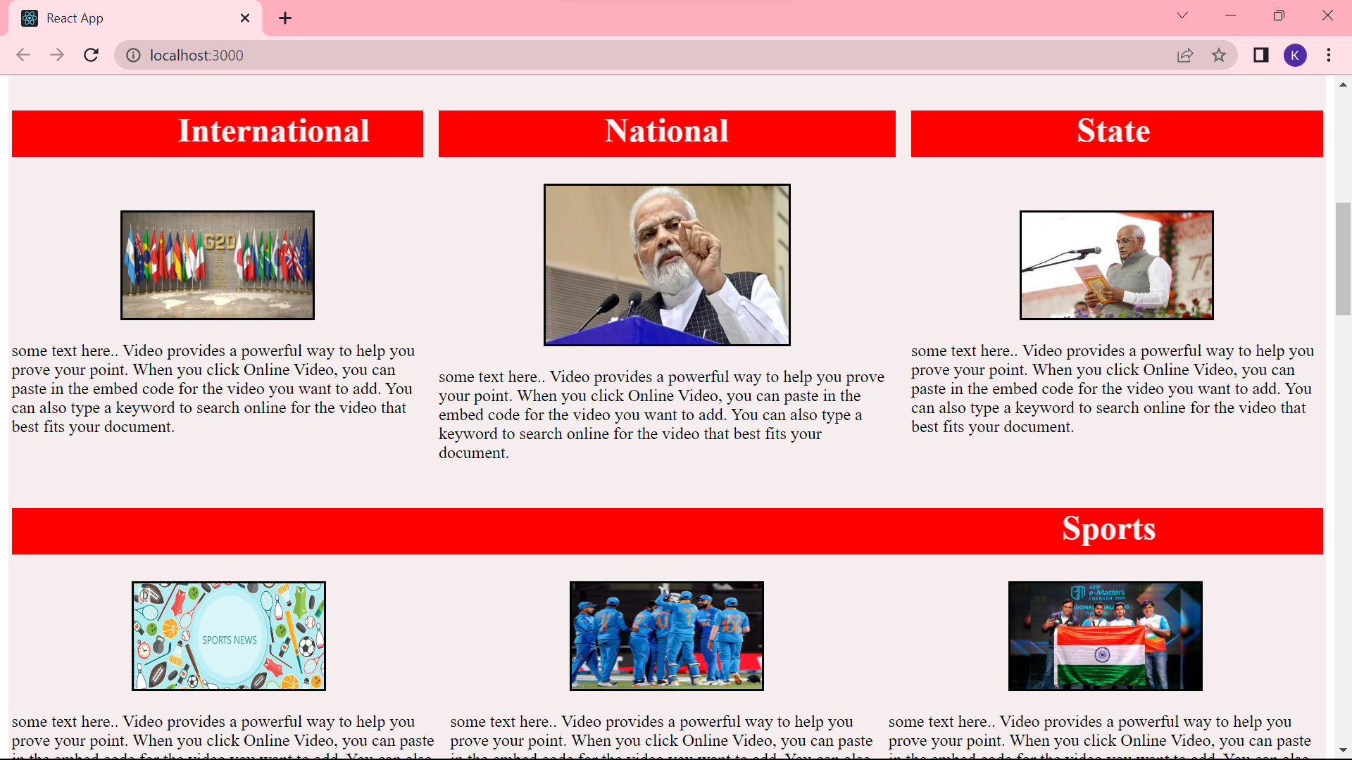
Contents

Slide 13
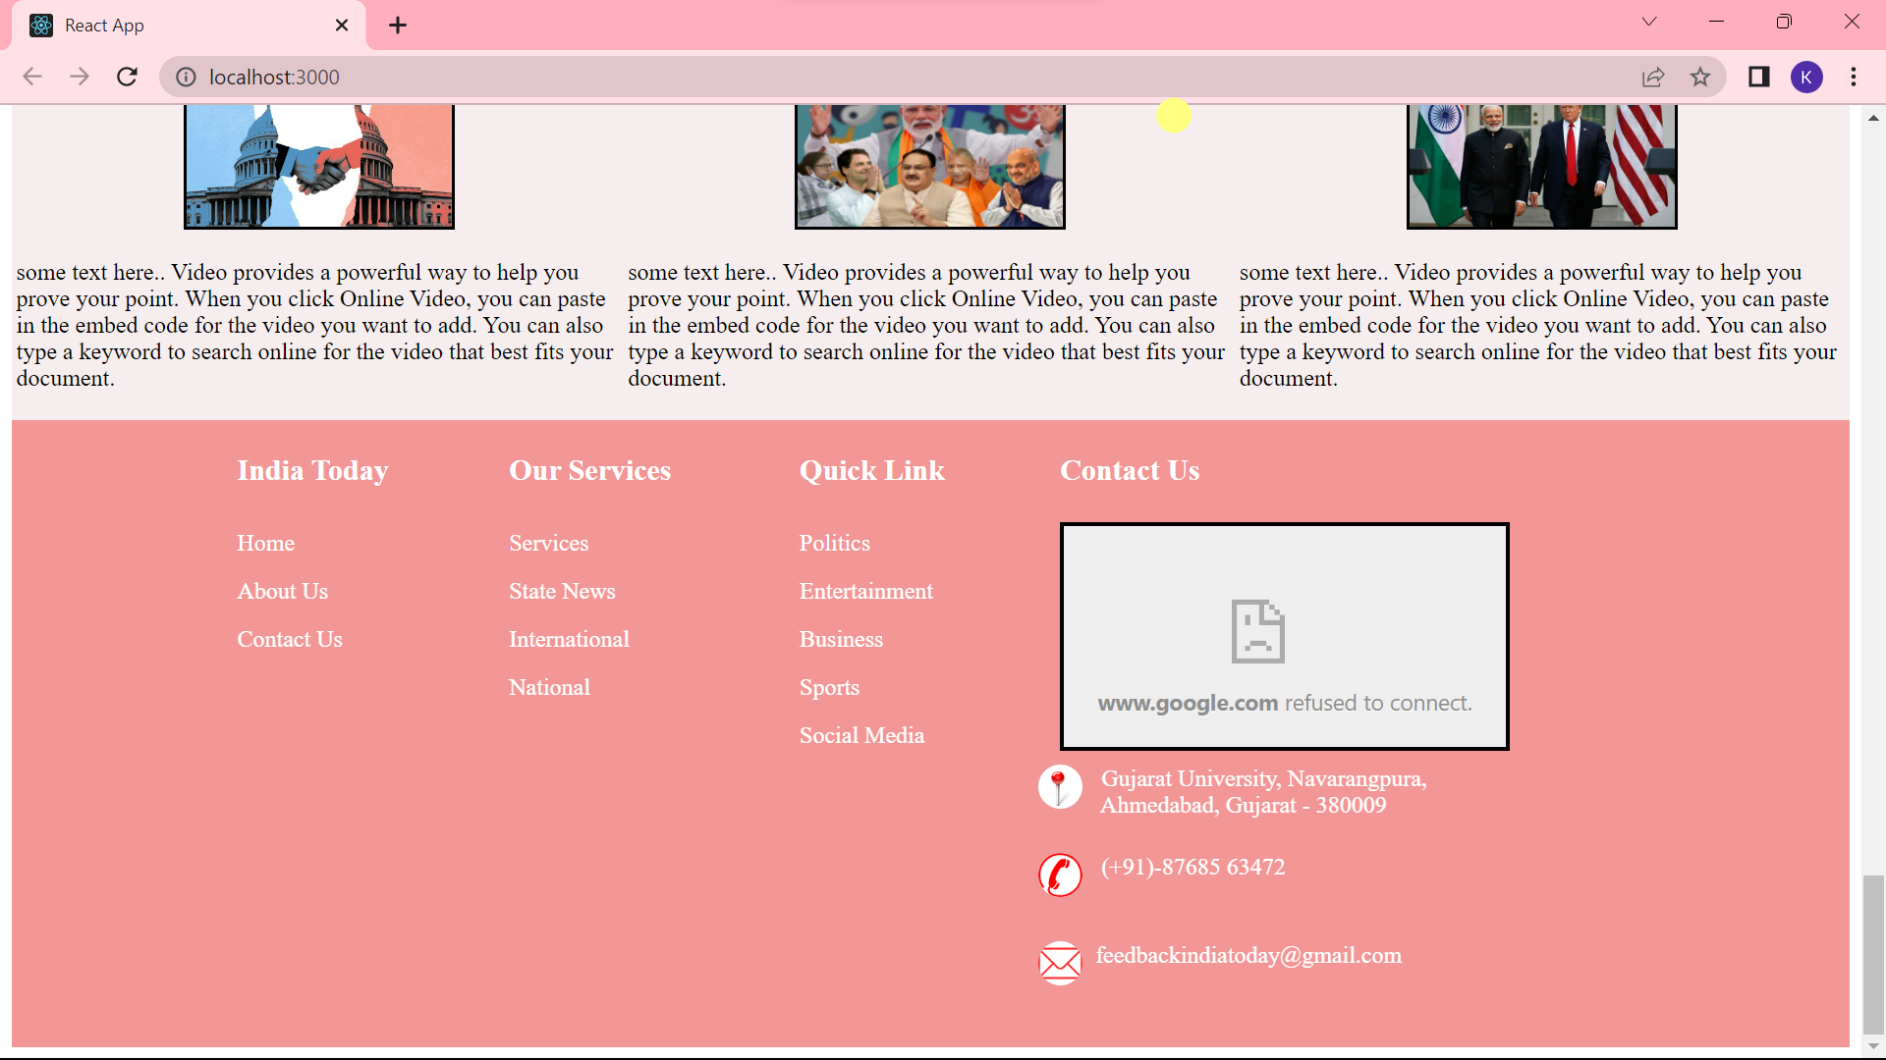
Footer

Slide 14
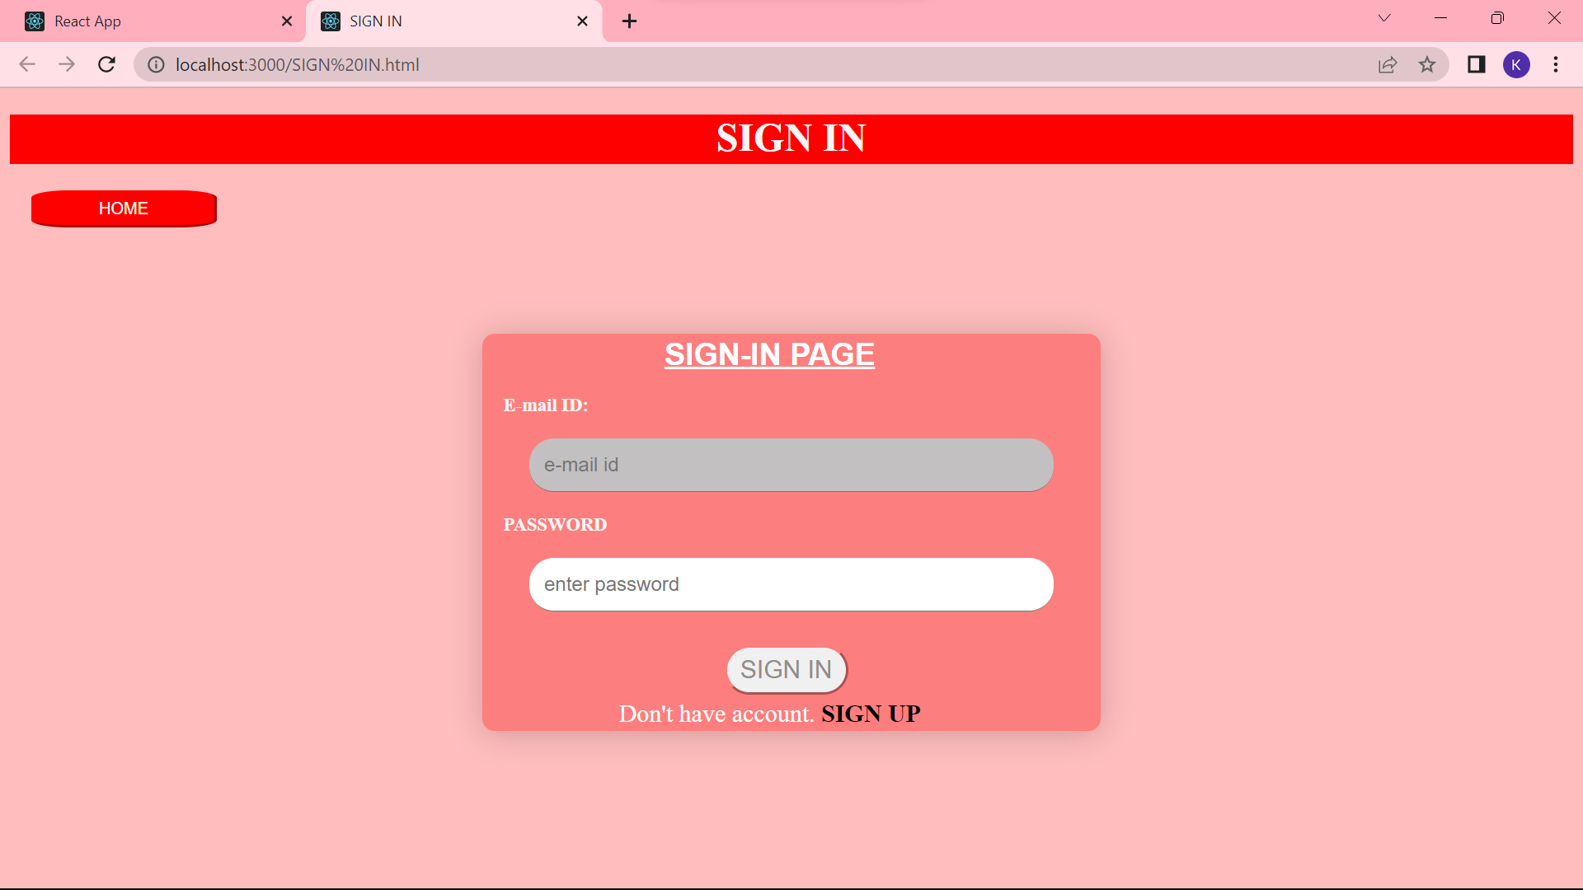
Sign-In

Slide 15
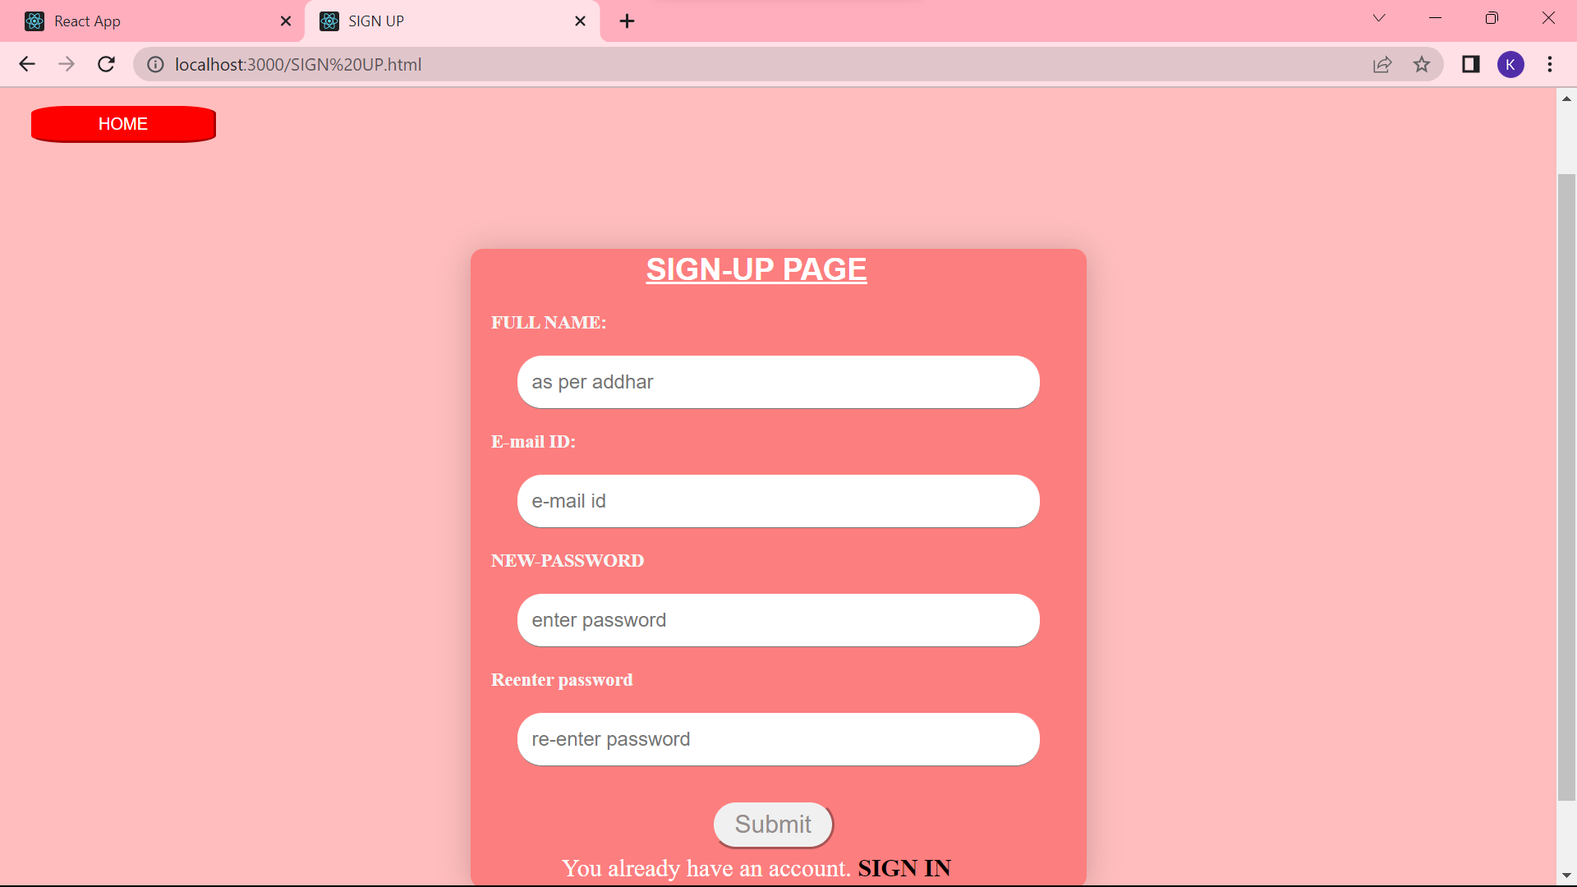
Sign-Up

Slide 16
Thank You😊😊

