Slide 1

Pricing Sustainability-Linked Derivatives Model Development
Project Lab -
Merton Ngan
Qayum Khan
Krishna Diggavi
Venkat Averineni
Chen Chen
Notes:
Welcome the participants to the program.
Introduce yourself and briefly summarize your experience at EY and your interest in presenting at Welcome to EY.
Have co-facilitators, if present, introduce themselves and provide background information.
State the following to help participants understand the context of Welcome to EY:
This course was designed for all ranks around the globe. It provides you with foundational knowledge that will help to explain our culture, our processes and how we go to market.
However, your service line will provide the specifics about your role and your job.
As an organization, we want to invest in you, give you consistent content globally, let you meet other new hires across service lines and meet some of our leaders.

Slide 2
Executive Summary
Background
Sustainability-Linked Derivatives (SLDs) have a key role to play in the transition to a more sustainable economy and in enhancing the flow of private capital to meet environmental, social & governance objectives.
Since the first SLD was executed in August 2019, an increasing number of market participants have expressed an interest in transacting in these derivatives.
Objective
In this project, we build three pricing models for binary options on KPI by using binomial tree model, continuous Black-Scholes and Monte Carlo simulation frameworks.
Extend the above three pricing models to cover binary options on KPI with potential negative pay-off and compare the results to show consistency of our assumptions.

Slide 3
Overview of Sustainability-Linked Derivatives (SLD)
SLD's are the traditional derivatives which have pay-off dependent on accepted ESG factors.(Environmental, Social & Governance factors)
SLDs are highly customizable transactions that use Key Performance Indicators(KPIs) to set sustainability targets.
SLD will likely be classified as an over-the-counter (OTC) derivative, which means existing regulatory requirements that apply to OTC derivatives need to be considered when trading SLDs.
The EU NFRD (Non-Financial Reporting Directive) applied since 2018 requires qualifying companies to disclose a non-financial statement in their annual reports, which must contain information on the way they operate and manage social and environmental challenges.
SFDR (Sustainable Finance Disclosure Regulation) requires market participants to consider any adverse sustainability impacts in their investment processes and the provision of sustainability related information with respect to financial products
Regulations:

Slide 4
Trade Flow
The below figure illustrates the main 4 steps involved while trading SLDs.
Pre -Trade
Regulatory framework for SLDs
Trade Execution
Greenwashing
Additional Risk considerations – 3rd party
Post -Trade
KPI disclosure
Monitoring
Trade Termination
Greenwashing
Capital and Risk considerations
Additional Risk considerations – 3rd party
The most principal aspect of the trade flow is the KPI disclosure, and it is done after the trade is executed.

Slide 5
Overview of Sustainability-Linked Derivatives (SLD)
An ESG overlay can be constructed in several different ways, including:
an adjustment to cashflows depending on whether the agreed ESG target(s) are met, so that a counterparty pays more if it fails to meet the agreed ESG target (s) and pays less if it meets the agreed ESG target(s) – for example, by way of:
an adjustment (upward or downward) to the spread applied to an interest rate (for example - an interest rate swap)
a fee (or a ‘greenium’) to be paid by the buy-side counterparty to the sell-side counterparty, or a rebate to be given by the sell-side counterparty to the buy-side counterparty.

Slide 6
Payoff of Sample Binary Option on KPI
Below figure compares the pay-offs of 2 sample binary options on KPI –
binary option with bonus of 10 bps if the KPI goal is reached and penalty of 10 bps if the company falls short of the KPI goal.
binary option with bonus of 5 bps if the KPI goal is reached and no penalty.
Pay-off
10 bps
5 bps
0 bps
KPI Goal
KPI
-10 bps
pay-off with reward and penalty based on the KPI goal.
pay-off with just the reward on achieving the KPI goal and no penalty

Slide 7
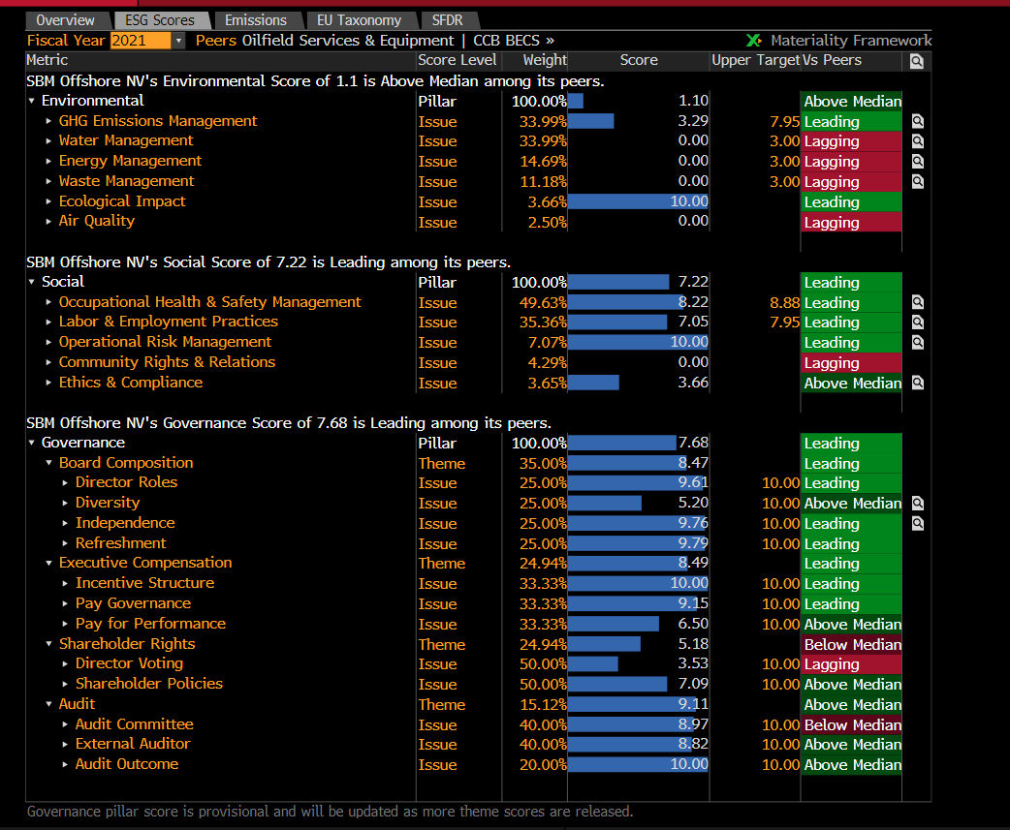
Sample KPI Data
Inference:
The figure illustrates different KPI factors under the subdivisions Enviornmental, Social and Governance.
Any of these factors can be used as underlying KPI based on contract requirements and companies involved in the contract.

Slide 8
Data Extraction
The challenge we faced with extracting the data is that we could not find the exact contract details of the past SLD trades in platforms like Bloomberg, Refinitiv Eikon etc executed as they are OTC products.
The underlying data used as input for model is extracted from Wharton Research Data Services - WRDS platform.
Sustainalytics is the vendor which provides ESG data.
Data Range and Company Ticker
Chose the required KPI factor
Historical weighted scores

Slide 9
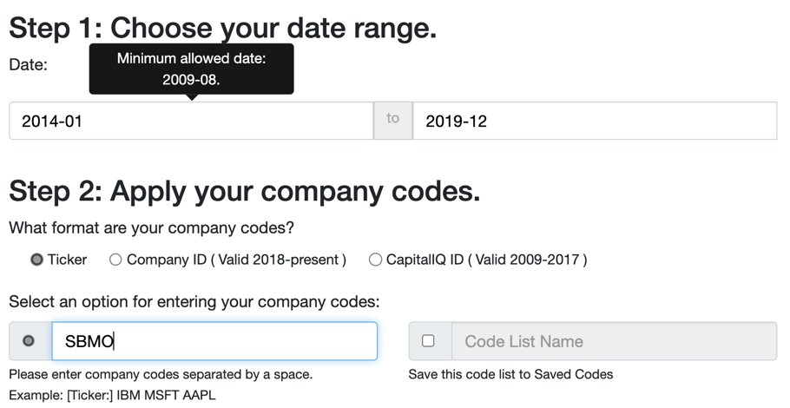
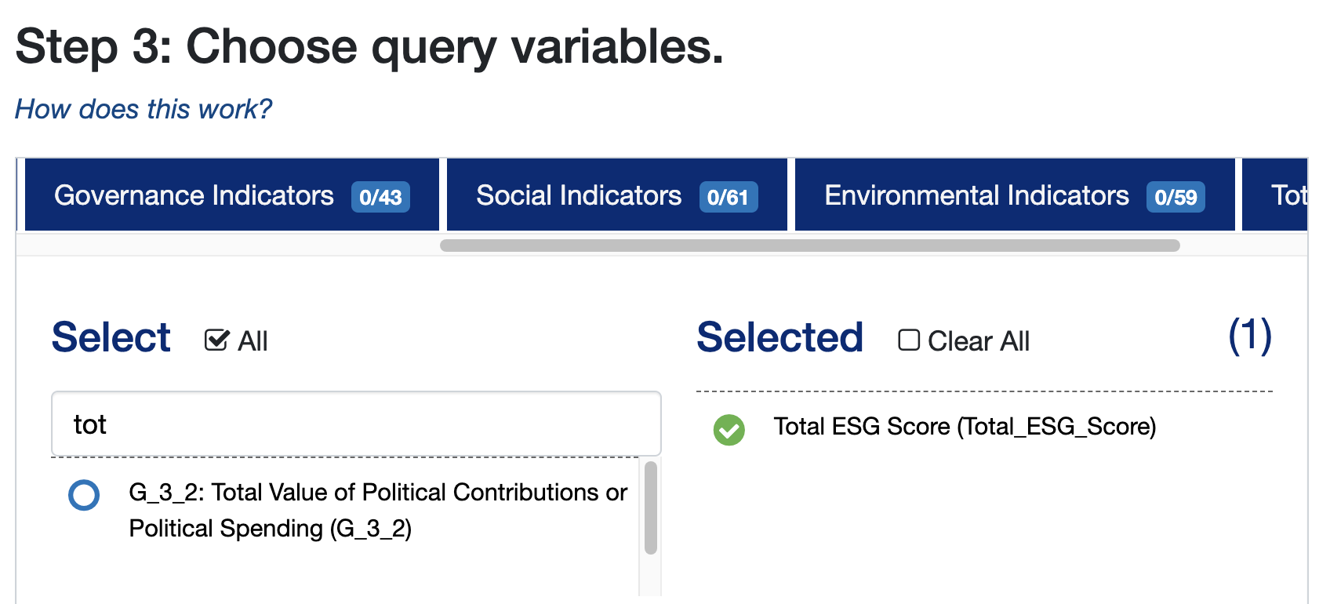
Data Extraction

Slide 10
Hypothetical Contract
We constructed a hypothetical contract with SBM Offshore Oil company.
SBM Offshore is a Dutch-based global group of companies selling systems and services to the offshore oil and gas industry.
The firm leases and operates Floating Production Storage and Offloading vessels for the offshore Oils and Gas industry.
Contract details:
KPI goal = 81%
Underlying maturity of contract = 10 Years
Time to maturity of option = 1 Year
Payment Frequency = monthly (1/12 of year)
Principal = 1 (in units of million dollars)
Spread = ±10bps for bonus or penalty
r = physical drift rate

Slide 11
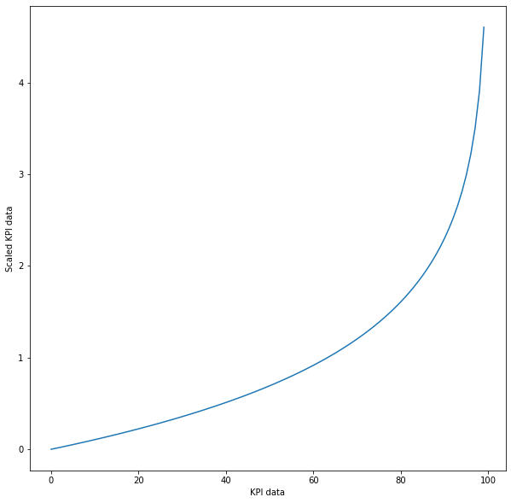
Scaling the historical data
Since one of the assumptions of BSM is that asset prices are positive without any bounds, we scaled the historical KPI data from [0, 100] to [0, ∞].
Used the below equation for scaling for an increasing function from 0 to infinity as KPI goes from 0 to 100.
x = - ln (1 – (KPI / 100))
The standard deviation for the log returns of the resulting scaled series is used as volatility for the pricing models.

Slide 12

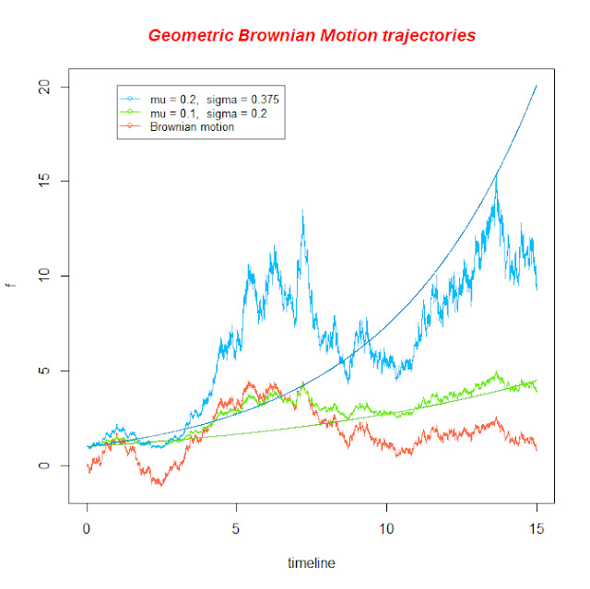
Geometric Brownian Motion (GBM)

Slide 13
Model Assumptions
If transformed KPI follows GBM (H₀ : the null hypothesis), it should satisfy the following:
Increments of transformed KPI should be normally distributed
Non overlapping increments should be independent
We check the normality condition by standardizing ( / √∆T ) and applying:
quantile-quantile (Q-Q) plot
Kolmogorov-Smirnov (KS) test.

Slide 14
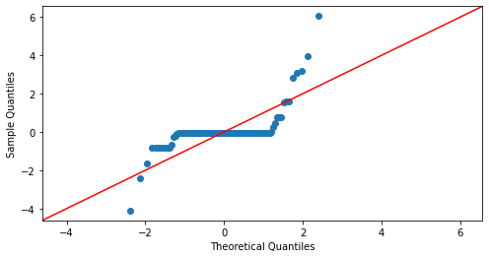
Goodness of Fit : Q-Q plot & KS test
The figure shows the plot for the data we considered with appropriate transformation of (0,100) to (0 ∞).
KS Test :
a) P value : 1e-17
b) With 99.9999999% confidence we reject null hypothesis:
(H₀ : Increments should be normally distributed)

Slide 15


Black-Scholes Model
The BS model is modified to price binary KPI options by incorporating bonus and penalty as inputs from the SLD contract.
Input Parameters:
K – Strike Price
T – Underlying maturity of contract
S₀ – Initial Stock Price
t – Maturity of option
r – Physical drift rate
Price of Binary call KPI option:

Slide 16
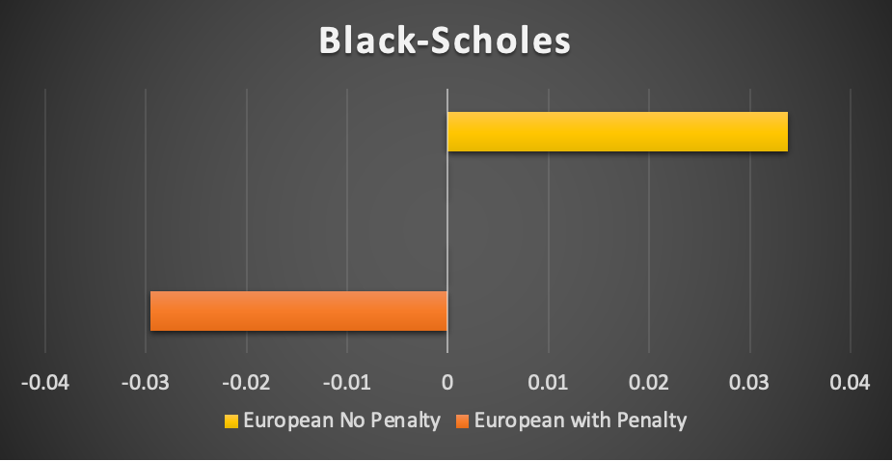
Results - Black Scholes Model
Prices of contracts using Black-Scholes Model
US Dollars ($) | European with Penalty | European No Penalty
Black Scholes | -0.0295 | 0.0338
Units – US Dollars ($)
As we have accounted for negative payoff, price for European options with penalty should be lower than the options without penalty.
Since Black-Scholes model only supports European options, we used binomial tree and MC simulations for pricing American options.

Slide 17
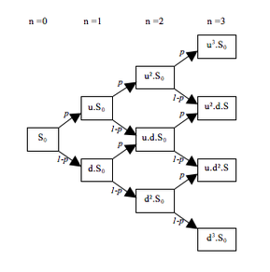


Binomial Tree Model
Model prices only moving up or down by fixed factor
Cox-Ross-Rubinstein methodology
u , d : Factor of stock price movement
p : Risk-neutral probability of price going up
Construct tree of stock prices
Construct tree of payoffs
Price = Discounted Risk-Neutral Expectation of Payoffs
European Option: Payoffs at maturity
Calculate risk-neutral expectation of payoffs
American Option: Backwards Induction
Compare continuation value and early exercise value at every node

Slide 18
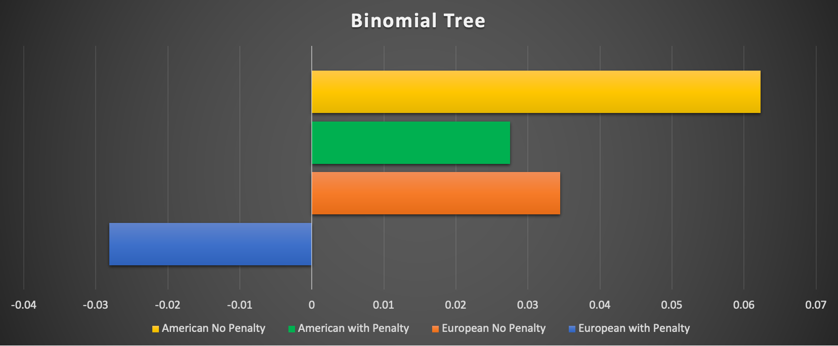
Results - Binomial Model
Prices of contracts using Binomial Tree
US Dollars ($) | European with Penalty | European No Penalty | American with Penalty | American No Penalty
Binomial Tree | -0.0281 | 0.0345 | 0.0275 | 0.0623
Units – US Dollars ($)
Since an American option is more flexible in terms of exercising, its price is expected to be greater than European option which is evident from the results above.
As we have accounted for negative payoff, price for European options with penalty should be lower than the options without penalty.

Slide 19
Monte Carlo (MC) Simulation Model
It is a forward-moving model using the Brownian motion W_{t,} in contrast to the backward-moving model of the binary-tree method.
Number of paths implemented in the simulation : 10,000
American option is executed immediately when the option is in-the money during the simulation.
The model allows for an antithetic pairs in the simulation (replaces W_{t} with – W_{t}).
Mean and standard deviation of the option prices, generated across 50 random seeds starting from 0 – 49, are reported.

Slide 20
Results – MC Simulation
US Dollars ($) - Mean Standard Deviation | European with Penalty | European No Penalty | American with Penalty | American No Penalty
Monte Carlo​ No Antithetic​ | -0.029792 (0.001000) | 0.033707 (0.000500) | 0.025372 (0.001053) | 0.061681 (0.000530)
Monte Carlo​ with Antithetic​ | -0.02964 (0.000740) | 0.033784 (0.000370) | 0.025358 (0.000623) | 0.061673 (0.000312)
The use of the antithetic pairs is shown above, when averaged over 50 random seeds, to reduce the parenthesized standard deviation, leading to a more reliable mean price.
Since an American option is more flexible in terms of exercising, its price is expected to be greater than European option which is evident from the results above.
As we have accounted for negative payoff, price for European options with penalty should be lower than the options without penalty.

Slide 21
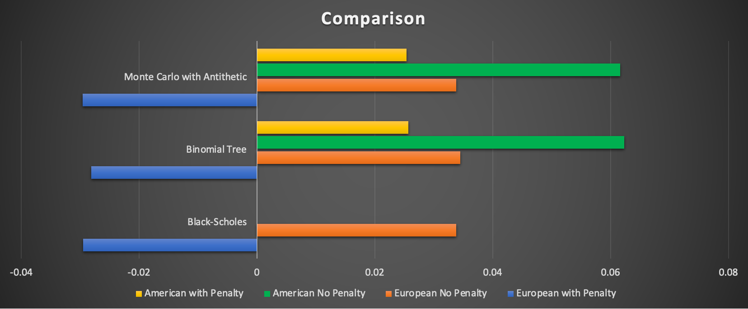
Comparison
The below chart compares results from the three pricing models used for American and European options with and without penalty.
Units – US Dollars ($)

Slide 22
Conclusion
For European options, results generated from Black-Scholes are analytically accurate (with penalty = $-0.0295 & without penalty = $0.0338) whereas for binomial tree ($-0.0281 & $0.0345) and Monte Carlo ($-0.0298 & $0.0337)
For American options, results generated from binomial tree ($0.0277 & $0.0620) and Monte Carlo ($0.0253 & $0.0616). Black-Scholes doesn't price American options.
Comparatively : Euro w/pen < Amer w/pen < Euro w/o pen < Amer w/o pen Numerically : $-0.0295 < $0.0253 < $0.0338 < $0.0616

Slide 23
Q & A
Please feel free to reach out if you have any questions:
Merton Ngan - mertonphngan@uchicago.edu
Qayum Khan - qayum@uchicago.edu
Krishna Diggavi – krishnadiggavi@uchicago.edu
Venkat Averineni - venkat7@uchicago.edu
Chen Chen - chen66@uchicago.edu

Slide 24


Appendix: Binomial Tree
Cox Ross Rubinstein:
Stock price at node u (n times), d(m times):
Risk-neutral probability of being at node u (n times), d(m times)
This is payoff at time t

Slide 25
Appendix: Binomial Tree
European option:​
At maturity, multiply each payoff by the risk-neutral probability above​
Take weighted average to arrive at the price

Slide 26
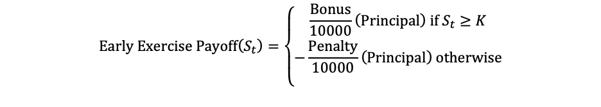
Appendix: Binomial Tree
American option: Backwards Induction
Go backwards in the tree
At each node, check if you want to exercise early:
Compare early exercise payoff with expected continuation payoff
Captures optimal exercise is as early as possible

Slide 27
References
Damian Karia, "Creating, Pricing, and Modeling ESG Derivatives" (2022), Master's thesis, University of Twente
http://essay.utwente.nl/92121/1/Karia_MA_BMS.pdf
Overview of ESG-related Derivatives Products and Transactions (2021)
https://service.betterregulation.com/document/480316
Sustainability-linked Derivatives: Where to Begin? (2022)
https://www.isda.org/a/UYVgE/Sustainability-linked-Derivatives-Where-to-Begin.pdf
Davide Lauria1, W. Brent Lindquist1, Stefan Mittnik2, and Svetlozar T. Rachev1 - ESG-Valued Portfolio Optimization and Dynamic Asset Pricing
https://arxiv.org/pdf/2206.02854.pdf
Wharton Research Data Services
https://wrds-www.wharton.upenn.edu/login/?next=/pages/get-data/

