Slide 1
JavaScript-2
Krishna Aryal

Slide 2
JavaScript Core
Character Sets
Keywords Words
Identifiers
Data Types
Operators
BasicIO

Slide 3
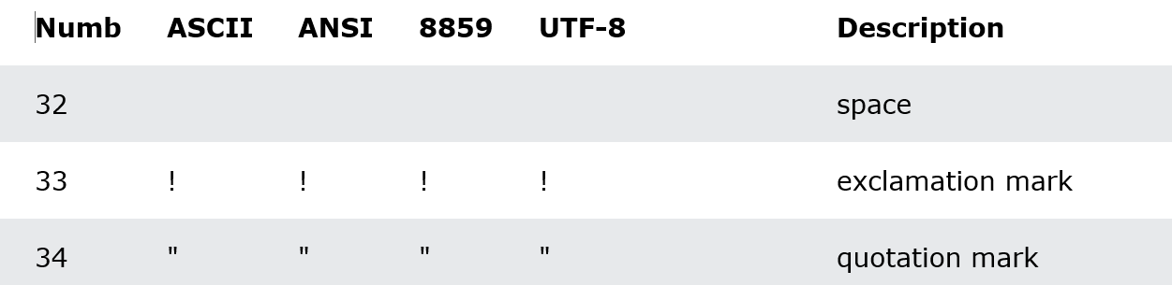
Character Sets
A-Z, a-z
0-9
Symbols

Slide 4
Keywords Words
Keywords Words
Reserved Words
Objects, Properties, and Methods
HTML Event Handlers

Slide 5
Identifiers
An identifier is a name of variables, functions, class, etc.
Rules for writing identifiers:
Must start with either a letter, an underscore _, or the dollar sign $
Case-sensitive
Keywords cannot be used as identifier names

Slide 6
Data Types
Primitive Data Types
undefined : let fullName
null : let address=null
Boolean : true | false
Number : 13 | 14.56
BigInt : 123456789456
String : ‘broadway’ | “broadway” | `broadway`
Symbol : let smb = Symbol(‘Hello’)

Slide 7
Data Types
Structural Data Types
Object : let Student = { }
Date : let today = new Date(“May 7 2022”);
Array : let nums = [3, 4, 2, 7, 5];

Slide 8
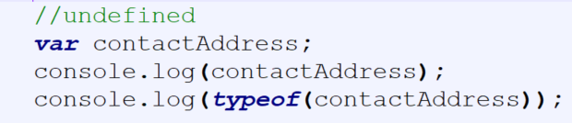
undefined
A variable or an object has an undefined value when no value is assigned before using it. So you can say that undefined means lack of value or unknown value.

Slide 9
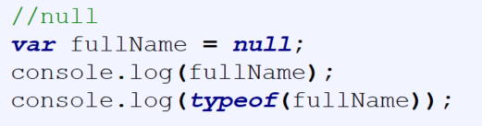
null
We can assign null to a variable to denote that currently that variable does not have any value but it will have later on. A null means absence of a value.

Slide 10
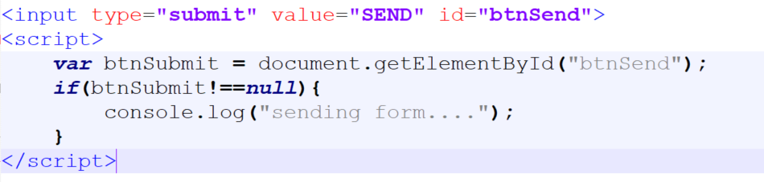
null

Slide 11
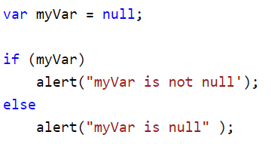
null

Slide 12
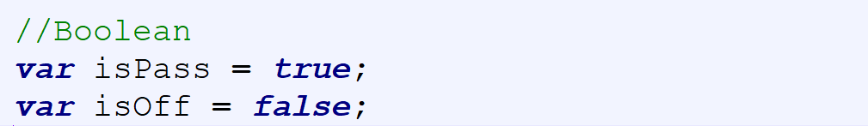
Boolean

Slide 13
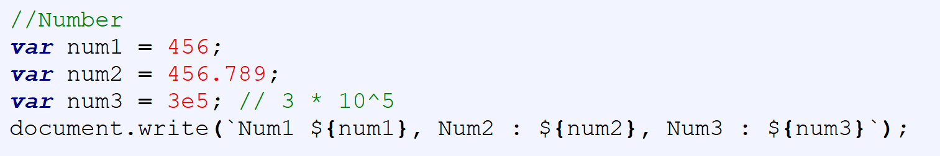
Number
Number type can only represent numbers less than (253 - 1) and more than -(253 - 1).

Slide 14
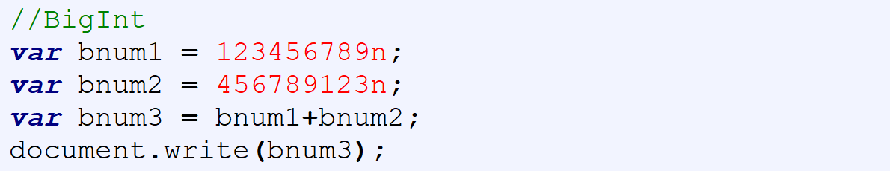
BigInt
Number type can only represent numbers less than (253 - 1) and more than -(253 - 1). However, if you need to use a larger number than that, you can use the BigInt data type.
A BigInt number is created by appending n to the end of an integer.

Slide 15
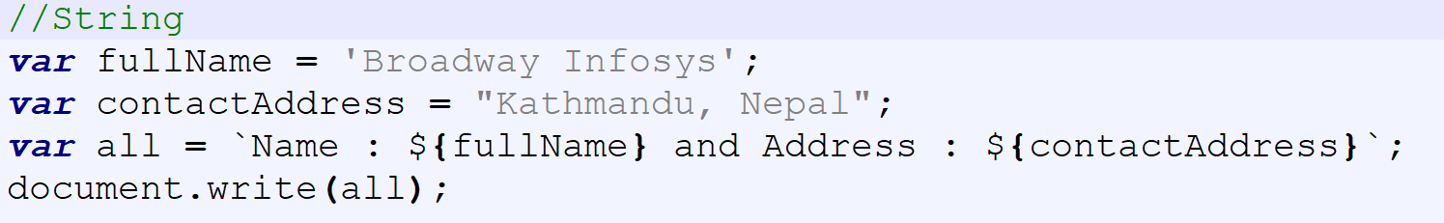
String
String must be enclosed in single or double quotation marks.

Slide 16
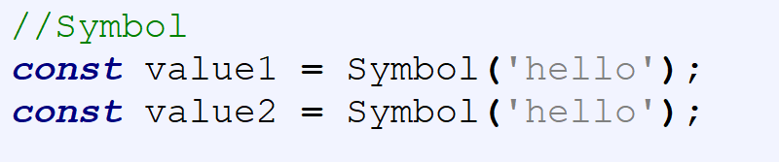
Symbol
A value having the data type Symbol can be referred to as a symbol value. Symbol is an immutable primitive value that is unique.

Slide 17
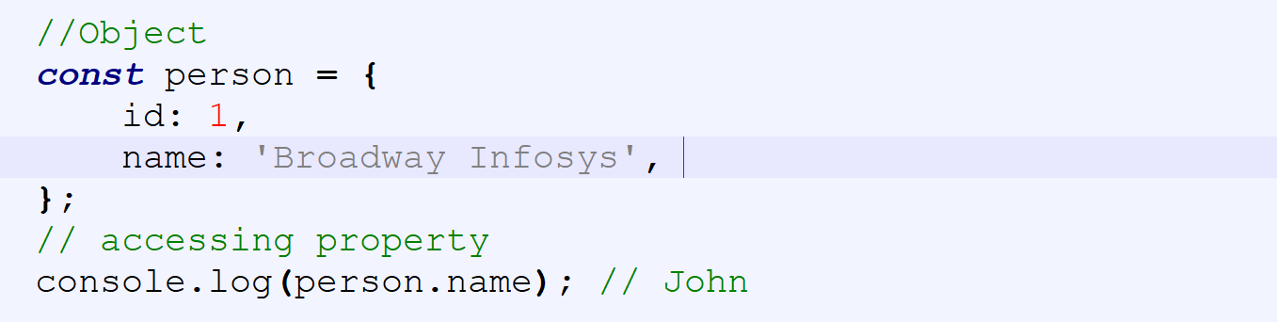
Object
An object is a complex data type that allows us to store collections of data.

Slide 18
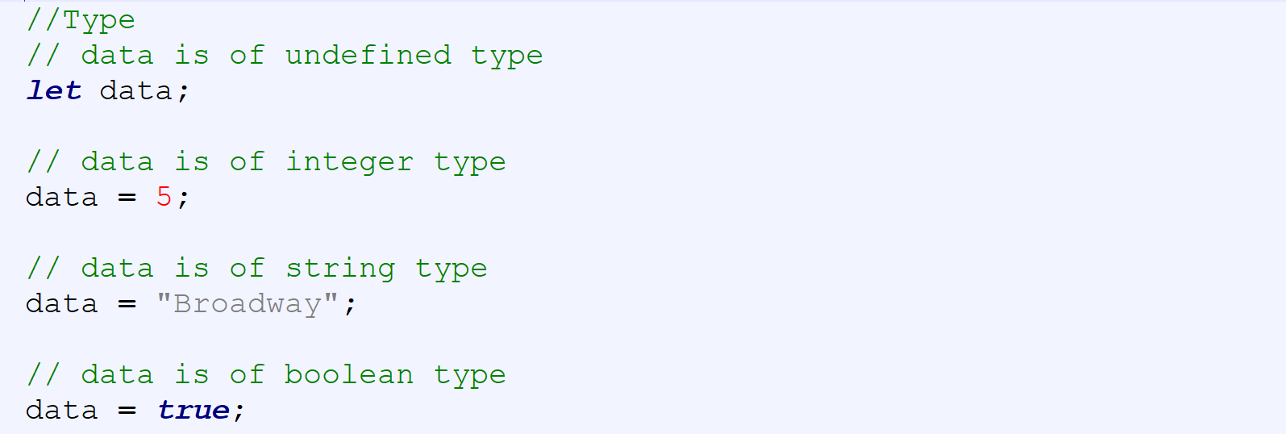
Type
JavaScript is a dynamically typed (loosely typed) language. JavaScript automatically determines the variables' data type.

Slide 19
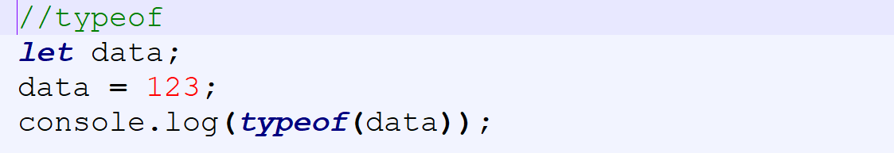
typeof
To find the type of a variable, you can use the typeof operator.

Slide 20
Operators
Operator is a special symbol used to perform operations on operands (values and variables)
Assignment Operators
Arithmetic Operators
Comparison Operators
Logical Operators
Bitwise Operators
String Operators
Other Operators

Slide 21
Comments
// - Single Line Comments
/* */ -Multi-line Comments

Slide 22
Type Conversion
Implicit Conversion - Automatic type conversion
Explicit Conversion - Manual type conversion

Slide 23
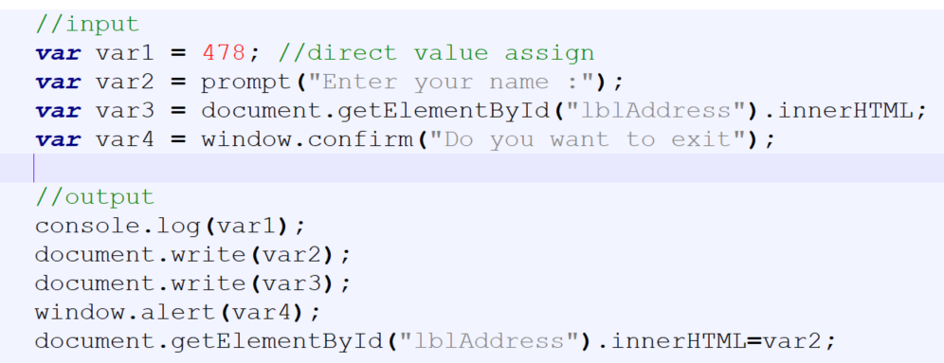
Basic IO

