Slide 1
JavaScript-3
Krishna Aryal

Slide 2
Control Statements
Comparison & Logical Operators
if Statement
if … else Statement
if … else if Statement
Nested if Statement
while Loop
for Loop
break, continue, and return statement

Slide 3
Comparison Operators
Comparison operators compare two values and give back a boolean value: either true or false.
Operator | Description
Equal (==) | Returns true if the operands are equal.
Not equal (!=) | Returns true if the operands are not equal.
Strict equal (===) | Returns true if the operands are equal and of the same type.
Strict not equal (!==) | Returns true if the operands are of the same type but not equal, or are of different type.

Slide 4
Comparison Operators
Comparison operators compare two values and give back a boolean value: either true or false.
Operator | Description
Greater than (>) | Returns true if the left operand is greater than the right operand.
Greater than or equal (>=) | Returns true if the left operand is greater than or equal to the right operand.
Less than (<) | Returns true if the left operand is less than the right operand.
Less than or equal (<=) | Returns true if the left operand is less than or equal to the right operand.

Slide 5
Logical Operators
Comparison operators compare two values and give back a boolean value: either true or false.
Operator | Description
&& | Logical AND: true if both the operands/boolean values are true, else evaluates to false
|| | Logical OR: true if either of the operands/boolean values is true. evaluates to false if both are false

Slide 6
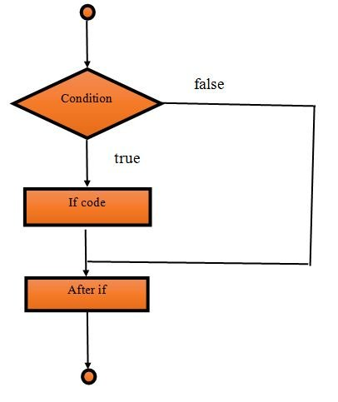
if Statement
Syntax Flowchart
if (condition) {
// the body of if
}

Slide 7
if Statement
Example
if (3 > 2) {
console.log(“True”);
}

Slide 8
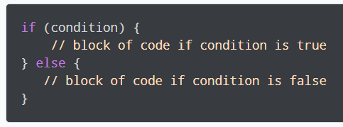
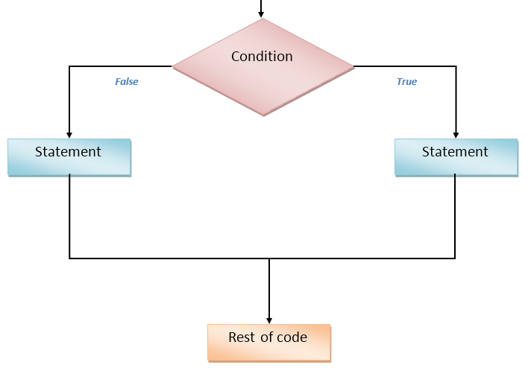
if … else Statement
Syntax Flowchart

Slide 9
if … else Statement
Syntax Flowchart
if (3 > 2){
console.log(“True”);
}
else{
console.log(“False”);
}

Slide 10
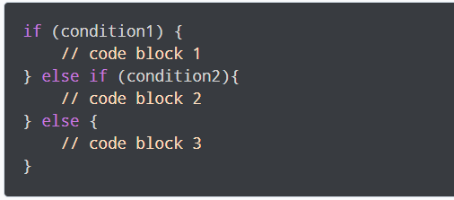
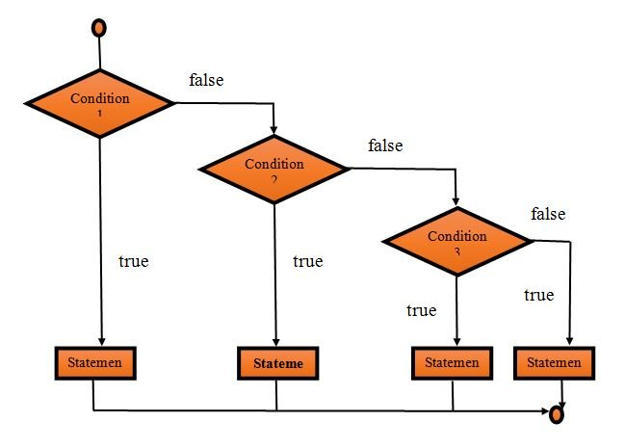
if … else if Statement
Syntax Flowchart

Slide 11
if … else if Statement
Example Flowchart
var n1=3;
if (n1 == 0){
console.log(“Zero”);
}
else if (n1 == 1){
console.log(“One”);
}
else if(n1 == 2){
console.log(“Two”);
}
else{
console.log(“Others”);
}

Slide 12
Nested if Statement
Example
if(n1 > n2)
if(n1>n3)
console.log(n1)

Slide 13
switch case Statement
Example
var var1 =1;
switch(var1){
case 0:
console.log(“Zero”);
break;
default:
console.log(“Other”);
}

Slide 14
Looping Statements
while Loop
do while Loop
for Loop
break, continue, and return statement

Slide 15
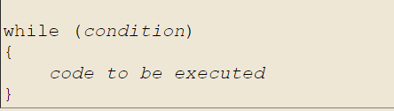
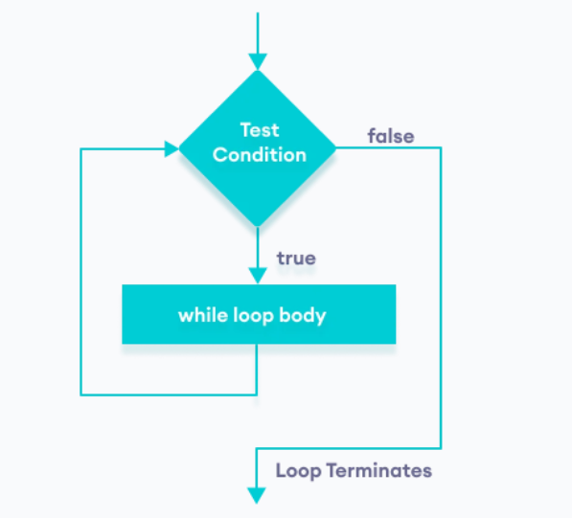
while Loop
Syntax Flowchart

Slide 16
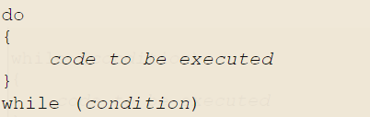
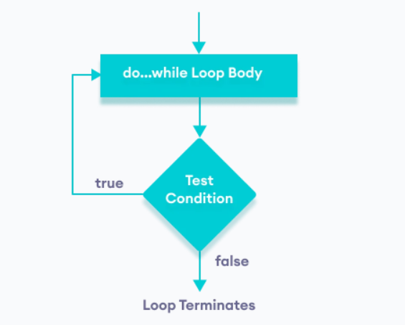
do while Loop
Syntax Flowchart

Slide 17
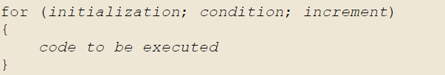
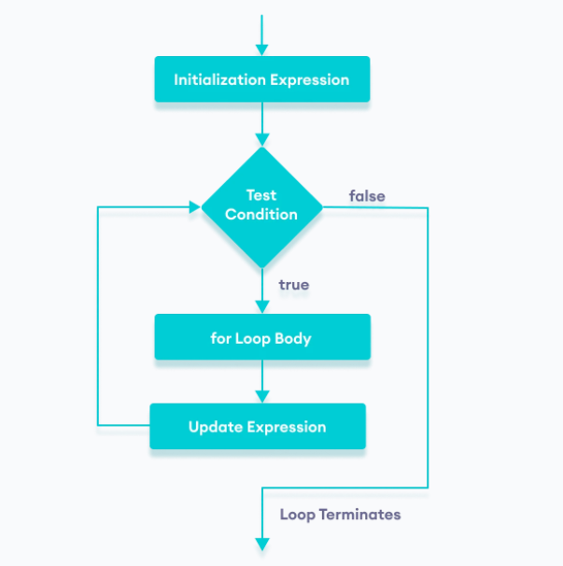
for Loop
Syntax Flowchart

Slide 18
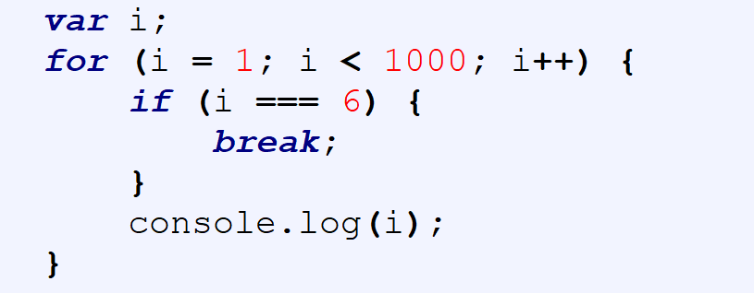
break statement
1
2
3
4
5

Slide 19
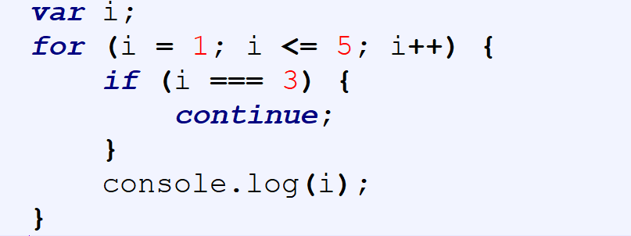
continue statement
1
2
4
5

Slide 20
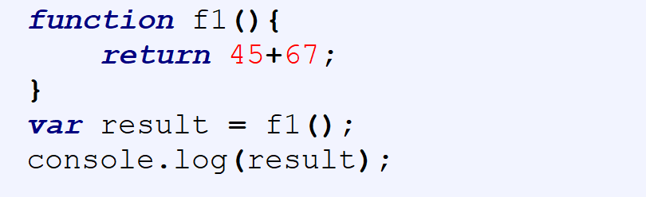
return statement

