Slide 1
JavaScript-4
Krishna Aryal

Slide 2
Functions
Introduction
Defining a function
Calling a function
Embedding JavaScript file
Function parameter and argument
Returning value
Variable scope and lifetime
Hoisting variable
Recursive function
Function expressions
Arrow function

Slide 3
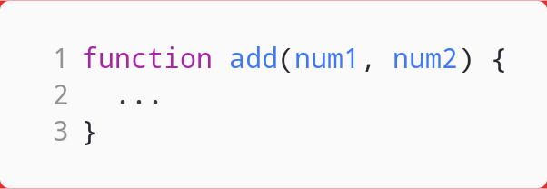
Functions
A function is a block of code that performs a specific task.
Index.html
About.html
Services.html
Contact.html

Slide 4
Defining a function
A function definition (also called a function declaration, or function statement) consists of the function keyword, followed by:
The name of the function.
A list of parameters to the function, enclosed in parentheses and separated by commas.
The JavaScript statements that define the function, enclosed in curly brackets, {...}.

Slide 5
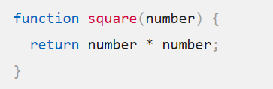
Defining a function

Slide 6
Calling a function
var x = square(10);
var y = square(10);
console.log(square(10));

Slide 7
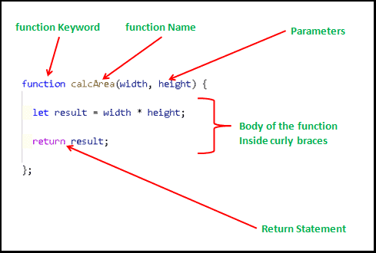
Embedding JavaScript file
myscripts.js index.html
<script src="myscripts.js"></script>
var result = calcArea(6, 7);
document.alert(result);

Slide 8
Function parameter, argument & returning value
index.html myscripts.js
<script src="myscripts.js"></script>
var result = calcArea(6, 7);
document.alert(result);

Slide 9
Variable Scope and Lifetime
Scope refers to the availability of variables and functions in certain parts of the code.
Global Scope
Local Scope

Slide 10
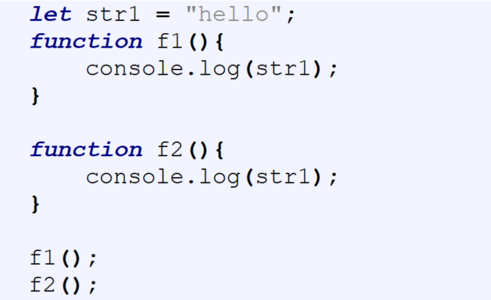
Global Scope

Slide 11
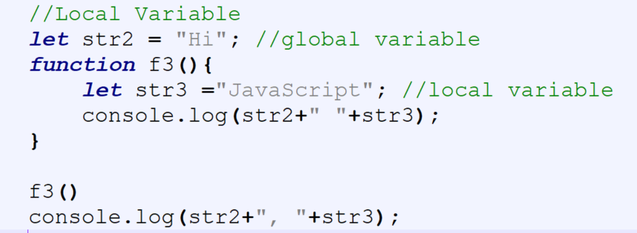
Local Scope

Slide 12
var, let, & const
Keyword | Scope | Hoisting | Can Be Reassigned | Can Be Redeclared
var | Function scope | Yes | Yes | Yes
let | Block scope | No | Yes | No
const | Block scope | No | No | No

Slide 13
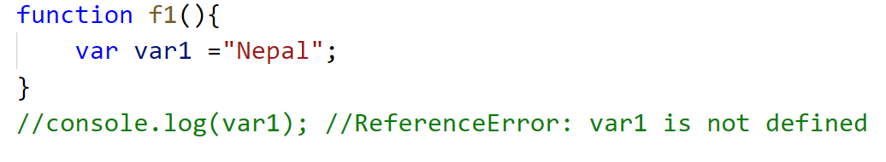
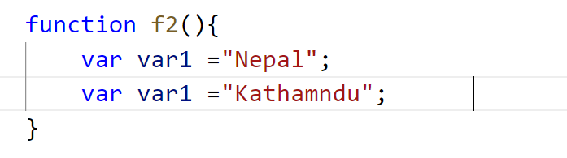
var, let, & const

Slide 14
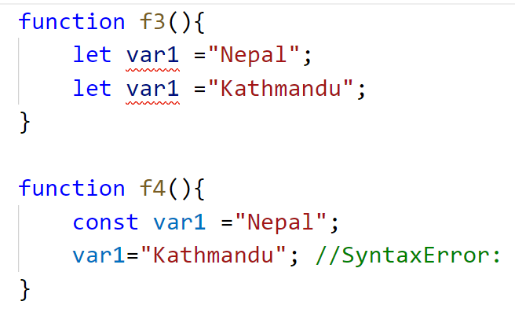
var, let, & const

Slide 15
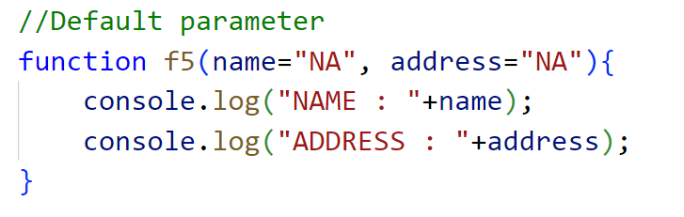
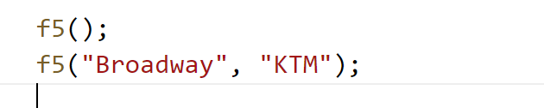
Default parameters

Slide 16
Default parameters

Slide 17
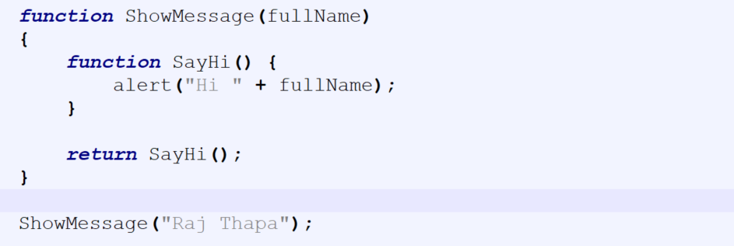
Nested Functions
A function can have one or more inner functions. These nested functions are in the scope of outer function. Inner function can access variables and parameters of outer function. However, outer function cannot access variables defined inside inner functions.

Slide 18
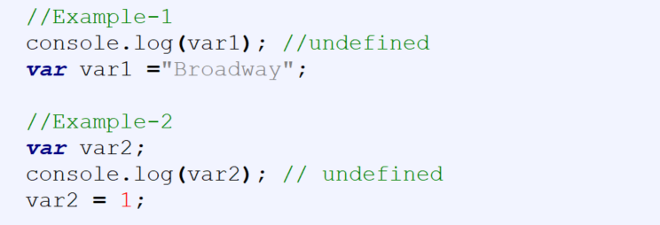
Hoisting variable

Slide 19
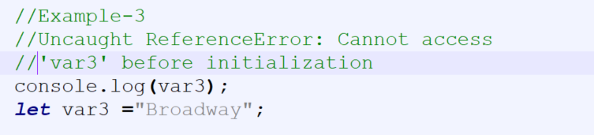
Hoisting variable

Slide 20
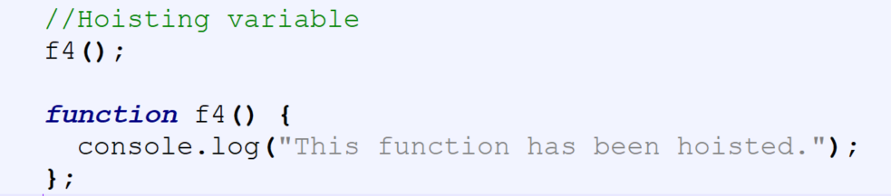
Hoisting function

Slide 21
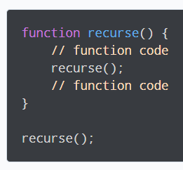
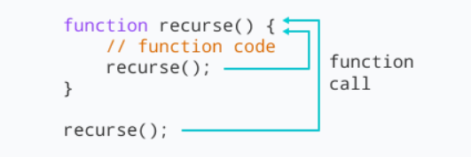
Recursive function
A function that calls itself is called a recursive function.

Slide 22
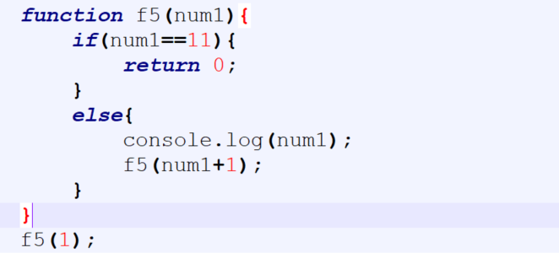
Recursive function

Slide 23
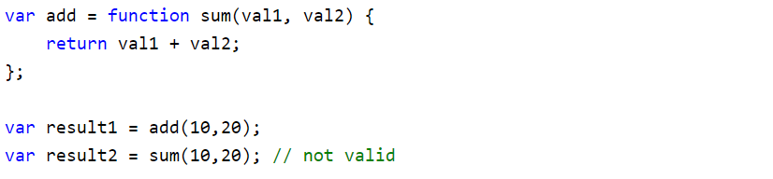
Function expressions
JavaScript allows us to assign a function to a variable and then use that variable as a function.

Slide 24
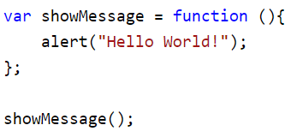
Anonymous Function
JavaScript allows us to define a function without any name. This unnamed function is called anonymous function. Anonymous function must be assigned to a variable.

Slide 25
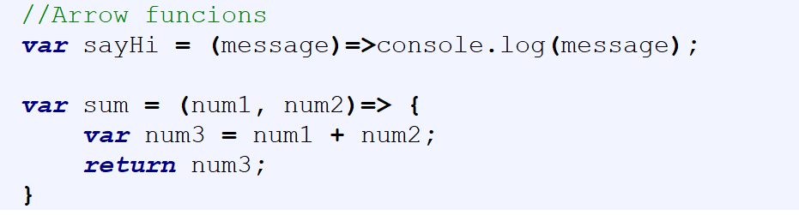
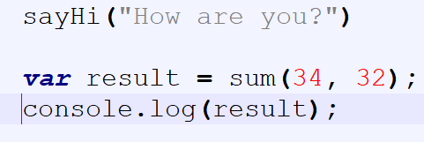
Arrow functions
Arrow functions are a new way to write anonymous function expressions, and are similar to lambda functions in some other programming languages, such as Java, Python etc.

Slide 26
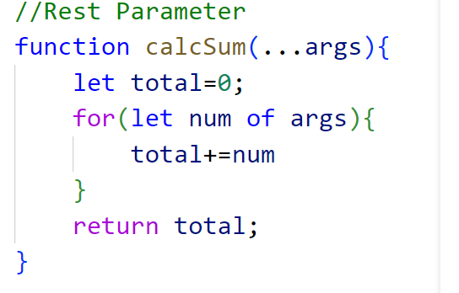

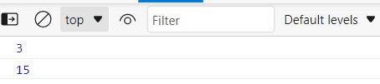
Rest parameter

