Slide 1
JavaScript-5
Krishna Aryal

Slide 2
OOPs
Introduction
Object
Constructor
Method
Property
Class
Encapsulation
Property
Constructor
Setters/Getters
Inheritance
Polymorphism

Slide 3
Introduction
Object-oriented programming (OOP) is a programming paradigm fundamental to many programming languages, including Java and C++. Mainly contains the features of encapsulation, inheritance and polymorphism.

Slide 4
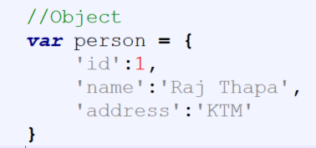
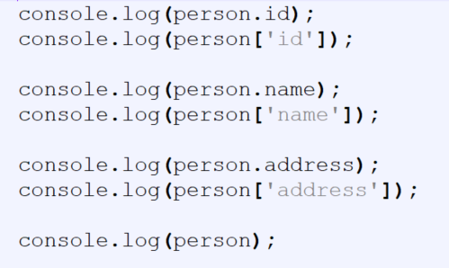
Object
Create a new object in JavaScript by setting its properties inside curly braces. Object literals property values can be any data types, like function literals, arrays, strings, numbers, or boolean.

Slide 5
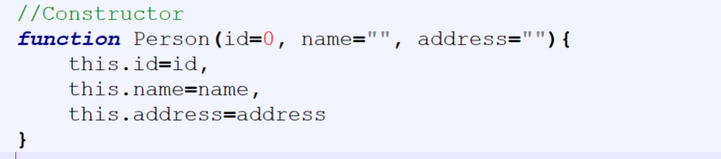
Object Constructor
Object constructor is the same as a regular function. It will be called each time an object is created. We can use them with the new keyword. Object constructor is useful when we want to create multiple objects with the same properties and methods.

Slide 6
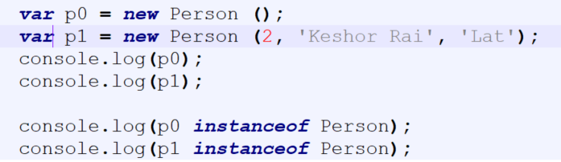
Object Constructor

Slide 7
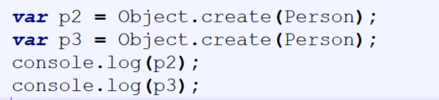
Object.create

Slide 8
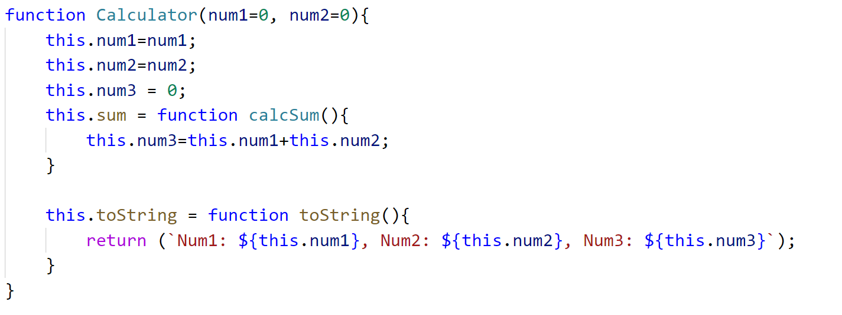
Methods

Slide 9
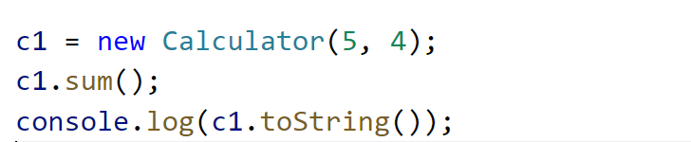
Methods

Slide 10
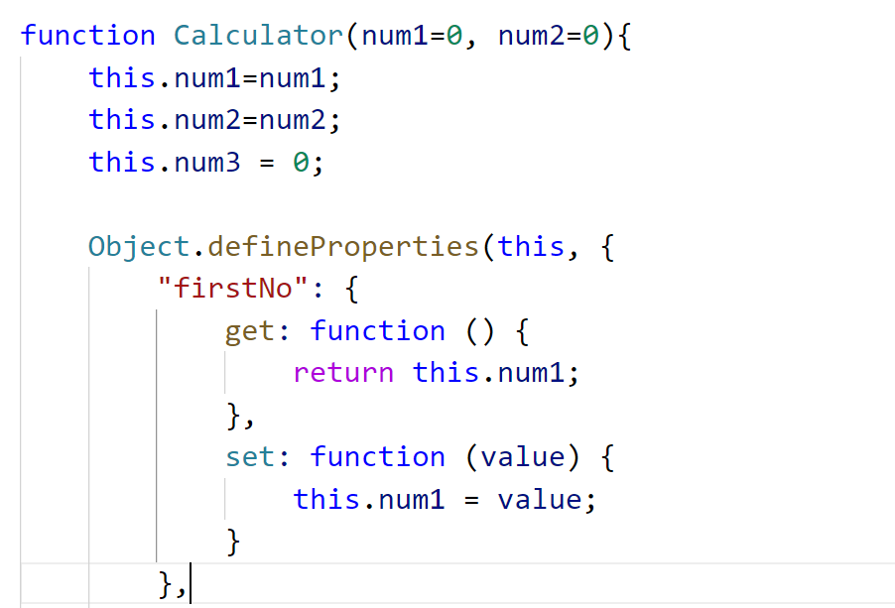
Properties

Slide 11
Properties-2

Slide 12
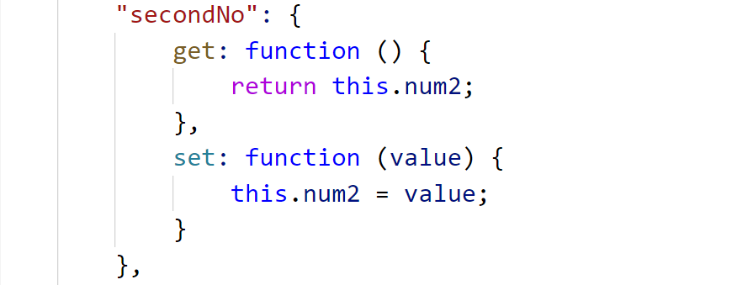
Properties-3

Slide 13
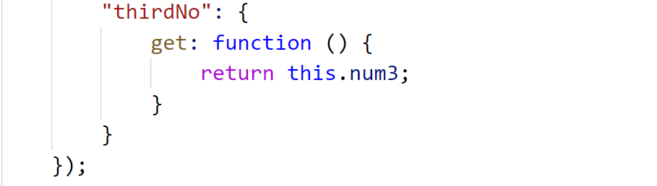
Properties-4

Slide 14
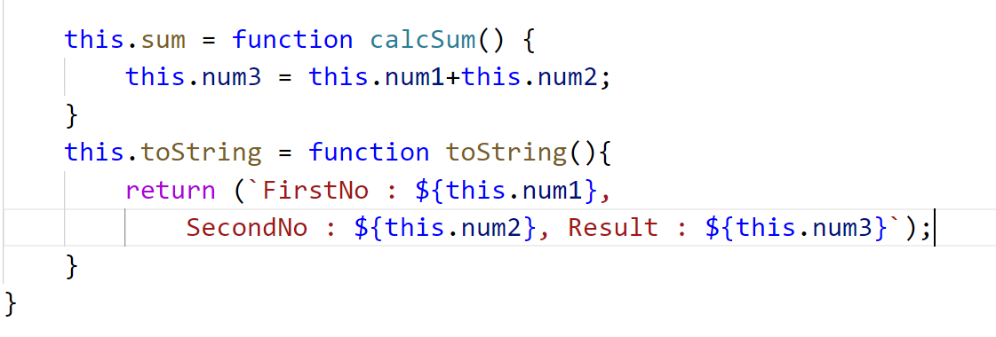
Properties-5

Slide 15
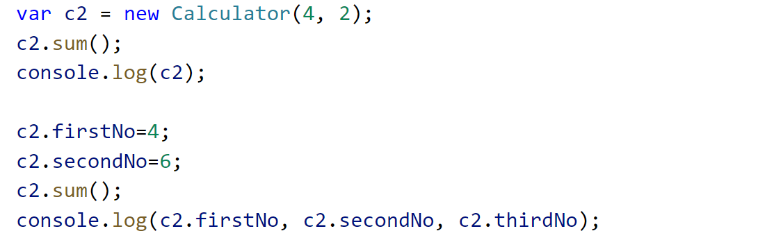
Properties-6

Slide 16
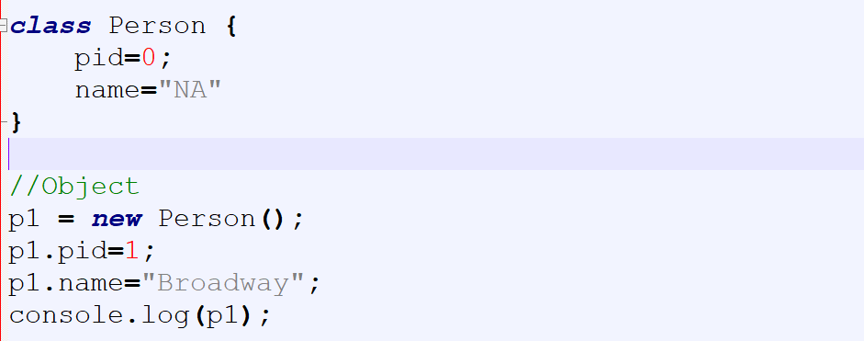
Class & Object

Slide 17
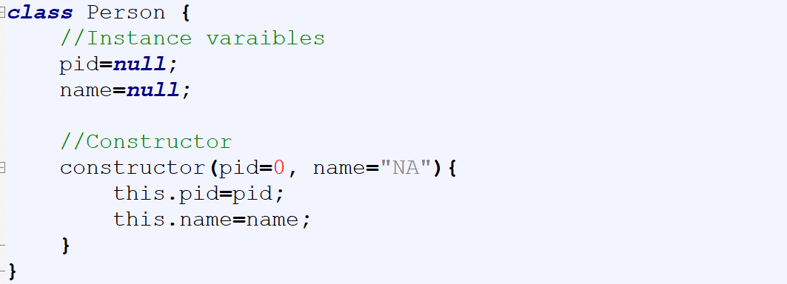
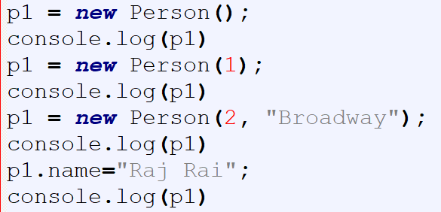
Constructor

Slide 18
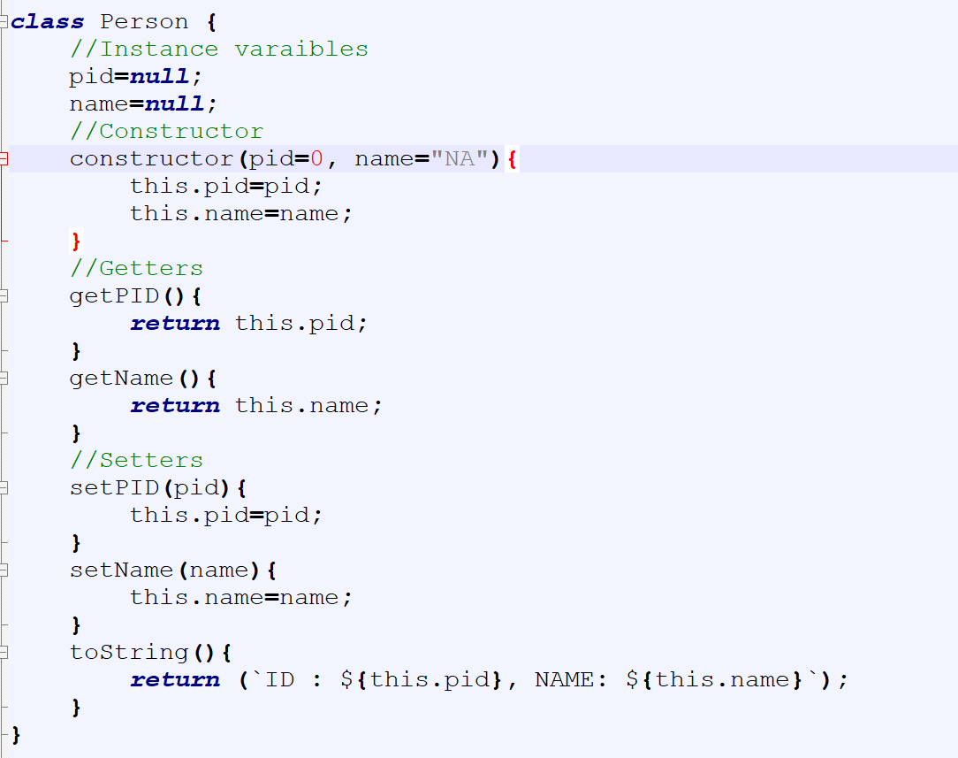
Getters, Setters, & Methods

Slide 19
Getters, Setters, & Methods

Slide 20
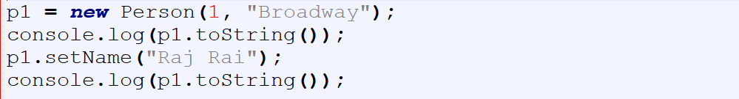
Getters, Setters, & Methods

Slide 21
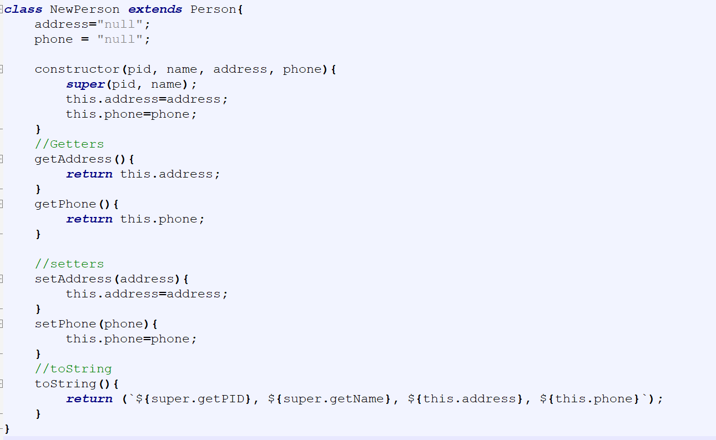
Inheritance

Slide 22
Inheritance

Slide 23
Inheritance

Slide 24
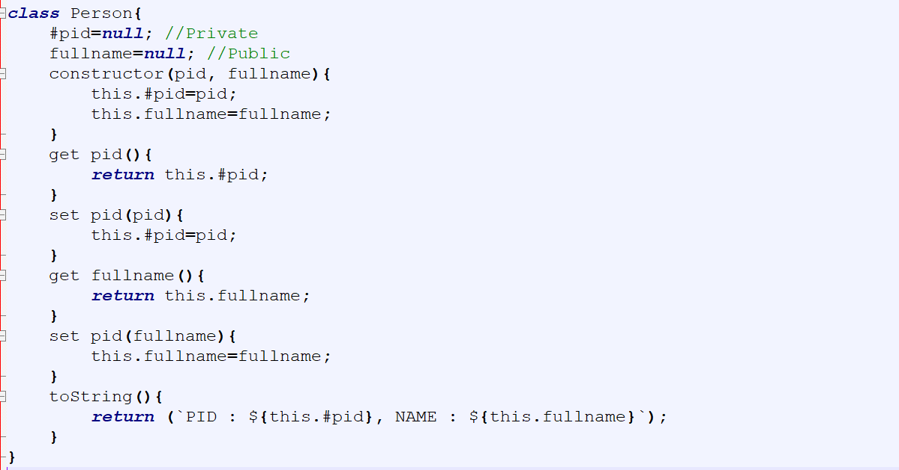
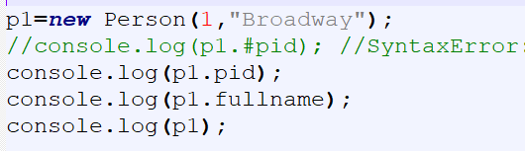
Encapsulation

