Slide 1
JavaScript-6
Krishna Aryal

Slide 2
Error Handling
Introduction to error
Types of error
Error handling

Slide 3
Introduction to error
Introduction
JavaScript is a loosely-typed language. It does not give compile-time errors. So some times we will get a runtime error for accessing an undefined variable or calling undefined function etc.
Type of errors
Syntax errors
Runtime errors
Logical errors

Slide 4

Syntax Errors
The most common type of errors are syntax errors, in which something incorrect in the syntax of the program body raises this error. Syntax errors are also known as parsing errors. In JavaScript, they occur at the interpretation time.

Slide 5


Runtime errors
Runtime errors occur during the runtime of the program after it's interpreted by the compiler.

Slide 6
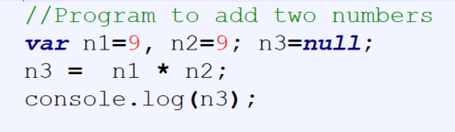
Logical Errors
Logical errors are the most difficult to find as they are when the syntax is correct but the logic is not.

Slide 7
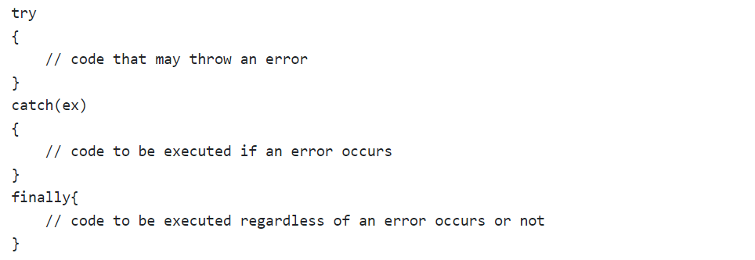
Error Handling
JavaScript provides error-handling mechanism to catch runtime errors using try-catch-finally block, similar to other languages like Java or C#.

Slide 8
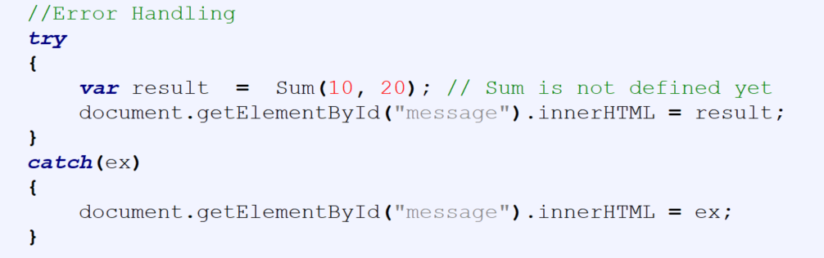
Error Handling

Slide 9
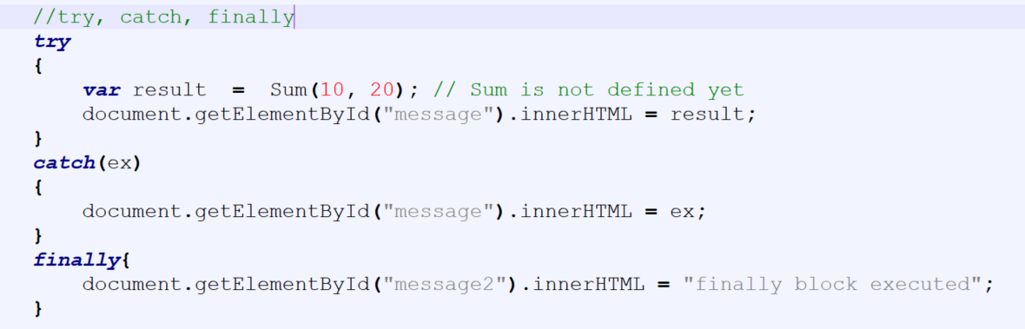
Error Handling

Slide 10
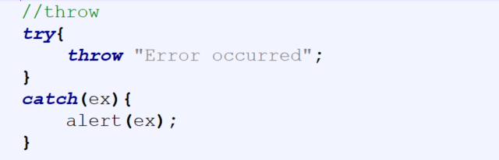
Error Handling

Slide 11
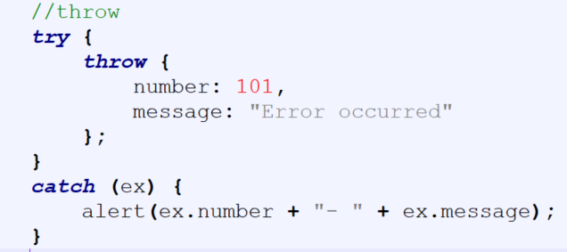
Error Handling

