Slide 1
JavaScript JSON
Krishna Aryal

Slide 2
JSON
Introduction
Create JSON
Property
Accessing
Adding
Update
Delete
Delete property

Slide 3
Introduction
JavaScript Object Notation (JSON) is a standard text-based format for representing structured data based on JavaScript object syntax. It is commonly used for transmitting data in web applications (e.g., sending some data from the server to the client.

Slide 4
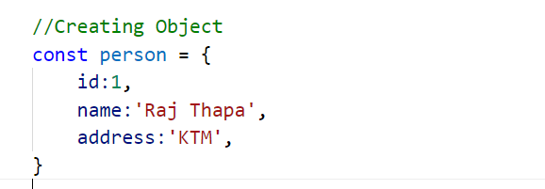
Creating an Object

Slide 5
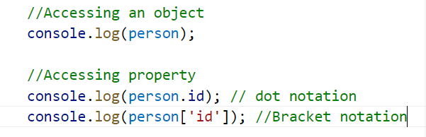
Accessing property

Slide 6
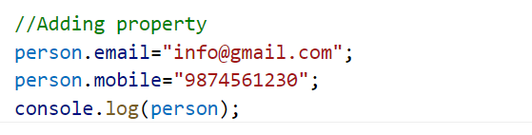
Adding property

Slide 7
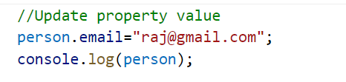
Update property

Slide 8
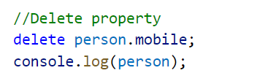
Delete property

Slide 9
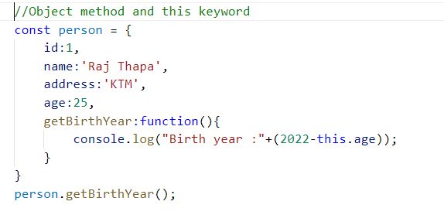
Object method and this keyword

Slide 10
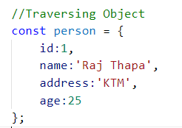
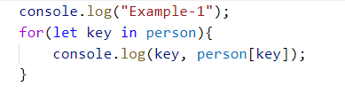

Traversing Object

Slide 11
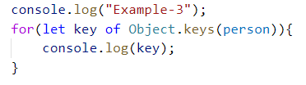
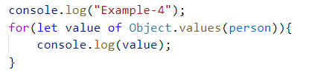
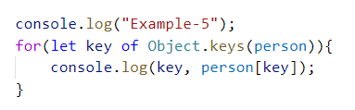
Traversing Object

Slide 12
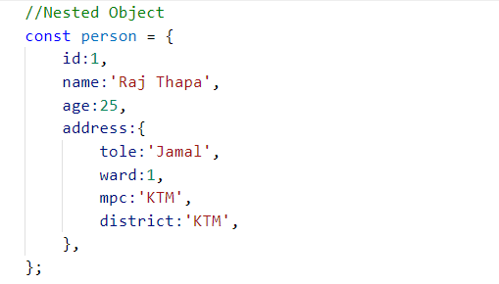
Nested Object

Slide 13
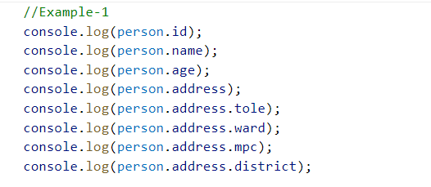
Object Destructuring

Slide 14
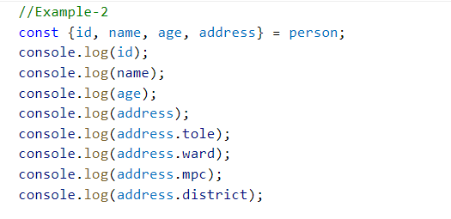
Object Destructuring

Slide 15
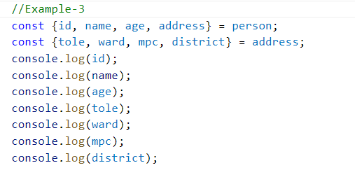
Object Destructuring

Slide 16
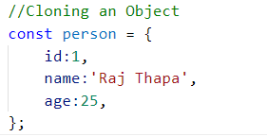
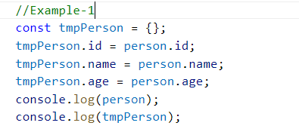
Object Cloning

Slide 17
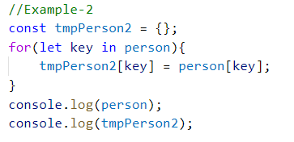
Object Cloning

Slide 18
Object Cloning

Slide 19

Object Cloning

Slide 20
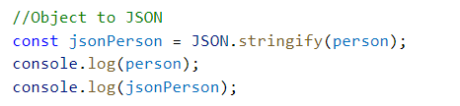
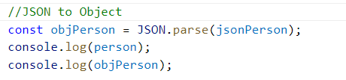
JSON Format

