Slide 1
JavaScript-9.1
Krishna Aryal

Slide 2
Build-in Objects
Introduction
Array Object
Boolean Object
Date Object
Math Object
Number Object
String Object
RegExp Object

Slide 3
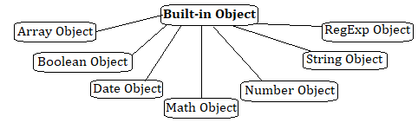
Introduction
JavaScript has several built-in or core language objects. These built-in objects are available regardless of window content and operate independently of whatever page your browser has loaded.

Slide 4
Array Object
The Array object enables us to store a collection of multiple items under a single variable name with different indexes.
JavaScript arrays are resizable and can contain a mix of different data types.
Array elements cannot be accessed using strings as indexes, but must be accessed using integers as indexes.
JavaScript arrays are zero-indexed

Slide 5
Array Object
Constructor
Array()
Creates a new Array object.

Slide 6
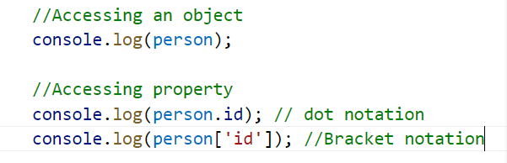
Accessing property

Slide 7
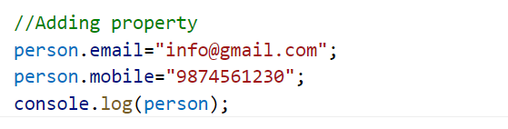
Adding property

Slide 8
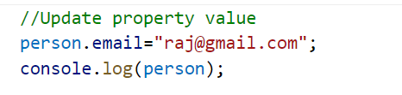
Update property

Slide 9
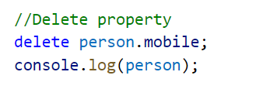
Delete property

Slide 10
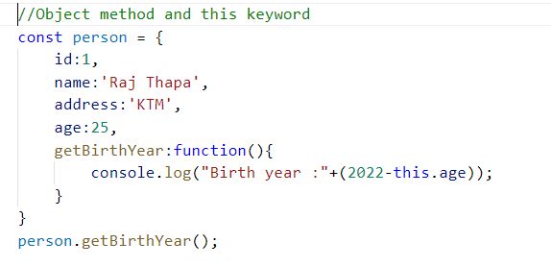
Object method and this keyword

Slide 11
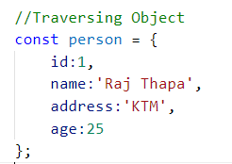
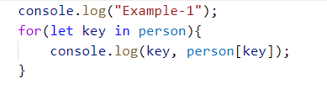

Traversing Object

Slide 12
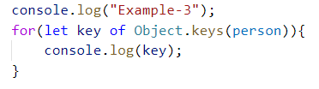
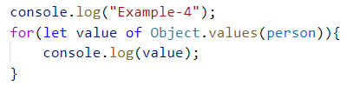
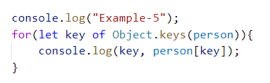
Traversing Object

Slide 13
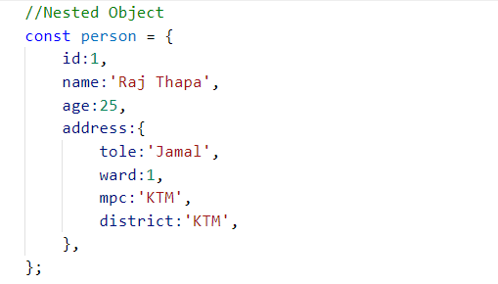
Nested Object

Slide 14
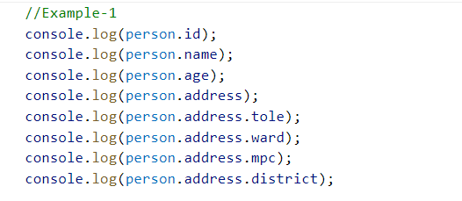
Object Destructuring

Slide 15
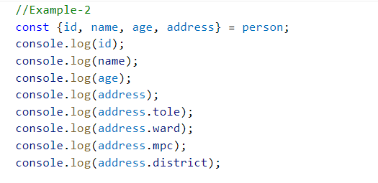
Object Destructuring

Slide 16
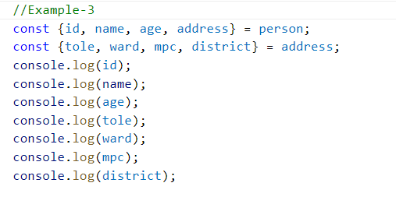
Object Destructuring

Slide 17
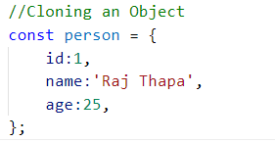
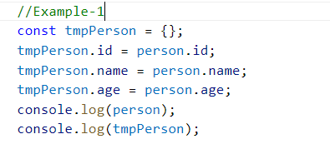
Object Cloning

Slide 18
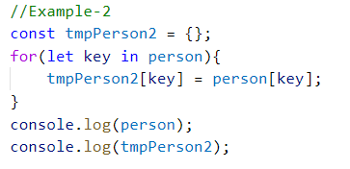
Object Cloning

Slide 19
Object Cloning

Slide 20

Object Cloning

Slide 21
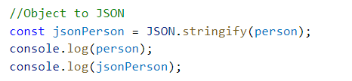
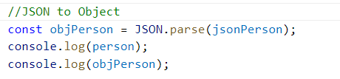
JSON Format

