Slide 1
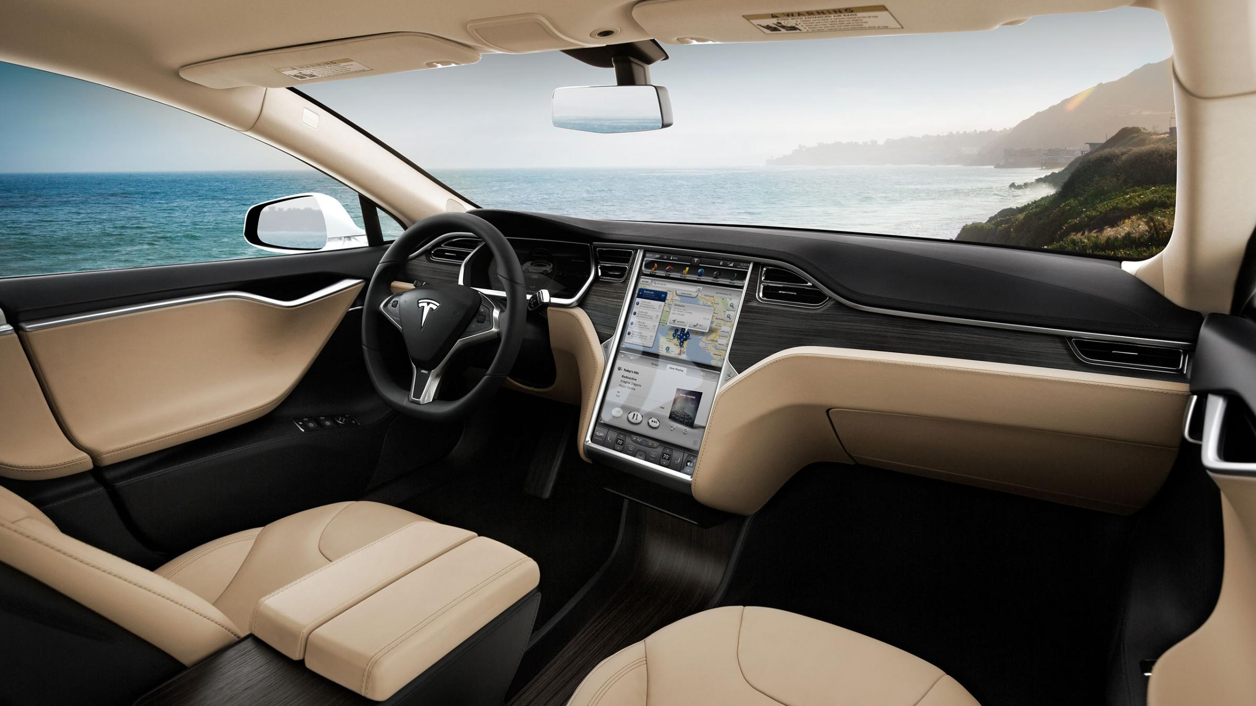
Environmental Conditions
Sharavan Koushik
Sai Krishna
Kaushik Vadlamani
Vineeth

Slide 2
Index
Architecturally Significant Requirements
Logical View
Process View
Development View
Physical View
IoT Reference Architecture
Scenario & Revision Discussion
Notes:
We're always reading that there are literally hundreds of technologies used in building a connected car. Few months ago, I had no inkling what a connected car is and I was completely stumped by the variety of features provided by the IOT connected devices that would swarm up on our roads in our near future. What are they? How convenient and easy to use would those features provided by the technologies would be? And what made them knocking on our doors?
And here are our 2 cents in building an "environmental conditions module" for the Connected cars, assuming everyone is familiar with 4+1 model architecture, I start with the Logical view and what made us go with these options.
What does the word "Environmental Conditions" mean for the connected car?
What significant requirements exist in building this module?

Slide 3
Architecturally Significant Requirements
Ambient Temperature Control
GPS linked Climate Control System (MTK & MRTe)
Luminosity Control
Bug Reports
Features
Sound Positioning
Air Quality Management
Humidity Control
Notes:
Temperature control --> Internal temperature & Surface temperature
The ambient (ATC) or outside air temperature sensor is an (NTC) negative temperature coefficient sensor that informs the semi automatic/automatic temperature control system of outside air temperature. The NTC sensor’s resistance decreases as the outside air temperature increases. The computer uses this input, along with other in-car temperature sensors to control temperature and blower speed. When there’s a problem with this sensor
GPS linked climate control system communicated with GPS linked solar sensor that determines the position of the sun relative to the driver& passenger I.e it uses the global satellites to tell dual-zone climate control system to keep sunny side of car cool.

Slide 4
Logical View

Slide 5
Specifies functional requirements of the system.
The main artifact of the logical view is the design model:
The design model consists of collaborating classes, organized into subsystems. Artifacts involved in the design model may include: class, interaction, and state diagrams the subsystems and their interfaces
Notes:
To maximize passenger comfort on short trips or long, the TLX features a dual-zone, automatic climate control, allowing the driver and front passenger to adjust their own temperature and airflow settings. With the Technology Package and above, a solar sensor measures the sun’s intensity to determine its impact on interior temperature. The GPS receiver on the Acura Navigation System¹⁰ tracks the sun’s position relative to the car.
As you approach, the TLX detects which remote you have and automatically sets your preferred climate-control settings.
When driving alone, all climate zones can synchronize to a single setting.
Adjustable vents behind the center console allow rear passengers to direct and control airflow.

Slide 6
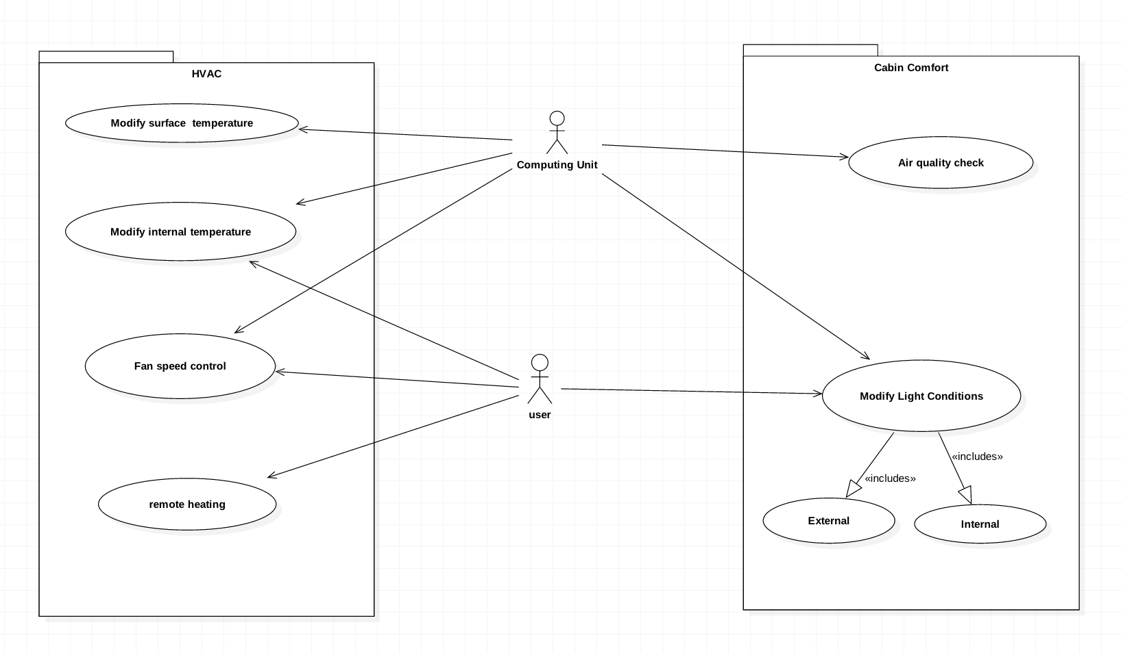
Use-case Diagram
Notes:
Since the features provided are both automatic and manual, user can control manually and computer performs automatic changes, user have also access to these features in use case

Slide 7
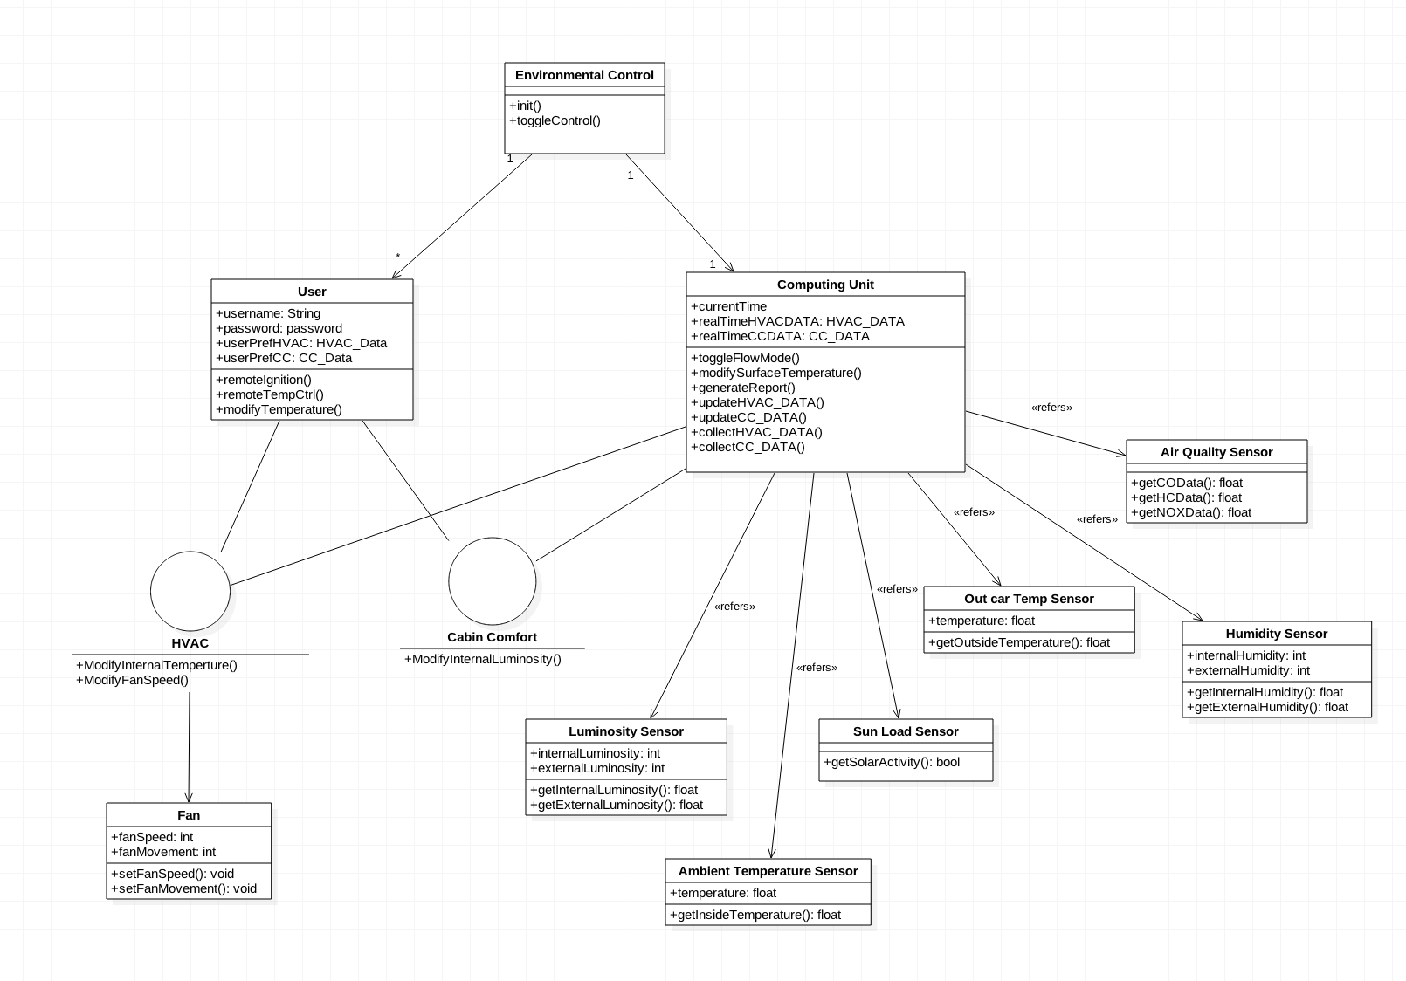
Notes:
let's applaud the person who came up with an idea of taking up the project of Electronic nose which we'd be using in our connected cars.
Air Quality sensor checks for pollutants inside the car such as CO / HC /NOX or other Volatile Organic Compounds.
Google NEST
When ignition is turned off a memory circuit stores previous settings
The blower controls convert low – current signals to high-current feed in the blower motor. The speed is controlled using a power transistor circuit

Slide 8
Process View

Slide 9
Process View
Runtime and execution view
Outlines various components and processes involved in system execution
Mapping of classes/subsystems onto processes/threads
Lists architecturally significant quality attributes
Describes architectural style/pattern used
Notes:
Describes view of the architecture that includes running processes and instantiated objects that exist in the system. It describes important concurrency and synchronization issues.
Set of independently executing logical networks of communicating programs(processes)
Classes/subsystems from logical view will be mapped onto processes
Qual Attrib: Availability, Usability, Connectivity, Interoperability

Slide 10
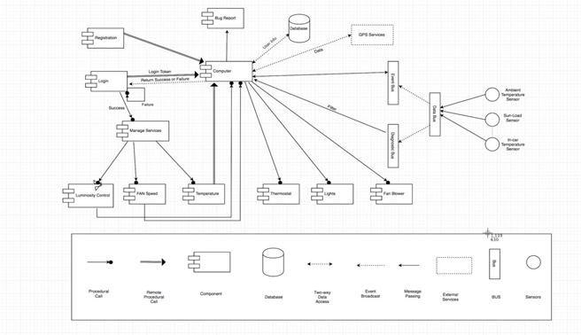
Process View Diagram
Notes:
Diagram gives view of all the processes, design patterns/styles, data flow,and connectors.
Remote temp process – computer requests/pulls cur temp data from event bus
Certain non-process components are also included because the processes communicate with them (shown as the paths between components)
Examples: database
Sensors send data in a stream to data bus (connector) using Simple Sensor Interface Protocol(SSI ). Data Bus then sends data to Event bus and diagnostic bus. Diagnostic bus filters data for errors. Errors are sent to computer for storing in status reports (bug reports).
Computer - event bus communication is bi-directional.Event bus pushes sensor data(such as luminosity)to computer. In other direction, computer can request (pull) curr temp data from event bus,and it will receive the data.
Manage Services: GUI elem. User passes control to computer via procedure call. Computer returns services. User makes choice, then manager service passes control to temp control, blower speed, or luminosity(via proc call connectors)

Slide 11
Architectural Style/Pattern
Event-Based Pattern was used for our project
The various sensors and services are independent
Sensor related events transmitted asynchronously
Our components communicate via various buses
Notes:
Pattern based on independent components that asynchronously emit and receive events, which are communicated over event buses
Components can concurrently generate/consume events,and are independent
Loosely coupled components (such as our various sensors). Event bus to computer communication bi-directional
Ambient temp sensor <- data bus <- event bus <- computer(pull request initiated by comp)
Luminosity sensor -> data bus->event bus->computer (pushed from event bus to comp, data from sensor sent in stream)

Slide 12
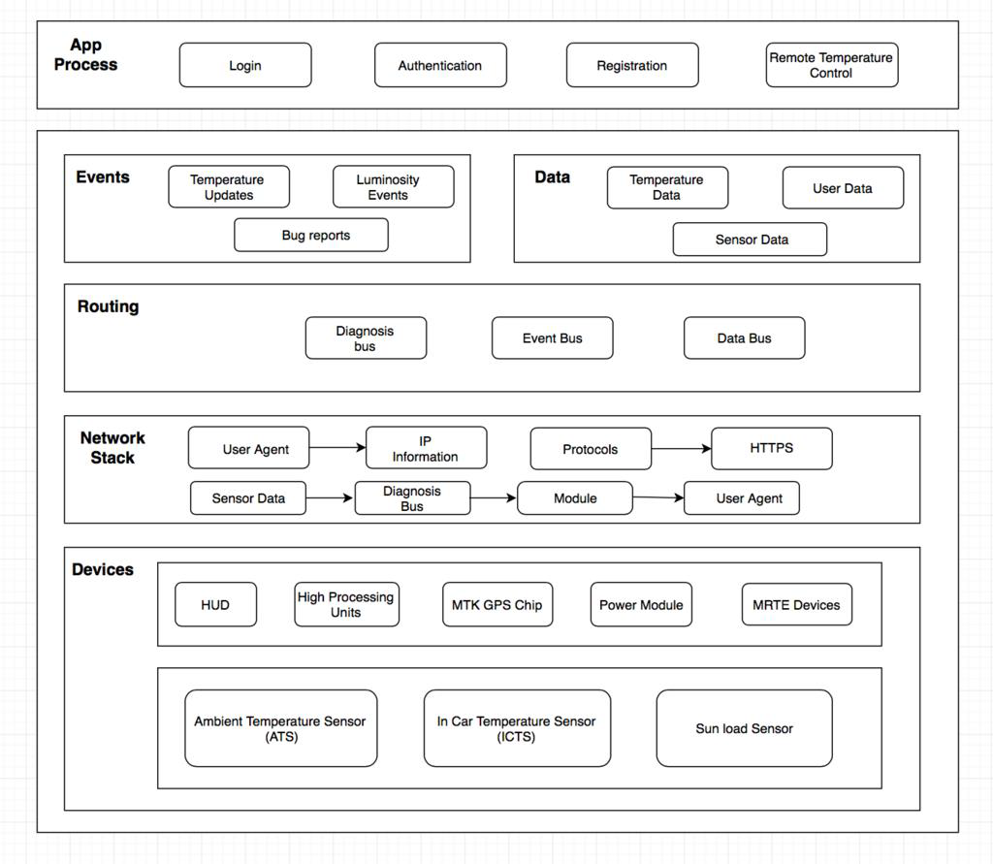
Alignment with Reference Architecture
Notes:
Legacy Services :
Navigation Services from Google
SunEarthTools API for sun positioning to assist with luminosity adjustment functionality
Login, Registration, Remote temp control are in App layer
Events: Temp Updates,Luminosity events, bug reports

Slide 13
Development View

Slide 14
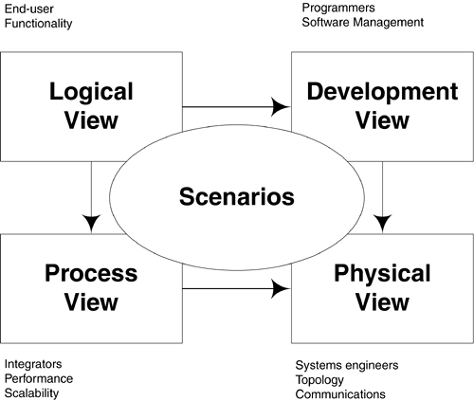
Development View
Focuses on module organization
Shows the layered structure of the software
Describes the responsibilities of each layer
Notes:
It illustrates from the programmer’s perspective and is also known as implementation view.

Slide 15
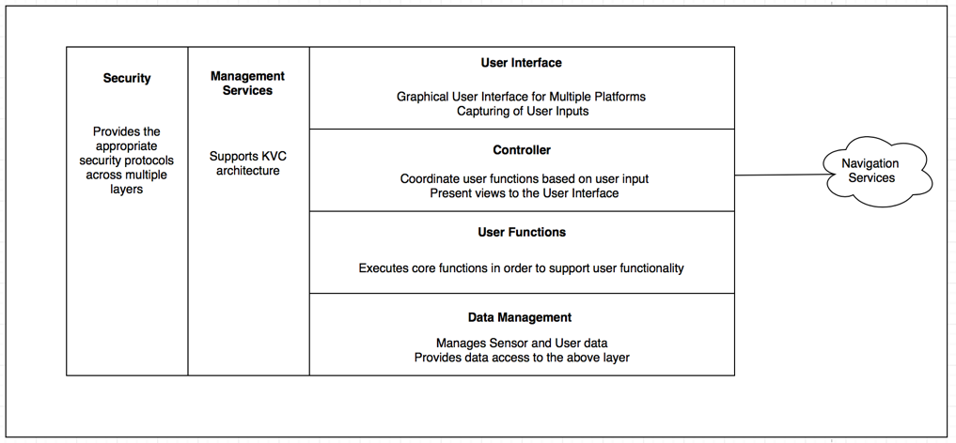
Development View Diagram
User Specific Layers
Data Specific Layer
Notes:
Basically there are 4 Layers and 2 Cross Cutting sections.
UI: This layer provides an interface for the user. This allows the user to communicate with the application.
User Functions: The functions in this layer are performed by each subsystem controlled by their respective coordinators on the layer above

Slide 16
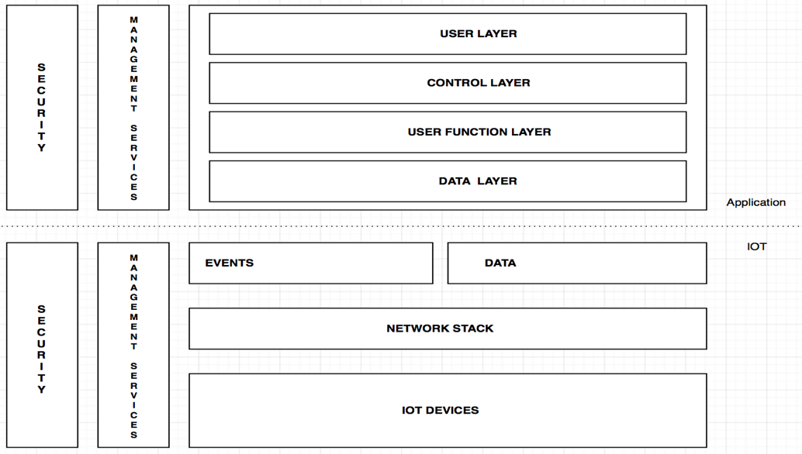
Alignment with Reference Architecture
Notes:
Events: This layer sends triggered events based on data from sensors.
Data: This is a data bus that sends and receives data from different devices.
N/w Stack: This layer establishes the connection b/w devices.
IoT Devices: This layer comprises of sensors and other components

Slide 17
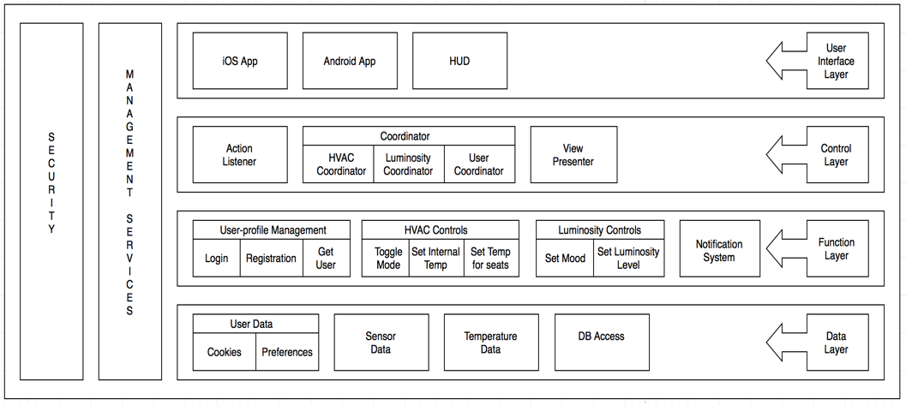
Modules
Notes:
UI Layer consists of 4 modules. 4th module is Web Module(it helps in invitation process)
Get user: This module gets the user preferences when a user is logged in( seat adjustments, steering adjustment, temp etc.)
Toggle mode: It switches b/w manual and semi-auto.

Slide 18
Physical View
Notes:
A list of procedures and steps, or a lecture slide with media.

Slide 19
Physical View
Components and nodes displayed
Describes various physical components
Shows physical connections between components
Also known as “Deployment View”
Notes:
The physical view displays the components and nodes that are required for the working of software that is built for this project. This view describes various physical components such as user devices, various types of servers, databases and connections between them.

Slide 20
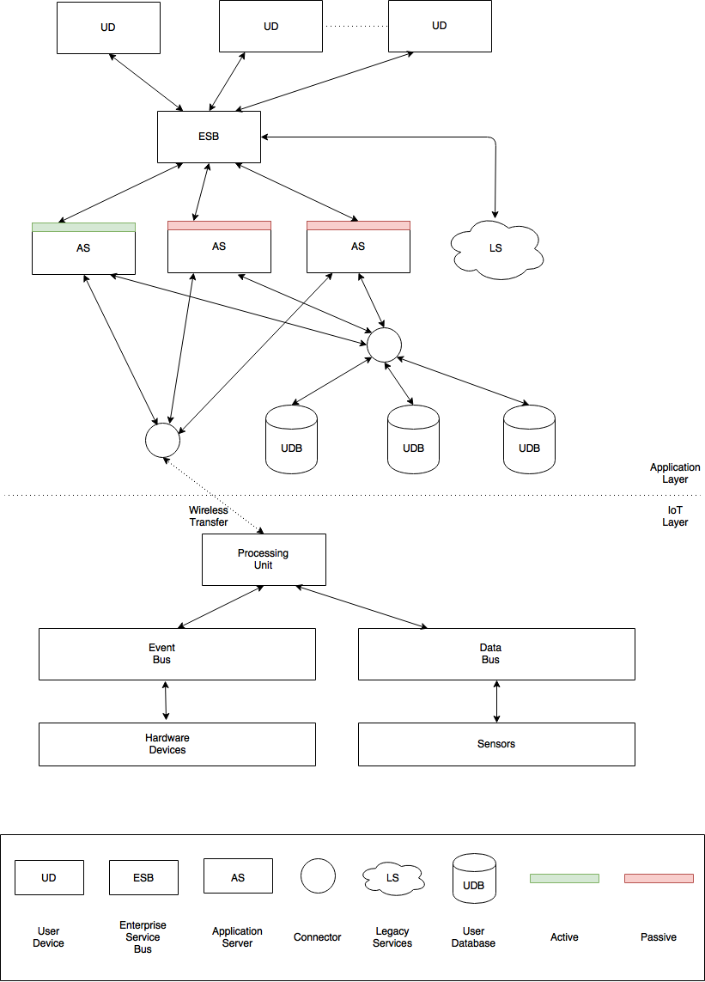
Physical View Node Diagram
Notes:
User devices are physical endpoints through which user can access the functionality. We assume to have thousands of users using this module, so we need to have a load balancer, ESB, Enterprise service bus, is used as a load balancer and also interacts with responses from server to direct the response from server. You must have seen User Management in the previous slides, which would require a server to do all the functions specified in the function layer. This is an application server which connects to user database that holds the information of users.

Slide 21
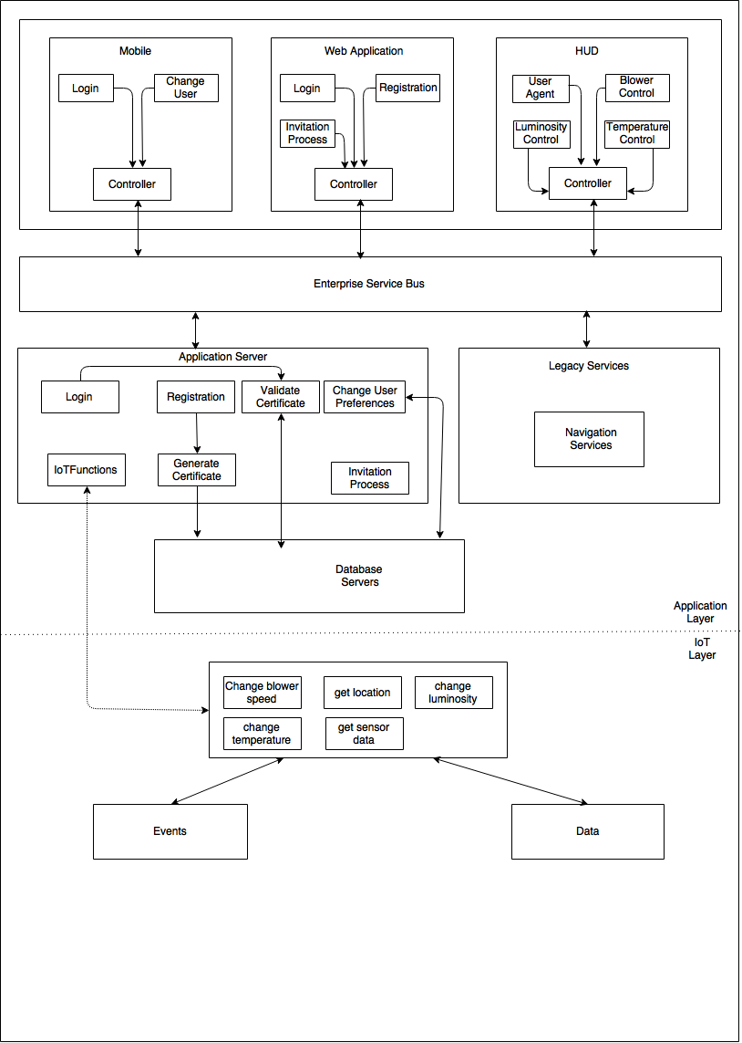
Physical View Process Diagram

Slide 22
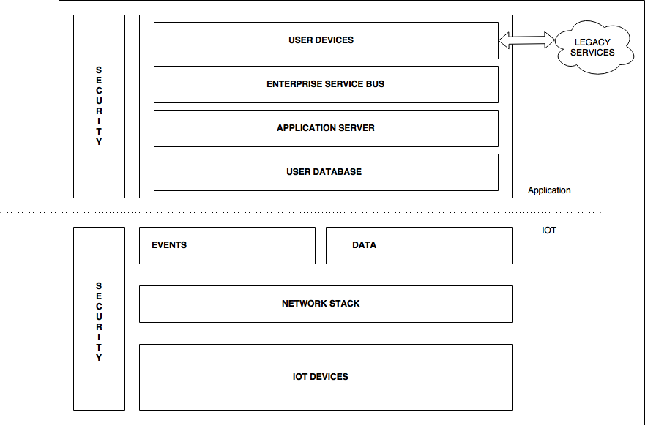
IoT Reference Architecture

Slide 23
Scenario & Revision Discussion

Slide 24
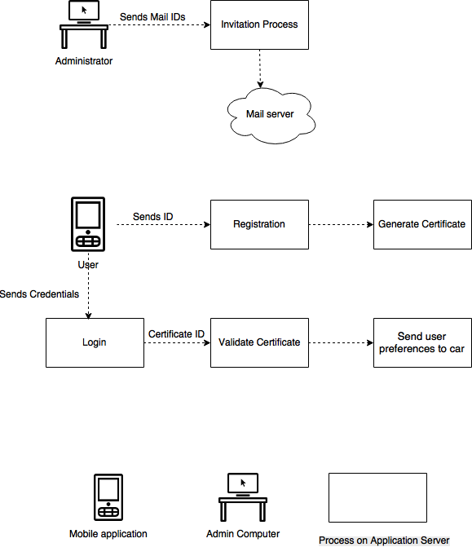
Scenario

Slide 25
Revision Discussion
Milestone 1
Features specified
ASRs filtered from features
Milestone 2
Revised ASRs based on feasibility
MVC architecture adopted
Milestone 3
Management Services added, for data observation and notification, as a cross cutting section
We removed diagnostic bus in the milestone 3
Milestone 4
Added web application to UI Layer
Adopted invitation process for added security

Slide 26
Thank you.
Notes:
Dare ask questions !

