Slide 1
Hospital Appointment Booking System
Business analysis, design and clickable prototype
Archana Jangamgunta · October 2026
Notes:
Walkthrough of the assessment: problem, business logic, design decisions, assumptions, testing and how Claude and GitHub were used.

Slide 2
Manual booking hides real availability, so slots clash and cancellations go to waste
Today
Appointments are booked by phone and at the front desk.
Two patients can be given the same doctor and time.
A cancelled slot is not visible to anyone who could use it.
Doctors have no single view of their day.
≥ 60%
of outpatient bookings made online within 6 months
0
confirmed double bookings
≤ 3 min
to complete a booking
Notes:
Objectives BO-01 to BO-05 in the BRD. The three shown are the measurable targets that drive the design: online share, zero double bookings and booking time.

Slide 3
Every deliverable lives in one GitHub repository, traced to the same requirement IDs
BRD
User flows
Wireframes
5 objectives, 50+ functional requirements, 16 business rules, 15 user stories with acceptance criteria, gaps and assumptions
Patient, doctor, admin and access-control flows plus the appointment lifecycle
All eight required screens, annotated with requirement IDs
docs/BRD.md · .docx
docs/user-flows
docs/wireframes
Prototype
Test cases
This deck
Responsive React app with mock data: book, cancel, reschedule, doctor and admin tools
38 cases executed in a browser, actual results recorded, plus 14 rule unit tests
Business logic, design decisions and assumptions
prototype/
docs/testing
docs/presentation

Slide 4
One rule decides whether a slot can be booked, so double bookings cannot happen
Published
In the future
Not taken
Slot is open
The doctor has made this time available
and
Not passed; within 30 days; on the half hour
and
No appointment with status Booked holds it
=
Shown as selectable and checked again on Confirm
Why it works
Availability is derived from appointments, never stored twice, so it cannot drift out of sync.
Cancel only changes a status, so the slot is released immediately (BR-05).
Reschedule moves one appointment, so the old slot frees and the new one is held in one step (BR-06).
Production needs the same check on the server plus a unique constraint on doctor + start time (NFR-03).
Notes:
The checks run in rules.js as pure functions; the UI, the store and the unit tests all call the same functions. Rule IDs are shown in error messages for traceability.

Slide 5
The brief gave eight rules; analysis found eight more that the system needs
Gap in the brief | Decision | Rule
How long is a slot? When is the clinic open? | 30 minutes, 09:00–16:30; book up to 30 days ahead | BR-09
Can patients cancel at the last minute? | Online changes allowed until 2 hours before | BR-10
Can a patient book two doctors at the same time? | No — blocked at confirm | BR-11
What if a doctor removes a booked slot? | Not allowed; cancel the appointment first | BR-12
Two patients confirm the same slot at once | Re-check on confirm; server unique constraint | FR-21
When can a visit be marked completed? | Only after its start time | BR-13
Can reschedule change the doctor? | No — cancel and book again | BR-14
One patient holding many slots | Maximum 3 upcoming appointments | BR-16
Notes:
Full gap list (G-01 to G-17) is in BRD section 11. Each decision is an assumption to confirm with the hospital.

Slide 6
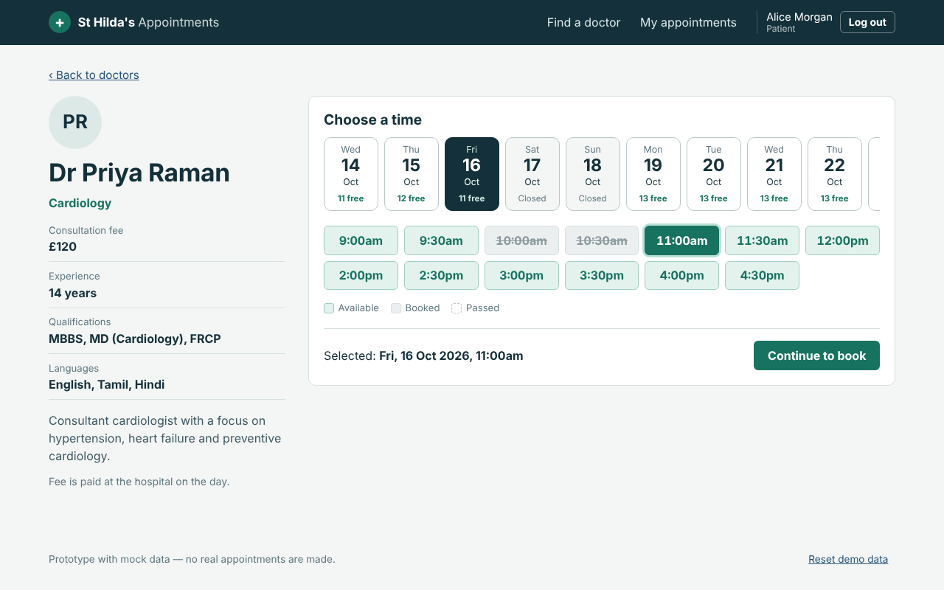
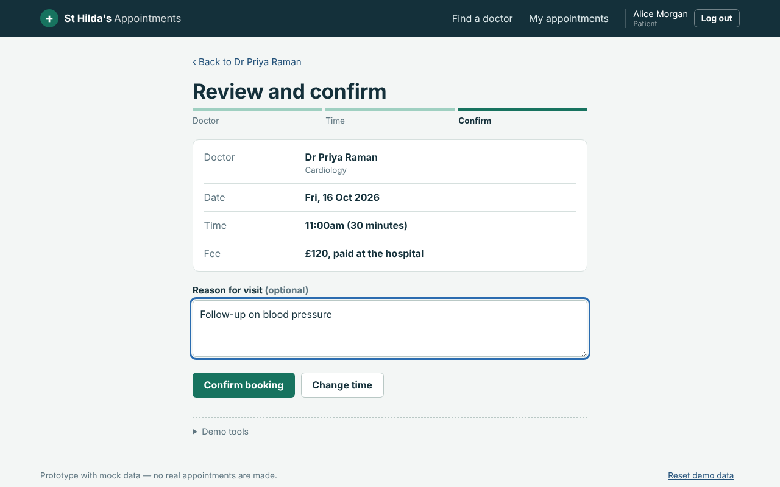
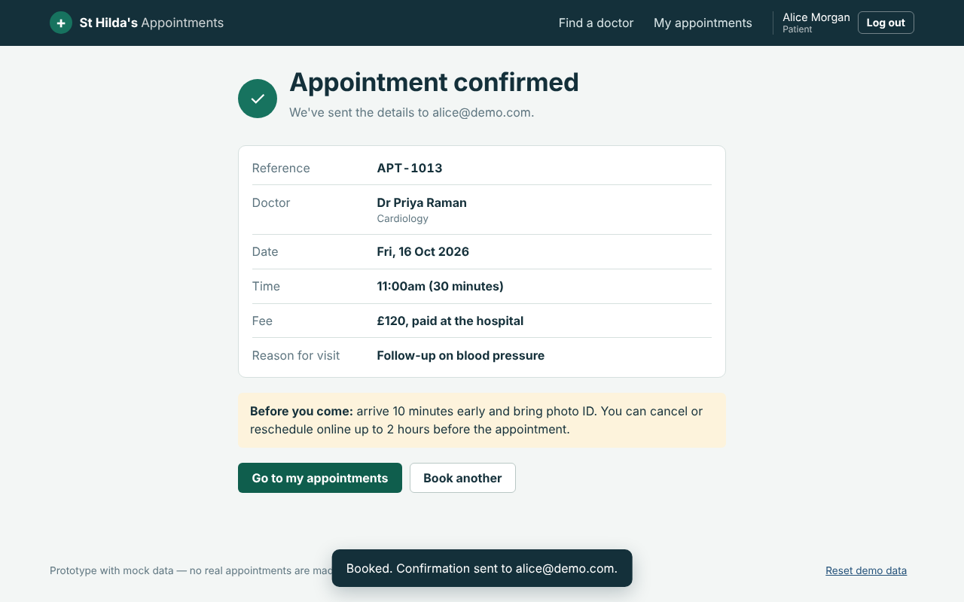
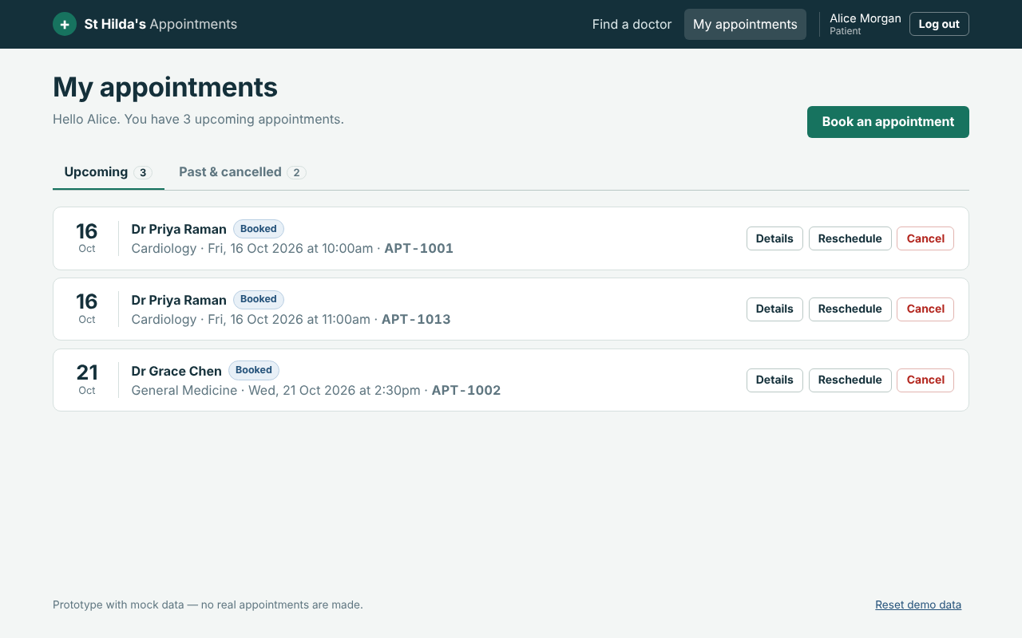
A patient goes from search to confirmed booking in four screens
1. Choose a free slot
2. Review and confirm
3. Confirmation
4. Manage
Booked times are struck through and cannot be picked
All rules re-checked before saving
Reference number and the 2-hour cut-off
Cancel or reschedule from one list
Guests can search and view profiles; login is asked for only at the booking step, and returns them to the slot they picked.

Slide 7
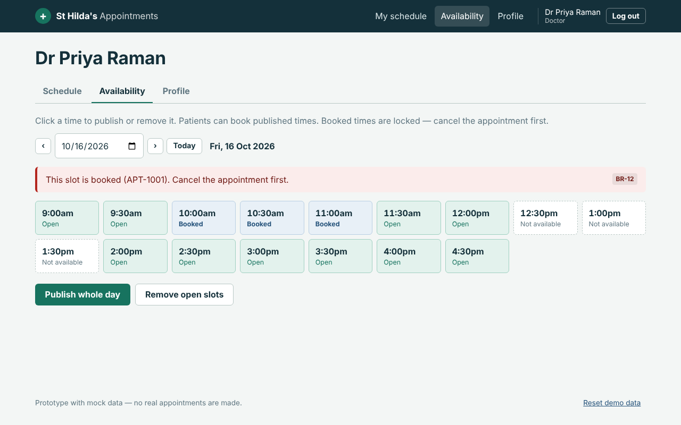
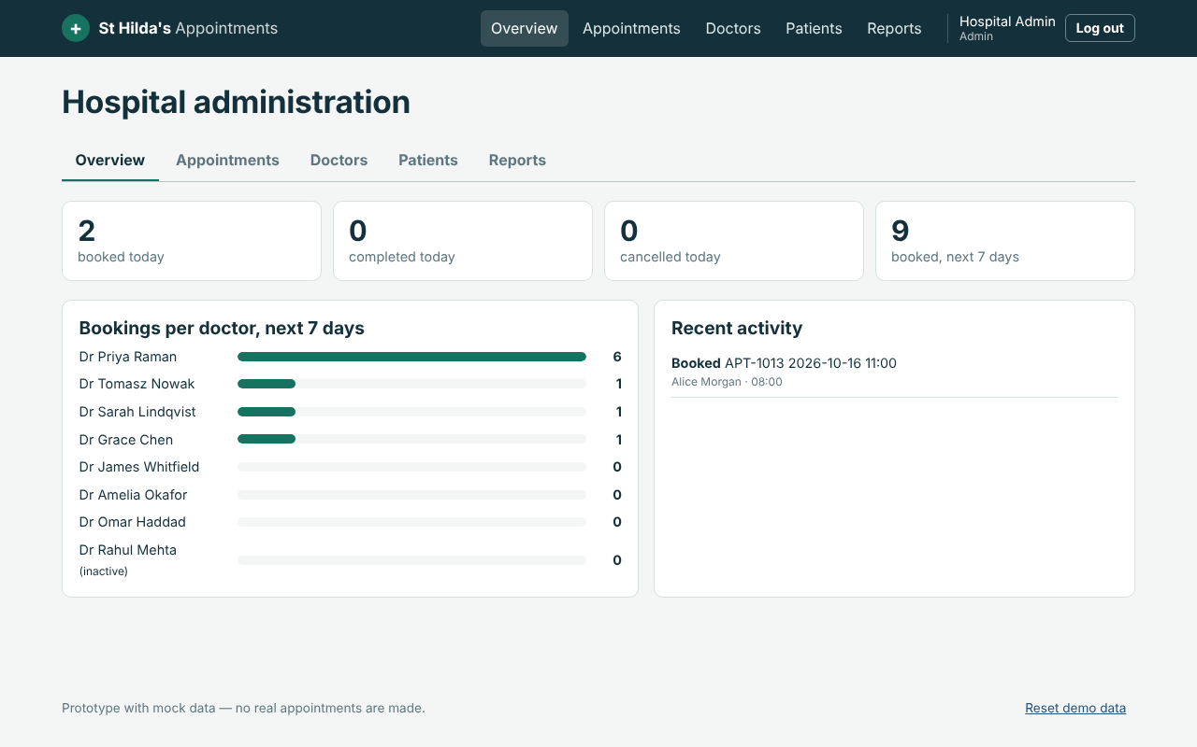
Doctors control their own availability; administrators see and fix everything
Doctor availability
Admin overview
Click a time to publish or remove it. Booked times are locked with the reason shown (BR-12).
Today's totals, demand per doctor and an activity log; tabs for appointments, doctors, patients and reports.

Slide 8
Five design decisions shaped the screens
Prevent errors instead of reporting them
Unavailable slots cannot be selected, so most invalid bookings never reach the confirm step.
Show the rule when an action is blocked
Disabled buttons carry the reason (e.g. the 2-hour cut-off and the phone number to call).
One login, role-based landing
Patients, doctors and admins share a login; each lands on their own dashboard and other pages redirect.
Readable for every patient
Atkinson Hyperlegible typeface, large touch targets, keyboard focus, layouts that work at 390 px.
Rules in one place
All business rules are pure functions reused by the UI and the tests — the same logic a backend would own.

Slide 9
Assumptions to confirm with the hospital before build
Single site, single time zone (Europe/London).
One appointment = one 30-minute slot, one patient, one doctor.
Fees are paid at the hospital; no online payment in this phase.
Doctors keep their own availability; admins can edit it for them.
Patients book only for themselves (no family accounts yet).
Email is the unique login for every role.
Email/SMS is sent by an existing hospital service.
The prototype enforces rules in the browser only; production enforces them on the server.
Out of scope: online payment, medical records, video consultations, native apps, PAS/HIS integration.

Slide 10
38 test cases were executed in a real browser, and all passed
38 / 38
passed (Playwright, fixed clock, fresh data per case)
14
unit tests on the business rules
2
viewports: desktop 1280 px and mobile 390 px
Limitation: with no backend, simultaneous booking (TC-06) is simulated in the page.

Slide 11
Claude did the analysis, design and build; GitHub holds every version
1
2
3
4
5
Analyse
Design
Build
Test
Version
Claude reviewed the brief, drafted the BRD and surfaced 17 gaps for decision
User flows in Mermaid and annotated HTML wireframes for all eight screens
React prototype written with Claude, business rules isolated in one tested module
Claude wrote and ran 38 browser test cases; results fed straight into the Excel sheet
One commit per deliverable, pushed to GitHub; README links every artefact
Every artefact is reproducible from the repository: the BRD Word file, test sheet and this deck are generated by scripts kept beside them.

Slide 12
Next steps
Confirm the assumptions and added rules with operations and clinical leads
Build the API and database with a unique constraint on doctor + slot start
Connect email/SMS notifications; complete a DPIA for patient data
Run UAT with patients, doctors and front-desk staff using the test sheet
Notes:
Claude was used for requirement analysis, wireframes, the React code, the test suite and documentation; GitHub holds the repository with commit history per deliverable.

