Slide 1
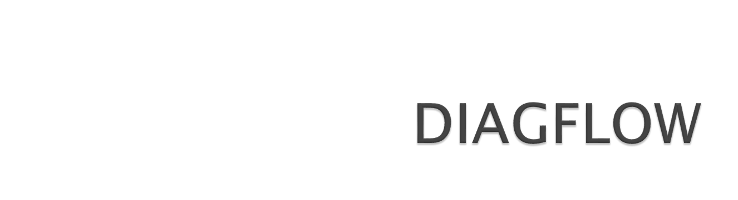
Cloud Infrastructure Automation

Slide 2
Business Context
Cost and Effort of provisioning and maintaining cloud infrastructure (public , private and hybrid) .
- Design
- Dimension
- Remediation
- Maintenance
- Risk and Compliance
- Security Vulnerability
In addition to cloud infrastructure costs, infrastructure engineering cost escalates.
Reduces the time to market.
Current infrastructure tooling solutions – Error prone, Vulnerable to security risks and mistakes

Slide 3
Solution Overview
Technology Usage
Deep Learning Framework and Vision Algorithms (Masked RCNN )
Natural Language Processing (RNN/LSTM)
Kubernetes for Infrastructure
React JS for UI
Pythonic !!!!
Cloud ArchitectureDiagram
DiagFlow Tool
Cloud Infrastructure
https://github.com/krishnagee/diagflow/blob/master/digramy.pdf

Slide 4
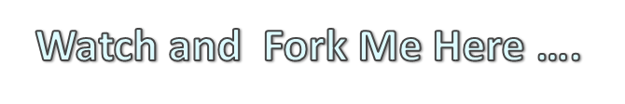
Future Roadmap
https://github.com/krishnagee/diagflow
Google , AWS and Azure marketplace
Provide as Kubernetes operator customized for kubernetes orchestration
Keep it always free and open

