Slide 1
TRACK · FACTORIES, FLEETS & SUPPLY CHAINS
SupplyShield
FIRST STOCKOUT
18.5 d
Continuity Engine
A supplier fire. A chip shortage. A production line that stops weeks later.
Chennai Plant · motor-control MCU
if no action is taken
See which factories run dry first — and compare recovery options before they do.
SYNTHETIC DEMO FIGURE
Team Vyntrix | ExaThon India 2026
Notes:
OPEN (about 20 seconds). Start with the pain, not the product: a supplier is hit, a shortage follows, and a production line stops weeks later. Then the one-line value: SupplyShield shows which factories run dry first and compares recovery options before they do.
Point at the 18.5 days: this is a synthetic demo figure generated by the app's own scenario assumptions (supplier outage of 21 days is a planning assumption), not a measurement or a validated prediction. Say 'synthetic' out loud.
NOTE: your brief mentioned 27.3 days as an example; the supplied app actually outputs 18.5 days for this scenario, so the deck uses 18.5.

Slide 2
One supplier fire can stall an industry
A real precedent — and the fictional scenario our demo uses
REAL EVENT · 2021
Renesas Naka fab fire
FICTIONAL · OUR DEMO
Mar 19, 2021
Fire at Renesas’ Naka plant; 23 machines damaged
Synthetic scenario
“Shenzhen MicroSemi” fab fire
↓ undispatched MCU shipments held
↓ Chennai & Pune lines at risk
21-day outage = planning assumption
Late Mar
Restart expected to take 3+ months; Toyota and Nissan plan production cuts
~Jun 1
Output back to ~88% of pre-fire level
Mid-Jun
Full production expected
Invented data. Not Renesas, not a real supplier.
Sources: Embedded Computing Design, 30 Mar 2021; Associated Press, 1 Jun 2021 (see presenter pack).
Notes:
About 20 seconds. Left: a real, documented precedent. A fire at Renesas' Naka plant on 19 March 2021 damaged 23 machines; Renesas expected a restart to take more than three months, Toyota and Nissan planned production cuts, and by 1 June output was around 88% of pre-fire levels with full production expected in mid-June (Embedded Computing Design, 30 Mar 2021; AP, 1 Jun 2021).
Right: our demo scenario is FICTIONAL. 'Shenzhen MicroSemi' is an invented supplier in synthetic data. We use the real event only to show why this decision problem matters; we do not claim our numbers describe Renesas or any real company.

Slide 3
The hard part: what breaks first?
Impact travels through four layers — usually held in separate systems
Supplier
Shipment
Inventory
Production line
01
02
03
Which components?
Which shipments?
Which lines?
A fire at one supplier touches every part it ships — but not every plant equally.
Some are in transit and continue; others are not dispatched and are held.
Stock covers some lines for weeks, others for days. The gap stays hidden until it is not.
Then: which recovery response, at what cost, time and risk?
Notes:
About 20 seconds. A disruption does not hit a factory directly; it travels supplier → shipment → inventory → production line. Operations teams need three answers: which components, which shipments, which factories and lines — and then they must choose between recovery responses that trade off cost, time and risk. In many companies that data sits in separate systems, so this tracing is slow and manual. (This framing follows the project README's problem statement.)

Slide 4
From disruption to decision
A continuity and decision-support engine — it recommends, it never executes
1
2
3
4
EXAMINE
ASSESS
COMPARE
DECIDE
Pick a disruption: supplier failure, shipment delay or port closure, inventory shortage
Trace supplier → shipment → stock → line. Project the stockout day and estimated loss
Score recovery options against a no-action baseline with a visible formula
Flag approval, record approve / reject / defer with a note
DETERMINISTIC & EXPLAINABLE
NO MACHINE LEARNING
ASSUMPTIONS SHOWN IN THE UI
Notes:
About 25 seconds. The workflow in four steps. Examine: choose a disruption. The app supports three scenario types: supplier failure, shipment disruption including port or route closure, and inventory shortage. Assess: it traces the cascade and projects when stock runs out. Compare: recovery options are scored against a no-action baseline. Decide: approval is flagged and a human decision is recorded.
Two honest points to say aloud: it recommends and never executes anything; and there is no machine learning in it, so the logic is deterministic and every assumption is visible. (Wording note: the app examines recorded or user-defined disruptions — it does not auto-detect from live feeds.)

Slide 5
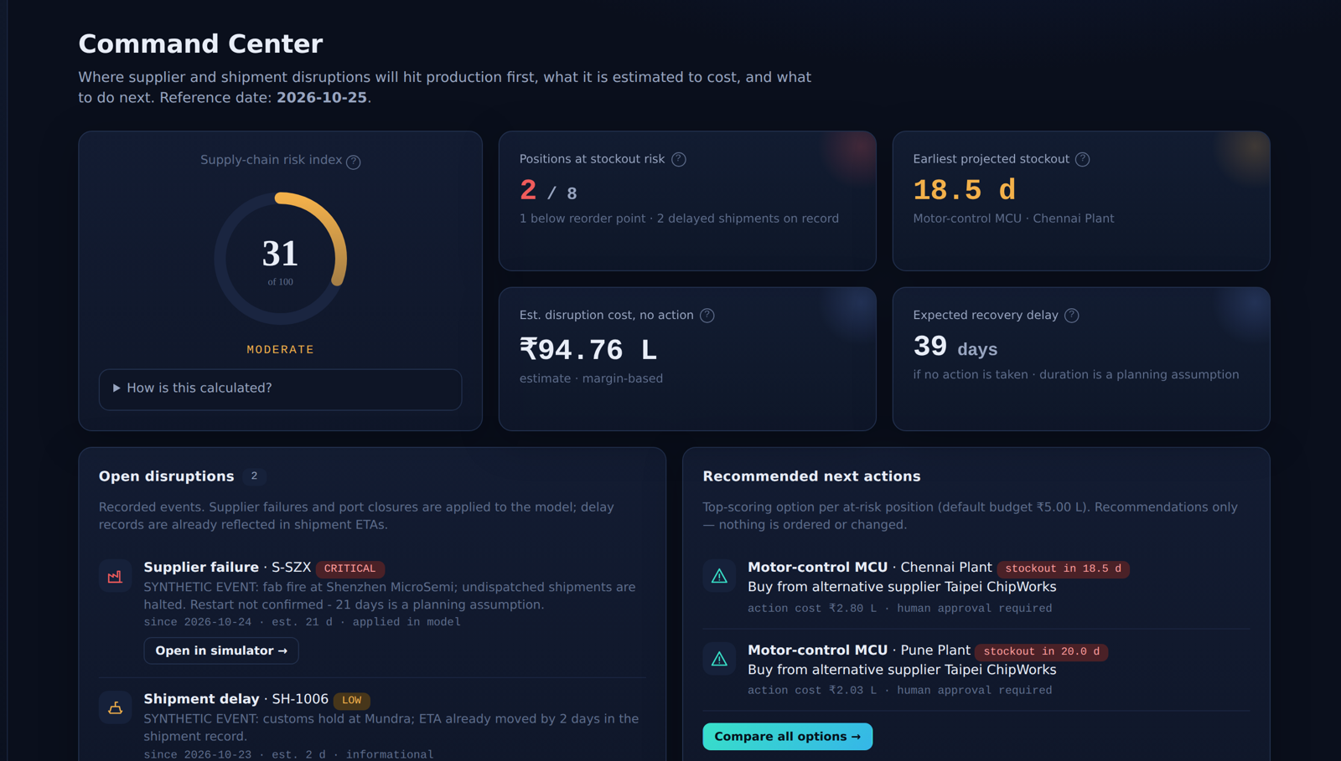
Live product walkthrough
Command Center — real screenshot of the supplied app
COMMAND CENTER
Risk, stockouts, next actions
SIMULATOR
Cascade and projected stock
RECOVERY
Options vs. no-action baseline
DECISION LOG
Human decision per run
Illustrative figures
Notes:
About 35 seconds — switch to the live app here if you can. Point at four things on the Command Center: risk index 31 out of 100 (click 'How is this calculated?' to show the formula); 2 of 8 positions at stockout risk; earliest projected stockout 18.5 days at the Chennai plant; estimated no-action cost of ₹94.76 lakh.
Say: these are estimates from stated assumptions on synthetic data, not measured losses. Then click 'Open in simulator' on the supplier-failure disruption.
The screenshot is from the supplied app running in explicit synthetic demo mode (the app shows a banner that nothing on screen was read from Exasol). REPLACE this screenshot with a live-Exasol capture after you verify the connection.

Slide 6
How it works: architecture
Mapped to the actual code — verified parts vs. parts awaiting a live test
AppService
Engine
mode · cache
decisions
Exasol only after
SELECT 1 succeeds
scenario propagation
+ recovery scoring
Dashboard
Flask API
browser UI
no DB access
app.py
JSON endpoints
ExasolService
Exasol
PyExasol · SQL
health check
tables + SQL views
SCENARIO_RUNS
Synthetic data
explicit click only
demo mode
Built & unit-tested (95 pass)
Coded; live Exasol read/write pending verification
Notes:
About 30 seconds. Left to right: the browser dashboard talks only to the Flask API; the browser never touches the database or credentials. AppService holds the mode, cache and decisions. Two paths sit behind it: the scenario engine, which does propagation and recovery scoring in Python, and ExasolService, which uses PyExasol with parameterised SQL to read tables and SQL views and to write scenario runs and decisions back.
Be precise about status. TEAL = built and covered by unit tests (95 pass, 3 integration tests skipped because they need a real database). AMBER = the Exasol path: the code and SQL exist, but at the time this deck was built they had NOT been executed against a live Exasol instance. The README itself says so.
If you complete live verification before presenting: change the amber items to teal, and replace the legend text with what you verified (for example 'SELECT 1 health check passed; table counts read from Exasol; run + decision written to SCENARIO_RUNS'). Say 'synthetic seed data in a live Exasol database' — a live connection does not make the data real.
The dashed synthetic generator is only entered by an explicit click; the app never silently falls back to demo data.

Slide 7
Supplier failure: options compared
Chennai Plant · motor-control MCU · 21-day outage (planning assumption)
OPTION | ACTION | EST. TOTAL | STOCKOUT | SCORE
No action | ₹0 | ₹55.43 L | 18.5 d | 13.5
Alt. supplier Bengaluru | ₹2.31 L | ₹37.04 L | 11.6 d | 34.1
Alt. supplier Taipei ★ | ₹2.80 L | ₹2.80 L | 0.0 d | 95.1
Transfer from Ahmedabad | ₹0.34 L | ₹30.70 L | 10.2 d | 29.9
★ = recommended. “Est. total” = action cost + estimated production loss; action cost counts premiums and fees only. Estimates from stated assumptions — not savings.
Source: app output (demo mode). Costs in ₹ lakh (L).
Notes:
About 35 seconds. This is the supplier-failure scenario from the app, for the Chennai plant's motor-control MCU. The chart shows projected stock: grey is the no-disruption path, red is no action — stock hits zero around day 18 — and teal is the recommended option.
The table compares the baseline with options the app actually evaluated: two alternative suppliers and a stock transfer from the Ahmedabad plant. Under the model's assumptions the Taipei option scores highest (95.1 vs 13.5 for no action) with no projected stockout. Say 'estimated difference versus baseline', never 'savings'. The app also lists options it did NOT evaluate and why (for example expedite is unavailable because the incumbent supplier is down).
Every number here is synthetic and driven by assumptions in config.py — the 21-day outage, the 50% surge capacity, setup fees — all visible in the UI. Optional live touch: lower the budget limit and show an option drop out.
Numbers come straight from the app's /api/simulate output (run id RUN-20261025-085453-4C8E, reference date 2026-10-25).

Slide 8
What it gives a planner
Practical value of the implemented approach — no unverified performance claims
EARLIER VISIBILITY
COMPARED OPTIONS
DECISION TRAIL
Day-by-day stock projection over a 45-day window shows where and when a shortage starts.
Alternatives sit next to a no-action baseline, scored on cost, time, loss, unmet demand and risk.
Approval is flagged by policy; approve / reject / defer plus a note is stored with the run.
WHAT MAKES IT CREDIBLE
FORMULAS ON SCREEN
NO SILENT DEMO FALLBACK
SOURCE ALWAYS LABELLED
RECOMMENDS ONLY
Notes:
About 20 seconds. Three practical benefits, all grounded in what the app does: earlier visibility of where and when stock runs out; recovery options compared side by side against a no-action baseline; and a decision trail — approval is flagged when action cost exceeds the INR 25,000 policy threshold or a new supplier is involved, and the human decision is recorded.
What makes it credible rather than a black box: formulas and assumptions are shown in the UI; if Exasol is unreachable you see an error, not silently substituted demo data; every screen labels its data source; and it only recommends.
We deliberately make no quantified-improvement claim — no savings, accuracy or speed numbers — because none has been validated.

Slide 9
Honest limits and next steps
What is true today — and what is future work
TODAY
FUTURE WORK
Data is synthetic; a database connection does not make it real
Outage and closure durations are planning assumptions, not forecasts
Options are evaluated one position at a time
No machine learning, so no accuracy claims
Live Exasol read/write: pending verification
Validate against real operational data
Add uncertainty analysis for durations and lead times
Back-test against historical disruptions
Combined multi-position recovery plans
Live ERP / WMS data feeds
Notes:
About 20 seconds. Be direct about limits — judges trust it. Today: the data is synthetic, and a live database connection would not change that; durations such as the 21-day outage are planning assumptions; options are evaluated one position at a time; there is no machine learning, so no accuracy claims.
First bullet on the left is the one to update after your Exasol test: if you have verified a successful SELECT 1 plus real reads and writes, replace 'pending verification' with exactly what you verified (for example 'Verified: connection test, reads from tables/views, run and decision written to SCENARIO_RUNS').
Future work (not built): validate with real operational data, add uncertainty analysis, back-test against historical disruptions, model combined plans across positions, and connect ERP/WMS feeds.

Slide 10
We cannot eliminate every disruption, but we can make better decisions before it becomes a crisis.
SupplyShield — turning supply-chain uncertainty into actionable decisions.
Team Vyntrix | ExaThon India 2026 | Factories, Fleets & Supply Chains
Notes:
About 10 seconds. Deliver the line slowly: 'We cannot eliminate every disruption, but we can make better decisions before it becomes a crisis.' Then: 'SupplyShield — turning supply-chain uncertainty into actionable decisions.' Thank the judges and invite questions. Be ready for: Is the data real? (No — synthetic, labelled.) Is Exasol connected? (State exactly what you verified.) Is there AI/ML? (No, deterministic by design.)

