Slide 1
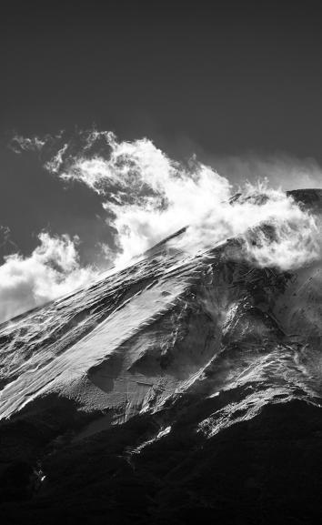
REINFORCEMENT LEARNING
Submited To : Mr. B. Satya Sai

Slide 2
BATCH - 09
J. GOPI KRISHNA – 231FA18141
P. KUMAR - 231FA18062
K. ANANAD - 231FA18427

Slide 3
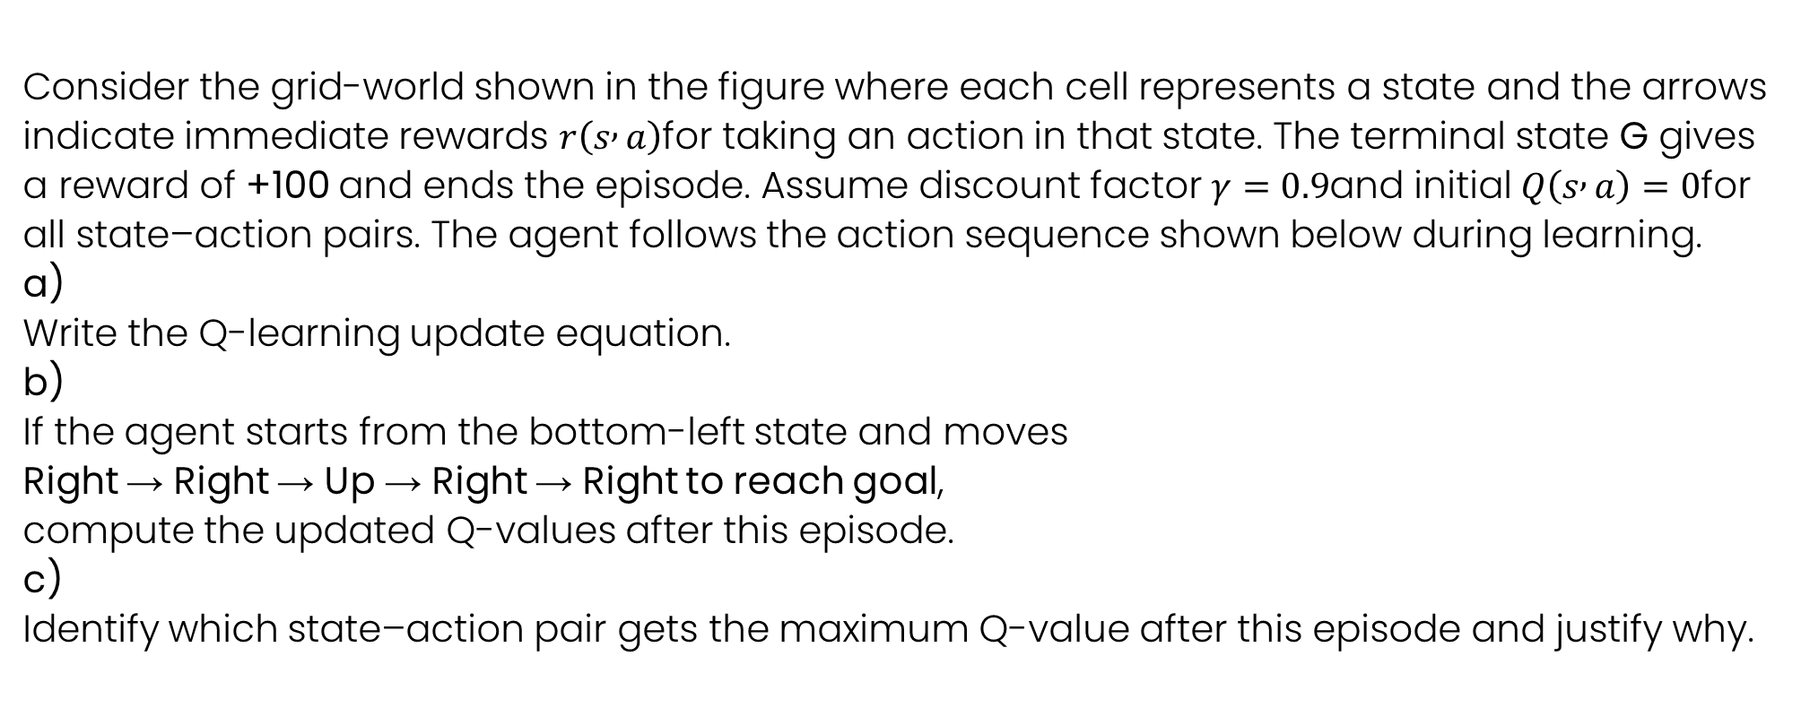
Consider the grid-world shown in the figure where each cell represents a state and the arrows indicate immediate rewards $r\left(s , a\right)$for taking an action in that state. The terminal state G gives a reward of +100 and ends the episode. Assume discount factor $γ=0.9$and initial $Q\left(s , a\right)=0$for all state–action pairs. The agent follows the action sequence shown below during learning. a) Write the Q-learning update equation. b) If the agent starts from the bottom-left state and moves Right → Right → Up → Right → Right to reach goal, compute the updated Q-values after this episode. c) Identify which state–action pair gets the maximum Q-value after this episode and justify why.

Slide 4
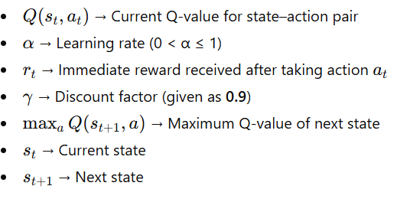
(a) Q-Learning Update Equation
The Q-learning update rule is used to iteratively update the action-value function $Q\left(s , a\right)$based on the agent’s experience.
Q-Learning Update Formula
WHere:

Slide 5

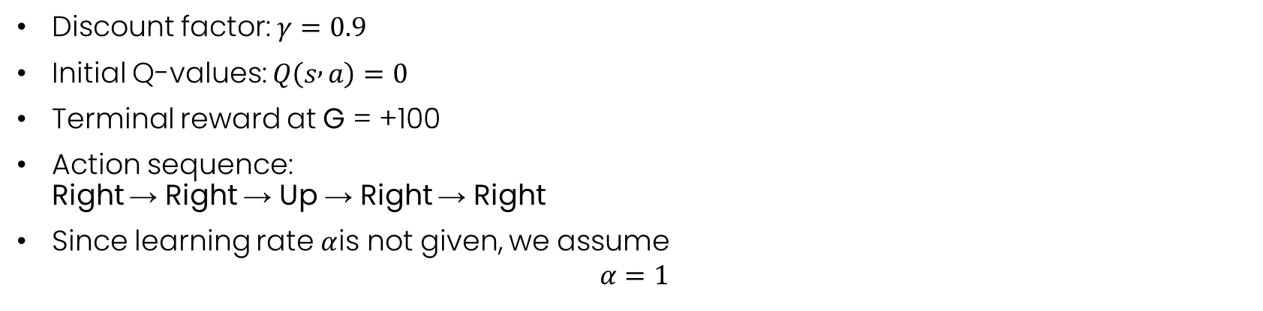

Given:
Discount factor: $γ=0.9$
Initial Q-values: $Q\left(s , a\right)=0$
Terminal reward at G = +100
Action sequence: Right → Right → Up → Right → Right
Since learning rate $α$is not given, we assume
$$α=1$$
(b) Updated Q-values After One Episode
Step 1: (Right)
$$Q\left(s_{0} , R\right)=0.9×72.9$$
$$Q\left(s_{0} , R\right)=65.61$$
Step 2: (Right)
$$Q\left(s_{1} , R\right)=0.9×81$$
$$Q\left(s_{1} , R\right)=72.9$$

Slide 6
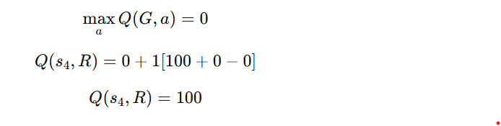
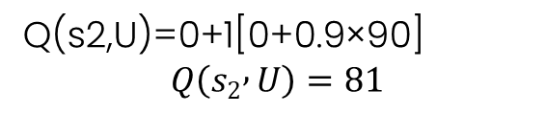
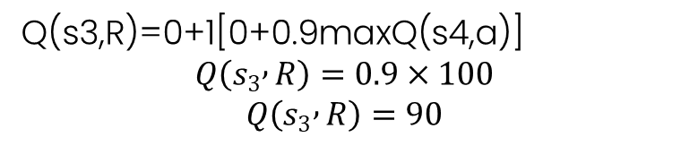
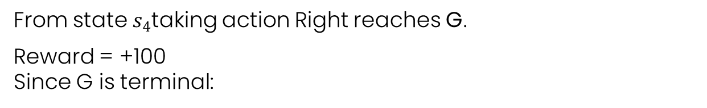
Step 3: (Up)
Q(s2​,U)=0+1[0+0.9×90]
$$Q\left(s_{2} , U\right)=81$$
Step 4: (Right)
Q(s3​,R)=0+1[0+0.9maxQ(s4​,a)]
$$Q\left(s_{3} , R\right)=0.9×100$$
$$Q\left(s_{3} , R\right)=90$$
Step 5: Last Action (Right → Goal G)
From state $s_{4}$taking action Right reaches G.
Reward = +100 Since G is terminal:

Slide 7

(c) State–Action Pair with Maximum Q-value
The maximum Q-value is:
Reason:
It directly leads to terminal state G
It receives immediate reward +100
No discounting is applied because it is one step before goal
Therefore it has the highest return

Slide 8
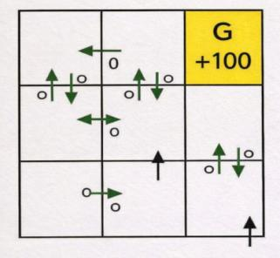
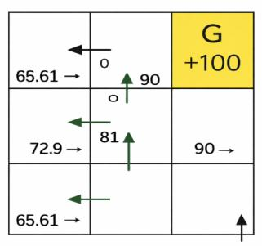

Slide 9

Thank you

