Slide 1

Monocef Injection: Case Study in Sterile Powder Formulation
Task 2 — Drug Formulation Case Study | Active Ingredient: Ceftriaxone Sodium

Slide 2

Monocef Is a Ceftriaxone Powder for Injection
Product Overview
Brand and strength: Monocef 2g is supplied as a vial containing ceftriaxone sodium equivalent to ceftriaxone 2g, classified under Anti-Bacterial Parenteral therapy.
Dosage form: Sterile powder for solution for injection or infusion, reconstituted immediately before administration.
Why a dry vial? The powder format avoids storing a ready-to-inject aqueous solution, significantly reducing risks associated with long-term water exposure, microbial growth, and chemical degradation.
PRESCRIPTION INJECTABLE
PARENTERAL

Slide 3




Formulation Must Deliver Four Critical Performance Attributes
Sterility
Potency
Parenteral route demands zero microbial contamination and rigorous endotoxin control throughout manufacture and storage.
Each vial must deliver the full labeled ceftriaxone activity upon reconstitution — no degradation or sub-potent release.
Reconstitution
Patient Safety
Powder must dissolve into a clear, usable solution with controlled pH and acceptable color within a clinically acceptable timeframe.
Packaging must limit particulate matter, prevent container–closure interaction, and minimize risk of dosing errors at the bedside.

Slide 4
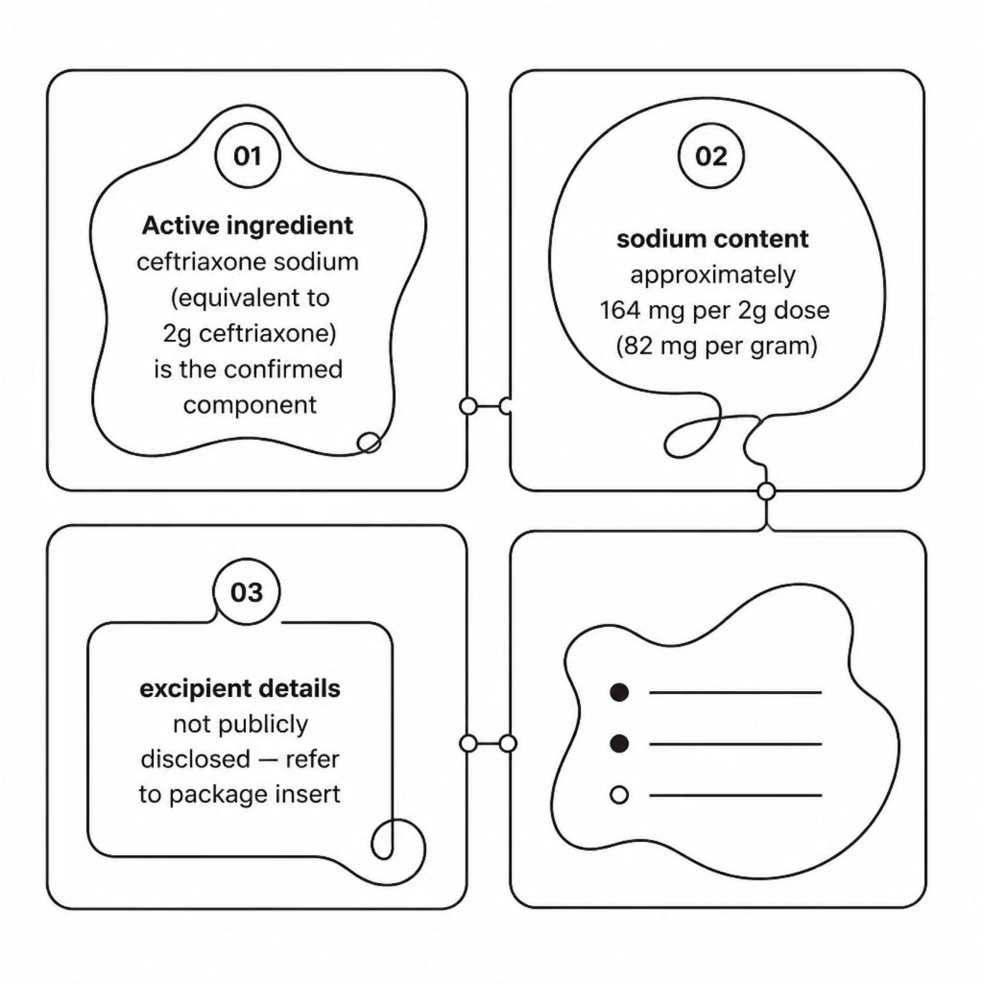

Composition: Ceftriaxone Sodium in a Protective Dry-Vial System
Active Pharmaceutical Ingredient
Ceftriaxone sodium, equivalent to 2g ceftriaxone per vial in the Monocef 2g presentation.
Ionic Sodium Contribution
Each gram of ceftriaxone activity contributes approximately 82–83 mg (3.6 mmol) of sodium — clinically relevant for patients on sodium-restricted regimens. A 2g dose delivers roughly 164–166 mg sodium total.
The public Monocef product listing identifies ceftriaxone sodium but does not publish a complete added-excipient formula. Do not assume buffers or stabilizers are present without consulting the approved batch record or current package insert.

Slide 5
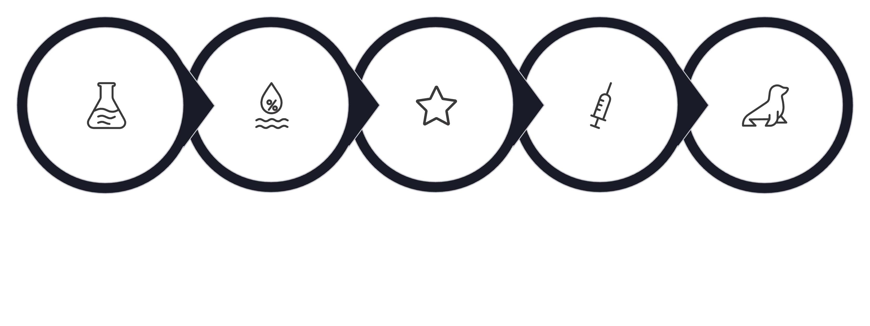
Representative Manufacturing Flow for Sterile Powder
API Qualification
Moisture Preparation
Component Sterilization
Stoppering & Sealing
Aseptic Filling
This representative flow reflects good aseptic manufacturing practice for ceftriaxone sodium powder-for-injection. Each stage is a critical control point — failure at any step compromises sterility, potency, or patient safety. The actual Aristo Pharma process is governed by their validated batch records and regulatory dossier.

Slide 6

Reconstitution and Administration Are Part of the Product Design
Intramuscular Route
Never use calcium-containing diluents — such as Ringer's solution or Hartmann's solution — to reconstitute ceftriaxone vials or to further dilute a reconstituted vial for IV administration. A precipitate can form, posing a serious patient safety risk.
For IM use, referenced product information specifies dissolving 1g ceftriaxone in 3.5 mL of 1% Lidocaine Injection BP, administered by deep intramuscular injection. Follow the exact Monocef package insert instructions for the 2g marketed strength.
Handling Requirements
Approved Diluents for IV Use
This is a prescription injectable. Use only approved diluents and routes. Reconstitution and administration must be performed by trained healthcare personnel only.
0.9% Sodium Chloride (normal saline)
5% Dextrose in Water (D5W)
Sterile Water for Injection
Avoid: Ringer's, Hartmann's, or any calcium-containing fluid

Slide 7
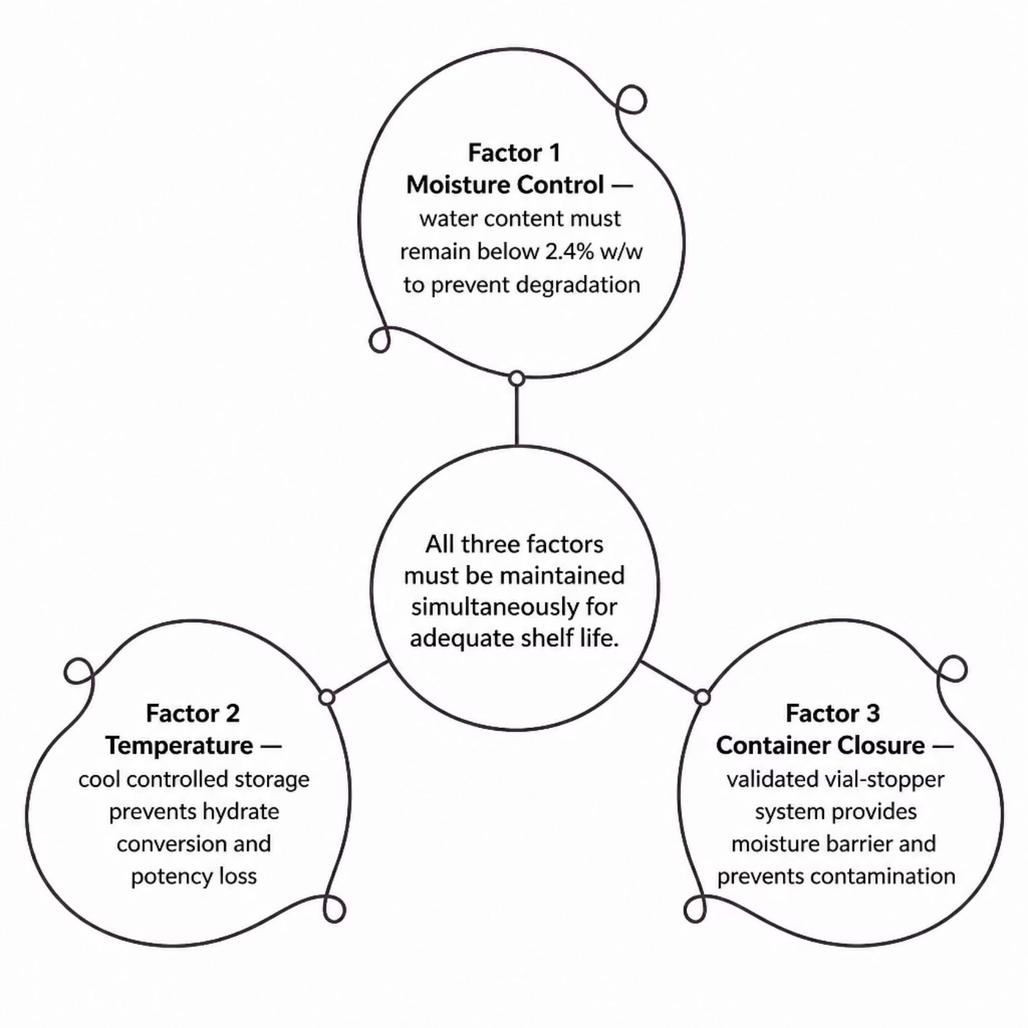
Stability Depends on Moisture, Temperature, and Container Closure
Moisture — The Critical Variable
Published research confirms ceftriaxone degrades when water content rises above 2.4% w/w. Humidity control during manufacture and a tight, validated seal are central to shelf-life protection. Even minor moisture ingress can trigger hydrolysis and potency loss.
Temperature Control
Hydrate distribution and stability differ between products and manufacturers. Controlled, cool storage conditions are especially important for generic powder preparations to maintain efficacy and stability throughout the declared shelf life.
Packaging Integrity
A validated vial–stopper system with strong moisture barrier properties and compatibility data is non-negotiable. Container-closure integrity testing is part of the stability program.

Slide 8



Quality-Control Checklist: Release Only When the Vial Is Fit for Use
1
2
Identity and Assay
Physical Quality
Confirm ceftriaxone identity by appropriate analytical method and verify labeled strength is met within specification.
Inspect powder appearance, reconstitution time, solution clarity and color, visible and subvisible particulates, and fill weight uniformity.
3
4
Microbiological Quality
Stability Program
Verify sterility and bacterial endotoxin limits; maintain validated aseptic controls and environmental monitoring programs.
Monitor potency, moisture content, degradation products, closure integrity, and reconstituted-solution usability throughout the approved shelf life.
Monocef's dry-vial design succeeds only when formulation science, aseptic processing, validated packaging, and precise clinical reconstitution instructions function as one integrated system.

Slide 9

Sources
Aristo Pharma — Monocef 2g Product Page
NAFDAC — Philocef Injection Summary of Product Characteristics
Scientific Reports — Storage Stability of Ceftriaxone Sodium
Monocef – 2g | Aristo Pharma
Official product listing: composition, strength, pack size, and therapy classification for Monocef 2g vial.
White to pale yellow crystalline powder — NAFDAC SMPC
Regulatory SmPC providing reconstitution instructions, sodium content data, diluent contraindications (calcium-containing solutions), and physicochemical description.
Research on storage stability differences between ceftriaxone sodium products | Scientific Reports
Peer-reviewed research documenting the 2.4% w/w water-content threshold for ceftriaxone degradation and the impact of sealing and cool storage on generic powder preparations.

