Slide 1
LENDING CLUB CASE STUDY
SUBMISSION
Group Facilitator: Krishna Parameshwar Iyer Group Member : Krishna Parameshwar Iyer

Slide 2
Abstract
This is a presentation on “Data Toolkit – Group Case Study 1” for the course “Advance Certification Course on Machine Learning and Deep Learning”. The objective is to find the driving factors (or driver variables) behind loan default, i.e. the variables which are strong indicators of default for Lending Club, a consumer finance company.

Slide 3
Problem solving methodology
Using the dataset loan.csv, we will perform EDA using the following strategy:
Define a metric to measure loan defaults, use percentage of defaults.
Perform univariate analysis to find variables that are directly related to loan default rate.
Perform bivariate analysis to find how strong the relationship between relevant variables and loan default rate.

Slide 4
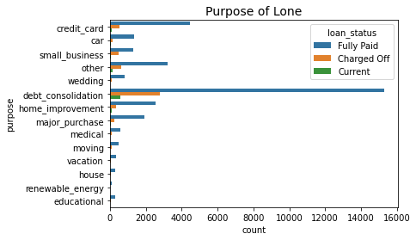
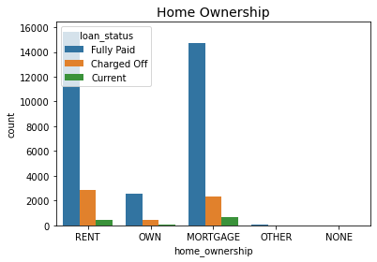
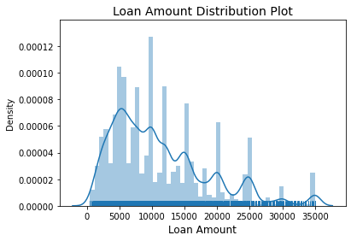
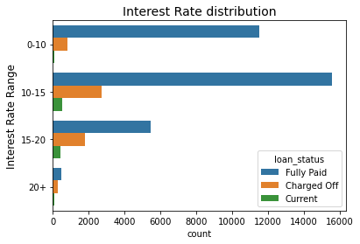
Analysis – Univariate analysis
Performing the univariate analysis we find the following variables are directly related to loan default rate:
Term – loan default rate increases with increase in term
Grade – loan default rate increases as grade worsen.
Sub-grade – loan default rate increases as sub-grade worsen.
Loan amount – loan default rate increases with increase in loan amount.
Interest rate – loan default rate increases as interest rate increases.
Annual income – loan default rate decreases with increase in annual income.
Revolving credit utilization rate – loan default rate increases along with revolving credit utilization rate.

Slide 5
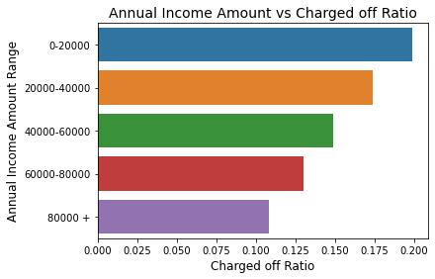
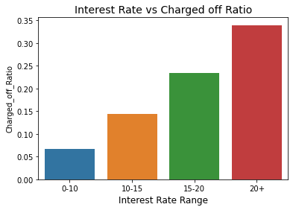
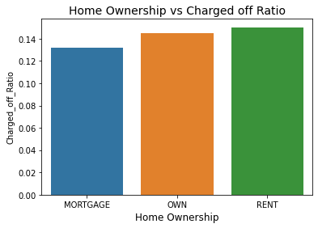
Analysis – Bivariate analysis
If the relation between loan default rate and variables from univariate analysis still holds true in bivariate analysis, we consider such relations as independent or fundamental.
Bivariate analysis shows that all the variables from univariate analysis are strong indicators of loan default rate except revolving credit utilization rate and loan amount as the relationship of these two variables with loan default rate doesn’t hold true for most cases during bivariate analysis. Chargedoff Proportion is found from the dataset and it is plotted against other variables for the analysis.

Slide 6
Conclusion
Performing EDA on the dataset, we conclude that the following variables are driving factors behind loan default:
Strong indicators
Term – Loan taken for higher term has more chance to default.
Annual Income – Loan default chance increases as Annual Income decrease
Purpose of Loan – Purpose of Loan can be used as optional indicator of loan default .
Interest rate – Loan with higher interest rate has higher probability of default.
Loan amount – Higher the loan amount, more the chance to default.

