Slide 1
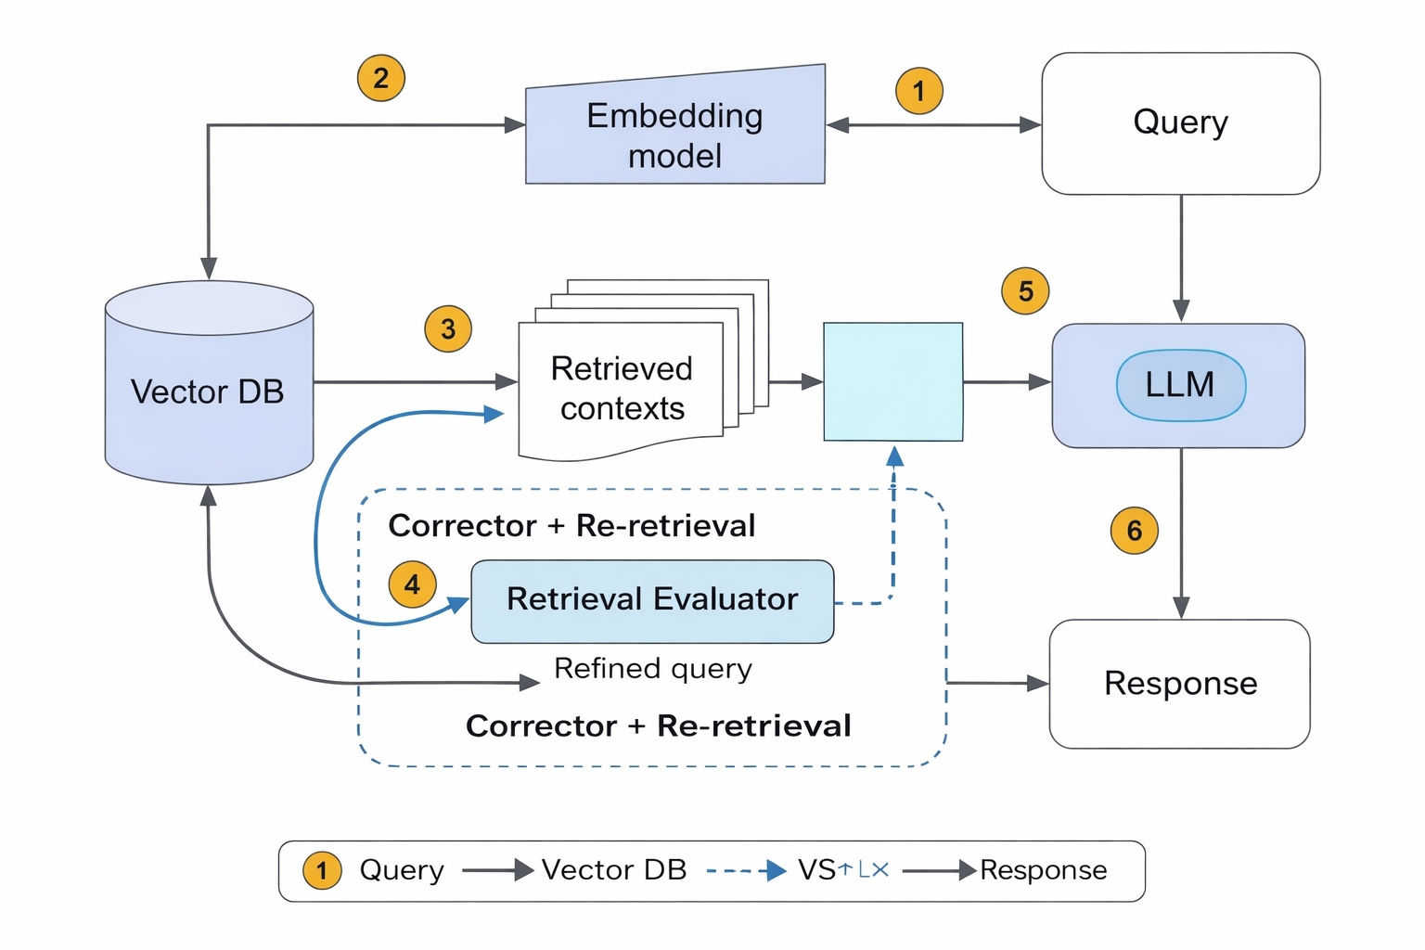
Corrective Retrieval‑Augmented Generation (CRAG)
Improving Accuracy, Trust, and Safety of Enterprise AI Systems
What is CRAG?
  CRAG is an advanced Retrieval‑Augmented Generation technique.
  It validates retrieved documents before generating answers.
  If the retrieved context is weak or irrelevant, it automatically corrects it through re‑retrieval.
Why do we use CRAG?
  Reduces hallucinations and incorrect responses
  Ensures high‑confidence, verified information
  Suitable for safety‑critical and compliance‑driven environments like aviation
Business Benefits
  Improves trust in AI‑driven decision support systems
  Reduces operational and compliance risk
  Enables reliable use of AI for SOPs, manuals, and internal knowledge systems
Key Takeaway: CRAG ensures AI responses are generated only after validating and correcting retrieved knowledge
— making AI safer and enterprise‑ready.

