Slide 1
Lending Club Case Study
Problem Statement:
Given the past data of a lending company, apply the basics of data analysis and come up with meaningful conclusions about its defaulters
Approach:
We started by Understanding the problem domain and the variables in the data. We moved onto to cleaning up the data, removing outliers, if any and formatting them.
For the data analysis itself, we began with univariate analysis and segmented univariate analysis to identify the driver variables. We then extended this with Bivariate analysis.
Note:
If the presentation is viewed via the GitHub browser, please click on “More Pages” at the end of page 5, to view all the pages & conclusions

Slide 2
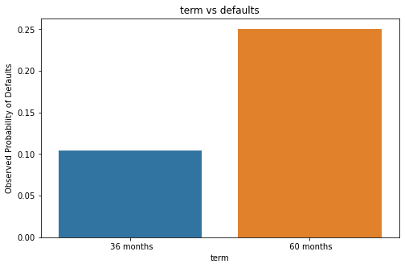
Conclusion 1
“term” is a strong driver variable of default
At least 1 out of 4 loans (25%) in “60 months” end up defaulting
This helps the company to manage their portfolio by not allocating a high number of loans in the high risk “60 month” category

Slide 3
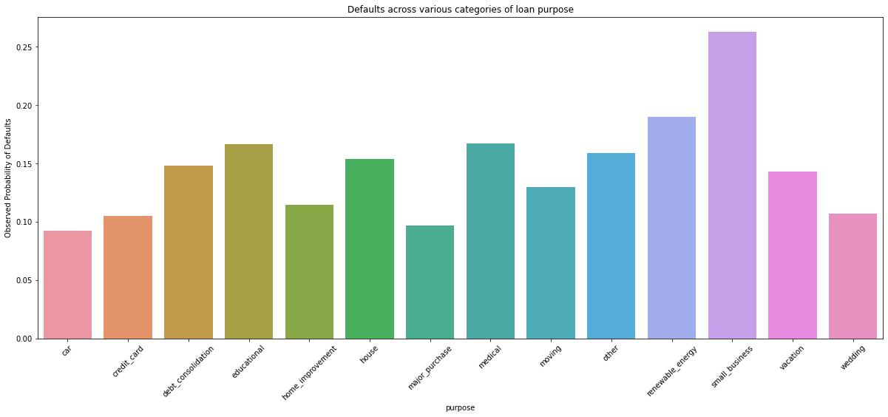
Conclusion 2
“purpose” is a strong driver variable of default
Ex: at least 1 out of 4 loans (>25%) in “small business” end up defaulting
This helps the company to manage their portfolio by not allocating a high number of loans in the high risk “purpose” categories like “small business”, “renewable energy”.

Slide 4
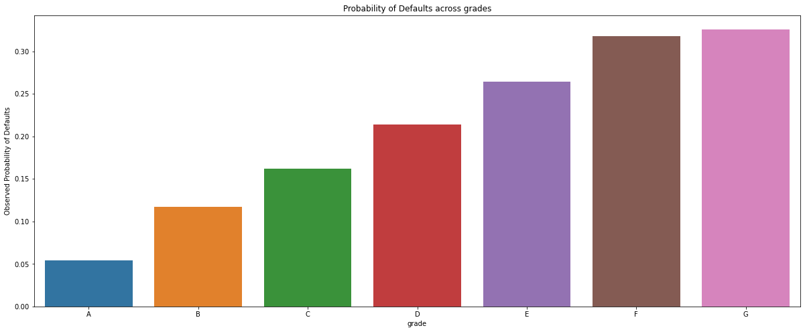
Conclusion 3
“grade” is a strong driver variable of default
Ex: more than 30% of loans in grade G & F end up defaulting
This helps the company to manage their portfolio by not allocating a high number of loans in the high risk “grade” categories like “G”, “F”

Slide 5
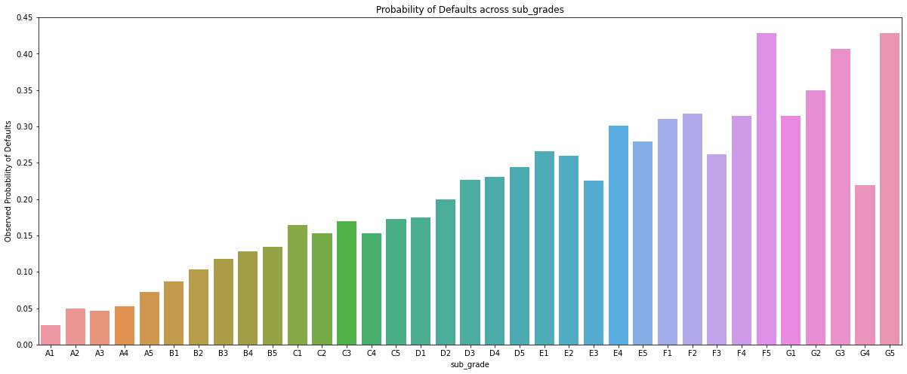
Conclusion 4
“sub_grade” is a strong variable of default
Ex: more than 40% of loans in “F5” & “G5” end up defaulting
This helps the company to manage their portfolio by not allocating a high number of loans in such high risk “sub_grade” categories

Slide 6
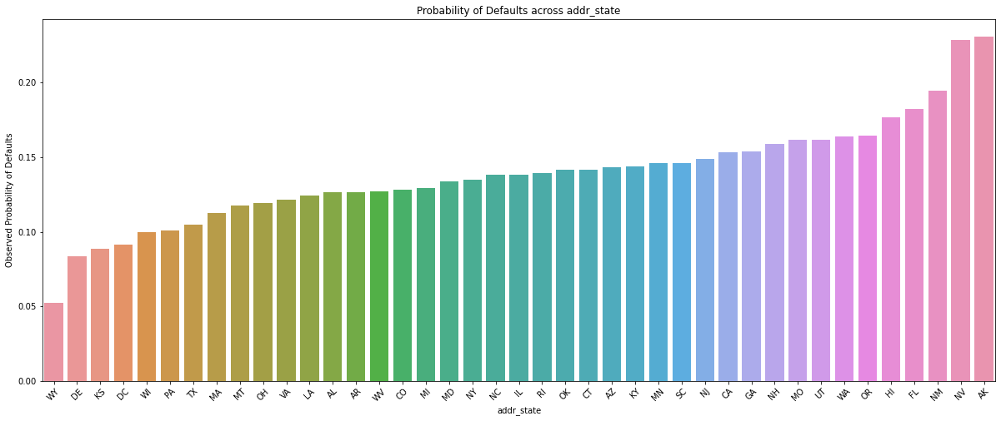
Conclusion 5
“addr_state” is a strong variable of default
Ex: more than 20% of loans in “NV” & “AK” end up defaulting
This helps the company to manage their portfolio by not allocating a high number of loans in such high risk “addr_state” categories

Slide 7
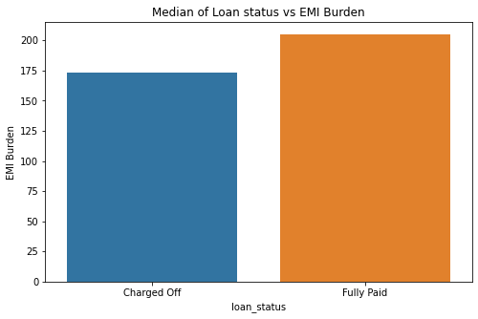
Conclusion 6
Business Driven Metric – EMI_BURDEN
Defined as the ratio of “annual_inc” to “installment”. It tries to quantify the ability to handle the burden of installments.
The medians of the calculated emi_burden are ”175” & “200” for “Charged Off & “Fully Paid” respectively.
Fully paid loans have much higher emi_burden values than that of defaults
This derived metric helps in predicting defaults at the time of approval
Note: The metric must be used with caution. An increase/decrease in “annual_inc” during the term can greatly affect its importance

Slide 8
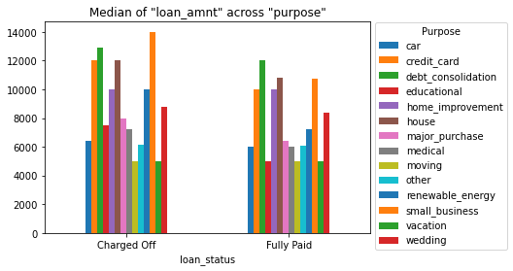
Conclusion 7
Defaulters have significantly higher “loan_amnt” for “purpose” – “small_business”, “credit_card”, “renewable_energy” categories
This helps the company to manage their portfolio by not approving loans of higher “loan_amnt” among such categories

Slide 9
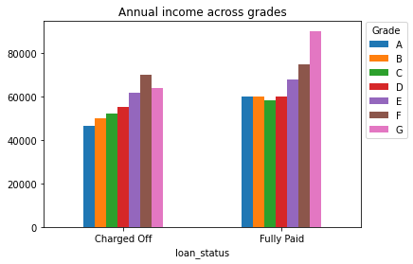
Conclusion 8
Among loans in grade “G”, “defaulters” have significantly lesser “annual_inc” compared to the ones who have “Fully Paid”
This potentially means that the company must consider higher values of “annual_inc” for approval of loans among applicants of grade “G”

Slide 10
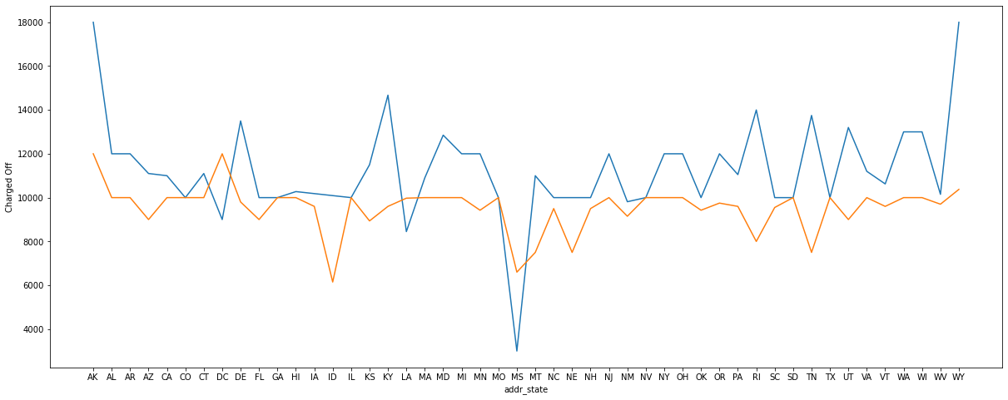
Conclusion 6
The fig shows median “loan_amnt” across “addr_state” categories, segmented by “loan_status”
Ex: “loan_amnt” in the state “WY” has the following medians:
“Default” : 180000, “Fully Paid” : 10375
The data can be used as Recommended “loan_amnt” for consideration of approval with a certain threshold
Ex: For the state “WY”, the loan could be rejected if ”loan_amnt” is outside the 1.5 * IQR range.
# change this chart

Slide 11
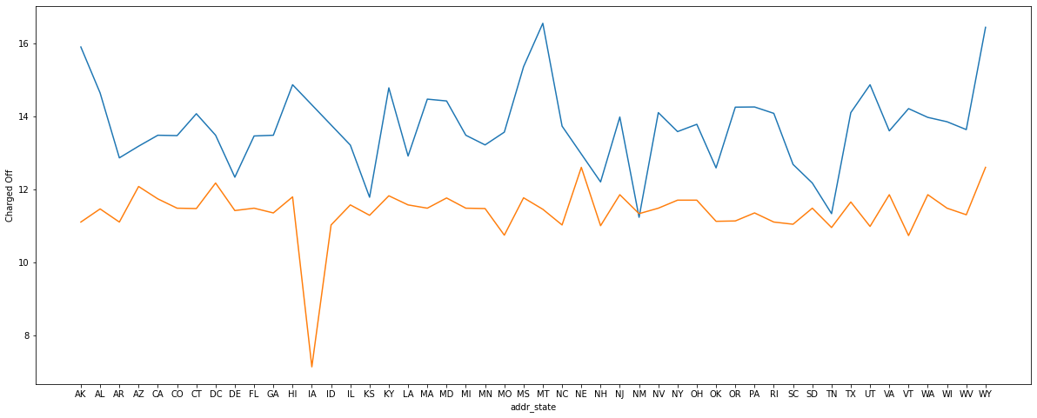
Conclusion 7:
The fig shows the “int_rate” across “addr_state” categories, segmented by “loan_status”
Ex: “int_rate” in the state “WY” has the following medians:
“Default” : 16.45, “Fully Paid” : 12.61
The company can use this data to determine the range of “int_rate” for each state and thereby increase the overall success rate of the loans.

Slide 12
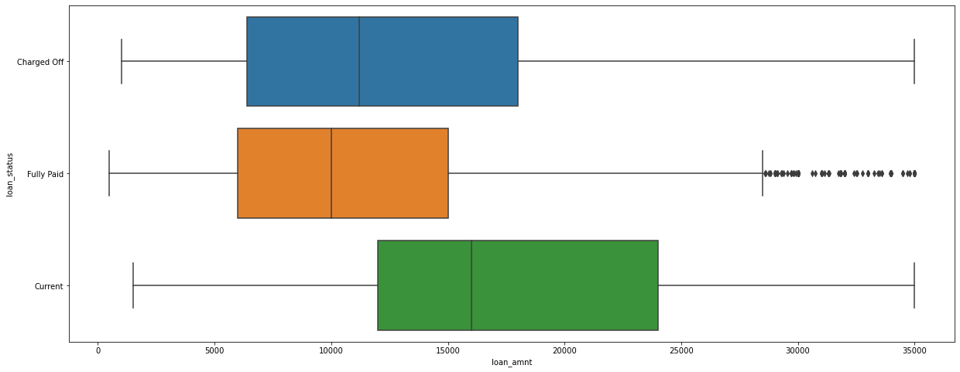
Loan_amnt

Slide 13
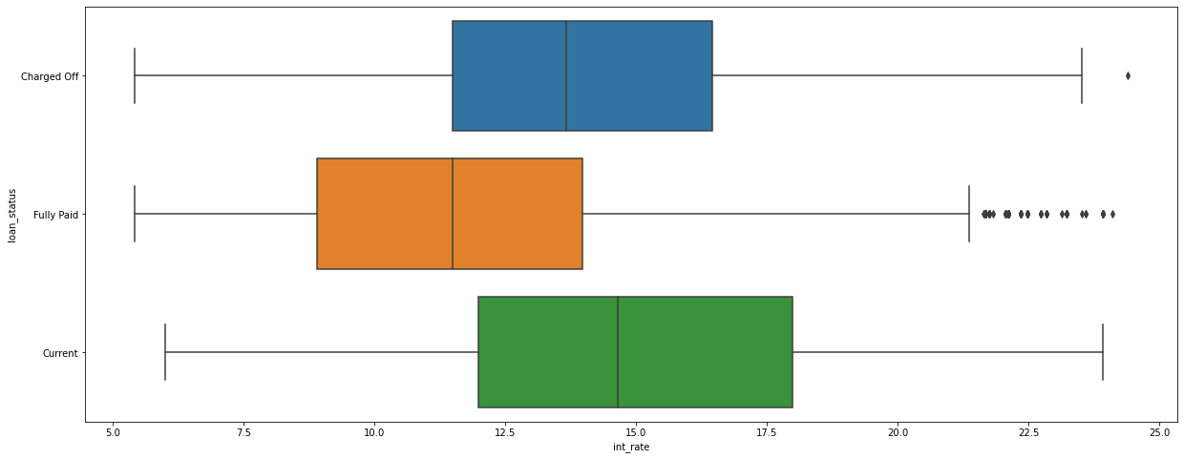
Int_rate

