Slide 1
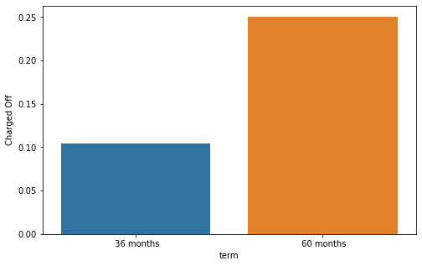
Conclusion 1
The fig shows the chances of default across the “term” categories
Ex: at least 1 out of 4 loans (25%) in “60 months” end up defaulting
This helps the company to manage their portfolio by not allocating a high number of loans in the high risk “60 month” category

Slide 2
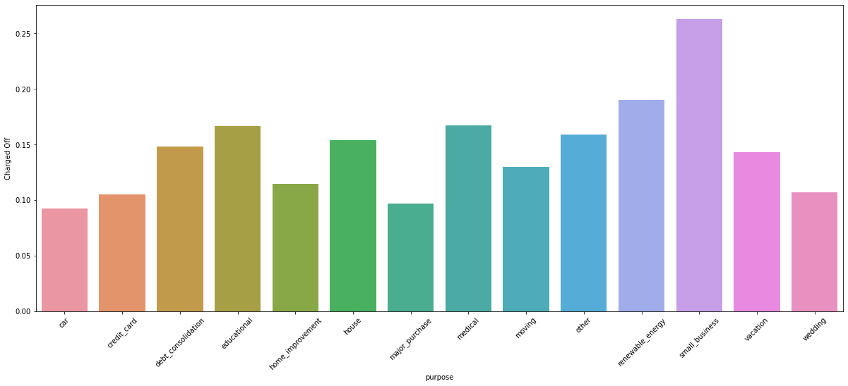
Conclusion 2
The fig shows the chances of default across the “purpose” categories
Ex: at least 1 out of 4 loans (>25%) in “small business” end up defaulting
This helps the company to manage their portfolio by not allocating a high number of loans in the high risk “purpose” categories like “small business”, “renewable energy”.

Slide 3
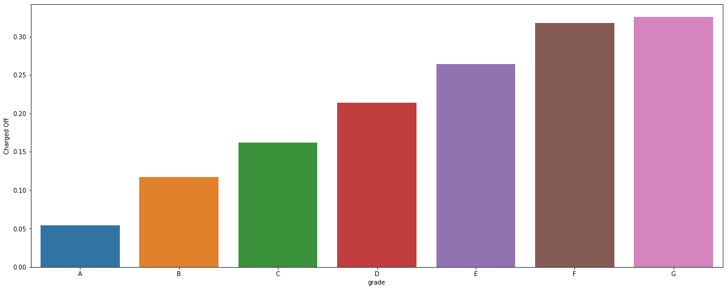
Conclusion 3
The fig shows the chances of default across the “grade” categories
Ex: more than 30% of loans in grade G end up defaulting
This helps the company to manage their portfolio by not allocating a high number of loans in the high risk “grade” categories like “G”, “F”

Slide 4
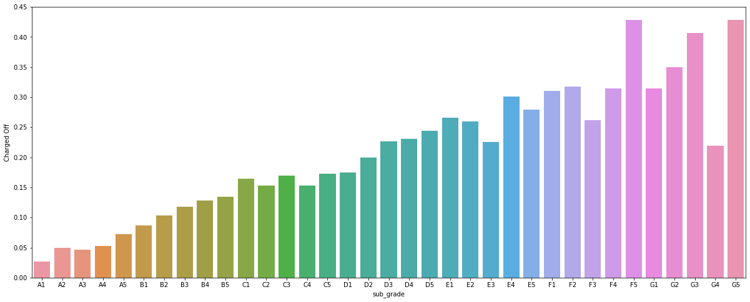
Conclusion 4
The fig shows the chances of default across the “sub_grade” categories
Ex: more than 40% of loans in “F5” & “G5” end up defaulting
This helps the company to manage their portfolio by not allocating a high number of loans in such high risk “sub_grade” categories

Slide 5
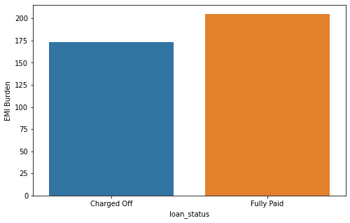
Conclusion 5
Business Driven Metric – EMI_BURDEN
The medians of the calculated emi_burden are ”173” & “205” for “Charged Off & “Fully Paid” respectively.
Fully paid loans have much higher emi_burden values than that of defaults
This derived metric helps in predicting defaults at the time of approval
Note: The metric must be used with caution. An increase/decrease in “annual_inc” during the term can greatly affect its importance

Slide 6
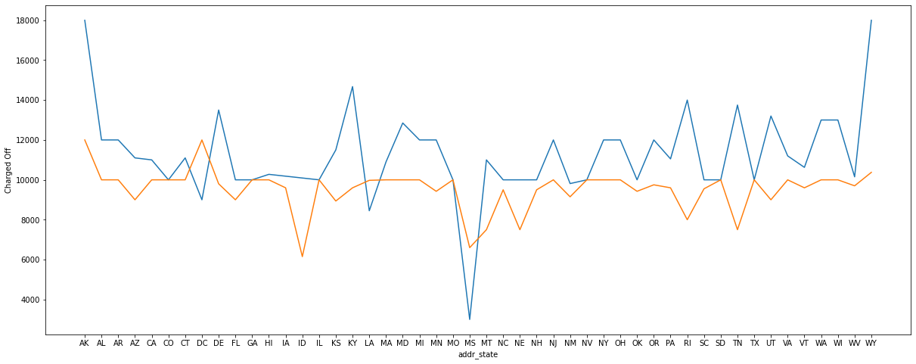
Recommendation 1:
The fig shows median “loan_amnt” across “addr_state” categories, segmented by “loan_status”
Ex: “loan_amnt” in the state “WY” has the following medians:
“Default” : 180000, “Fully Paid” : 10375
The data can be used as Recommended “loan_amnt” for consideration of approval with a certain threshold
Ex: For the state “WY”, and a threshold of 10%,
Acceptable “loan_amnt” = 10375 + 10% of 10375

Slide 7
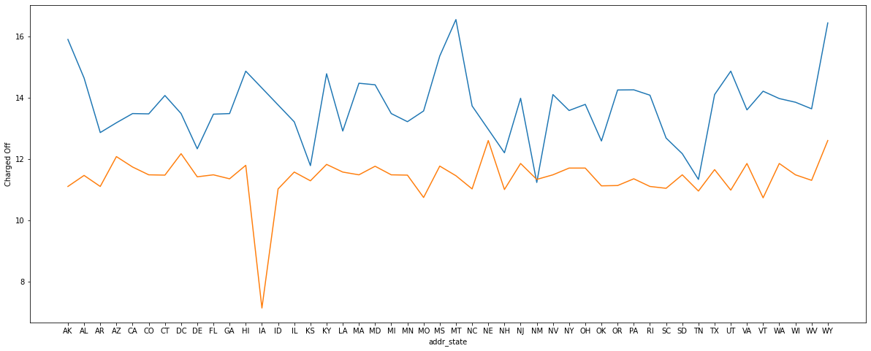
Recommendation 2:
The fig shows the “int_rate” across “addr_state” categories, segmented by “loan_status”
Ex: “int_rate” in the state “WY” has the following medians:
“Default” : 16.45, “Fully Paid” : 12.61
The company can use this data to determine “int_rate” for each state and thereby increase the overall success rate of the loans.

Slide 8
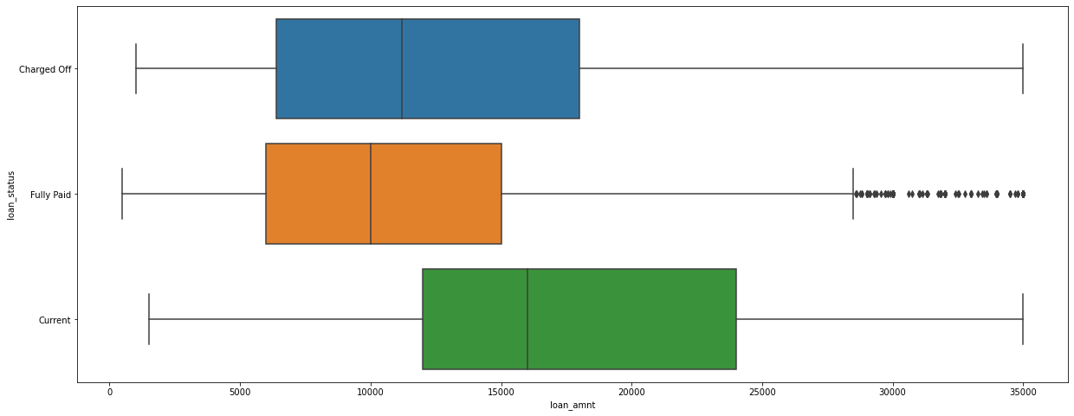
Loan_amnt

Slide 9
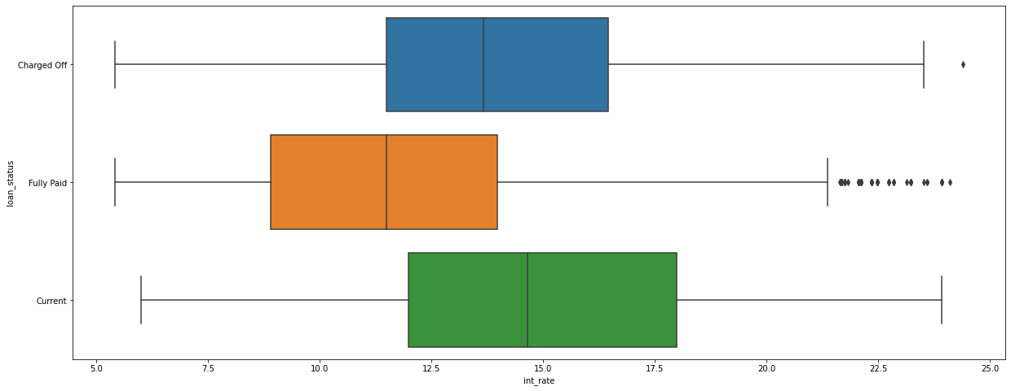
Int_rate

