Slide 1
Note:
If the presentation is viewed via the GitHub browser, please click on “More Pages” at the end of page 5, to view all the pages & conclusions

Slide 2
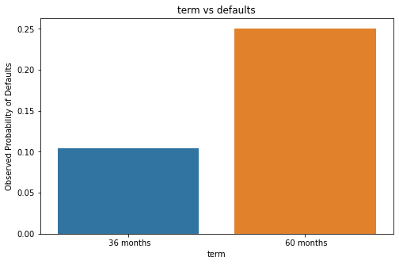
Conclusion 1
“term” is a strong driver variable of default
At least 1 out of 4 loans (25%) in “60 months” end up defaulting
This helps the company to manage their portfolio by not allocating a high number of loans in the high risk “60 month” category

Slide 3
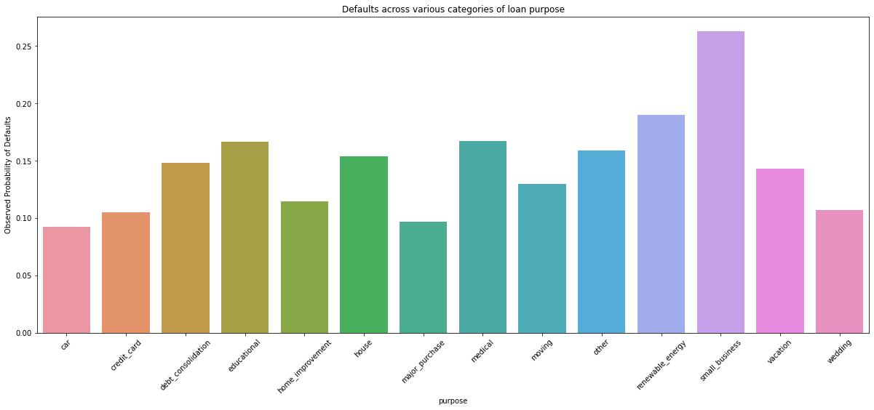
Conclusion 2
“purpose” is a strong driver variable of default
Ex: at least 1 out of 4 loans (>25%) in “small business” end up defaulting
This helps the company to manage their portfolio by not allocating a high number of loans in the high risk “purpose” categories like “small business”, “renewable energy”.

Slide 4
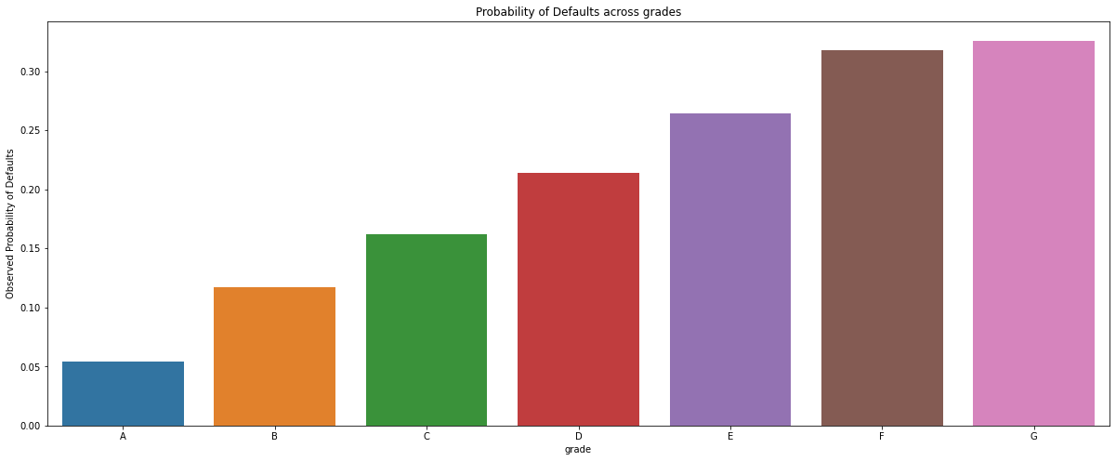
Conclusion 3
“grade” is a strong driver variable of default
Ex: more than 30% of loans in grade G & F end up defaulting
This helps the company to manage their portfolio by not allocating a high number of loans in the high risk “grade” categories like “G”, “F”

Slide 5
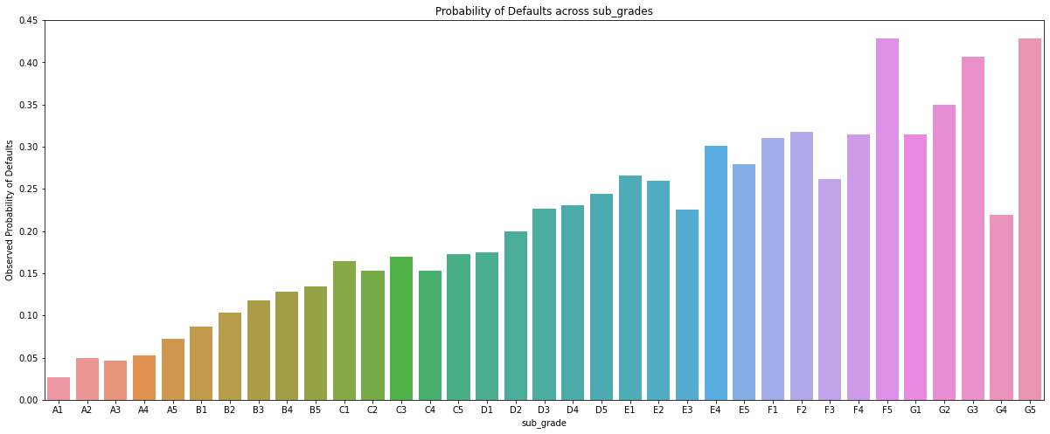
Conclusion 4
“sub_grade” is a strong variable of default
Ex: more than 40% of loans in “F5” & “G5” end up defaulting
This helps the company to manage their portfolio by not allocating a high number of loans in such high risk “sub_grade” categories

Slide 6
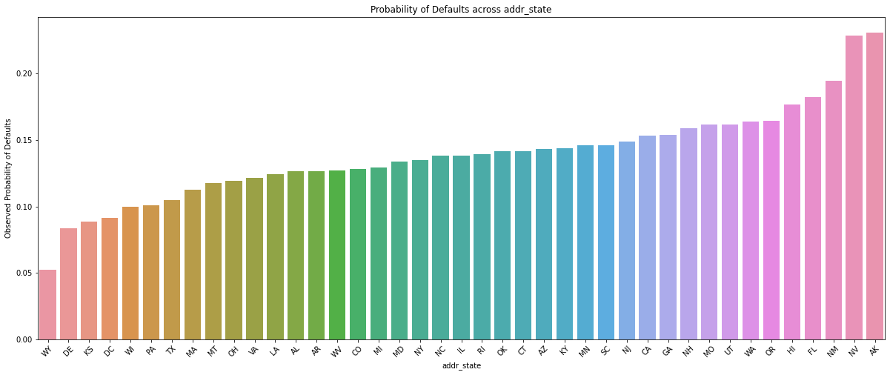
Conclusion 5
“addr_state” is a strong variable of default
Ex: more than 20% of loans in “NV” & “AK” end up defaulting
This helps the company to manage their portfolio by not allocating a high number of loans in such high risk “addr_state” categories

Slide 7
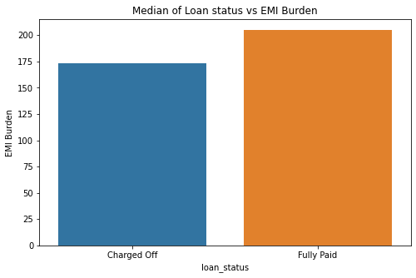
Conclusion 6
Business Driven Metric – EMI_BURDEN
Defined as the ratio of “annual_inc” to “installment”
The medians of the calculated emi_burden are ”173” & “205” for “Charged Off & “Fully Paid” respectively.
Fully paid loans have much higher emi_burden values than that of defaults
This derived metric helps in predicting defaults at the time of approval
Note: The metric must be used with caution. An increase/decrease in “annual_inc” during the term can greatly affect its importance

Slide 8
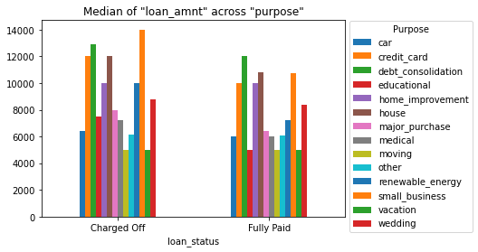
Conclusion 7
Defaulters have significantly higher “loan_amnt” for “purpose” – “small_business”, “credit_card”, “renewable_energy” categories
This helps the company to manage their portfolio by not approving loans of higher “loan_amnt” among such categories

Slide 9
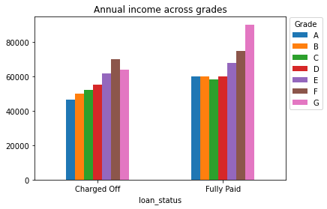
Conclusion 8
Among loans in grade “G”, “defaulters” have significantly lesser “annual_inc” compared to the ones who have “Fully Paid”
This potentially means that the company must consider higher values of “annual_inc” for approval of loans among applicants of grade “G”

Slide 10
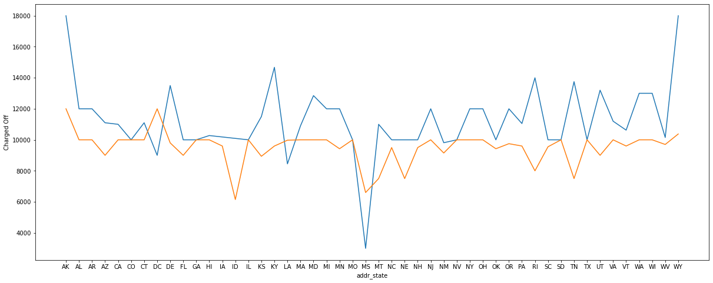
Conclusion 6
The fig shows median “loan_amnt” across “addr_state” categories, segmented by “loan_status”
Ex: “loan_amnt” in the state “WY” has the following medians:
“Default” : 180000, “Fully Paid” : 10375
The data can be used as Recommended “loan_amnt” for consideration of approval with a certain threshold
Ex: For the state “WY”, the loan could be rejected if ”loan_amnt” is outside the 1.5 * IQR range.
# change this chart

Slide 11
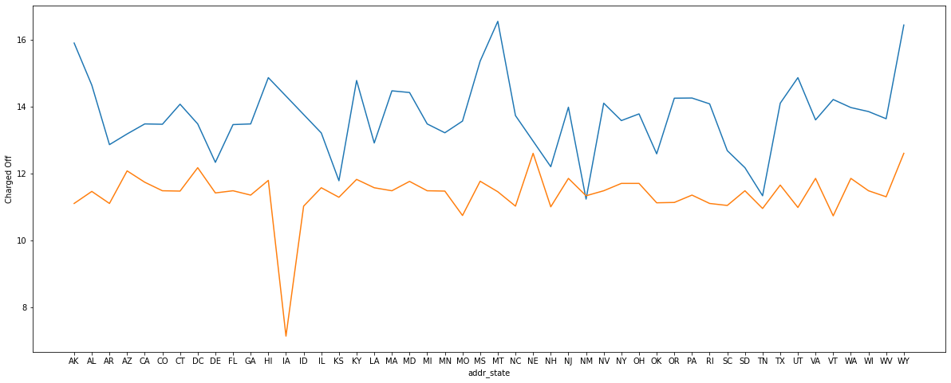
Conclusion 7:
The fig shows the “int_rate” across “addr_state” categories, segmented by “loan_status”
Ex: “int_rate” in the state “WY” has the following medians:
“Default” : 16.45, “Fully Paid” : 12.61
The company can use this data to determine the range of “int_rate” for each state and thereby increase the overall success rate of the loans.

Slide 12
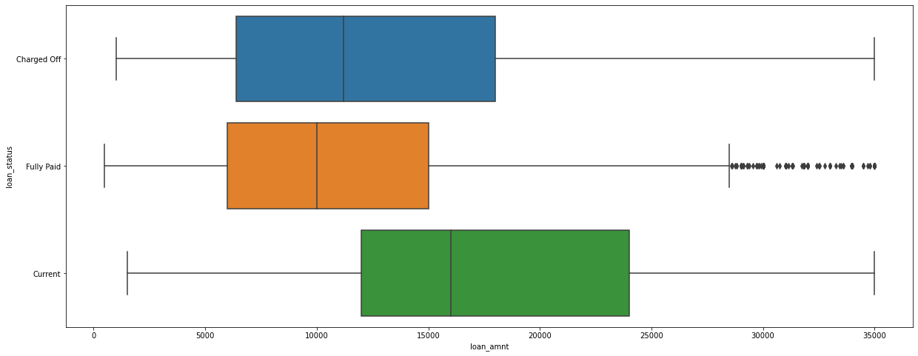
Loan_amnt

Slide 13
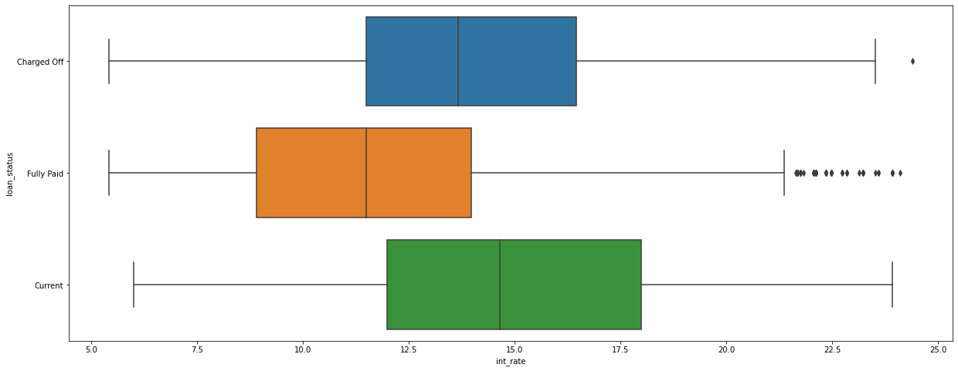
Int_rate

