Slide 2
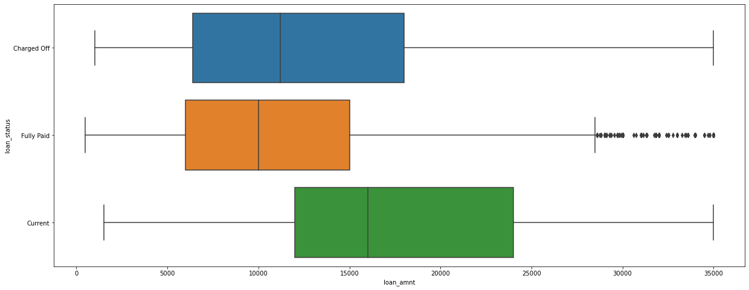
Loan_amnt

Slide 3
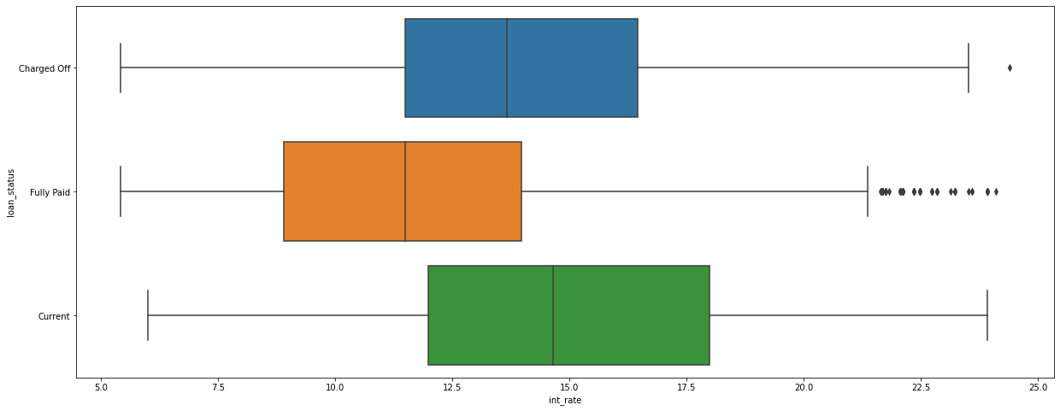
Int_rate

Slide 4
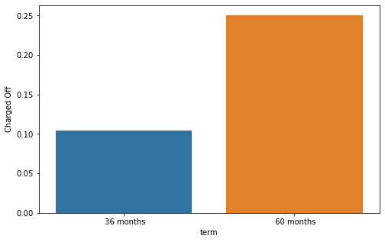
Conclusion
The fig shows the chances of default across the “term” categories
For Ex: at least 1 out of 4 loans (>25%) in “60 months” end up defaulting
This helps the company to manage their portfolio by not allocating a high number of loans in the high risk “term” categories

Slide 5
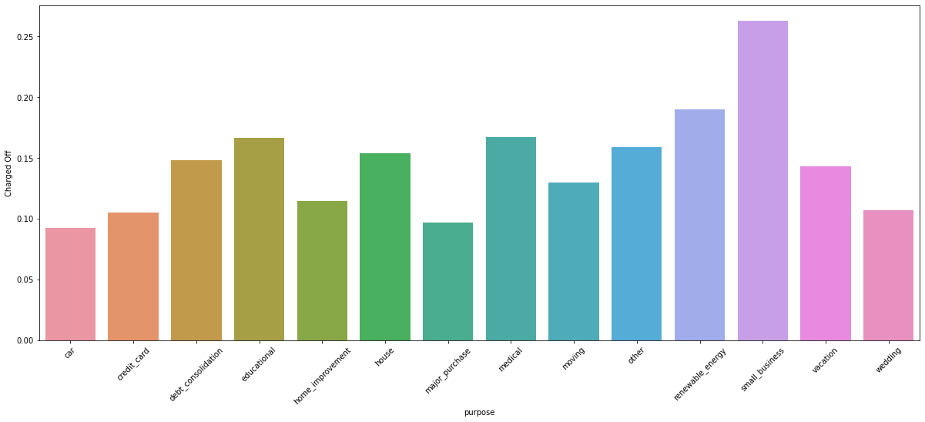
Conclusion
The fig shows the chances of default across the “purpose” categories
For Ex: at least 1 out of 4 loans (>25%) in “small business” end up defaulting
This helps the company to manage their portfolio by not allocating a high number of loans in the high risk “purpose” categories

Slide 6
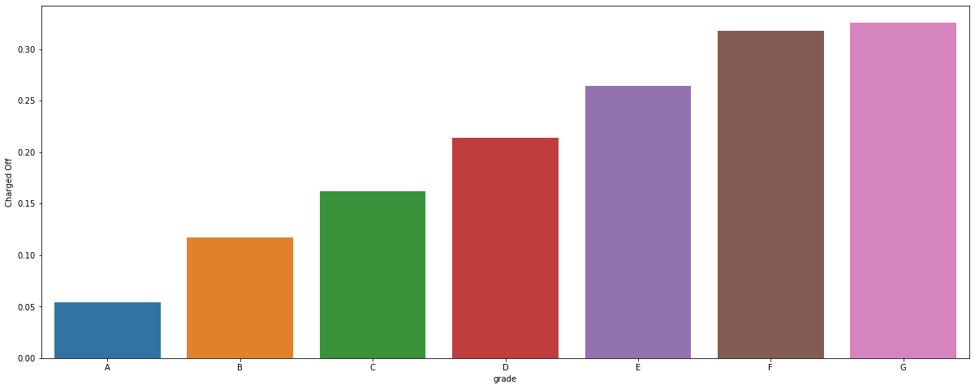
Conclusion
The fig shows the chances of default across the “grade” categories
For Ex: more than 30% of loans in grade G end up in defaulting
This helps the company to manage their portfolio by not allocating a high number of loans in the high risk “grade” categories

Slide 7
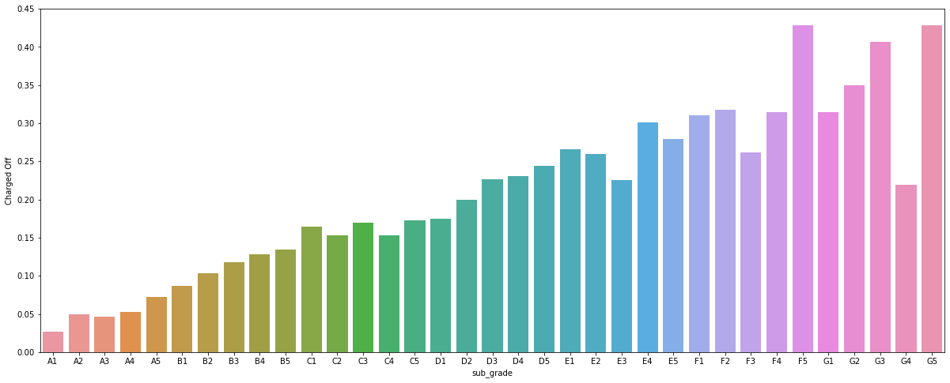
Conclusion
The fig shows the chances of default across the “sub_grade” categories
For Ex: more than 40% of loans in sub_grade F5 & G5 end up in defaulting
This helps the company to manage their portfolio by not allocating a high number of loans in the high risk “sub_grade” categories

Slide 8
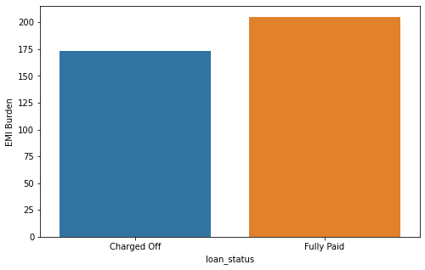
Conclusion
Business Driven Metric – EMI_BURDEN
The medians of the calculated emi_burden are ”173” & “205” for “Charged Off & “Fully Paid” respectively.
Fully paid loans have much higher emi_burden values than that of defaults
The derived metric helps in predicting defaults at the time of approval
Note: The metric must be used with caution. An increase/decrease in annual_inc during the term can greatly affect its importance

Slide 9
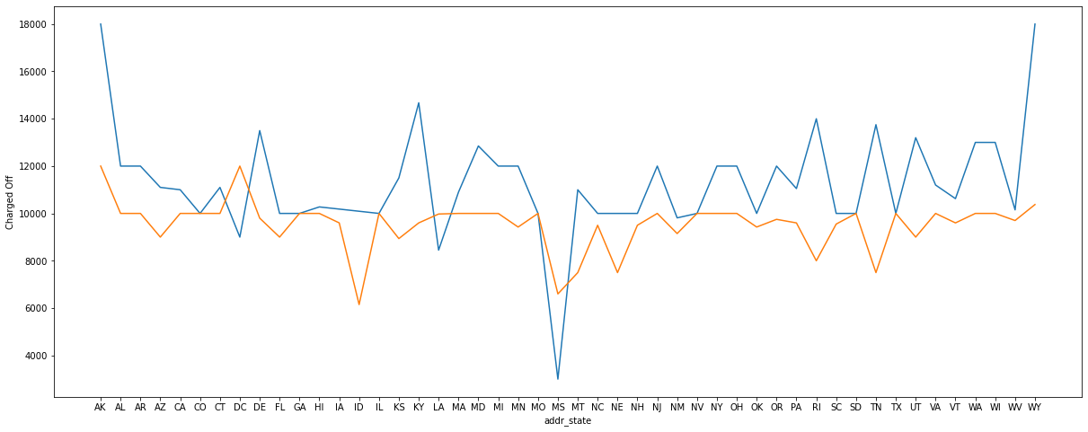
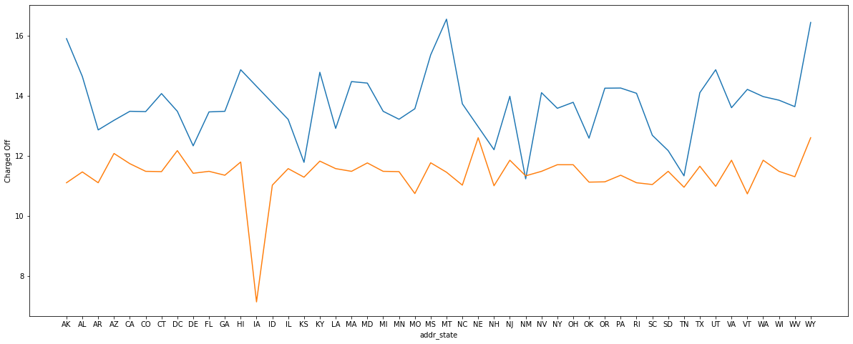
Loan_amnt/int_rate across addr_state

