Slide 1
Chat Platform with JADE
Sai Krishna Kalyan

Slide 2
Overview
Introduction
JADE Platform
Android Platform
Architecture
Practical Demonstration

Slide 3
Jade Platform
Architecture
Agent Behavior
FIPA Standards
API

Slide 4
Android Platform
Applications intended to run in an Android environment are fully written in Java.
JadeAndroid will be used to develop this chat application which can be downloaded from the JADE website.

Slide 5
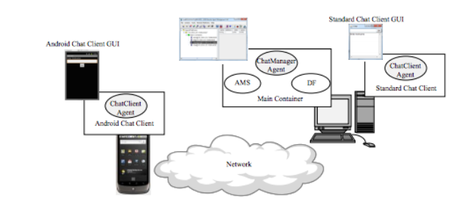
Architecture

Slide 6
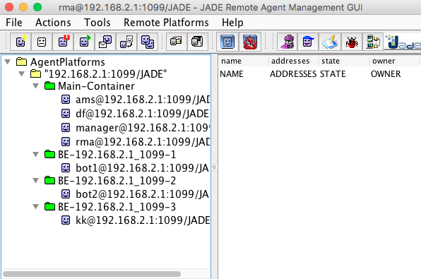
Practical Demonstration

Slide 7
Thank you for your attention

