Slide 2




Introduction
A Liquid Crystal Display (LCD) is a thin , flat panel display device used for electronically displaying information such as text ,images and moving picture.
LCD is used in Computer monitors, Televisions , Instrument panels, Gaming devices etc.
Polarization of lights is used here to display objects.

Slide 3
Why LCD ?
Smaller size —LCDs occupy approximately 60 percent less space
than CRT displays an important feature when office space is limited.
Lower power consumption—LCDs typically consume about half the power and emit much less heat than CRT displays.
Lighter weight —LCDs weigh approximately 70 percent less than CRT displays of comparable size.
No electromagnetic fields —LCDs do not emit electromagnetic fields and are not susceptible to them. Thus, they are suitable for use in areas where CRTs cannot be used.
Longer life —LCDs have a longer useful life than CRTs.

Slide 4
Liquid crystals
Liquid crystals are liquid chemicals in a state that has properties between those conventional liquid and solid crystals. That is a liquid crystal may flow like a liquid, but its molecules may be oriented in a crystal like way.
Liquid crystals molecules can be aligned precisely when subjected to electric fields, as like as in the way metal shavings line up in the field of a magnet. When properly aligned, the liquid crystals allow light to pass through.

Slide 5
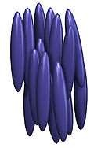
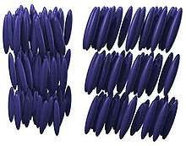
Liquid crystals
Two liquid crystal materials which are important in display technology are nematic and smectic.
Nematic phase
smectic phase

Slide 6
Liquid crystals
The most popular liquid crystal structure is the nematic liquid crystal(NLC). When they are in a nematic phase, liquid crystals are a bit like a liquid: their molecules can move around and shuffle past one another, but they all point in broadly the same direction.
The liquid is normally transparent, but if it is subjected to a strong electric field, ions move through it and disrupt the well ordered crystal structure, causing the liquid to polarise and hence turn opaque. The removal of the applied field allows the crystals structure to reform and the material regains its transparency.

Slide 7
How LCDs work
Liquid crystals can adopt a twisted up structure and when we apply electricity to them, they straighten out again. This is the key how LCD displays turn pixels on and off.
The polarization property of light is used in LCD screen to switch its colored pixels on or off. At the back of the screen, there is a bright light that shines out towards the viewer. In front of this, there are the millions of pixels, each one made up of smaller areas called sub-pixels, that are colored Red, Green, or Blue.

Slide 8

LCD working
Each pixel has a polarizing glass filter behind it and another in front of it at 90 degrees. Normally the pixels looks dark.
In between the two polarizing filters there is a tiny twisted, nematic liquid crystal that can be switched on or off electronically.
When it is switched on, it rotates the light passing through it through 90 degrees, effectively not allowing light to flow through the two polarizing filters and making the pixel look dark.
Each pixel is controlled by a separate transistor that can switch it on or off many times each second.

Slide 9
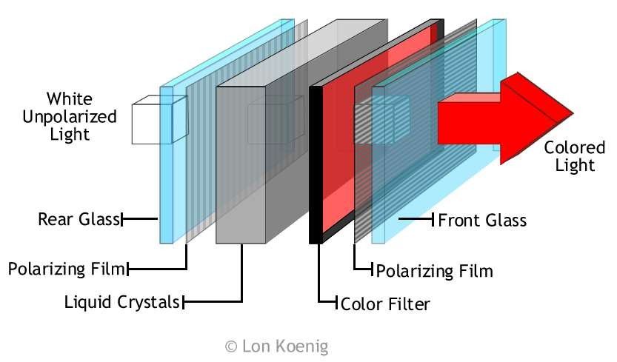
LCD working

Slide 10
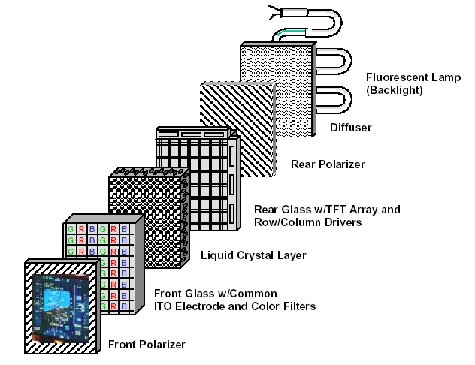
LCD working

Slide 11
Types of LCD
Direct Address Display
Passive Matrix Display
Active Matrix Display

Slide 12
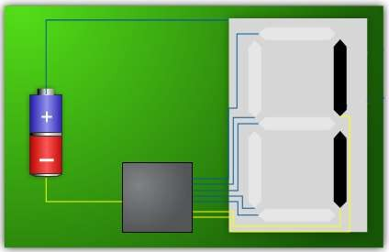
Direct Address Display
When the display include limited variable components such as
Watches
Calculators
Simple electronics is used to control the components

Slide 13
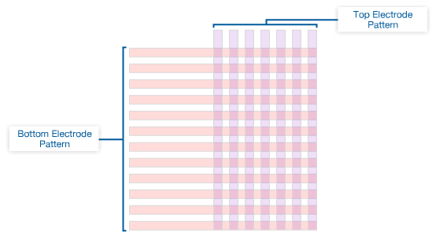
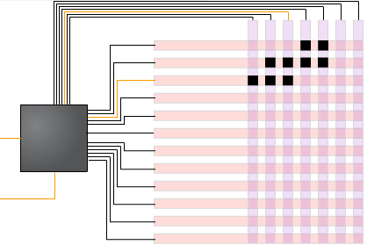
Passive Matrix Display
Passive matrix display has
Rows of electrodes on one piece of glass.
Columns of electrodes on the
opposing piece of glass.
Complex electrical waveform control the voltage differential at the intersection of the electrodes.
The intersection of the columns and rows are the pixels

Slide 14
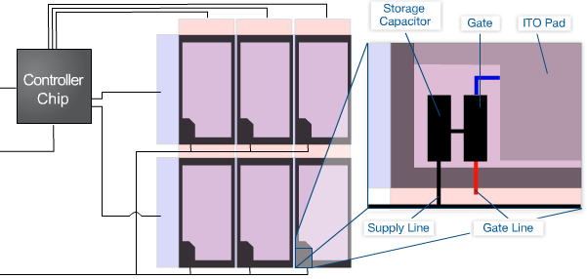
Active Matrix Display
Allow very high resolution
Each sub-pixel is individually controlled by an isolated thin-film transistor (TFT).
It allows the electrical signal for each sub-pixel to avoid influencing adjacent elements.
The TFT is patterned into the glass layer

Slide 15

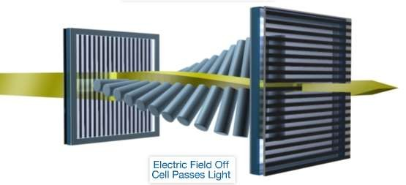
Twisted Nematic (TN) Display
Is the most common LCD Display.
The two alignments layer for the liquid crystal material are orthogonal.
The light entering the polarize panel rotates by the twist in the liquid crystal and allowing it to pass through the second polarize

Slide 16

Disadvantages of Passive Matrix Display
As more rows and columns are added the range of the allowed voltage is reduced.
At high range adjacent channels interferes
Range limit reduces contrast
Limit the types of useful liquid crystal.
It is usually limited to about 50 rows
Twisted nematic (TN) Display work best with large voltage variation.
It can not be used in Passive Matrix Display

Slide 17

Advantage of Active Matrix Display
Higher sizes
Higher contrast
Higher gray scale
Higher resolution
Higher viewing angle
Faster response. Eliminates “ghosting”
Better control of the color

Slide 18
Advantage of Twisted Nematic Display
Shortest response time.
Higher brightness.
They are cheap to manufacture, resulting in low prices for end user.

Slide 19

Refferences
http://en.m.wikipedia.org/wiki/Liquid-crystal_display
http://www.explainstuff.com/lcdtv.html
http://www.slideshare.com
Electronic Instrumentation by H S Kalsi

Slide 20
Thank you

