Slide 1

PROFINCH Internship
Krishnakanth E

Slide 2
Topic: AML and Fraud Detection
Contents
System Overview
Dataset Description
ML Classification
Rule Based Classification
Future Work

Slide 3
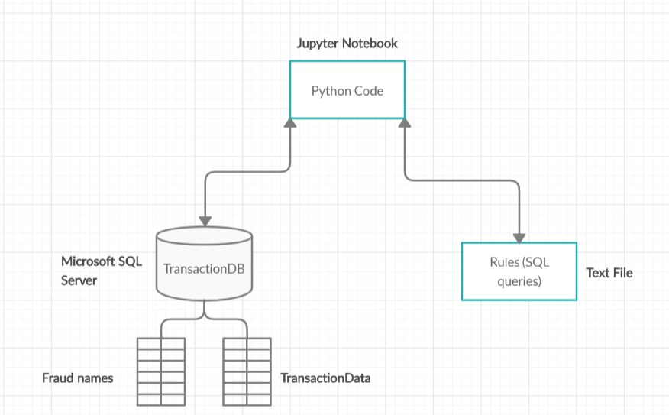
System Overview

Slide 4
Dataset
Generated using mockaroo
Columns generated include:
first_name, last_name, social_security_number, gender, age, country, state, card number, card type, job title, salary
money_withdrawn_amount, money_withdrawn_reason, money_withdrawn_location, money_withdrawn_date, sender_id, receiver_id, amount_transferred, receiver_country, no.of transactions
Target class : Suspicious Activity ( Boolean )
Bolded columns: features used in the rules

Slide 5
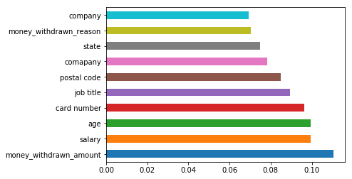
ML Classification
Randomly generated ‘Fraudulent’ column using numpy.random()
Label Encoded the object string columns
Converted money_withdrawn_amount to type float ( originally in dollars )
Train test spilt of 70-30 is done
Classifiers used:
Decision Tree
Logistic Regression ( highest accuracy )
K Nearest Neighbors
Extra Trees
Random Forest

Slide 6
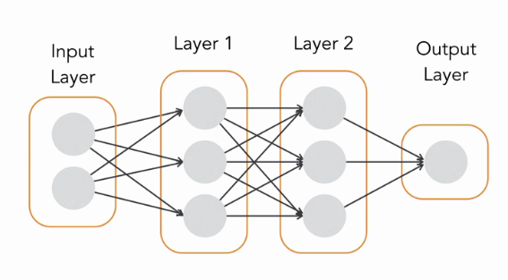
Keras model
Simple keras Sequential model is implemented
One hidden layer model with Relu activation functions and output layer Sigmoid function is used
200 epoch model produced maximum accuracy = 80.00

Slide 7
Rule based classification
Connection to the SQL server is established using
the pyodbc library and rules are written as SQL queries
within a text-file.
The file is read in the notebook and a function is written
to execute the queries in the database.
Suspicious activity is marked accordingly if any
particular transaction satisfies any rule.
The names of people marked suspicious are updated in
the fraud names table.

Slide 8
Rule based classification
Rule1:
Select the rows where the money_withdrawn_amount is greater than
a certain limit ( 25,000 for example)
If this condition satisfies with the following two, this transaction is marked as
suspicious:
The withdrawal takes between 1 AM and 5 AM in the morning.
The withdrawal takes place in a state different than the person’s native
state.

Slide 9
Rule based classification
Rule2:
This rule takes into account the same person making multiple withdrawals on the same day such that the total money taken exceeds the specified limit.
The rule selects the SUM( money_withdrawn_amount ) as well as other columns grouped by the money_withdrawn_date.
The selection is updated as the new transaction table in the database and Rule1 can be run again for finding defaulters.

Slide 10
Rule based classification
Rule3:
This rule considers transaction mapping between multiple senders/receivers.
Example:
Sender | Receiver | Amount
1 | 4 | 100
4 | 5 | 50
7 | 8 | 200
5 | 10 | 50
8 | 11 | 100
Mapping | Total Amount
1 4 5 10 | 200
7 8 11 | 300

Slide 11
Rule based classification
Rule3:
After finding the total amount of the mappings, the rule checks whether the total amount exceeds limit and marks the Suspicious Activity.
Rule4:
This rule checks whether multiple transactions are made just under the maximum amount you can withdrawn in a day.
Rule5:
This rule checks that the money transferred is not to any blacklisted country such as North Korea, Iran, Syria etc.

Slide 12
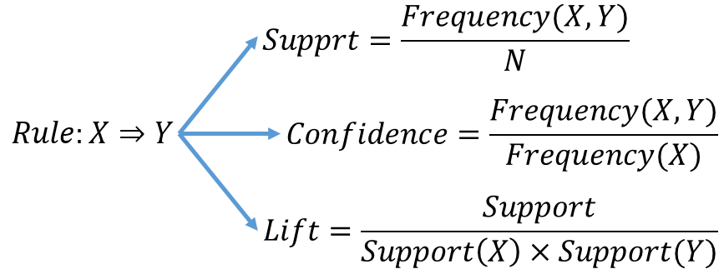
Rule Mining
Association rule mining:-is done to find the most likely antecedents
and consequents after mentioning support and confidence levels.
The idea is to first implement Apriori algorithm which finds the frequent
itemsets in the data. The sets determined can be used to form
association rules highlighting general treads in the data.

Slide 13
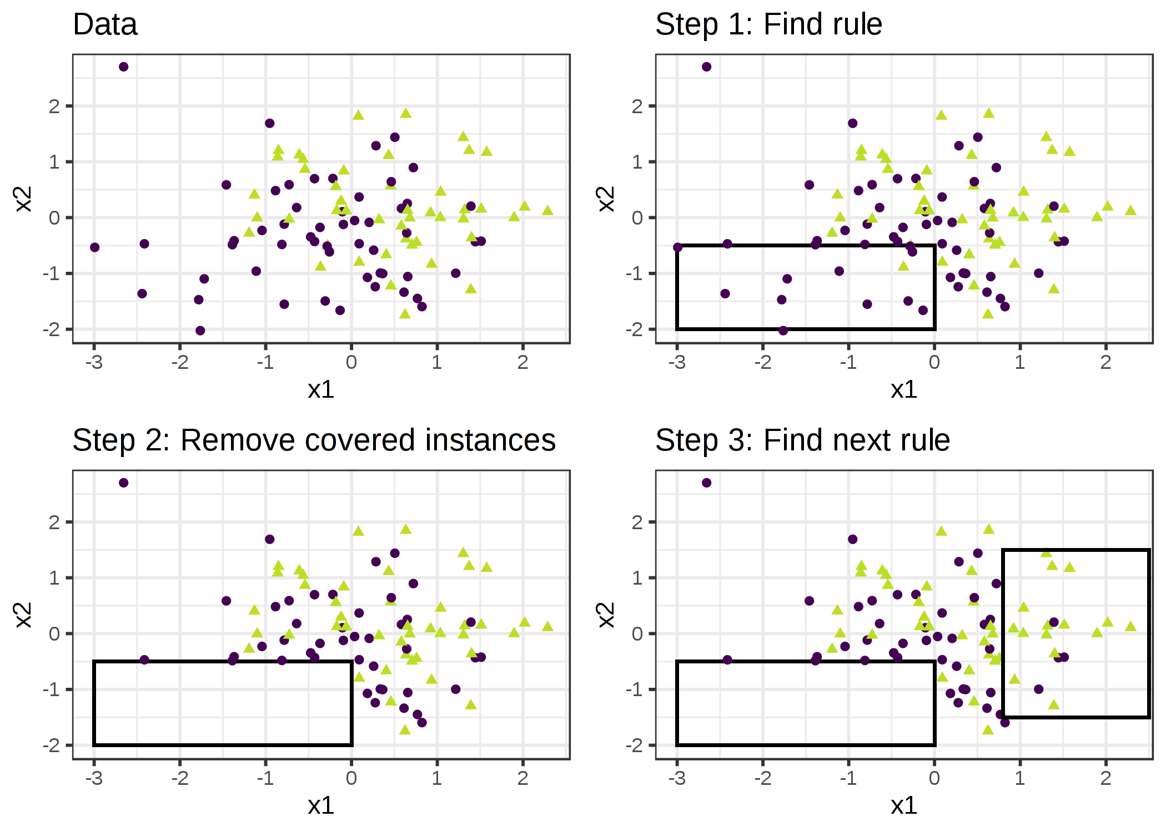
Future Work
Sequential covering algorithm-
It repeatedly learns a single rule to create a decision list that covers the entire dataset rule by rule.

Slide 14
Thank you!

