Slide 1

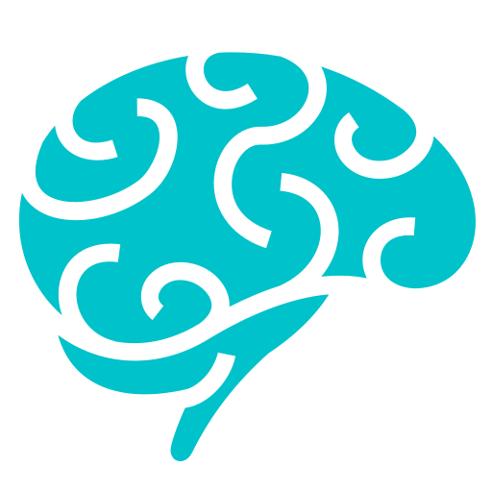
GESTUREX
GestureX
AI Sign Language & Gesture Control System
Using Computer Vision and Machine Learning
Turning hand gestures into sign language text and hands-free computer control — in real time, using just a webcam.
GESTUREX — PROJECT INTRODUCTION
1 / 10
Notes:
Good [morning/afternoon] everyone. I am presenting GestureX, an AI-based Sign Language and Gesture Control System built using Computer Vision and Machine Learning. In one line — GestureX watches a hand through a webcam, understands what it is doing, and turns that into either a recognized sign-language letter or a real command that controls the Windows computer, all in real time. Let's start with the problem this project solves.

Slide 2

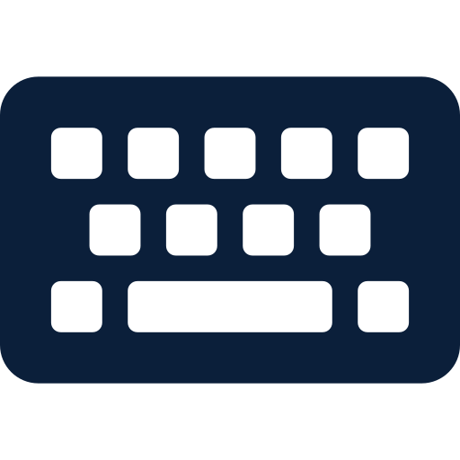


THE WHY
Problem Statement, Motivation & Objectives
PROBLEM & MOTIVATION
MAIN OBJECTIVES
Communication Gap
1
Recognize hand-formed signs / alphabets in real time using a webcam
Sign-language users often struggle to communicate with people who don't know sign language.
2
Enable hands-free control of the computer through hand gestures
Limitations of Traditional Input
Keyboards, mice, and remotes need physical contact and aren't always convenient or accessible.
3
Extract accurate hand-landmark features using MediaPipe
Need for Hands-Free Interaction
Many situations call for controlling a computer without touching any device.
4
Train a reliable Machine Learning model (Random Forest) for classification
Project Motivation
5
Provide a simple, interactive Streamlit interface for both modes
Combine computer vision and ML to bridge this gap using nothing but an ordinary webcam.
6
Map recognized gestures to real Windows actions
GESTUREX — PROBLEM, MOTIVATION & OBJECTIVES
2 / 10
Notes:
There is a real communication gap between sign-language users and people who don't understand sign language. At the same time, traditional input devices like keyboards and mice always need physical contact, which is not always convenient — for example, when hands are busy or a touch-free interface is preferred. This motivated us to build GestureX, a system that uses only a webcam, computer vision, and machine learning to both recognize signs and let users control their computer hands-free. Our main objectives were: real-time sign recognition, hands-free gesture control, accurate landmark extraction using MediaPipe, a reliable Random Forest classifier, an easy-to-use Streamlit interface, and mapping gestures to real Windows actions.

Slide 3










HOW IT WORKS
Proposed System & Architecture
Webcam
MediaPipe
Hands
21 Hand
Landmarks
63
Features
Preprocessing
Random
Forest
Label
Encoder
Prediction
Sign Output / Windows Action
Mode 1 — Sign Language Recognition
Mode 2 — Gesture Control
Converts hand-formed signs into predicted alphabets / signs in real time
Converts hand gestures into real Windows actions instantly
Both modes share the same detection pipeline above — only the trained model and final output differ.
GESTUREX — PROPOSED SYSTEM & ARCHITECTURE
3 / 10
Notes:
This is the complete workflow of GestureX. The webcam captures the video feed, MediaPipe Hands detects the hand and extracts 21 hand landmarks. Each landmark has x, y, z coordinates, giving 63 numeric features. These features are preprocessed and passed to a trained Random Forest model, whose output is converted back into a readable label using a Label Encoder, giving the final prediction. Depending on which mode is active, that prediction becomes either a Sign Output or a Windows Action. GestureX has two independent modes: Sign Language Recognition and Gesture Control — both share the same core pipeline but use separately trained models.

Slide 4





TECH STACK
Technologies & Tools Used
Python
OpenCV
MediaPipe
NumPy
Core programming language
Video capture & image handling
Real-time hand landmark detection
Numerical feature computation
Pandas
Scikit-learn
Random Forest
Joblib
Dataset handling & structuring
ML training utilities
Classification algorithm used
Saving / loading trained models
Streamlit
Streamlit-WebRTC
PyAV
Windows API / ctypes
Interactive web application UI
Real-time webcam streaming in browser
Audio/video stream processing
Sending real keypress/volume actions
GESTUREX — TECHNOLOGIES & TOOLS USED
4 / 10
Notes:
GestureX is built entirely in Python. OpenCV handles webcam video capture, while MediaPipe is the key library that detects the hand in each frame and extracts landmark points. NumPy and Pandas manage the numeric features and datasets, and Scikit-learn provides the tools to train our Random Forest classifier. Trained models are saved and loaded using Joblib. On the interface side, Streamlit — along with Streamlit-WebRTC and PyAV — powers the real-time webcam-based web application. Finally, the Windows API through Python's ctypes module is what lets GestureX actually send real keypress and volume commands to the operating system. The highlighted cards — MediaPipe, Random Forest, Streamlit, and the Windows API — are the four technologies most central to this project.

Slide 5
UNDER THE HOOD
Data Processing & Machine Learning
FROM HAND TO FEATURES
Why Random Forest?
1
Landmark Extraction
MediaPipe detects 21 key points on the hand for every frame.
Handles many numeric features (63) well
2
21 Landmarks × (x, y, z)
Each of the 21 points has 3 coordinates — 21 × 3 = 63 features.
Combines many decision trees for stable, reliable predictions
3
Normalization / Scaling
Coordinates are scaled/preprocessed for consistent, reliable input.
Less prone to overfitting than a single decision tree
4
Label Encoding
Text labels (signs/gestures) are encoded into numeric classes.
Fast to train and fast for real-time prediction
5
Random Forest Training
The 63-feature vectors train a Random Forest classifier.
Works well even with moderately sized datasets
6
Model Saving (Joblib)
Trained model, encoder, and scaler are saved as .pkl files.
GESTUREX — DATA PROCESSING & MACHINE LEARNING
5 / 10
Notes:
For every frame, MediaPipe gives us 21 hand landmarks, and each landmark has an x, y, and z coordinate — so 21 multiplied by 3 gives us 63 numerical features per hand. These features are normalized and preprocessed for consistency, and the sign or gesture labels are converted into numbers using label encoding. This structured, numeric data is what we use to train our Random Forest classifier, and the trained model — along with the label encoder and scaler — is saved using Joblib so it can be reloaded instantly during real-time prediction. We chose Random Forest because it handles a moderate number of numeric features very well, combines many decision trees for more stable and reliable predictions, resists overfitting better than a single tree, and is fast enough for real-time use.

Slide 6

MODE 1
Sign Language Recognition
Camera
Hand
Detection
Landmark
Extraction
63
Features
Preprocessing
Sign Random
Forest
Label
Encoder
Alphabet /
Sign Prediction
MODEL FILES USED
Real-Time Prediction & Confidence
●
random_forest.pkl — trained classifier
Every webcam frame is processed live — no delay for the user
●
label_encoder.pkl — converts predictions to labels
Extracted 63 features are fed to the trained Random Forest model
●
scaler.pkl — feature scaling (if available)
Model outputs the predicted sign along with a confidence score
Output: predicted alphabet / sign shown live on-screen as the user signs in front of the webcam.
Prediction is decoded via Label Encoder into a readable sign/alphabet
Results are displayed instantly on the Streamlit interface
GESTUREX — SIGN LANGUAGE RECOGNITION
6 / 10
Notes:
In Sign Language Recognition mode, the camera captures the hand, MediaPipe detects it and extracts landmarks, and those become 63 features after preprocessing. These features go into the Sign Random Forest model, whose numeric output is converted into a readable alphabet or sign using the Label Encoder. Three model files power this: random_forest.pkl is the trained classifier, label_encoder.pkl converts predictions back to labels, and scaler.pkl handles feature scaling where available. This entire pipeline runs on every single frame in real time, and along with the predicted sign, the system also shows a confidence score so the user knows how certain the model is about its prediction.

Slide 7
MODE 2
Gesture Control & Windows Integration
Gesture | Windows Action
Thumbs Up | Volume Up
Thumbs Down | Volume Down
Fist | Play / Pause
Index Left | Left Arrow
Index Right | Right Arrow
Up | Up Arrow
Down | Down Arrow
OK | Enter
Palm | Palm Detected
No Gesture | No Action
Model Files Used
●
gesture_control_rf.pkl — trained gesture classifier
●
gesture_encoder.pkl — label encoder for gestures
Windows virtual key codes are triggered via Python's ctypes module
Real-Time, Hands-Free Control
Recognized gesture is mapped to a specific Windows action
ctypes sends the equivalent virtual key press to Windows
Media, navigation and system actions run instantly, hands-free
GESTUREX — GESTURE CONTROL & WINDOWS INTEGRATION
7 / 10
Notes:
In Gesture Control mode, the same landmark pipeline feeds a separately trained gesture model — gesture_control_rf.pkl — with its own gesture_encoder.pkl. Each recognized gesture is mapped to a specific Windows action, as shown in this table: for instance, Thumbs Up increases volume, a Fist toggles play/pause, and directional gestures act as arrow keys or Enter. These actions are actually sent to Windows using virtual key codes through Python's ctypes module, so the system isn't just recognizing gestures — it is genuinely controlling the computer hands-free in real time.

Slide 8
IN ACTION
User Interface & Real-Time Working
GestureX — Streamlit Dashboard
FRAME-BY-FRAME WORKING
Sign Language Mode
Gesture Control Mode
1
Capture current webcam frame
PREDICTION
Detect hand & extract 21 landmarks
Sign: 'A'
2
CONFIDENCE
High
3
Convert to 63 numeric features
WINDOWS ACTION
—
4
Predict using trained model
Live Webcam Feed + Hand Landmarks
MODEL LOADED
random_forest.pkl
5
Display sign / trigger Windows action
Dashboard shows: camera feed · landmarks · prediction · confidence · Windows action · loaded model paths
6
Move to the next frame — repeat
GESTUREX — USER INTERFACE & REAL-TIME WORKING
8 / 10
Notes:
GestureX uses a Streamlit-based dashboard with two tabs — Sign Language Mode and Gesture Control Mode. The interface shows the live webcam feed with hand landmarks drawn on it, along with the current prediction, confidence, the Windows action triggered, and which model files are loaded. Internally, the system works frame by frame: it captures a frame, detects the hand and extracts 21 landmarks, converts them to 63 features, runs the prediction, displays the result or triggers the Windows action, and then immediately repeats for the next frame — giving the smooth, real-time experience you see on screen.

Slide 9



WHERE WE STAND
Results, Advantages, Limitations & Future Scope
Results
Advantages
Real-time hand detection
Windows control
Contactless interaction
Low-cost, webcam-based
Sign recognition
Integrated Streamlit UI
Real-time performance
Combines sign recognition + PC control
Gesture recognition
Easy to use
Limitations
Future Scope
Depends on lighting/background
More sign languages
Better datasets
Accuracy depends on training data
More gestures
Deep-learning models
Focused on trained gestures/signs
Two-hand recognition
Voice/text integration
Single-hand operation where applicable
GESTUREX — RESULTS, ADVANTAGES, LIMITATIONS & FUTURE SCOPE
9 / 10
Notes:
In terms of results, GestureX successfully achieves real-time hand detection, sign recognition, gesture recognition, Windows control, and an integrated Streamlit interface bringing everything together. The key advantages are that it is contactless, real-time, easy to use, low-cost since it only needs a webcam, and it combines sign recognition with computer control in one system. That said, there are some limitations — performance can depend on lighting and background, accuracy depends on the quality of training data, the system currently focuses on the trained gestures and signs only, and it operates on a single hand where applicable. Looking ahead, the future scope includes supporting more sign languages, more gestures, two-hand recognition, better datasets, deep-learning-based models, voice or text integration, and more computer-control functions.

Slide 10


CONCLUSION
GestureX brings together Computer Vision and Machine Learning to make interaction more natural.
Computer Vision
Machine Learning
Sign Recognition
Gesture-Based Control
MediaPipe extracts precise hand landmarks in real time
Random Forest classifies signs and gestures accurately
Recognizes hand-formed signs and alphabets live
Turns hand gestures into real Windows actions
Together, these enable smooth real-time interaction — bridging communication gaps and enabling hands-free computer control through a single webcam-based system.
Thank You
Questions & Answers
GESTUREX — CONCLUSION
10 / 10
Notes:
To conclude, GestureX successfully brings together Computer Vision and Machine Learning to make human-computer interaction more natural. Using MediaPipe for precise hand-landmark extraction and a Random Forest model for classification, the system performs real-time sign language recognition and gesture-based Windows control through nothing more than a standard webcam. Together, these features bridge communication gaps for sign-language users and offer a genuinely hands-free way to control a computer. Thank you for your attention — I am happy to take any questions.

