Slide 1
MODERN OPERATING SYSTEMS
Third Edition
ANDREW S. TANENBAUM
Chapter 4
File Systems
Tanenbaum, Modern Operating Systems 3 e, (c) 2008 Prentice-Hall, Inc. All rights reserved. 0-13-6006639

Slide 2
File Systems (1)
Essential requirements for long-term information storage:
It must be possible to store a very large amount of information.
The information must survive the termination of the process using it.
Multiple processes must be able to access the information concurrently.
Tanenbaum, Modern Operating Systems 3 e, (c) 2008 Prentice-Hall, Inc. All rights reserved. 0-13-6006639

Slide 3
File Systems (2)
Think of a disk as a linear sequence of fixed-size blocks and supporting reading and writing of blocks. Questions that quickly arise:
How do you find information?
How do you keep one user from reading another’s data?
How do you know which blocks are free?
Tanenbaum, Modern Operating Systems 3 e, (c) 2008 Prentice-Hall, Inc. All rights reserved. 0-13-6006639

Slide 4
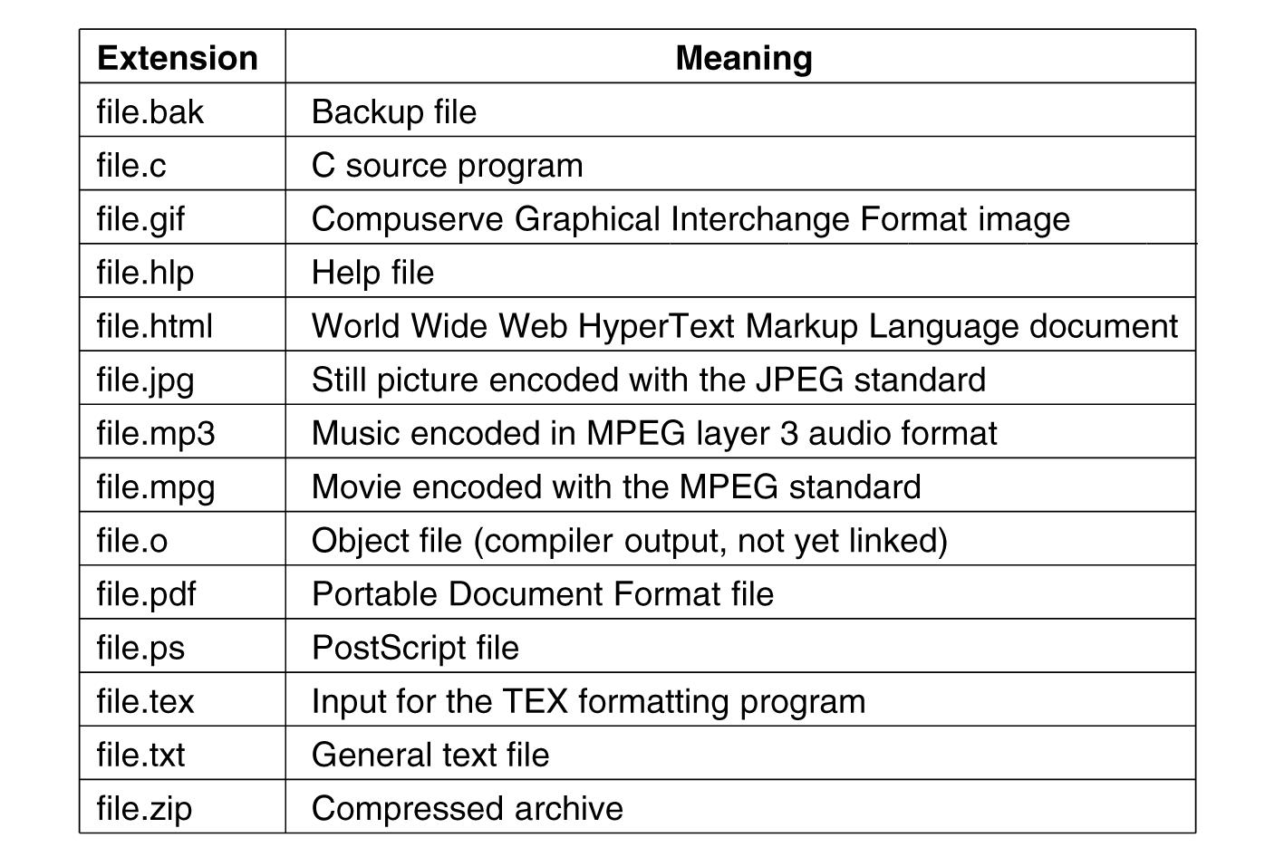
File Naming
Figure 4-1. Some typical file extensions.
Tanenbaum, Modern Operating Systems 3 e, (c) 2008 Prentice-Hall, Inc. All rights reserved. 0-13-6006639

Slide 5
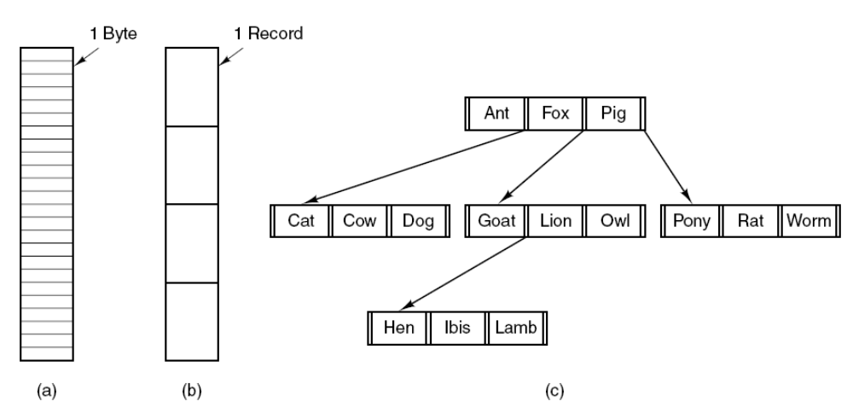
File Structure
Figure 4-2. Three kinds of files. (a) Byte sequence.
(b) Record sequence. (c) Tree.
Tanenbaum, Modern Operating Systems 3 e, (c) 2008 Prentice-Hall, Inc. All rights reserved. 0-13-6006639

Slide 6
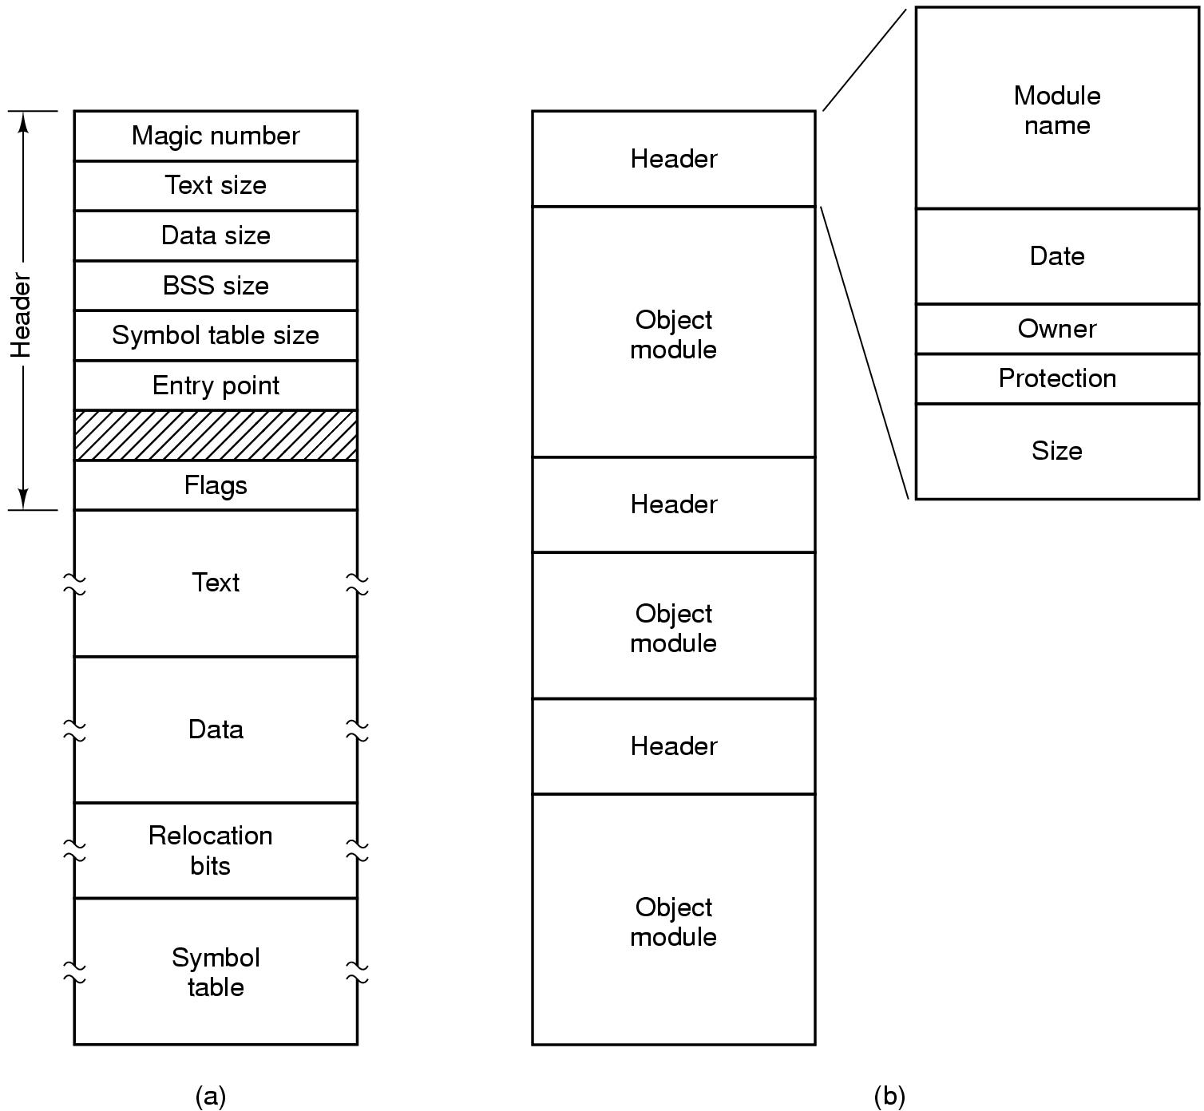
File Types
Figure 4-3. (a) An executable file. (b) An archive.
Tanenbaum, Modern Operating Systems 3 e, (c) 2008 Prentice-Hall, Inc. All rights reserved. 0-13-6006639

Slide 7
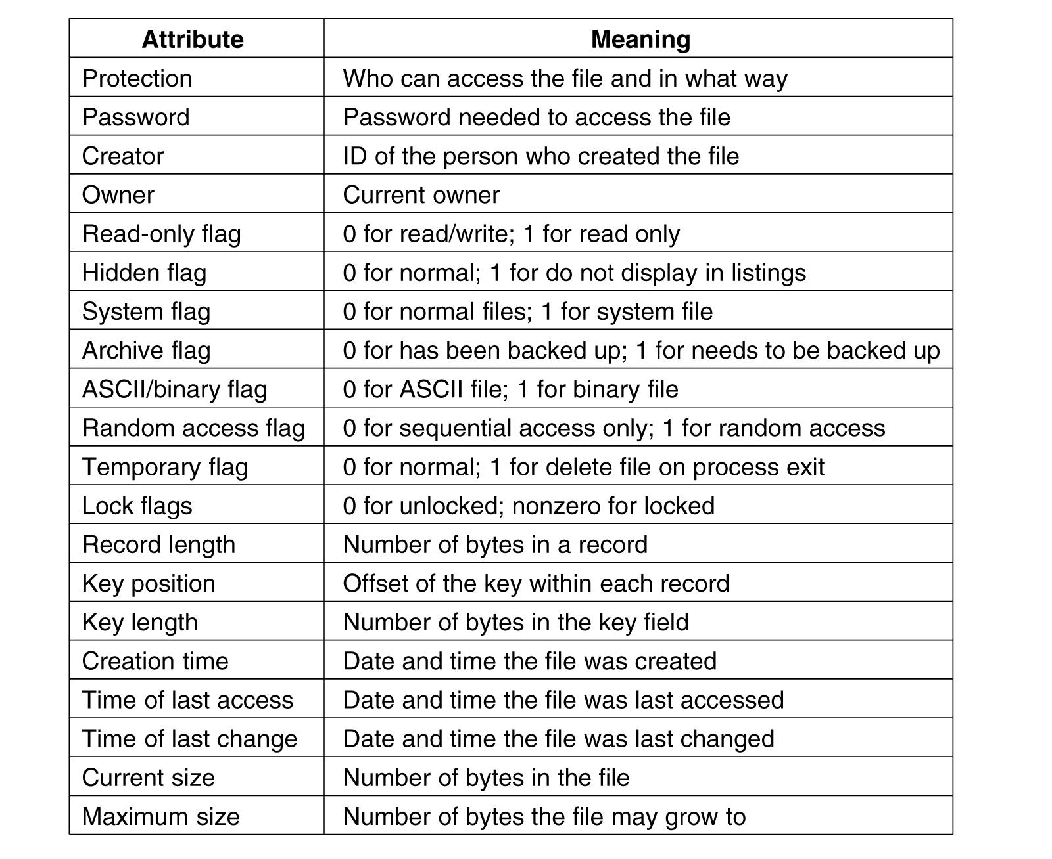
File Attributes
Figure 4-4a. Some possible file attributes.
Tanenbaum, Modern Operating Systems 3 e, (c) 2008 Prentice-Hall, Inc. All rights reserved. 0-13-6006639

Slide 8
File Operations
The most common system calls relating to files:
Create
Delete
Open
Close
Read
Write
Append
Seek
Get Attributes
Set Attributes
Rename
Tanenbaum, Modern Operating Systems 3 e, (c) 2008 Prentice-Hall, Inc. All rights reserved. 0-13-6006639

Slide 9
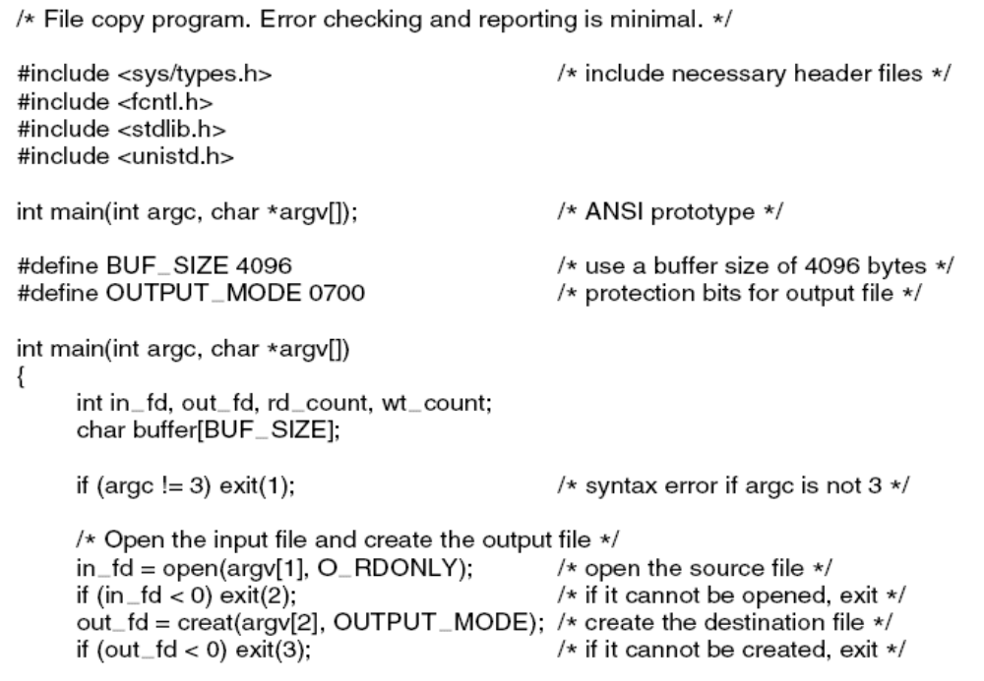
Example Program Using File System Calls (1)
. . .
Figure 4-5. A simple program to copy a file.
Tanenbaum, Modern Operating Systems 3 e, (c) 2008 Prentice-Hall, Inc. All rights reserved. 0-13-6006639

Slide 10
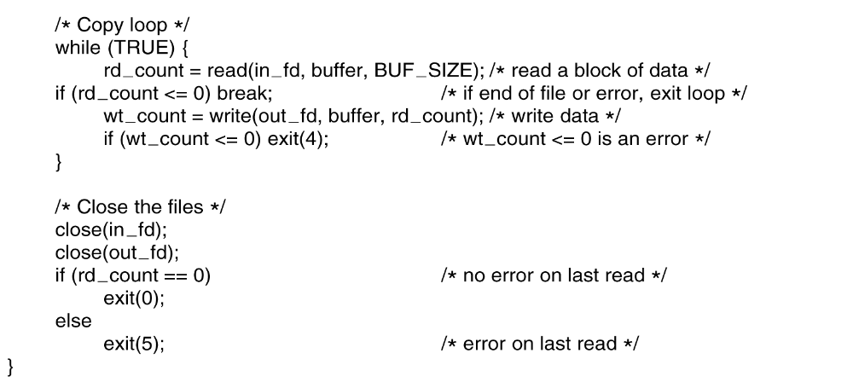
Example Program Using File System Calls (2)
Figure 4-5. A simple program to copy a file.
Tanenbaum, Modern Operating Systems 3 e, (c) 2008 Prentice-Hall, Inc. All rights reserved. 0-13-6006639

Slide 11
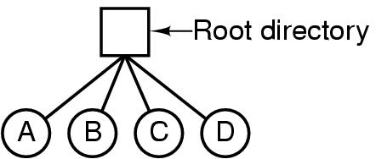
Hierarchical Directory Systems (1)
Figure 4-6. A single-level directory system containing four files.
Tanenbaum, Modern Operating Systems 3 e, (c) 2008 Prentice-Hall, Inc. All rights reserved. 0-13-6006639

Slide 12
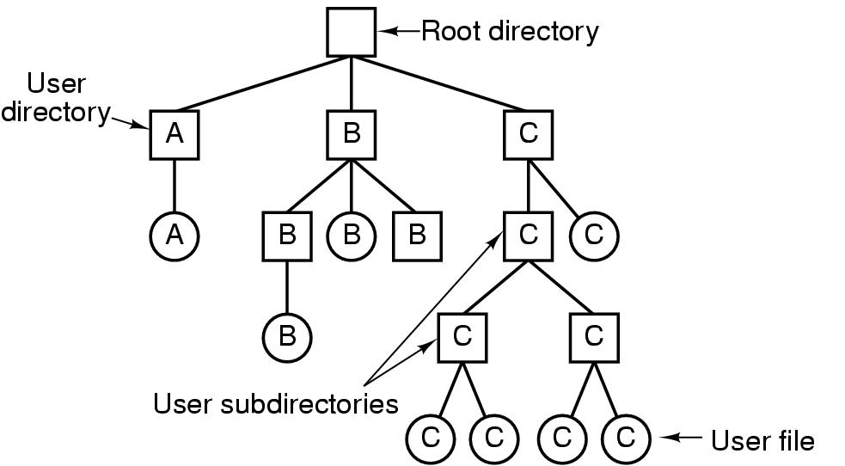
Hierarchical Directory Systems (2)
Figure 4-7. A hierarchical directory system.
Tanenbaum, Modern Operating Systems 3 e, (c) 2008 Prentice-Hall, Inc. All rights reserved. 0-13-6006639

Slide 13
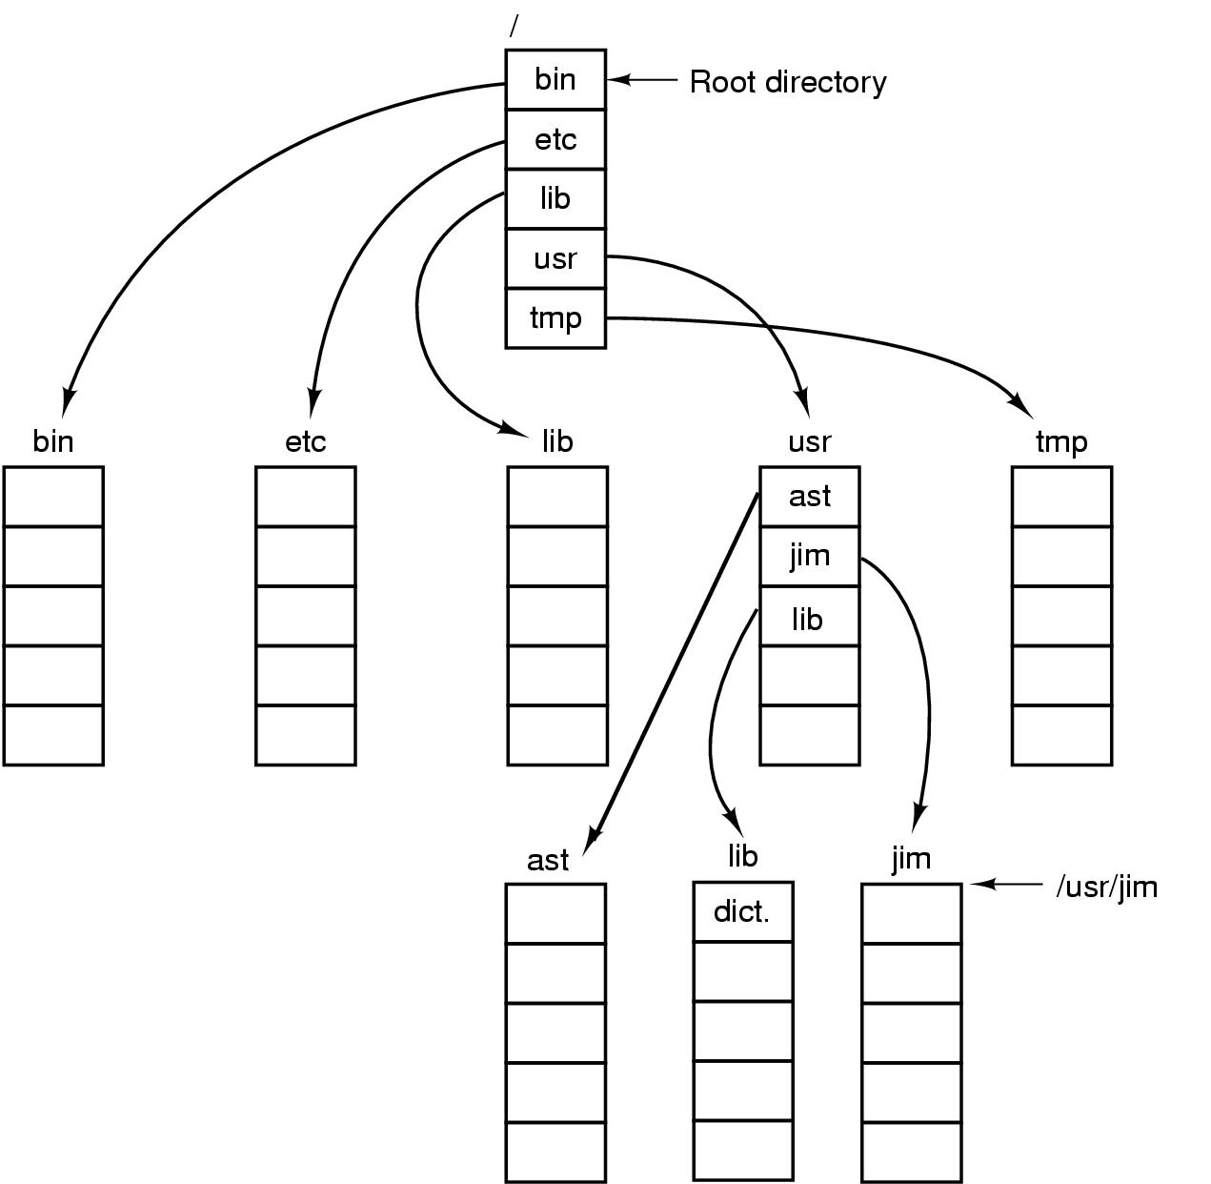
Path Names
Figure 4-8. A UNIX directory tree.
Tanenbaum, Modern Operating Systems 3 e, (c) 2008 Prentice-Hall, Inc. All rights reserved. 0-13-6006639

Slide 14
Directory Operations
System calls for managing directories:
Create
Delete
Opendir
Closedir
Readdir
Rename
Link
Uplink
Tanenbaum, Modern Operating Systems 3 e, (c) 2008 Prentice-Hall, Inc. All rights reserved. 0-13-6006639

Slide 15
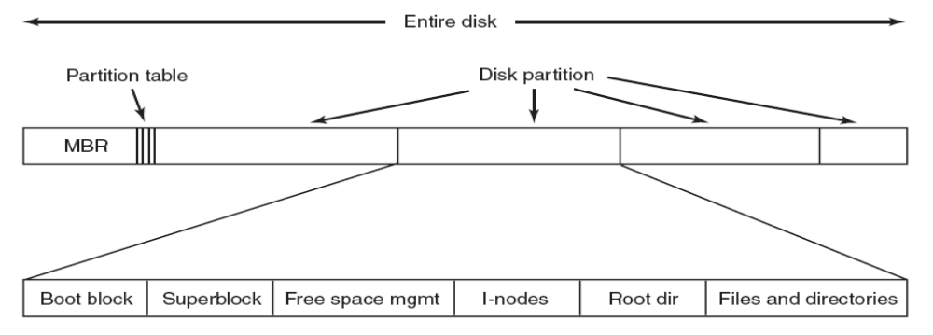
File System Layout
Figure 4-9. A possible file system layout.
Tanenbaum, Modern Operating Systems 3 e, (c) 2008 Prentice-Hall, Inc. All rights reserved. 0-13-6006639

Slide 16

Contiguous Allocation
Figure 4-10. (a) Contiguous allocation of disk space for 7 files.
(b) The state of the disk after files D and F have been removed.
Tanenbaum, Modern Operating Systems 3 e, (c) 2008 Prentice-Hall, Inc. All rights reserved. 0-13-6006639

Slide 17

Linked List Allocation
Figure 4-11. Storing a file as a linked list of disk blocks.
Tanenbaum, Modern Operating Systems 3 e, (c) 2008 Prentice-Hall, Inc. All rights reserved. 0-13-6006639

Slide 18
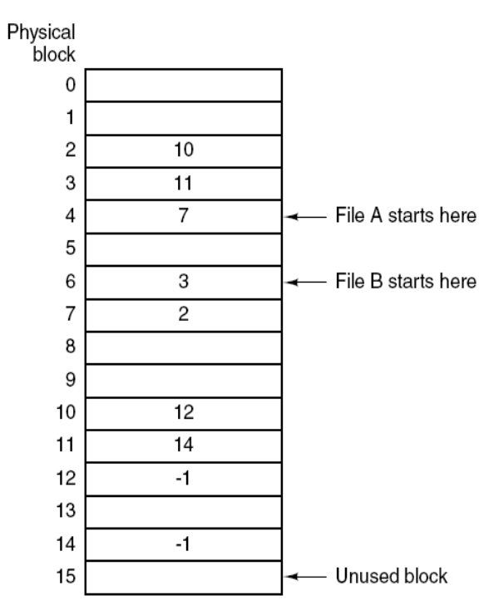
Linked List Allocation Using a Table in Memory
Figure 4-12. Linked list allocation using a file allocation table in main memory.
Tanenbaum, Modern Operating Systems 3 e, (c) 2008 Prentice-Hall, Inc. All rights reserved. 0-13-6006639

Slide 19
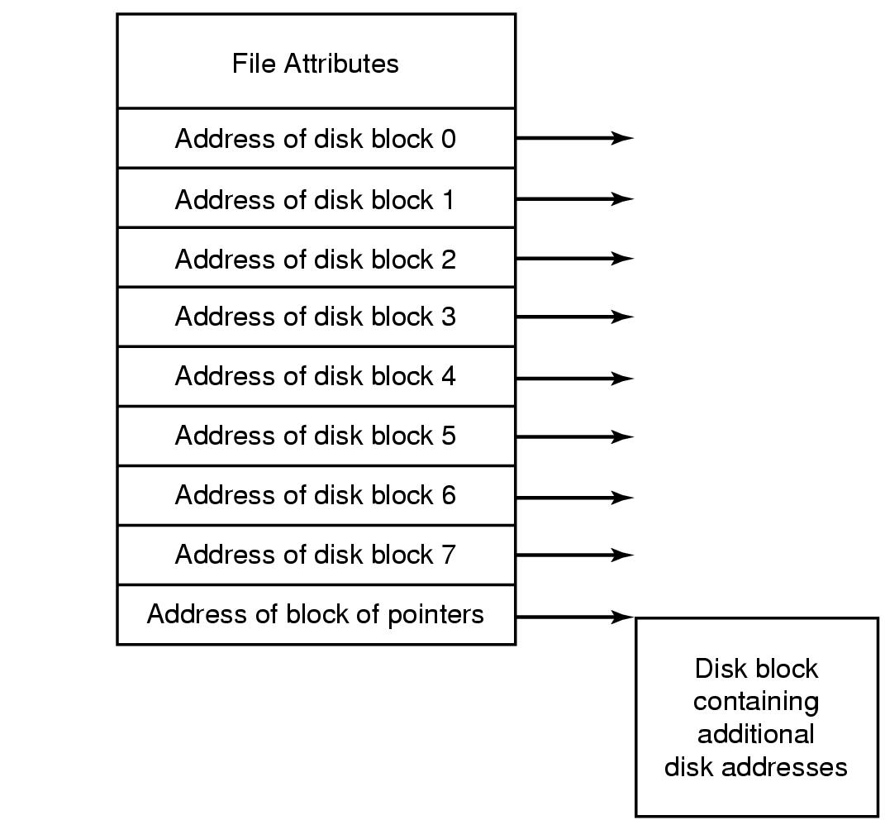
I-nodes
Figure 4-13. An example i-node.
Tanenbaum, Modern Operating Systems 3 e, (c) 2008 Prentice-Hall, Inc. All rights reserved. 0-13-6006639

Slide 20
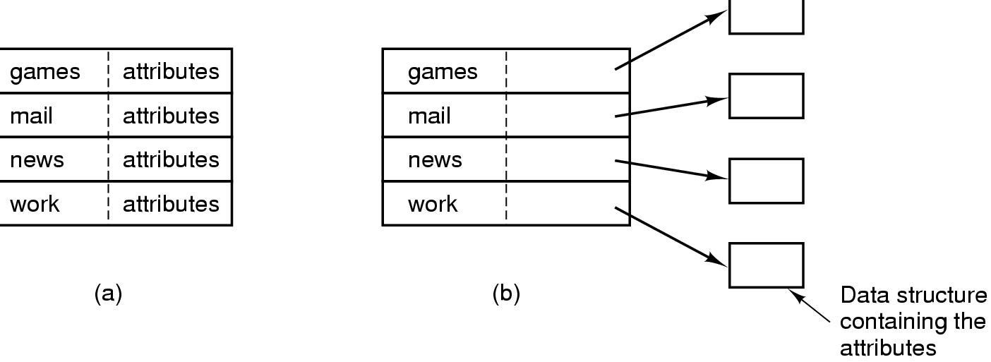
Implementing Directories (1)
Figure 4-14. (a) A simple directory containing fixed-size entries with the disk addresses and attributes in the directory entry. (b) A directory in which each entry just refers to an i-node.
Tanenbaum, Modern Operating Systems 3 e, (c) 2008 Prentice-Hall, Inc. All rights reserved. 0-13-6006639

Slide 21
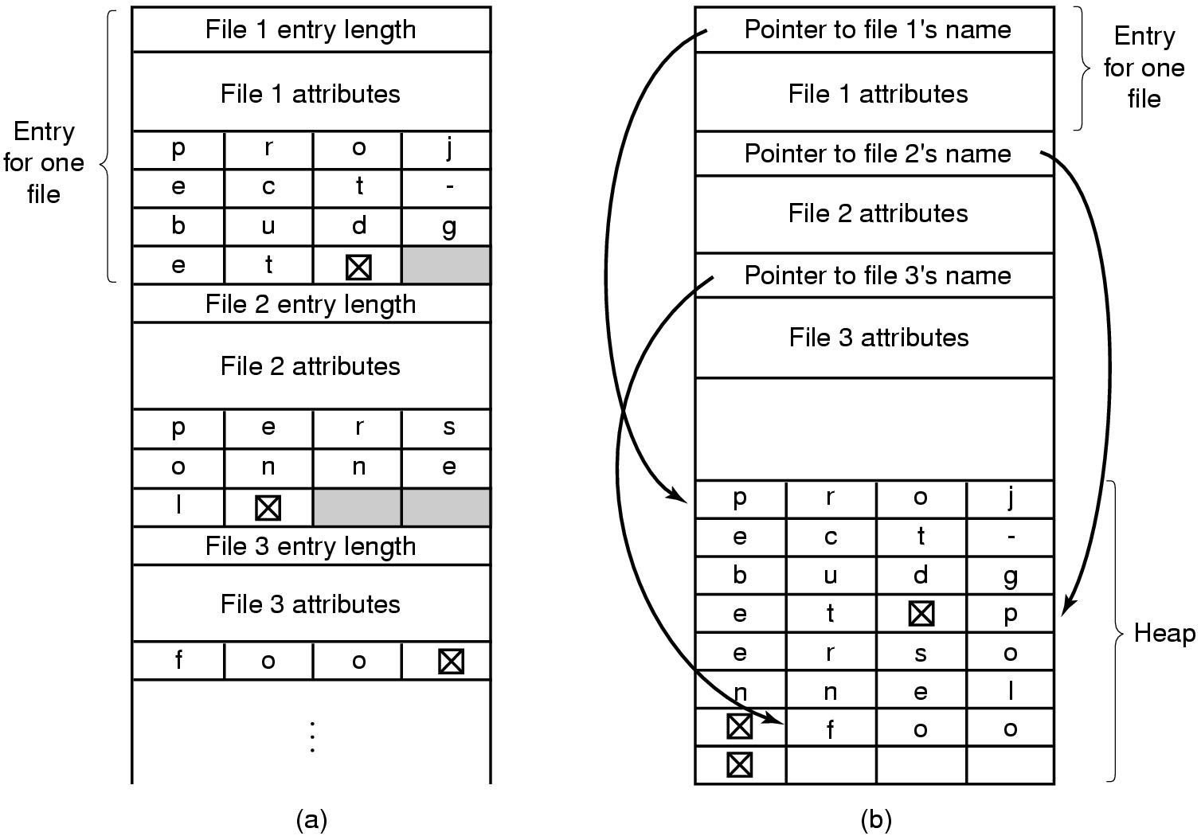
Implementing Directories (2)
Figure 4-15. Two ways of handling long file names in a directory. (a) In-line. (b) In a heap.
Tanenbaum, Modern Operating Systems 3 e, (c) 2008 Prentice-Hall, Inc. All rights reserved. 0-13-6006639

Slide 22
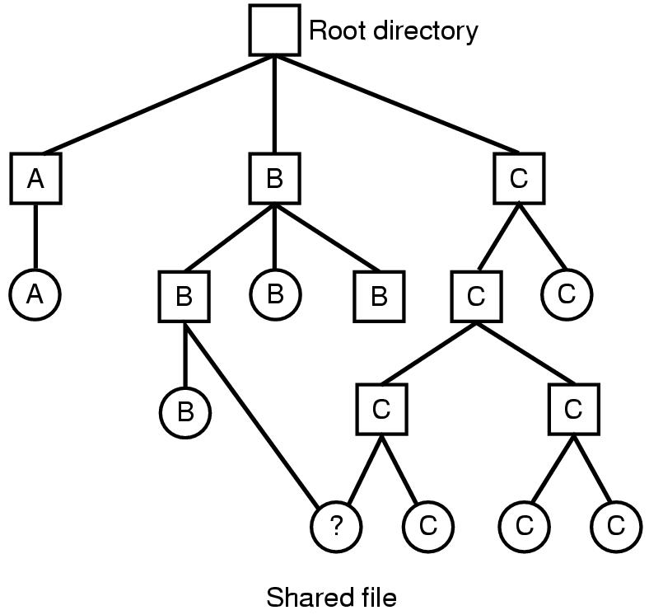
Shared Files (1)
Figure 4-16. File system containing a shared file.
Tanenbaum, Modern Operating Systems 3 e, (c) 2008 Prentice-Hall, Inc. All rights reserved. 0-13-6006639

Slide 23
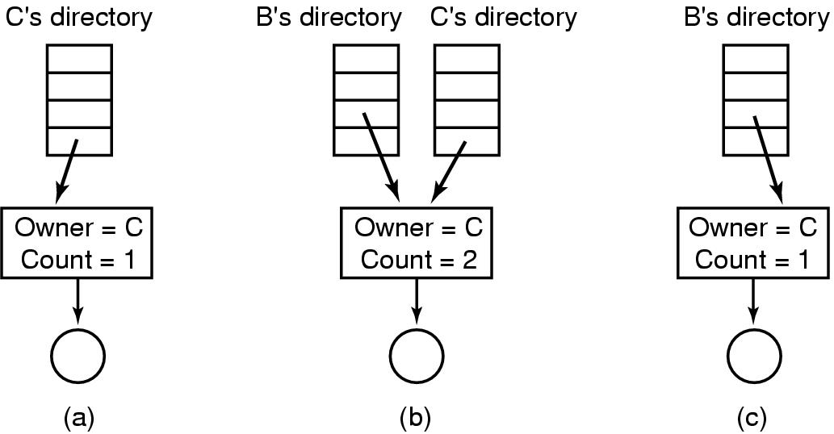
Shared Files (2)
Figure 4-17. (a) Situation prior to linking. (b) After the link is created. (c) After the original owner removes the file.
Tanenbaum, Modern Operating Systems 3 e, (c) 2008 Prentice-Hall, Inc. All rights reserved. 0-13-6006639

Slide 24
Journaling File Systems
Operations required to remove a file in UNIX:
Remove the file from its directory.
Release the i-node to the pool of free i-nodes.
Return all the disk blocks to the pool of free disk blocks.
Tanenbaum, Modern Operating Systems 3 e, (c) 2008 Prentice-Hall, Inc. All rights reserved. 0-13-6006639

Slide 25
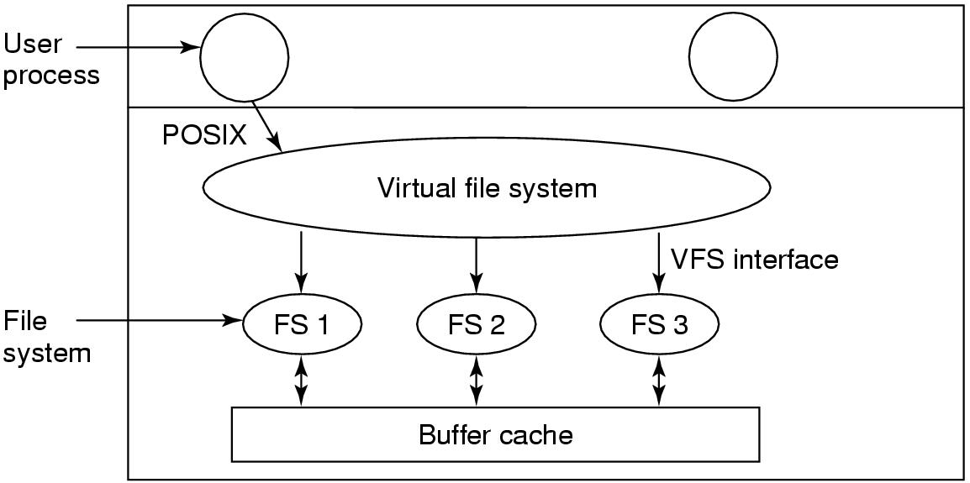
Virtual File Systems (1)
Figure 4-18. Position of the virtual file system.
Tanenbaum, Modern Operating Systems 3 e, (c) 2008 Prentice-Hall, Inc. All rights reserved. 0-13-6006639

Slide 26
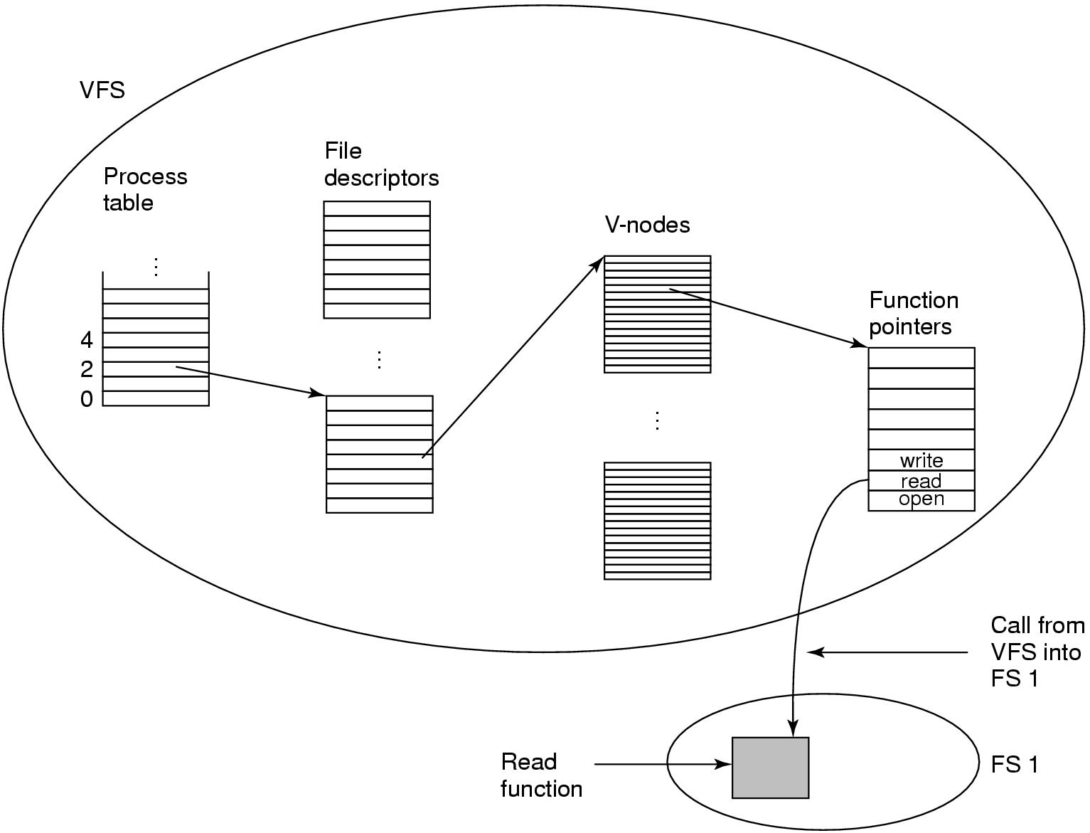
Virtual File Systems (2)
Figure 4-19. A simplified view of the data structures and code used by the VFS and concrete file system to do a read.
Tanenbaum, Modern Operating Systems 3 e, (c) 2008 Prentice-Hall, Inc. All rights reserved. 0-13-6006639

Slide 27
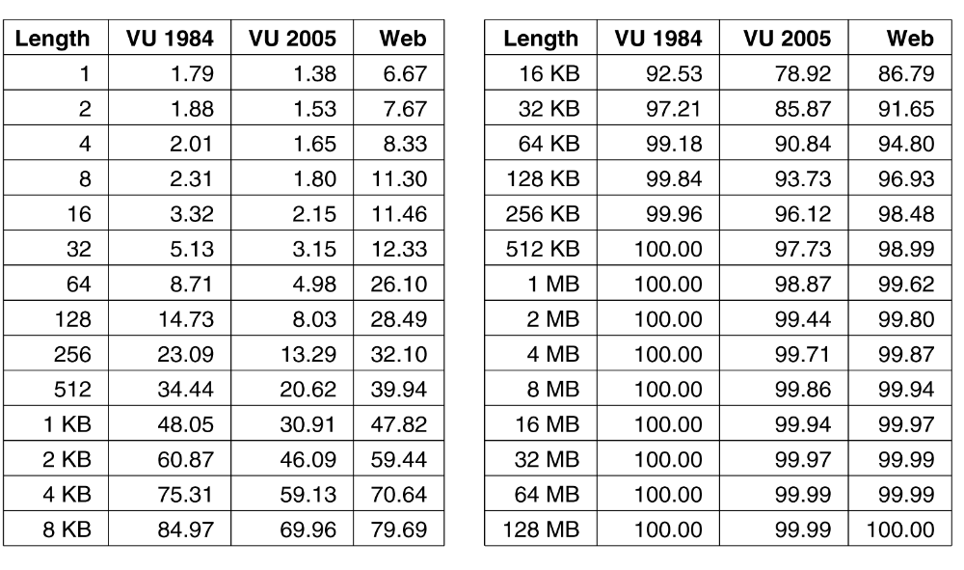
Disk Space Management Block Size (1)
Figure 4-20. Percentage of files smaller than a given size
(in bytes).
Tanenbaum, Modern Operating Systems 3 e, (c) 2008 Prentice-Hall, Inc. All rights reserved. 0-13-6006639

Slide 28
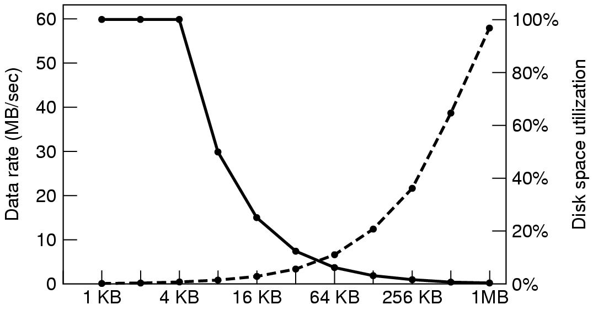
Disk Space Management Block Size (2)
Figure 4-21. The solid curve (left-hand scale) gives the data rate of a disk. The dashed curve (right-hand scale) gives the disk space efficiency. All files are 4 KB.
Tanenbaum, Modern Operating Systems 3 e, (c) 2008 Prentice-Hall, Inc. All rights reserved. 0-13-6006639

Slide 29
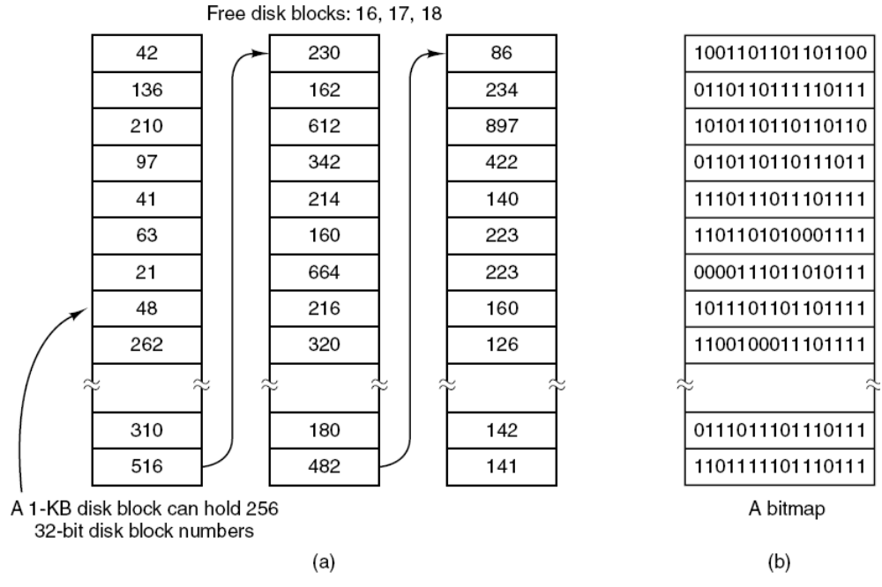
Keeping Track of Free Blocks (1)
Figure 4-22. (a) Storing the free list on a linked list. (b) A bitmap.
Tanenbaum, Modern Operating Systems 3 e, (c) 2008 Prentice-Hall, Inc. All rights reserved. 0-13-6006639

Slide 30
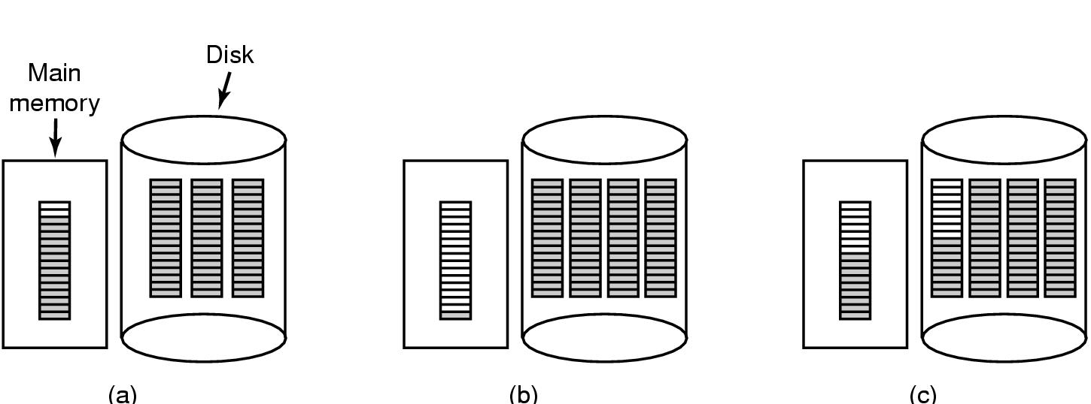
Keeping Track of Free Blocks (2)
Figure 4-23. (a) An almost-full block of pointers to free disk blocks in memory and three blocks of pointers on disk. (b) Result of freeing a three-block file. (c) An alternative strategy for handling the three free blocks. The shaded entries represent pointers to free disk blocks.
Tanenbaum, Modern Operating Systems 3 e, (c) 2008 Prentice-Hall, Inc. All rights reserved. 0-13-6006639

Slide 31
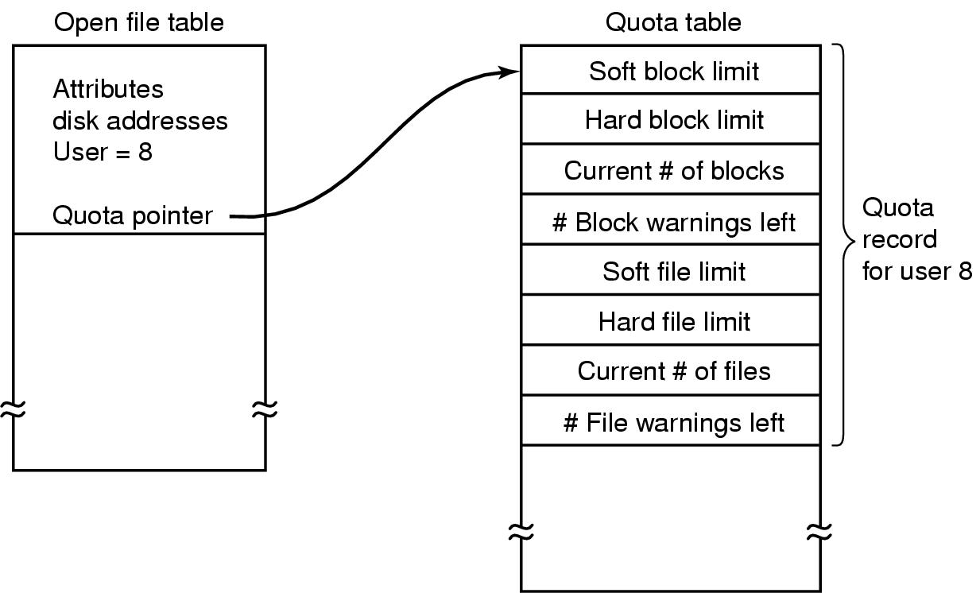
Disk Quotas
Figure 4-24. Quotas are kept track of on a per-user basis
in a quota table.
Tanenbaum, Modern Operating Systems 3 e, (c) 2008 Prentice-Hall, Inc. All rights reserved. 0-13-6006639

Slide 32
File System Backups (1)
Backups to tape are generally made to handle one of two potential problems:
Recover from disaster.
Recover from stupidity.
Tanenbaum, Modern Operating Systems 3 e, (c) 2008 Prentice-Hall, Inc. All rights reserved. 0-13-6006639

Slide 33
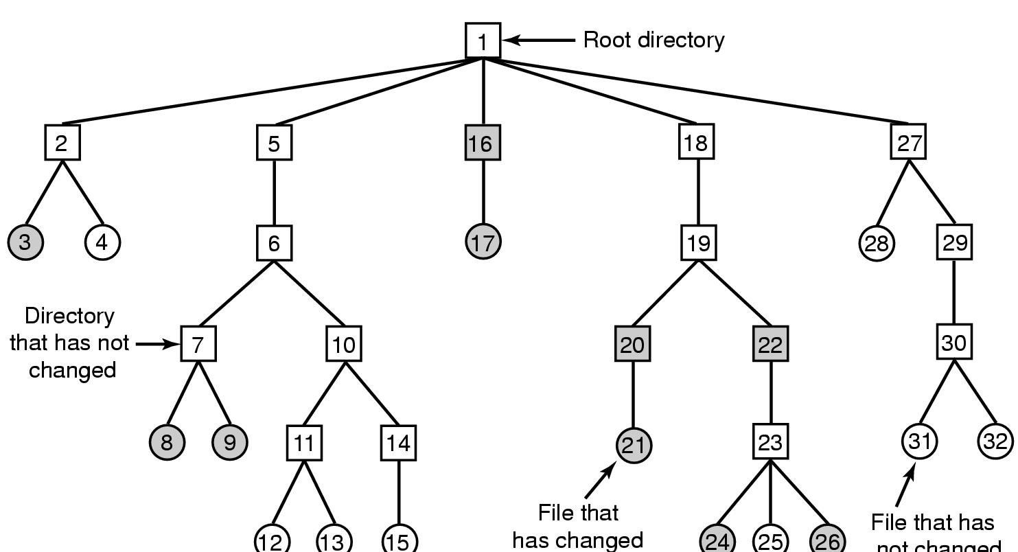
File System Backups (2)
Figure 4-25. A file system to be dumped. Squares are directories, circles are files. Shaded items have been modified since last dump. Each directory and file is labeled by its i-node number.
Tanenbaum, Modern Operating Systems 3 e, (c) 2008 Prentice-Hall, Inc. All rights reserved. 0-13-6006639

Slide 34
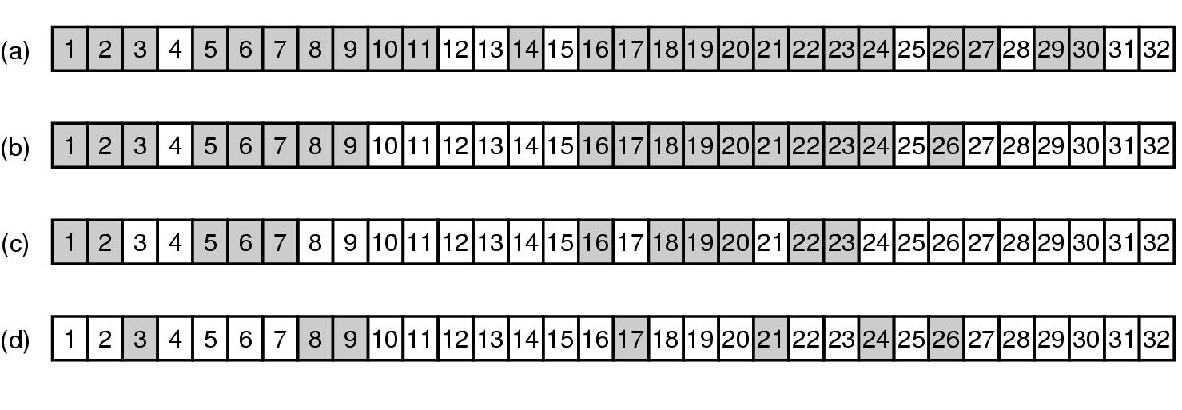
File System Backups (3)
Figure 4-26. Bitmaps used by the logical dumping algorithm.
Tanenbaum, Modern Operating Systems 3 e, (c) 2008 Prentice-Hall, Inc. All rights reserved. 0-13-6006639

Slide 35
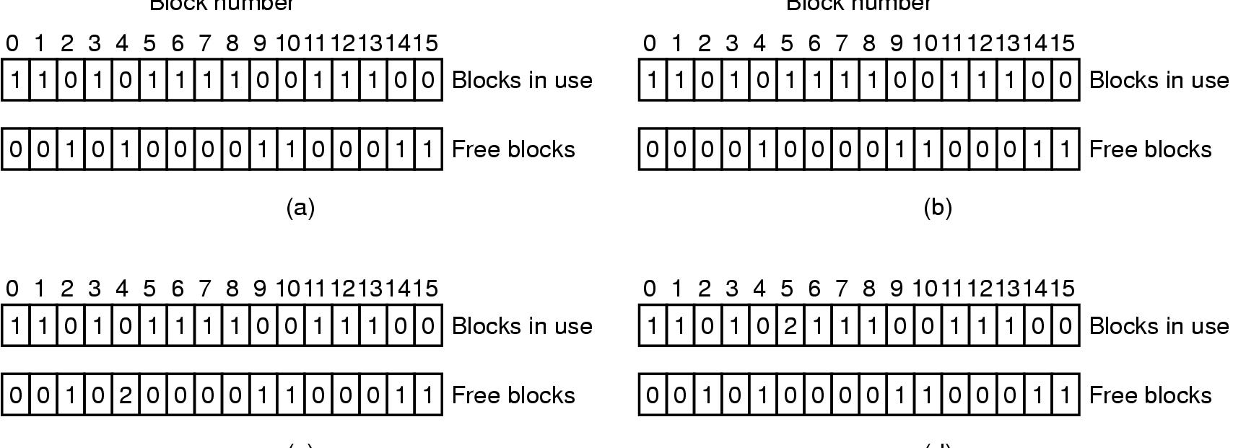
File System Consistency
Figure 4-27. File system states. (a) Consistent. (b) Missing block. (c) Duplicate block in free list. (d) Duplicate data block.
Tanenbaum, Modern Operating Systems 3 e, (c) 2008 Prentice-Hall, Inc. All rights reserved. 0-13-6006639

Slide 36
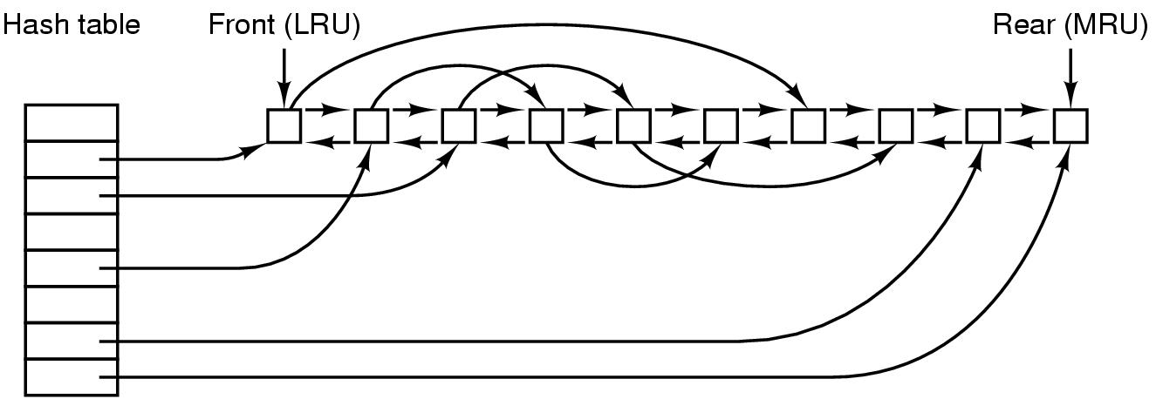
Caching (1)
Figure 4-28. The buffer cache data structures.
Tanenbaum, Modern Operating Systems 3 e, (c) 2008 Prentice-Hall, Inc. All rights reserved. 0-13-6006639

Slide 37
Caching (2)
Some blocks, such as i-node blocks, are rarely referenced two times within a short interval.
Consider a modified LRU scheme, taking two factors into account:
  Is the block likely to be needed again soon?
  Is the block essential to the consistency of the file system?
Tanenbaum, Modern Operating Systems 3 e, (c) 2008 Prentice-Hall, Inc. All rights reserved. 0-13-6006639

Slide 38

Reducing Disk Arm Motion
Figure 4-29. (a) I-nodes placed at the start of the disk.
(b) Disk divided into cylinder groups, each with its own blocks and i-nodes.
Tanenbaum, Modern Operating Systems 3 e, (c) 2008 Prentice-Hall, Inc. All rights reserved. 0-13-6006639

Slide 39
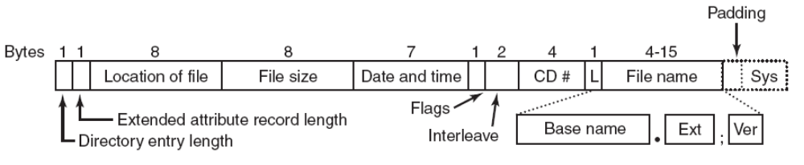
The ISO 9660 File System
Figure 4-30. The ISO 9660 directory entry.
Tanenbaum, Modern Operating Systems 3 e, (c) 2008 Prentice-Hall, Inc. All rights reserved. 0-13-6006639

Slide 40
Rock Ridge Extensions
Rock Ridge extension fields:
PX - POSIX attributes.
PN - Major and minor device numbers.
SL - Symbolic link.
NM - Alternative name.
CL - Child location.
PL - Parent location.
RE - Relocation.
TF - Time stamps.
Tanenbaum, Modern Operating Systems 3 e, (c) 2008 Prentice-Hall, Inc. All rights reserved. 0-13-6006639

Slide 41
Joliet Extensions
Joliet extension fields:
Long file names.
Unicode character set.
Directory nesting deeper than eight levels.
Directory names with extensions
Tanenbaum, Modern Operating Systems 3 e, (c) 2008 Prentice-Hall, Inc. All rights reserved. 0-13-6006639

Slide 42
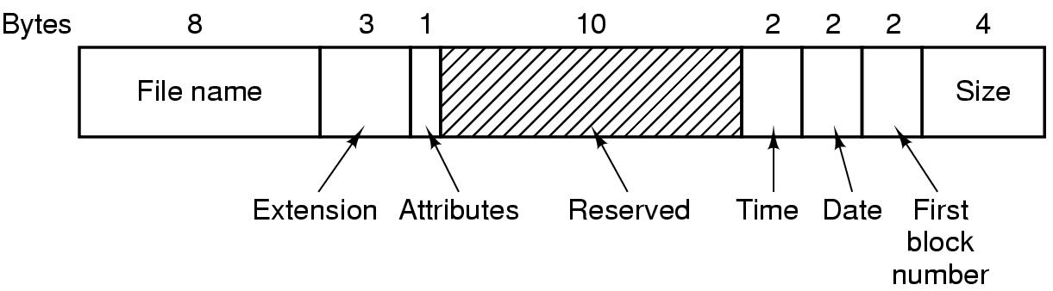
The MS-DOS File System (1)
Figure 4-31. The MS-DOS directory entry.
Tanenbaum, Modern Operating Systems 3 e, (c) 2008 Prentice-Hall, Inc. All rights reserved. 0-13-6006639

Slide 43
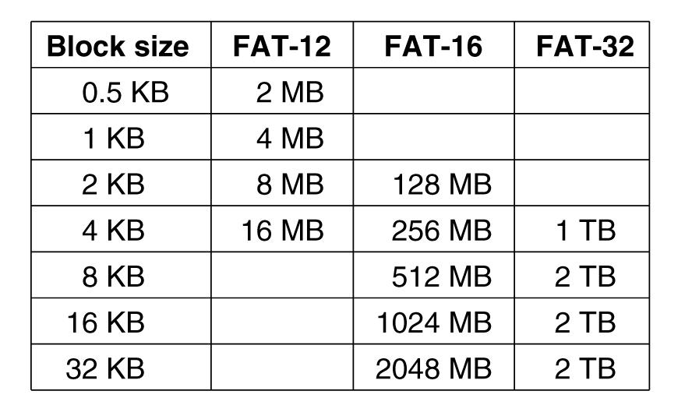
The MS-DOS File System (2)
Figure 4-32. Maximum partition size for different block sizes. The empty boxes represent forbidden combinations.
Tanenbaum, Modern Operating Systems 3 e, (c) 2008 Prentice-Hall, Inc. All rights reserved. 0-13-6006639

Slide 44
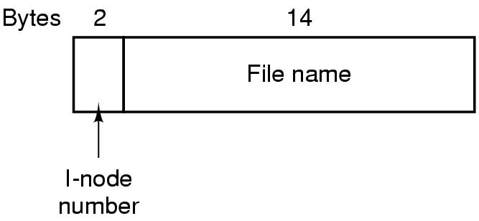
The UNIX V7 File System (1)
Figure 4-33. A UNIX V7 directory entry.
Tanenbaum, Modern Operating Systems 3 e, (c) 2008 Prentice-Hall, Inc. All rights reserved. 0-13-6006639

Slide 45
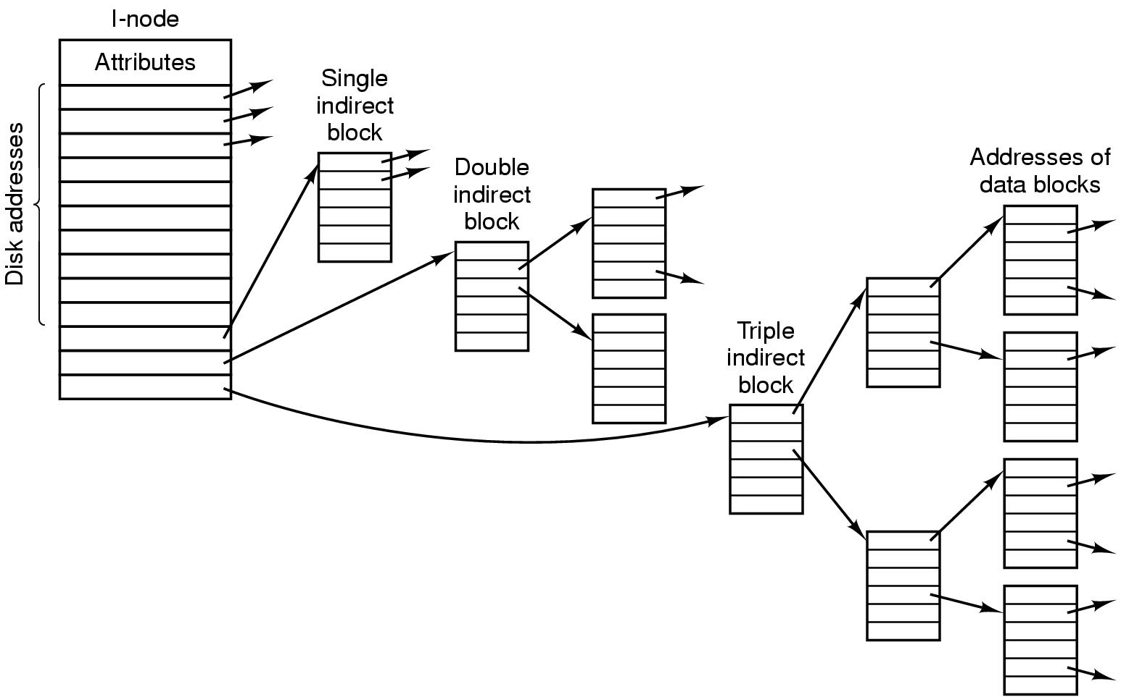
The UNIX V7 File System (2)
Figure 4-34. A UNIX i-node.
Tanenbaum, Modern Operating Systems 3 e, (c) 2008 Prentice-Hall, Inc. All rights reserved. 0-13-6006639

Slide 46
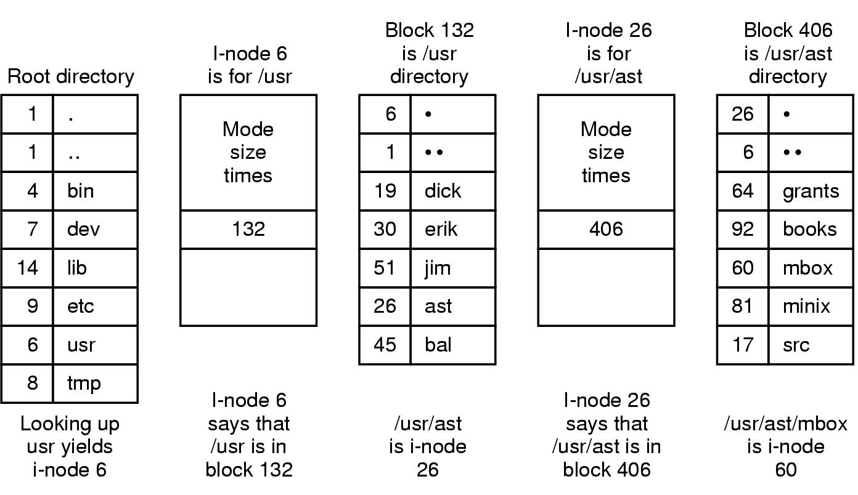
The UNIX V7 File System (3)
Figure 4-35. The steps in looking up /usr/ast/mbox.
Tanenbaum, Modern Operating Systems 3 e, (c) 2008 Prentice-Hall, Inc. All rights reserved. 0-13-6006639

