Slide 1
Forecasting Cash Flow and Personalized Customer Experience
CSCI-P556: Applied Machine Learning Fall 2019
Adam Hilgenkamp, Kaitlin Pet, Jashjeet Singh Madan, and Surya Prateek Soni
Notes:
Current version = 25 slides
Average 24 sec per slide to hit 10min Can cut time from transition slides to get to 32 sec per content slide…
9 slides are transitions < 10 sec = 90
16 slides have content < 32 sec = 512

Slide 2
Background & Research Questions

Slide 3
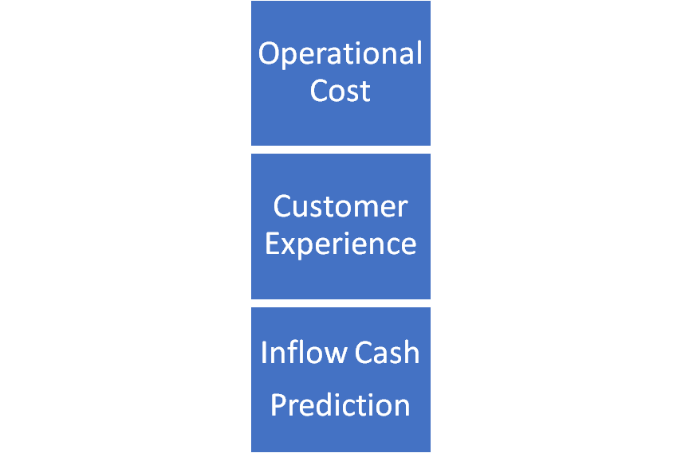
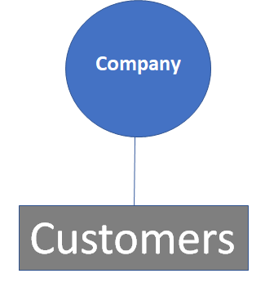
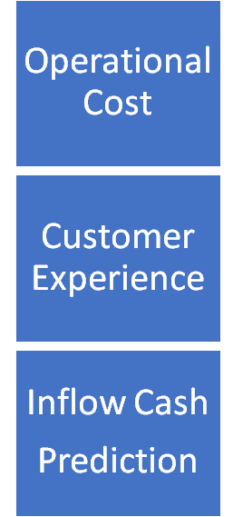

The Current Collections Process
Background & Research Questions
Reminder to ALL customers
Payment is received
High
Follow up to ALL Customers in SAME fashion
Bad
Send service shut off notice
Written off as bad debt
Uncertain
Notes:
Talk Track:
So, specifically what is the collections process?
At a high level it is from when the customer signs an agreement to when the payment is received or written off.
The key components and where our models fit in:

Slide 4
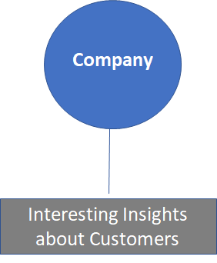
The Proposed Collections Process
Background & Research Questions
Reminder to SELECTED customers
Payment is received
Very Low
Follow up to HIGH RISK Customers in different ways
Excellent
Send service shut off notice
Written off as bad debt
Optimized
Notes:
Talk Track:
So, specifically what is the collections process?
At a high level it is from when the customer signs an agreement to when the payment is received or written off.
The key components and where our models fit in:

Slide 5
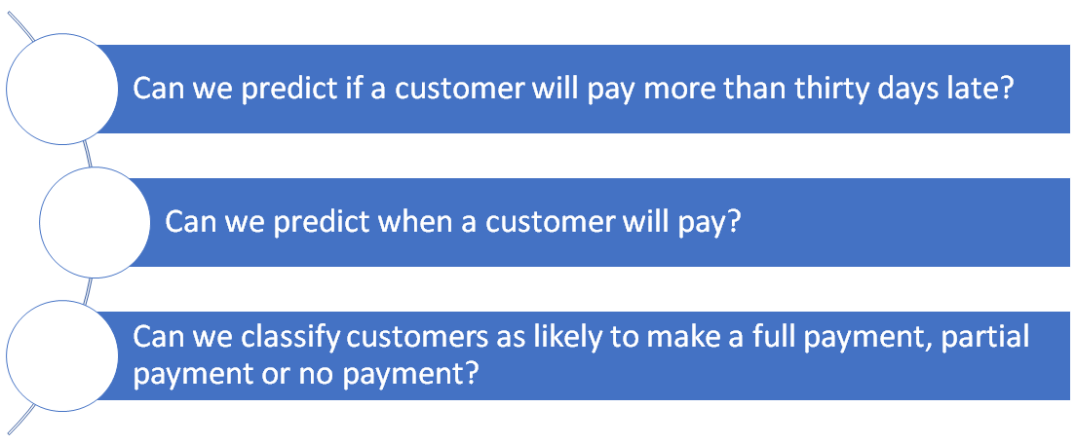
Research Questions
Background & Research Questions
Notes:
Talk Track:
Just review the research questions. Probably don’t need to spend a long time on this slide.

Slide 6
The Data

Slide 7
Data Collection
The Data
Base dataset filtered from ~12.6M observations down to ~305k
Base datasets contain ~689 features. Train set filtered down to 37
The dataset contains observations from 2018 and 2019
Transactions
Accounts
Contracts
Cases

Slide 8
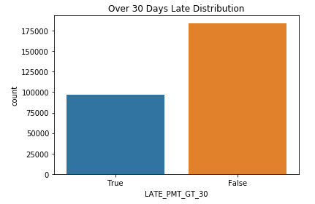
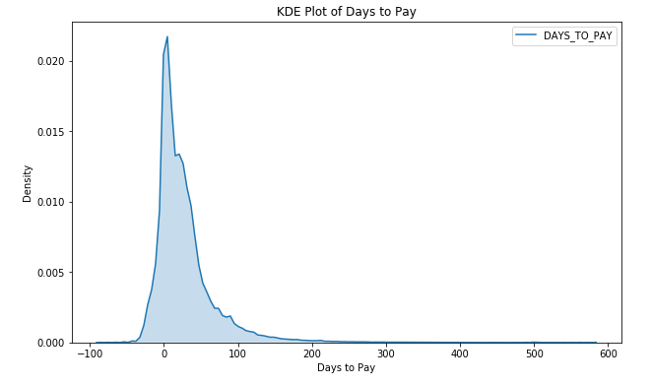
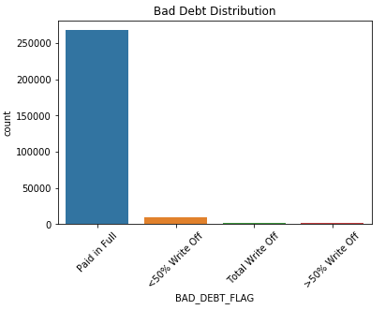
Distribution of “Y” values
The Data

Slide 9
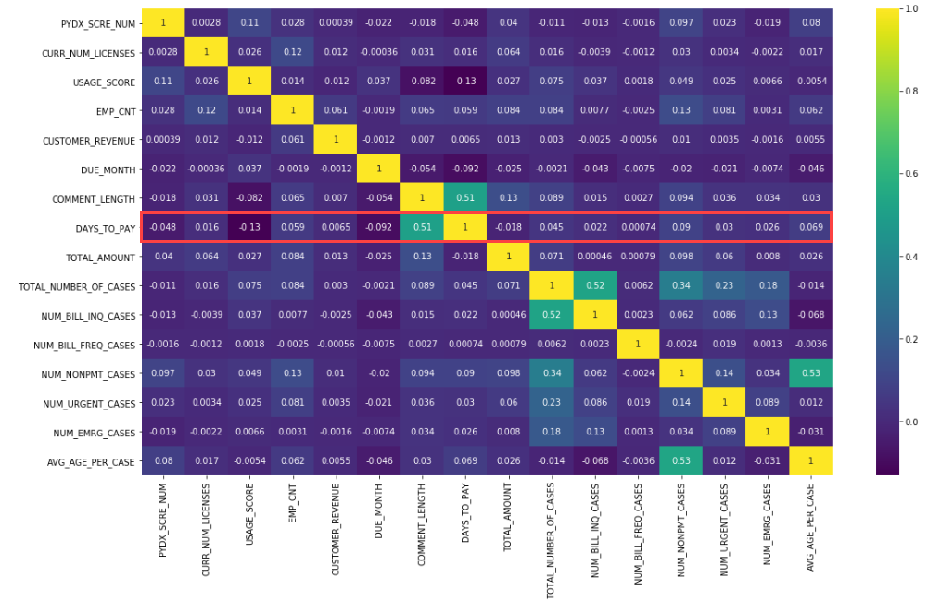
Numeric Variable Correlation
The Data
Usage score has the highest negative correlation (-0.13)
The variable with the highest correlation was the comment length (0.51)
No other numeric variables had a correlation higher than 0.1 or less than -0.1

Slide 10
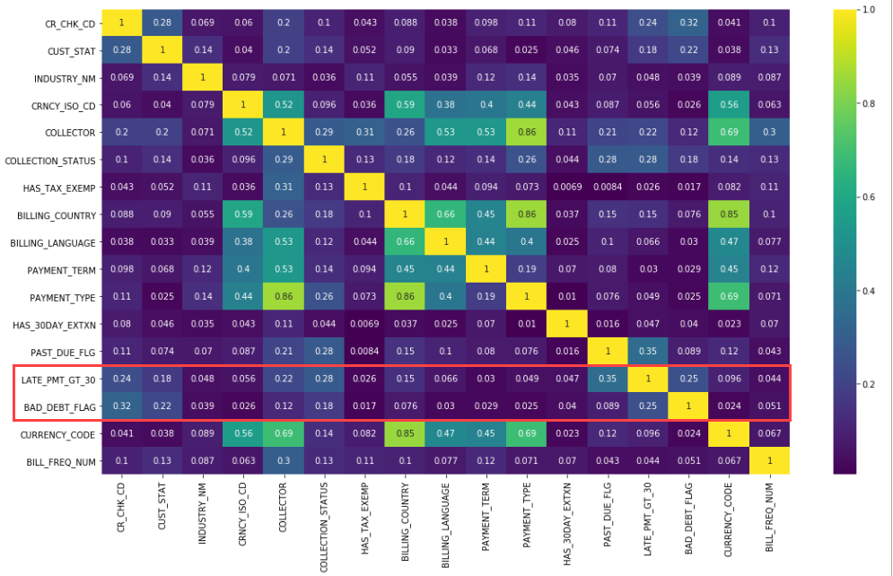
Nominal Variable Correlation
The Data
Associations between nominal variables plotted using Cramer’s V statistic
The variables with the highest association were the collection status (0.28) and credit decision (0.24)
Correlation matrix of One-hot-encoded collection status shows that a status of “Non-Responsive” has a correlation of 0.22

Slide 11
Methods & Results

Slide 12
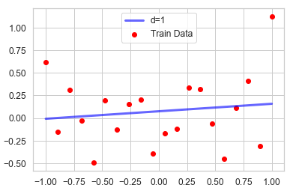
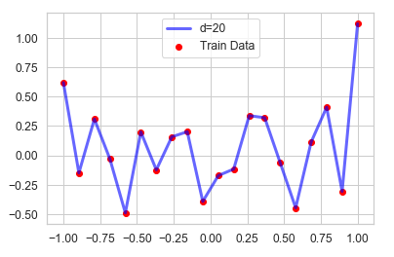
General Research Method
Methods & Results
Simple
Complex
Notes:
Talk Track:
Our general method for each research question was to start with a simple model and increase the complexity to see if we can achieve significantly better results

Slide 13
Can we predict if a customer will pay more than 30 days late?
Question 1

Slide 14
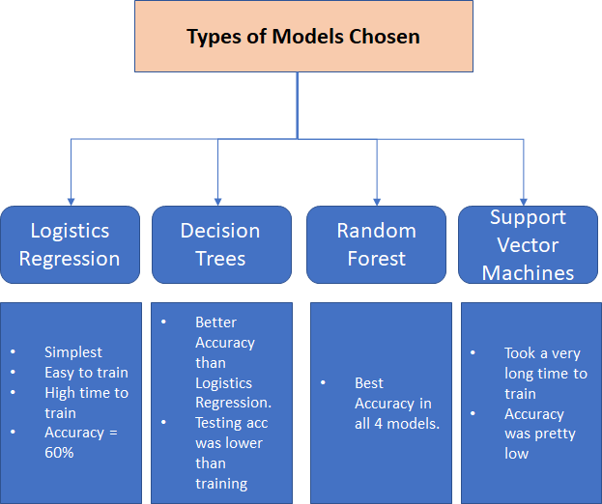
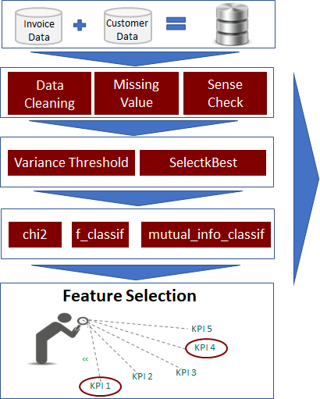
Data Pre-processing and Types of Models
Methods & Results
Notes:
Talk Track:
Our general method for each research question was to start with a simple model and increase the complexity to see if we can achieve significantly better results

Slide 15
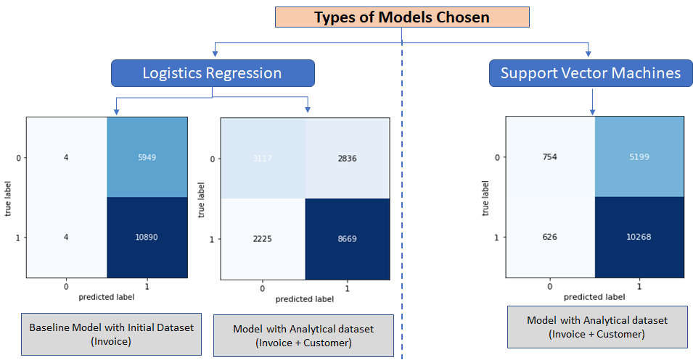
Logistics Regression & SVM
Methods & Results: Research Question 1

Slide 16
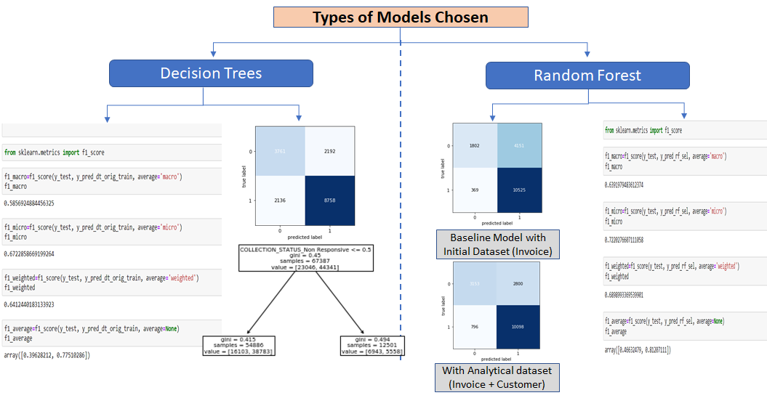
Decision Trees and Random forest
Methods & Results: Research Question 1

Slide 17
Can we predict when a customer will pay?
Question 2

Slide 18
Baseline Model: Linear Regression
Methods & Results: Research Question 2

Slide 19
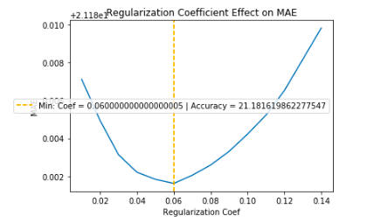
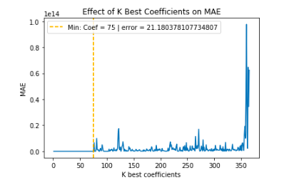
Model Optimization
Feature Selection
Ridge Regularization

Slide 20
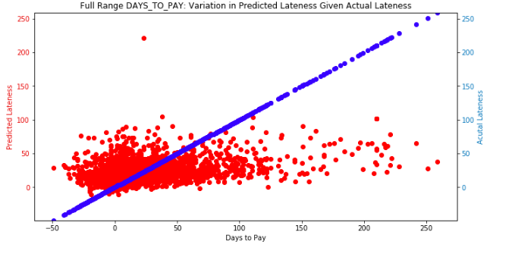
Model Performance
Test error:
22.43 Days

Slide 21
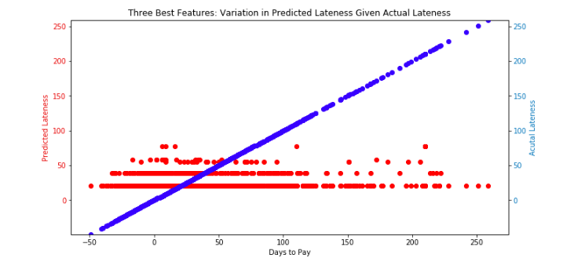
Best Three Features Performance
Test error:
23.96 Days

Slide 22
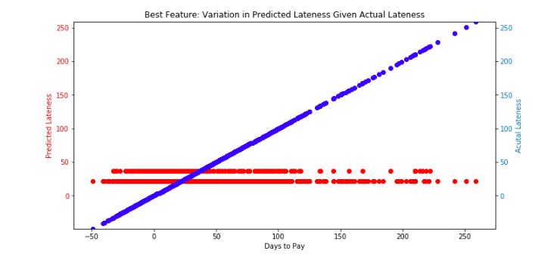
Best Single Feature Performance
Test error:
23.96 Days

Slide 23
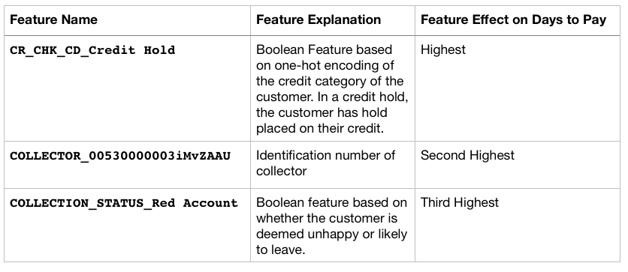
Best Feature Description

Slide 24
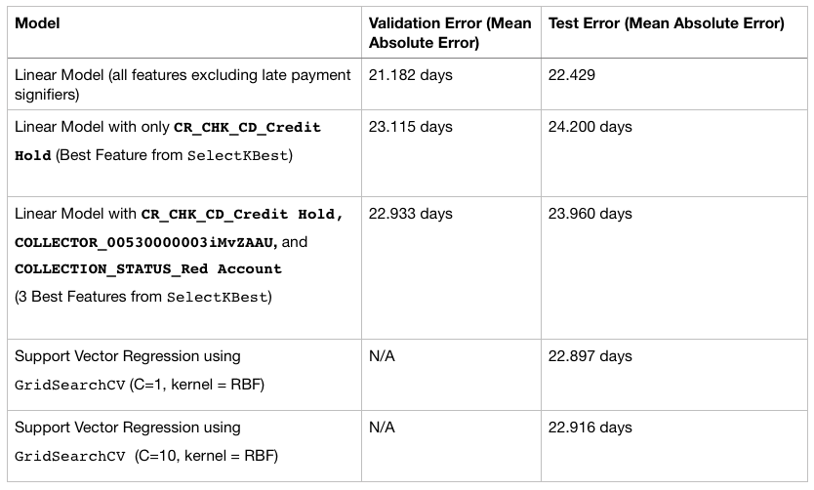
Model Results

Slide 25
Can we classify customers as likely to make a full payment, partial payment or no payment?
Question 3

Slide 26
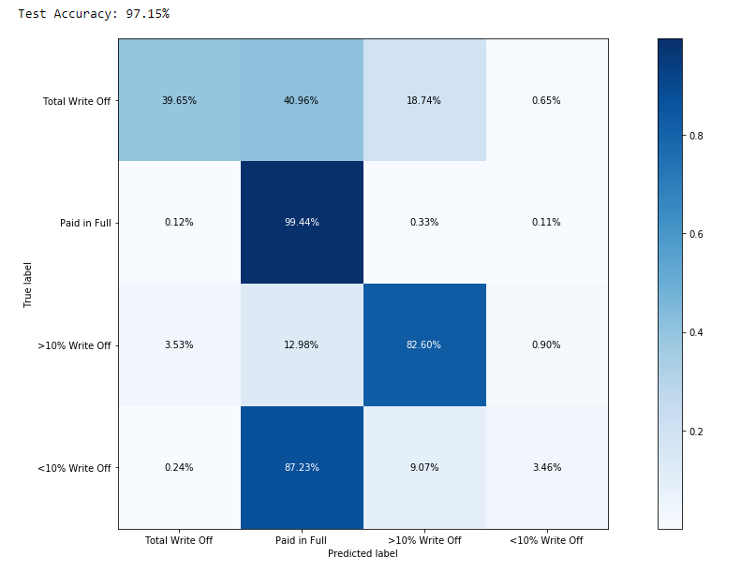
Imbalanced Dataset Results
Methods & Results: Research Question 3
Overall accuracy = ~97%
Model was not very good at predicting full write off (39.6%) but predicted paid in full correctly 99% of the time.
Balanced dataset using SMOTE oversampling technique

Slide 27
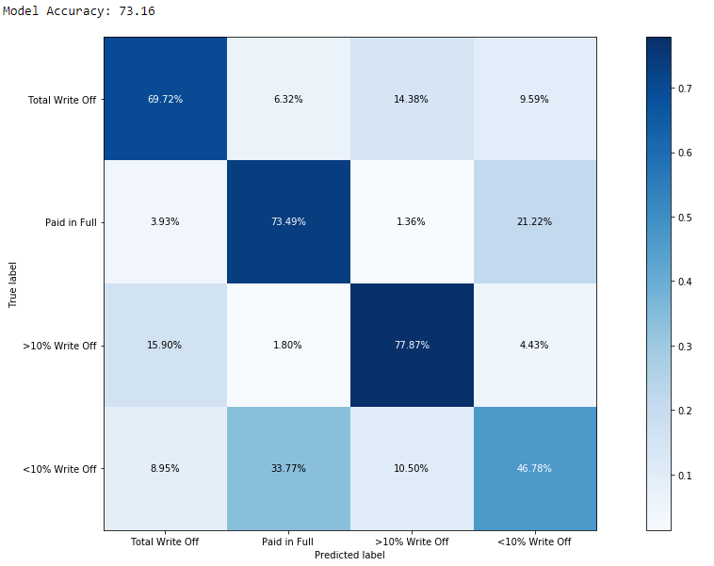
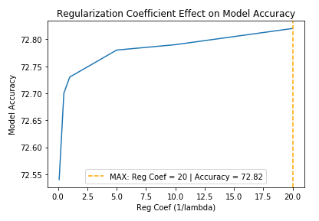
Baseline Model: Multiclass Logistic Regression
Methods & Results: Research Question 3

Slide 28
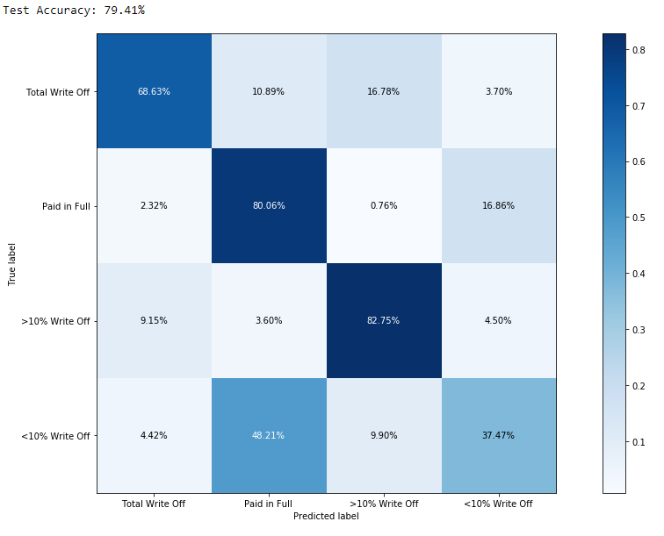
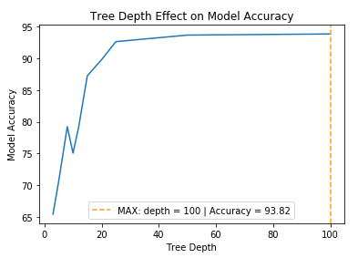
Decision Tree
Methods & Results: Research Question 3

Slide 29
Conclusions

Slide 30
Summary and Next Steps
Conclusions
More Data for better accuracy.
Experiment with Feature Selection and Engineering.
Add more features, such as Customer’s past records to analyze his payment behaviour.
Try new models.
Get data for different industries/ companies and compare results.

Slide 31
Thank You!

Slide 32
The Collections Process
Background & Research Questions
Customer signs a purchase agreement
Invoice is sent to the customer
Reminder email is sent to the customer
Payment is received
Collector follows up with the customer
If payment is really late service shut off notice is sent
Written off as bad debt
Notes:
Talk Track:
So, specifically what is the collections process?
At a high level it is from when the customer signs an agreement to when the payment is received or written off.
The key components and where our models fit in:

Slide 33
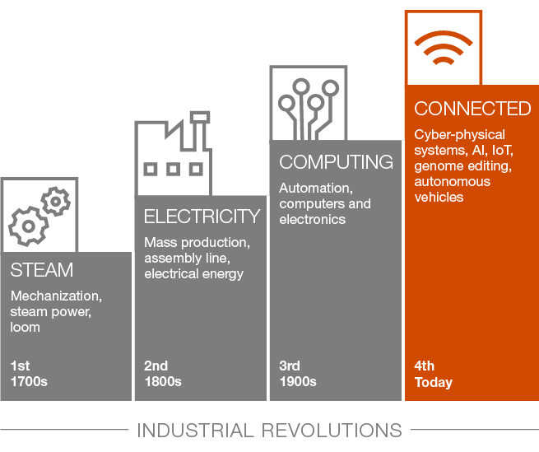
Increasing Stakeholder Expectations
Background & Research Questions
Source: https://www.pwc.com/us/en/library/4ir-ready.html
Notes:
Talk Track:
The 4th industrial revolution is a term used by the World Economic Forum to describe the current age of innovation.
Each change brings about new technologies, new industries, and new ways that we connect with one another.
Example:
Steam brought trains which allowed us to travel to new places
The 2nd industrial revolution saw the development of automobiles furthering freedom and connection
The internet of the computing age allowed us to share information across the globe with a click
Now in the 4th industrial revolution data is being utilized to provide personal recommendations and experiences to consumers.
This trend is not limited to the consumer space. Businesses that sell to other companies need to innovate as well.
The part of the customer/stakeholder experience that we are focusing on in this project is not always the first thing that is thought of when discussion how ML can impact business.
The collections process can sometimes be frustrating and challenging for customers and stakeholders can be blindsided by variations in cash flow.
Providing self-service functionality with personalized experiences is an improvement for the buyer.
This also benefits the leaders and investors in a company as they may be able to more accurately predict the amount of cash inflows which allows them to make other investments using cash that is formerly held back in case of a variance in the estimated collections.

Slide 34
Research Questions
Background & Research Questions
Can we predict if a customer will pay more than thirty days late?
Can we predict when a customer will pay?
Can we classify customers as likely to make a full payment, partial payment or no payment?
Notes:
Talk Track:
Just review the research questions. Probably don’t need to spend a long time on this slide.

Slide 35
Impact of Improving the Process
Background & Research Questions
Notes:
Talk Track:
Customer Experience – Customers don’t want to be bombarded with emails and phone calls if they usually pay on time.
Forecasting Accuracy – Improved accuracy can allow a business to hold less reserves and to invest capitol sooner.
Scale & Efficiency – As the business grows using ML to help collectors focus on the potential issues.

Slide 36
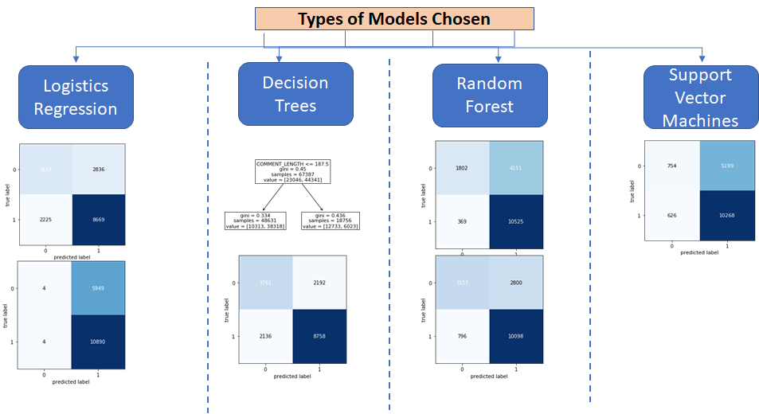
4 Different Models and their Results
Methods & Results: Research Question 1

