Slide 1

MC03094171 RESEARCH WORK (PHASE-1) / MINOR PROJECT
Smart Trip Planner
A web application that turns a destination, travel dates and a budget tier into a day-wise itinerary and a cost estimate.
1
2
3
4
Destination
Day-wise itinerary
Budget estimate
My Trips
PRESENTED BY
GUIDED BY
Udit Mishra
255300694026
Backend / Database / API
Prof. Payal Chauhan
Hardik Vaghela
255300694009
Frontend / UI
PRESENTATION-1
21 September 2026
Vraj Panchal
255300694064
Documentation / UML / System Design
Sardar Vallabhbhai Patel Institute of Technology, Vasad · Master of Computer Applications — Semester III
Notes:
[Vraj] Good morning. We are presenting Smart Trip Planner, our minor project for MC03094171 Research Work (Phase-1) / Minor Project. Introduce the three of us and our roles: Udit on backend, database and API; Hardik on the frontend; Vraj on documentation, UML and system design. Name our guide. One line on the idea: you give a destination, dates and a budget tier, and the system returns a day-wise itinerary with a cost estimate.

Slide 2
OVERVIEW
Presentation Agenda
01
02
03
04
05
Study
Proposed system
Requirements
Design
Progress
Existing System
Need for the New System
Objective of the New System
Problem Definition
Scope of the Project
Core Components
Development Tools & Technologies
Assumptions and Constraints
Functional Requirements
Targeted Users
Use Case Diagram
Activity Diagram
Interaction Diagram
Class Diagram
Data Dictionary
Implementation Status
Demo Flow
Questions
Smart Trip Planner · Presentation-1
02
Notes:
[Vraj] Walk through the five parts, do not read every item. First we study how trips are planned today and define the problem. Then the proposed system and its tools, the requirements, the UML design with the data dictionary, and finally what is already built with a live demo. Vraj covers the study and the structural diagrams, Udit the system internals and data, Hardik the requirements, user flows and implementation.

Slide 3
PART 1 · STUDY
Existing System
1
2
3
4
Research
Locate
Price
Assemble
BLOGS AND VIDEOS
MAPS APPLICATION
BOOKING PORTALS
NOTES / SPREADSHEET
Scattered opinions. No single list of what is worth visiting and for how long.
Places are checked one at a time. Nothing groups nearby places into the same day.
Built to sell rooms and tickets. They do not give a whole-trip estimate.
The plan is typed by hand and reworked whenever dates or group size change.
Result
Hours of effort · no distance-aware day plan · budget is a guess · nothing saved in one place
Smart Trip Planner · Presentation-1
03
Notes:
[Vraj] There is no single existing system; planning today is a manual process spread over four kinds of tools. You research on blogs and videos, check each place on a maps app, look up prices on booking portals, and finally assemble everything in notes or a spreadsheet. Point at the strip: it takes hours, days are not grouped by distance, the budget is guesswork, and any change means redoing the work.

Slide 4
PART 1 · STUDY
Need for the New System
EXISTING WAY
SMART TRIP PLANNER
Information
Spread over blogs, maps and portals
One curated catalogue: destinations with activities, fees, timings
Day plan
Made by hand, distance ignored
Generated day-wise, stops ordered to cut travel
Budget
A rough guess, often only the hotel
Stay, food, transport and activities; total and per person
Changes
Rework the whole plan
Change an input and regenerate
Record
Screenshots and loose notes
Saved in My Trips with notes and status
Smart Trip Planner · Presentation-1
04
Notes:
[Vraj] Compare row by row. Today information is scattered; we keep a curated catalogue of destinations and activities. Today the day plan is made by hand; we generate it and order stops by distance. Today budget is guesswork; we break it into stay, food, transport and activities. A change means starting again versus regenerating in one click, and the plan finally lives in one place, My Trips.

Slide 5
PART 1 · STUDY
Objective of the New System
01
02
03
Plan in one step
Less time on the road
A budget you can read
One form in, a complete day-wise itinerary out.
Each day groups nearby places; stops are ordered by distance.
Stay, food, transport and activities, with total and per-person cost in INR.
04
05
06
Try before sign-up
Works without the internet
Secure and tested
Anyone can preview a plan. Login is needed only to save it.
Seeded data and a local distance provider by default; OpenStreetMap and Google are optional.
JWT authentication, validated input, trips visible only to their owner, automated tests.
Smart Trip Planner · Presentation-1
05
Notes:
[Vraj] Six objectives. One form should give a complete plan. Stops inside a day should be close to each other. The budget must show where the money goes. A visitor can try the planner before creating an account. The demo must not depend on the internet, so seeded data and a local distance calculation are the default. And the API must be secure and covered by automated tests.

Slide 6
PART 1 · STUDY
Problem Definition
Given a destination, travel dates, group size, budget tier, interests and pace, produce a feasible day-wise itinerary that keeps travel between stops low, together with a transparent cost estimate — in one step, and keep it for later.
THE TRAVELLER GIVES
Destination
Start and end date
Travellers (1–12)
Budget tier
Interests
Pace
THE SYSTEM RETURNS
Feasible = visit time + travel time fits the day: 6 h relaxed, 8 h balanced, 10 h packed.
Day-wise itinerary with start and end times
Budget: stay · food · transport · activities
Smart Trip Planner · Presentation-1
06
Notes:
[Vraj] Read the statement once, slowly. Then point right: the six inputs the traveller gives, and the two outputs the system must produce. Stress the word feasible: a day has a limit of 6, 8 or 10 visiting hours depending on pace, and travel time between stops counts against it.

Slide 7
PART 1 · STUDY
Scope of the Project
In scope
Out of scope
12 Indian destinations, 8–10 curated activities each
Online payments
Destination search, category filter and details page
Hotel, ticket or cab booking
Day-wise itinerary from dates, interests and pace
Chatbot or AI assistant
Budget estimate in three tiers: economy, standard, luxury
Native mobile application
Register, login, and My Trips: save, notes, status, delete
Live prices and availability
Discover nearby places through the Places provider
Admin screens (role field is reserved)
Smart Trip Planner · Presentation-1
07
Notes:
[Vraj] Left is what Phase-1 delivers: twelve Indian destinations with curated activities, search and filter, the plan generator, the three-tier budget, accounts with My Trips, and nearby-place discovery. Right is what we deliberately left out. We do not take payments or make bookings, there is no chatbot and no mobile app, prices are estimates and not live. Saying this clearly avoids questions about features we never promised.

Slide 8
PART 2 · PROPOSED SYSTEM
Core Components
React client
Express REST API
MongoDB
VITE · REACT ROUTER
/API/V1 · JSON · JWT
MONGOOSE MODELS
Pages, AuthContext, apiClient
routes → controllers → services
users · destinations · activities · trips
SERVICES INSIDE THE API
Auth
Destination
Itinerary
Budget
Trip
Providers
Register, login, JWT issue and verify, bcrypt hashing.
Catalogue search, category filter, details with activities.
Scores activities, builds days by nearest stop, schedules times.
Tier-based estimate: stay, food, transport, activities.
Saves plans, enforces ownership, updates notes and status.
Route and Places adapters: local, OpenStreetMap (free) or Google.
Smart Trip Planner · Presentation-1
08
Notes:
[Udit] Three tiers. The React client talks only to our REST API under /api/v1; the API is layered as routes, controllers and services; MongoDB holds four collections. The six blocks below are the services where the logic lives. Controllers only handle HTTP, so itinerary and budget are pure functions that we can unit test. Providers hide where distance and places come from: local by default, OpenStreetMap/OSRM or Google by configuration.

Slide 9
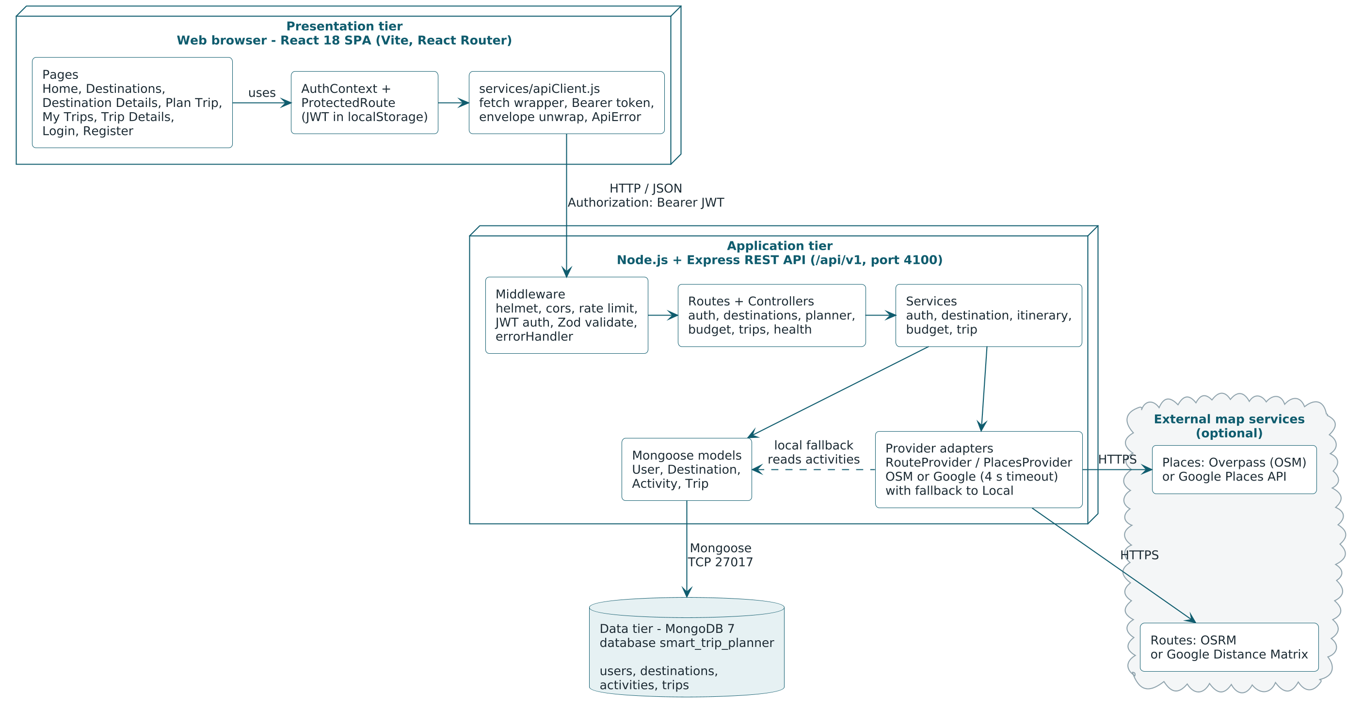
PART 2 · PROPOSED SYSTEM
Core Components — System Architecture
Browser → REST API → MongoDB. External map services are optional; every call falls back to the local provider.
Smart Trip Planner · Presentation-1
09
Notes:
[Udit] Same three tiers, now as deployed for the demo: Vite dev server on 5173 proxies /api to Express on 4100, MongoDB 7 runs in Docker on 27017. Follow one request: page, apiClient, route, validate middleware, controller, service, model. When the provider is set to OpenStreetMap or Google the providers call the external places and distance services with a timeout, otherwise, or on any failure, the local provider answers.

Slide 10
PART 2 · PROPOSED SYSTEM
Core Components — How the Plan Is Computed
Itinerary
Budget
1
Score
rating + 1.5 when the type matches an interest
nights = max(days − 1, 1)
rooms = ceil(travellers ÷ 2)
stay = rate.stay × rooms × nights
food = rate.food × travellers × days
transport = rate.transport × travellers × days
activities = entry fees × travellers
total = sum of the four
perPerson = round(total ÷ travellers)
2
Capacity
hours per day: relaxed 6 · balanced 8 · packed 10
3
Build the day
start at the best activity, keep adding the nearest one that still fits
4
Order
morning places first, evening places last
5
Schedule
from 09:00, travel time between stops, 60-minute lunch after 13:00
4 days, 2 travellers → 3 nights, 1 room. rate = the destination's daily cost for the chosen tier.
Smart Trip Planner · Presentation-1
10
Notes:
[Udit] This is the heart of the project. Each activity gets a score: its rating plus 1.5 if it matches an interest. Pace sets the hours per day. Each day starts from the best unassigned activity, then keeps adding the nearest one from the top half of the pool while visit plus travel time fits. Morning places move to the front, evening ones to the end, and the day is timed from 9 am with a lunch hour. It is deterministic, same input gives the same plan. Budget on the right: two people share a room, nights are days minus one, everything is in whole rupees.

Slide 11
PART 2 · PROPOSED SYSTEM
Development Tools & Technologies
Layer | Technology | Role in the project
Frontend | React 18, Vite, React Router | Single-page client, routing, protected pages
Styling | HTML5, hand-written CSS3, design tokens | Responsive from 360 px, accessible forms, no UI kit
Backend | Node.js 20+, Express.js (ES modules) | REST API under /api/v1 with a uniform response envelope
Security | JWT, bcrypt, Zod, helmet, cors, rate limit | Login tokens, password hashing, input validation, hardening
Database | MongoDB 7, Mongoose | Four collections; itinerary and budget embedded in a trip
External APIs | Overpass (OpenStreetMap), OSRM; optional Google Places, Distance Matrix | Place discovery and road distance; local fallback
Testing | Vitest, Supertest, mongodb-memory-server | Unit tests for services, API tests on an in-memory database
Tooling | Git, Docker Compose, npm | Version control, one-command database, scripts and seed
Smart Trip Planner · Presentation-1
11
Notes:
[Hardik] The stack is MERN with JavaScript end to end. On the client React 18 with Vite and React Router, and hand-written CSS with design tokens, no UI kit. On the server Node 20 and Express, with Zod for validation and JWT plus bcrypt for security. MongoDB 7 with Mongoose, run through Docker Compose. OpenStreetMap Overpass and OSRM are the free map services; Google Places and Distance Matrix are optional. Vitest and Supertest for tests, Git for version control.

Slide 12
PART 2 · PROPOSED SYSTEM
Assumptions and Constraints
Assumptions
Constraints
Two travellers share one room
12
1–14
Nights = days − 1, never less than one
seeded Indian destinations
days per trip
Costs are daily averages per tier, in whole INR
1–12
4 s
Local road distance = straight line × 1.3 at 25 km/h
travellers per trip
External API timeout, then local fallback
Sightseeing starts at 09:00 with a one-hour lunch
20 / 15 min
Node 20+
Figures are estimates, not quotations
auth requests allowed per IP
and MongoDB 7 to run the system
Smart Trip Planner · Presentation-1
12
Notes:
[Udit] Assumptions are what the estimate takes for granted: two travellers share a room, nights are days minus one, costs are daily averages per tier, and with the local provider the road distance is straight-line times 1.3 at 25 km per hour. Constraints are hard limits in the code: twelve destinations, up to fourteen days, up to twelve travellers, a four-second timeout on external route calls, and twenty auth requests per fifteen minutes per IP.

Slide 13
PART 3 · REQUIREMENTS
Functional Requirements (1 of 2)
ID | The system shall… | Module
FR-01 | register a user with name, email and password (min. 8 characters); reject a duplicate email | Auth
FR-02 | log a user in with email and password and issue a JWT | Auth
FR-03 | restore the session on reload; send a protected page to login and return afterwards | Auth
FR-04 | list destinations with keyword search, category filter and pagination | Destinations
FR-05 | show destination details: overview, best season, daily cost table, activities | Destinations
FR-06 | discover nearby places for a destination, optionally by type | Destinations · Providers
FR-07 | accept a plan: destination, dates, travellers, budget tier, interests, pace | Planner
FR-08 | validate a plan: end ≥ start, at most 14 days, start not in the past, 1–12 travellers | Planner
Smart Trip Planner · Presentation-1
13
Notes:
[Hardik] Sixteen functional requirements, grouped by module; each maps to a page and an API route. FR-01 to 03 are accounts. FR-04 to 06 are the destination catalogue. FR-07 and 08 are the plan form and its validation rules: end date not before start, at most fourteen days, not in the past. Do not read all rows; pick one from each group.

Slide 14
PART 3 · REQUIREMENTS
Functional Requirements (2 of 2)
ID | The system shall… | Module
FR-09 | generate a day-wise itinerary with timings, ordered to reduce travel between stops | Itinerary
FR-10 | estimate the budget: stay, food, transport, activities, total and per person | Budget
FR-11 | let a guest preview the generated plan without an account | Planner
FR-12 | save a plan to My Trips after login; keep the pending plan across the login step | Trips
FR-13 | recompute itinerary and budget on the server when saving; never trust client totals | Trips
FR-14 | list the user's saved trips, newest first, with a status filter | Trips
FR-15 | show trip details and allow editing of title, notes and status | Trips
FR-16 | delete a trip; one user can never read or change another user's trip | Trips
Smart Trip Planner · Presentation-1
14
Notes:
[Hardik] FR-09 and 10 are the two outputs, itinerary and budget. FR-11 is important for usability: a guest can preview without an account. FR-12: if the guest presses Save, we keep the plan in session storage, send them to login, and restore it. FR-13 is a security point: the server regenerates the numbers on save. FR-14 to 16 are trip management, with strict ownership: another user's trip simply returns not found.

Slide 15
PART 3 · REQUIREMENTS
Targeted Users
Student group
Family on holiday
First-time visitor
ECONOMY TIER · PACKED PACE
STANDARD TIER · RELAXED PACE
ANY TIER · BALANCED PACE
NEED
Needs the per-person cost before committing.
NEED
Wants short days and little road time.
NEED
Does not know what to see or how long it takes.
GETS
Budget split per person; up to 12 travellers.
GETS
6-hour days, nearby stops grouped together.
GETS
Curated activities with duration, fee and best time.
No account. Browses destinations, opens details, generates and previews a plan.
Logged in. Everything a guest can do, plus save to My Trips, add notes, change status, delete.
ROLE 1
ROLE 2
Guest
Registered traveller
Smart Trip Planner · Presentation-1
15
Notes:
[Hardik] Our users are people planning a domestic leisure trip on their own. Three typical cases: a student group watching every rupee, a family that wants a relaxed pace, and a first-time visitor who does not know the place. Inside the system there are only two roles that matter in Phase-1: a guest, who can browse and preview, and a registered traveller, who can save and manage trips. The role field also allows admin, but there are no admin screens in this phase.

Slide 16
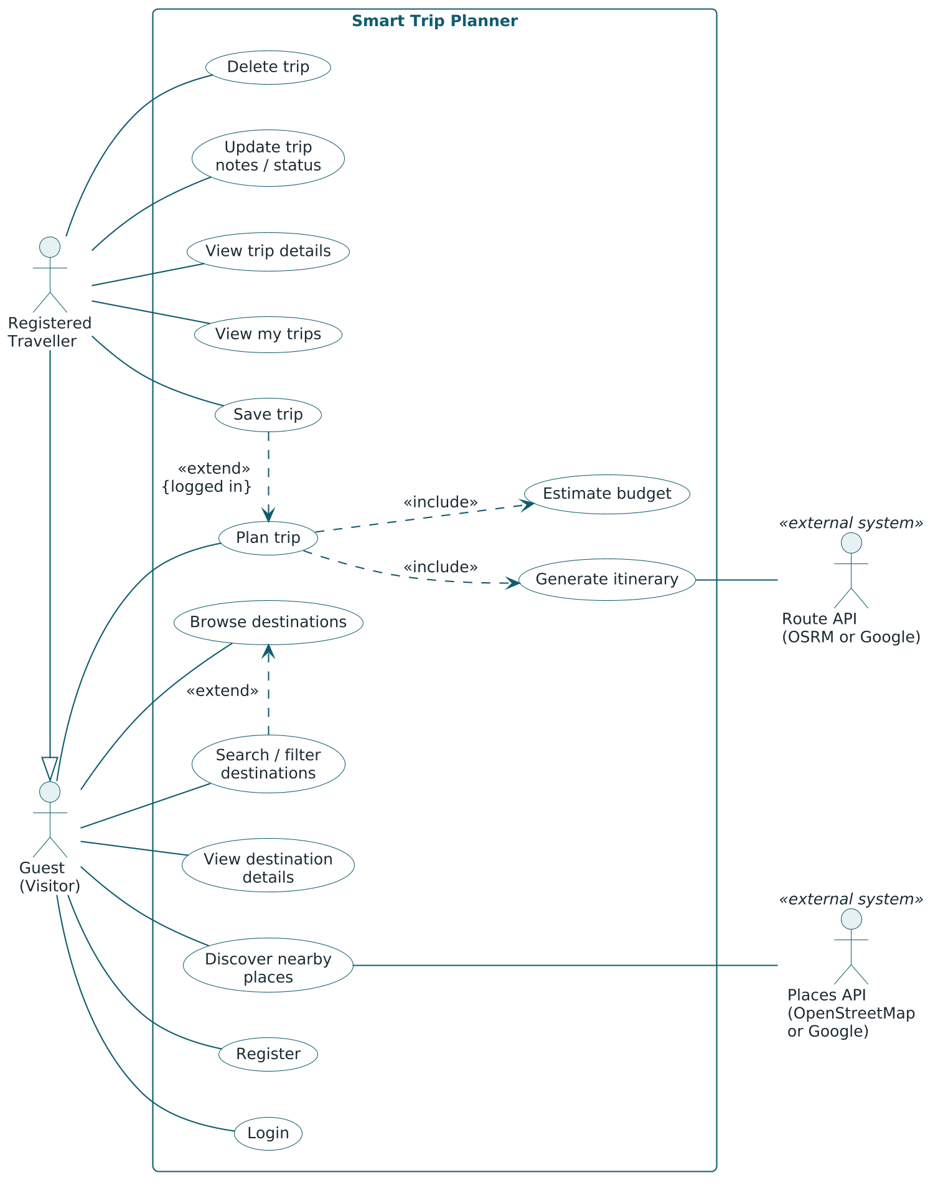
PART 4 · DESIGN
Use Case Diagram
WHAT TO NOTICE
A guest can browse and preview a plan; saving and managing trips require a registered traveller.
1
Registered Traveller inherits every use case of the Guest.
2
Plan trip includes Generate itinerary and Estimate budget.
3
Save trip extends Plan trip only when logged in. The Places and Route APIs are external actors.
Smart Trip Planner · Presentation-1
16
Notes:
[Vraj] Two human actors. A guest can browse destinations, view details, discover nearby places and generate a plan preview. A registered traveller does all of that and also saves trips, views My Trips, updates notes and status, and deletes. Generating a plan always includes building the itinerary and estimating the budget. The map services appear as external, optional actors.

Slide 17
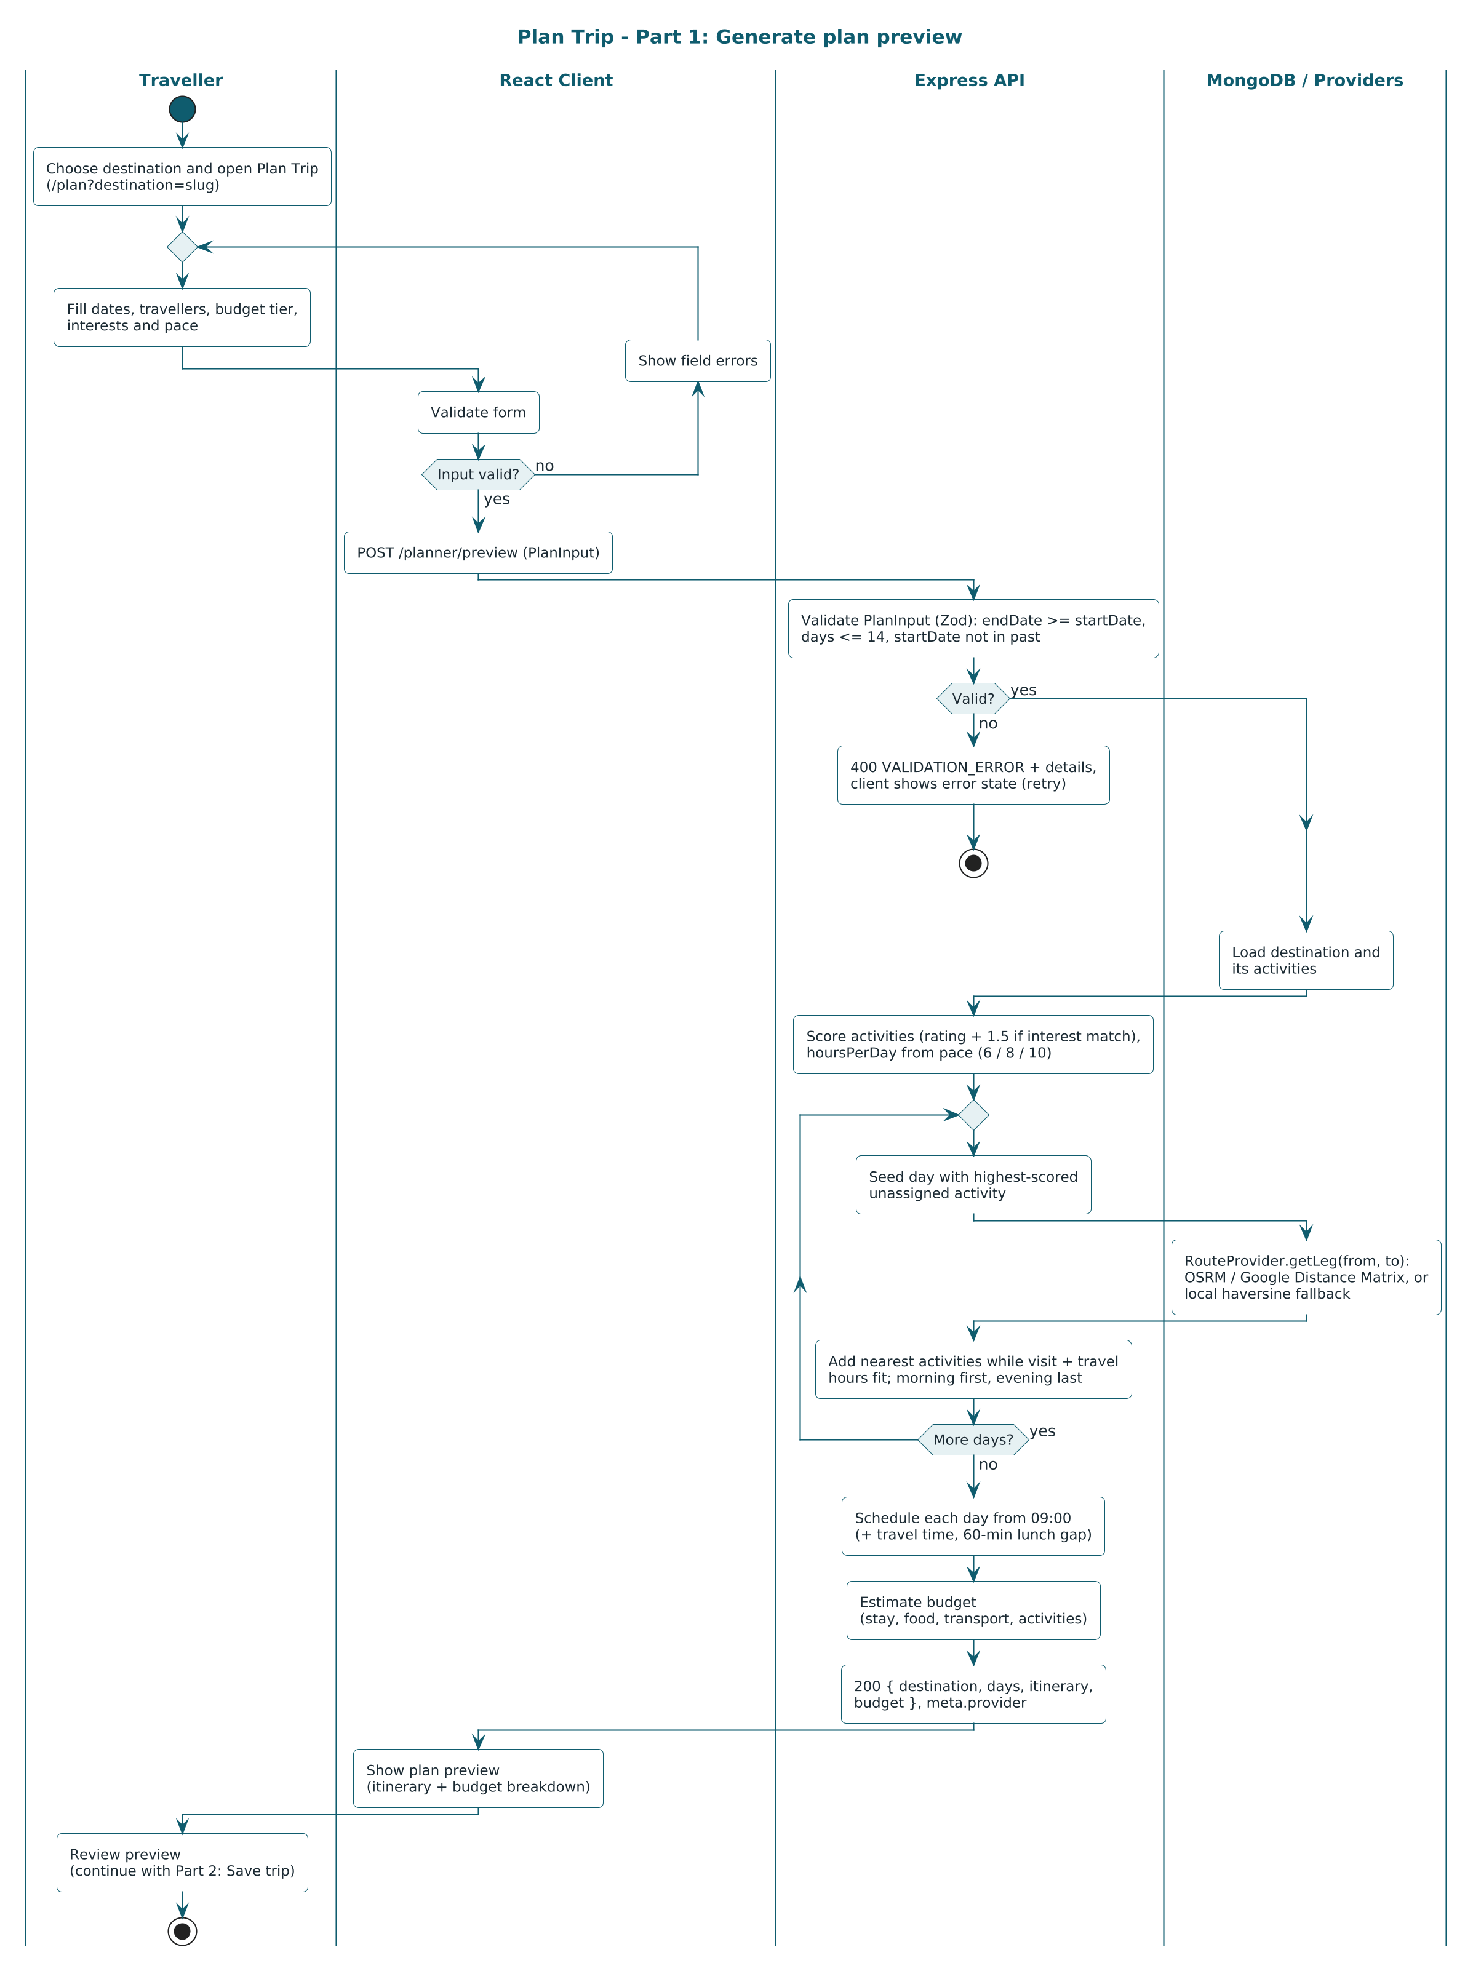
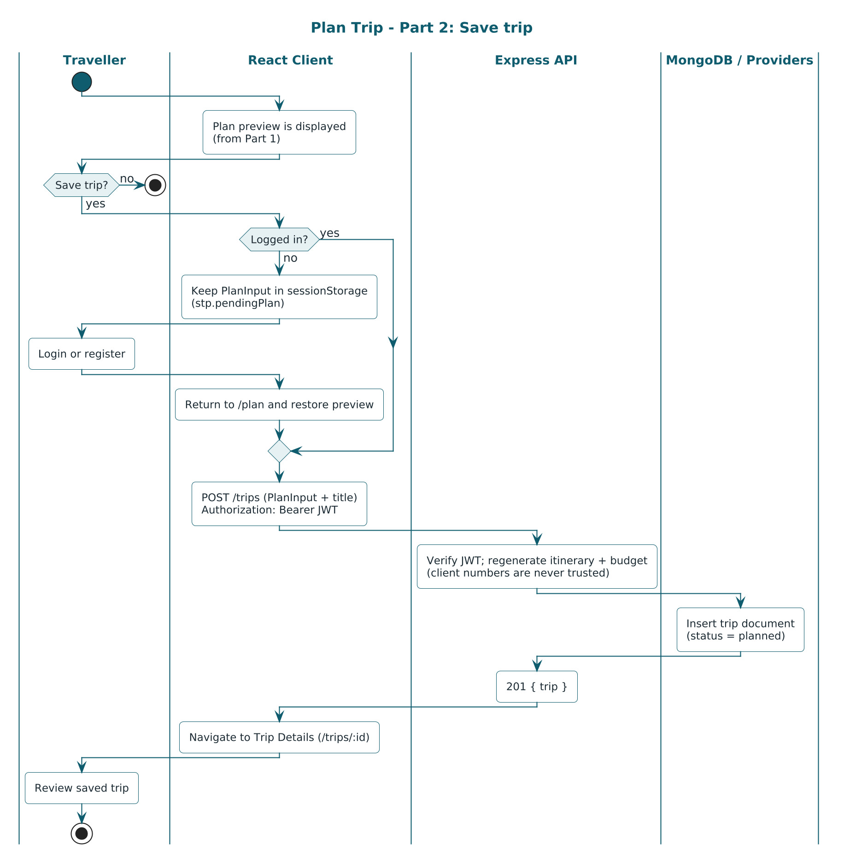
PART 4 · DESIGN
Activity Diagram — Plan a Trip
From choosing a destination to a saved trip, including validation and the login detour on Save.
Smart Trip Planner · Presentation-1
17
Notes:
[Hardik] This is the main flow you will see in the demo. The traveller picks a destination, fills the plan form, and the input is validated: dates in order, not in the past, at most fourteen days. The server builds the itinerary and the budget and the client shows the preview. On Save there is one decision: logged in or not. If not, the plan is kept in session storage, the user logs in or registers, comes back to the same preview and saves.

Slide 18
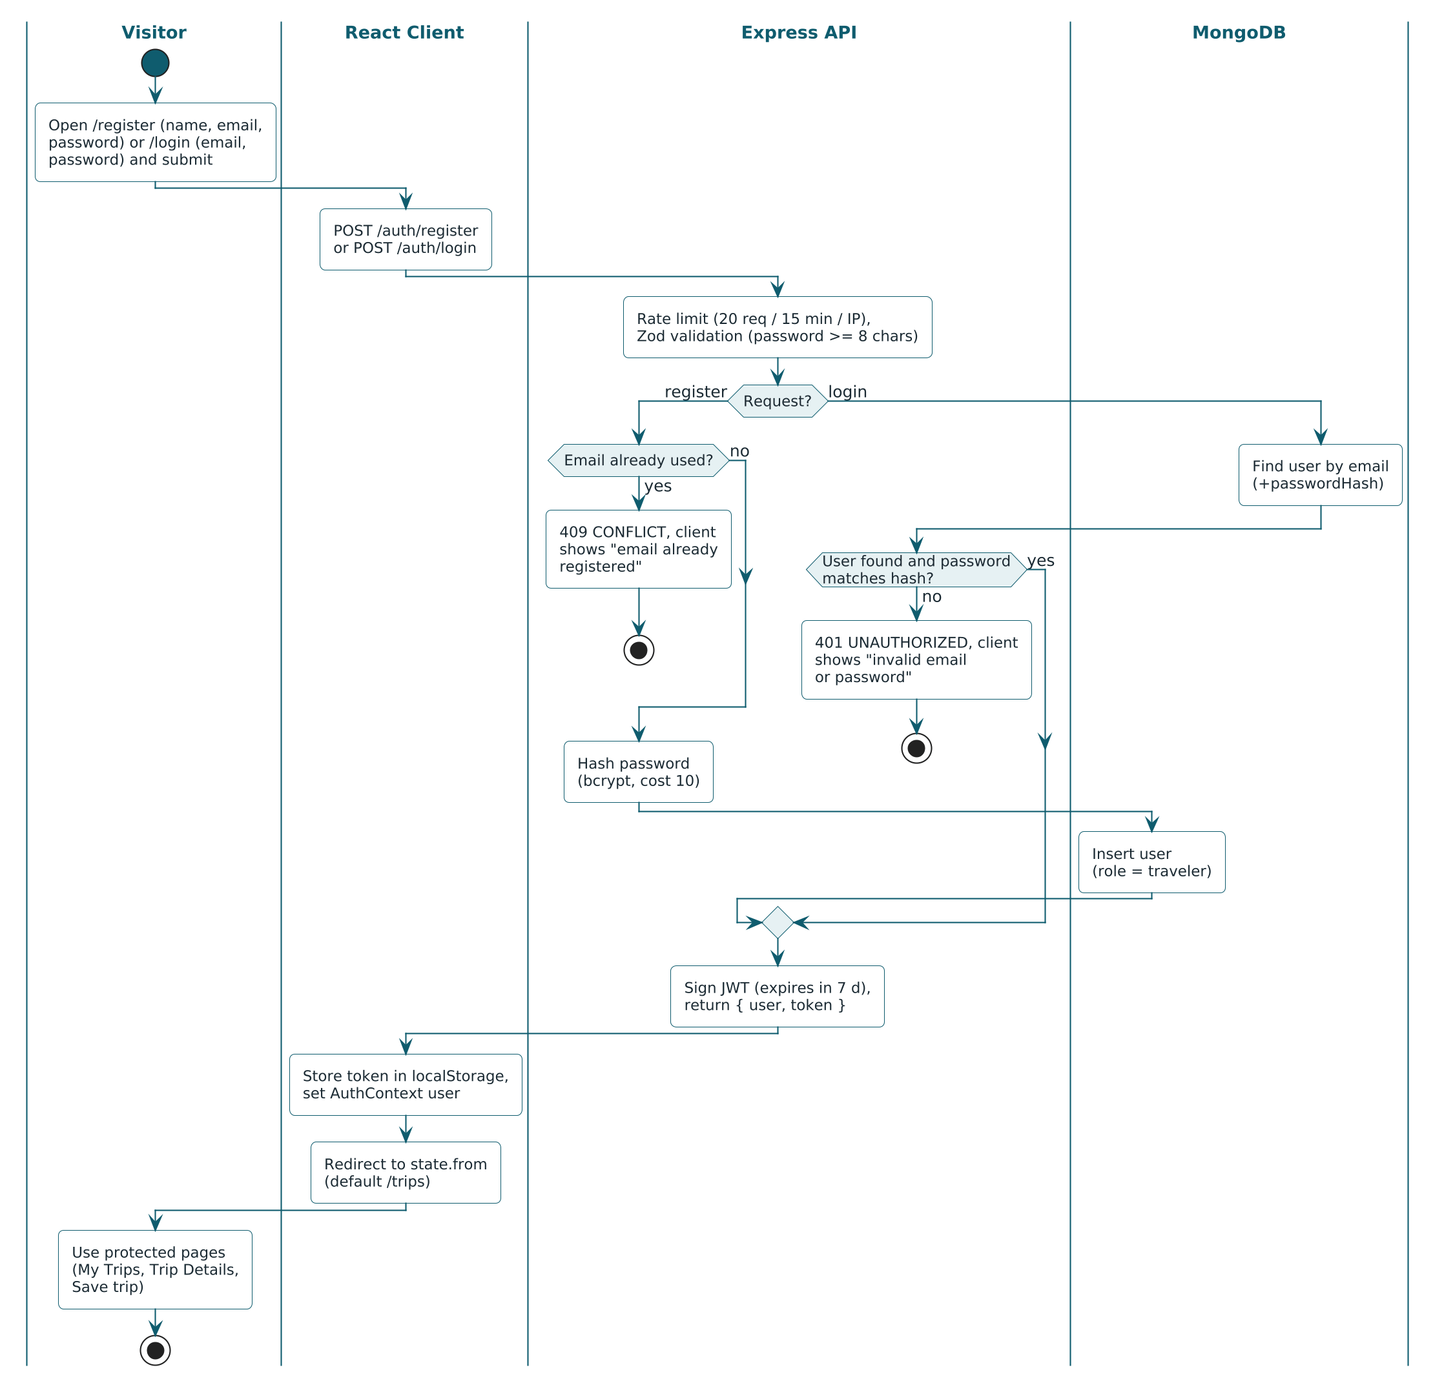
PART 4 · DESIGN
Activity Diagram — Register and Login
WHAT TO NOTICE
Registration and login share one outcome: a JWT stored on the client and a return to the page the user came from.
1
Duplicate email ends in a conflict message, not a crash.
2
Wrong credentials give one generic error.
3
After success the user returns to the page that asked for login.
Smart Trip Planner · Presentation-1
18
Notes:
[Hardik] Register checks the input, rejects an email that already exists with a 409 conflict, hashes the password with bcrypt and returns a token. Login verifies the password and returns the same kind of token; wrong email or wrong password give the same 401 message. The client stores the token, loads the user, and sends them back to where they were, for example the plan preview.

Slide 19
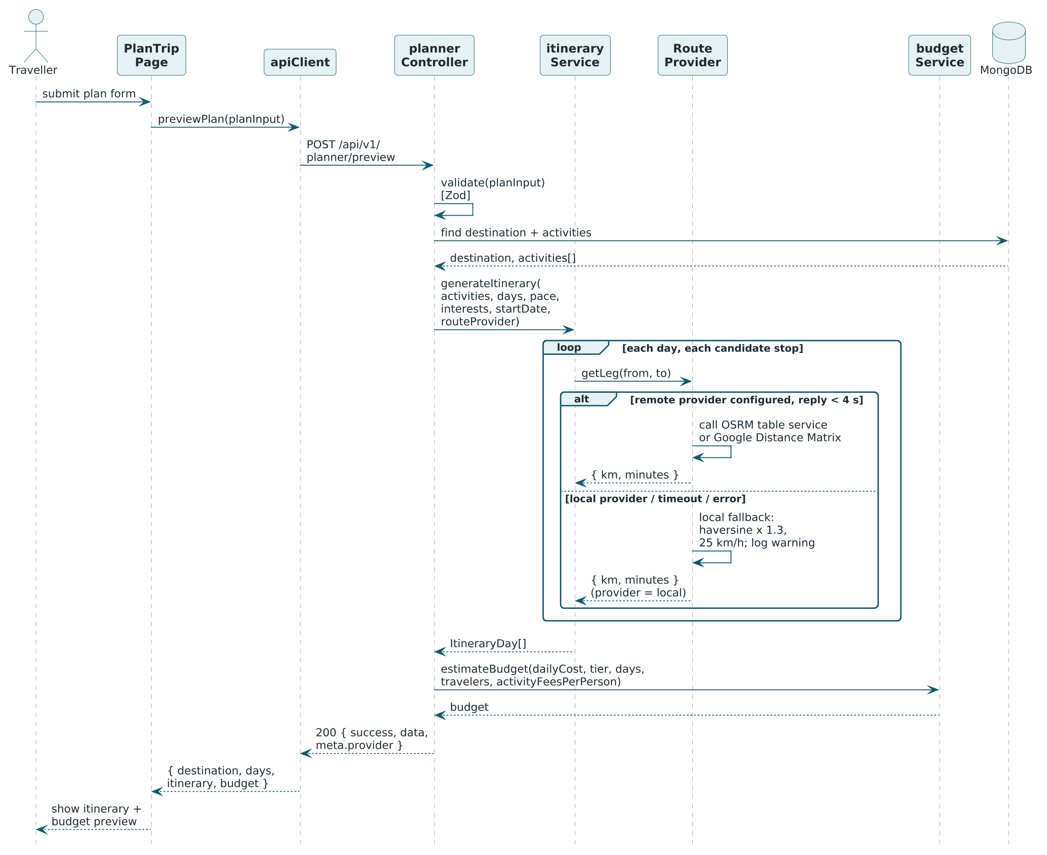
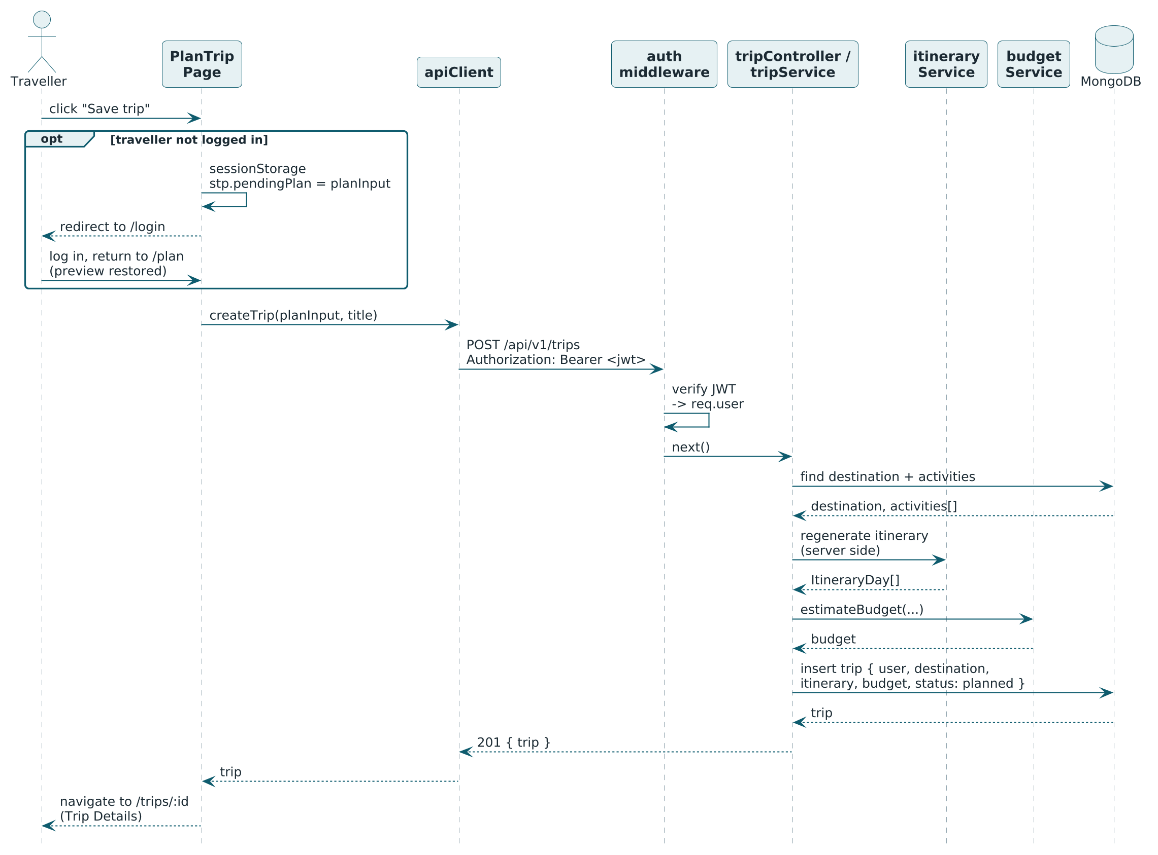
PART 4 · DESIGN
Interaction Diagram — Plan and Save (Sequence)
Preview is public; on Save the server recomputes the itinerary and budget before writing the trip.
Smart Trip Planner · Presentation-1
19
Notes:
[Udit] Read it top to bottom. The client posts the plan input to /planner/preview. The controller calls the itinerary service, which asks the route provider for distances, then the budget service, and returns both. When the user saves, the client posts the same input to /trips with the JWT. The auth middleware verifies the token, the trip service regenerates itinerary and budget, and only then writes the trip document. So a tampered total from the browser can never reach the database.

Slide 20
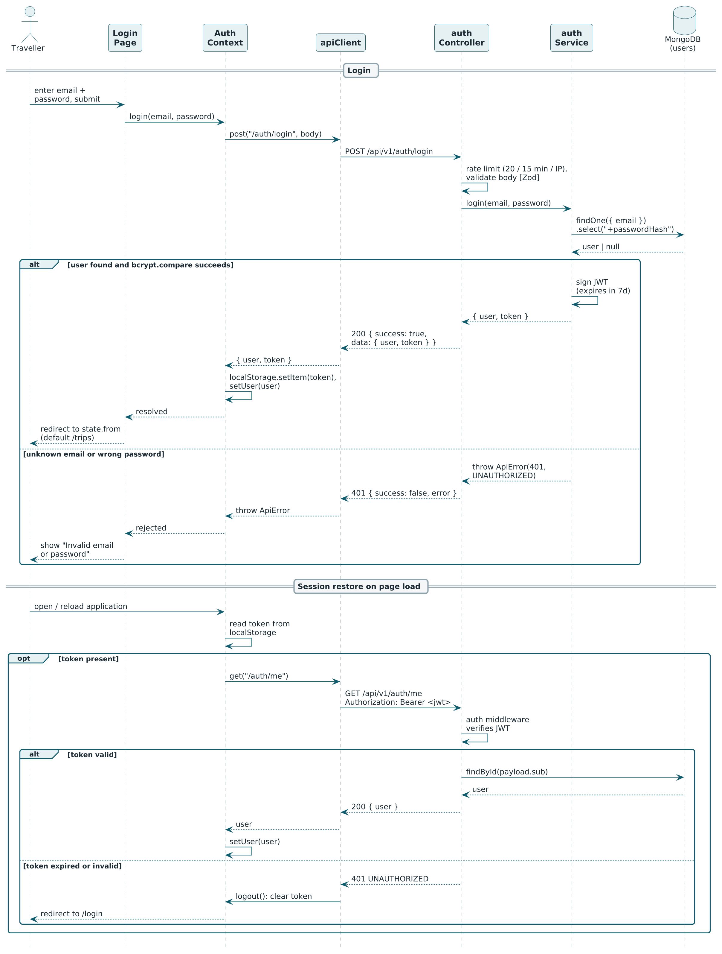
PART 4 · DESIGN
Interaction Diagram — Login (Sequence)
WHAT TO NOTICE
Credentials go in once; every later request carries the JWT in the Authorization header.
1
The password hash is read only for comparison and never returned.
2
The token is kept in localStorage; /auth/me restores the session.
3
A 401 on any later call logs the user out and redirects to login.
Smart Trip Planner · Presentation-1
20
Notes:
[Udit] The login page posts email and password. The auth service loads the user with the password hash, compares with bcrypt, signs a JWT and returns user plus token. The hash never leaves the server. The client keeps the token in local storage and attaches it as a Bearer header. On reload it calls /auth/me to restore the session. The auth routes are rate limited to twenty requests per fifteen minutes per IP.

Slide 21
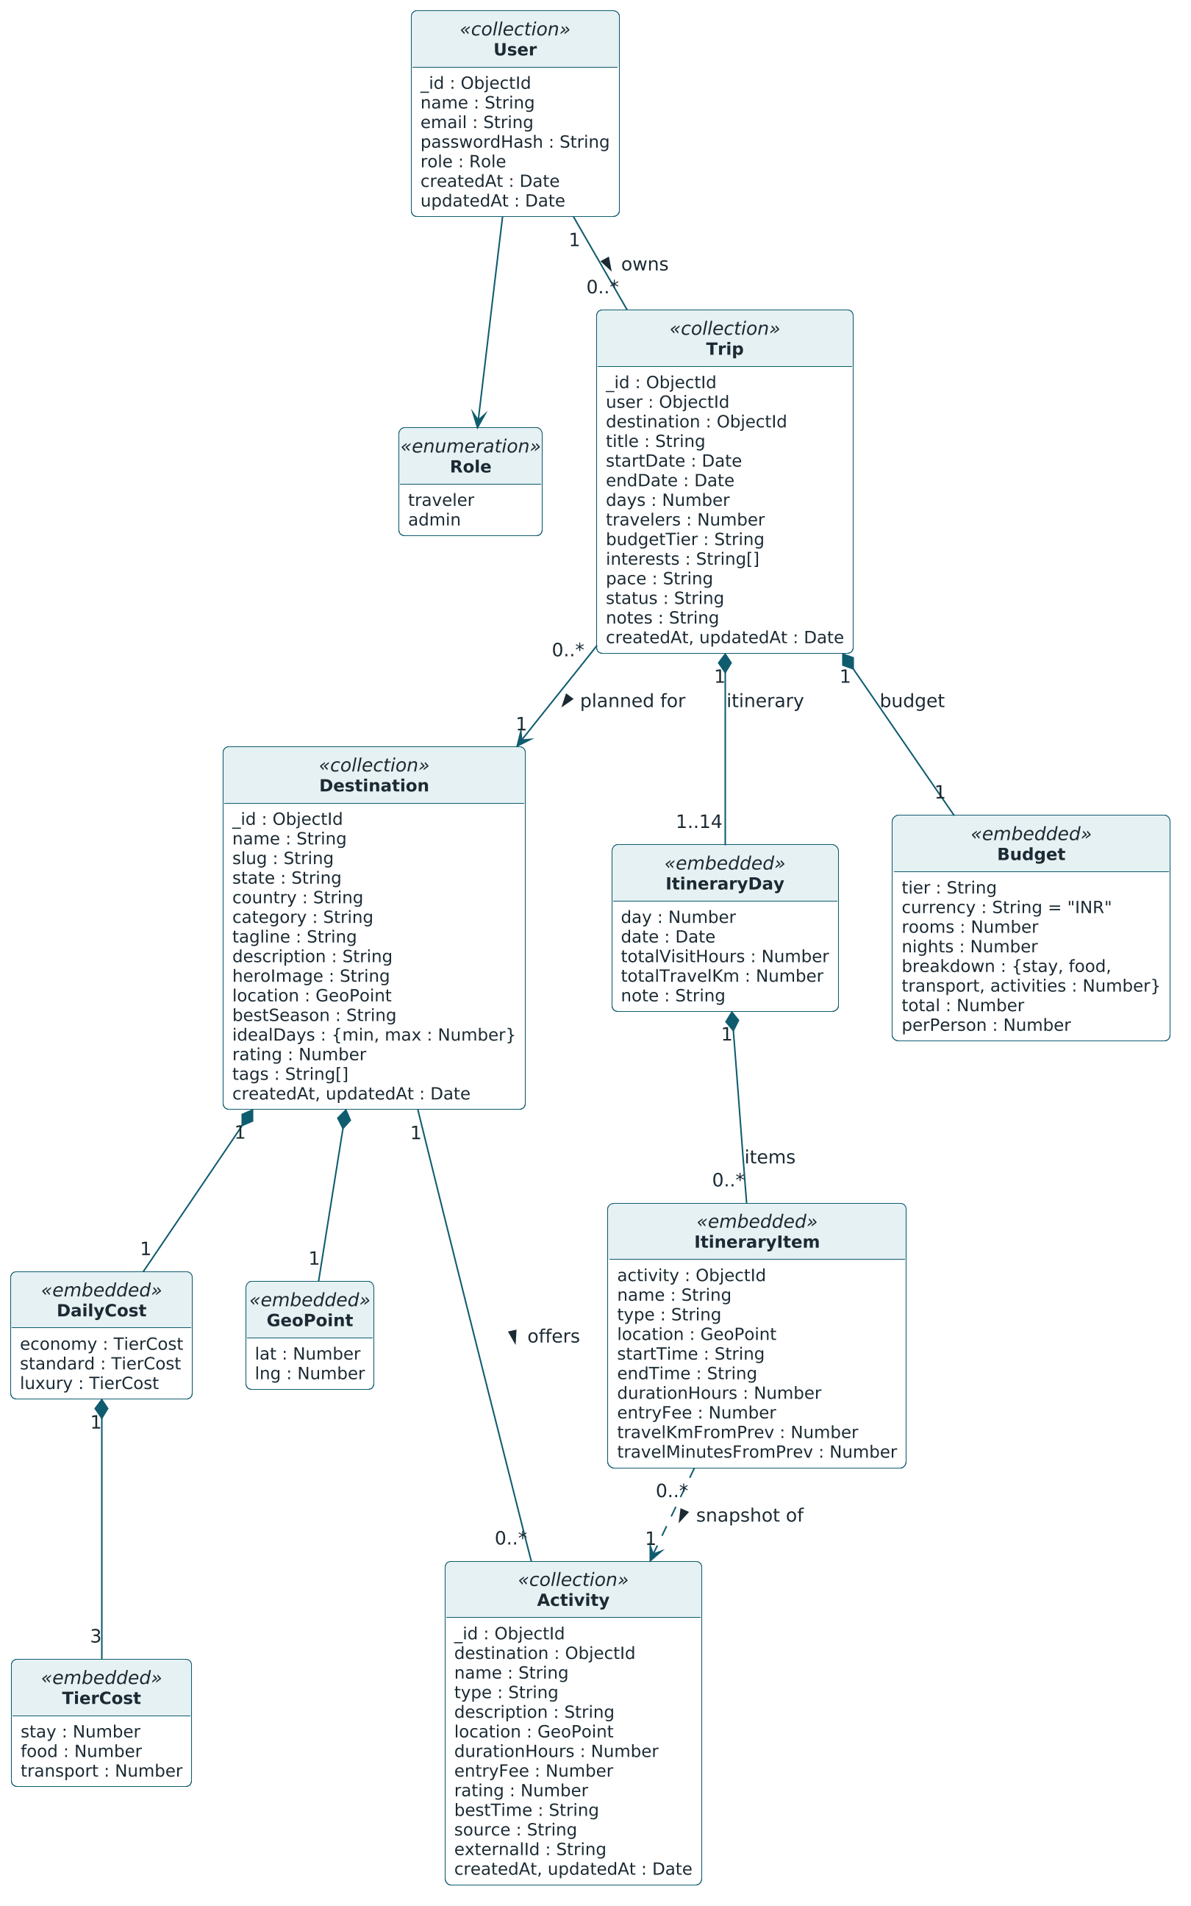
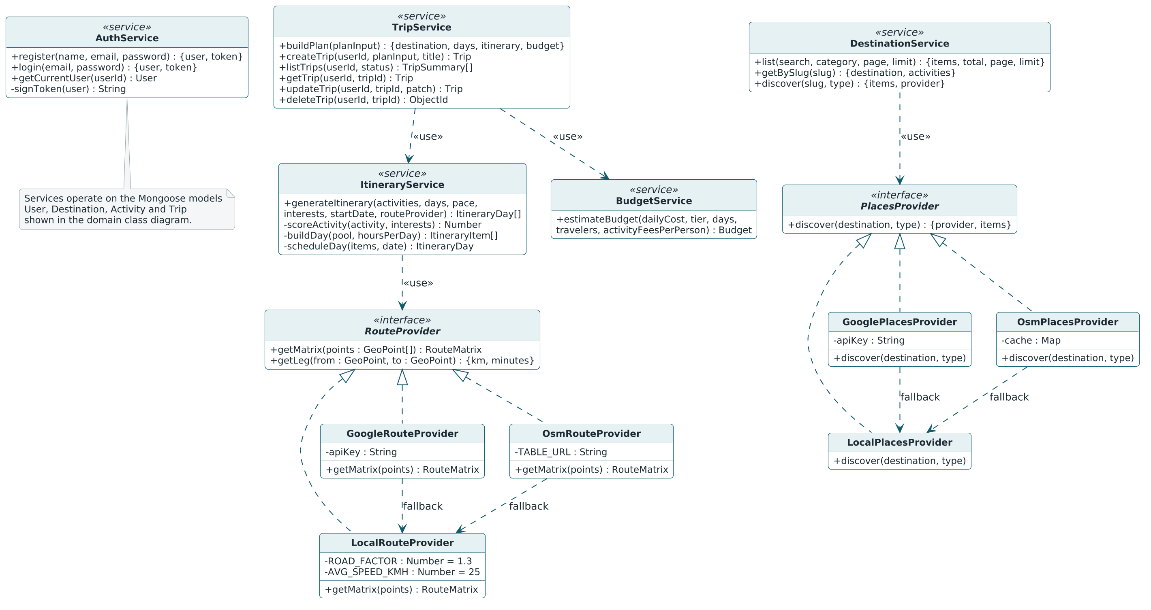
PART 4 · DESIGN
Class Diagram
Left: four persistent classes, with a Trip composed of days, items and a budget. Above: the service classes and provider interfaces.
1
User 1 — many Trip; Destination 1 — many Activity and Trip.
2
ItineraryItem is a snapshot of an Activity, so a saved trip never changes.
3
Route and Places providers are interfaces; OpenStreetMap and Google implementations fall back to local.
Smart Trip Planner · Presentation-1
21
Notes:
[Vraj] Four persistent classes that map one to one to MongoDB collections: User, Destination, Activity and Trip. A user has many trips, a destination has many activities and many trips. Trip is composed of itinerary days, each with itinerary items, and one budget. An itinerary item copies the activity's name, fee and location, so a saved trip stays stable even if the catalogue changes later. The service classes carry the behaviour.

Slide 22
PART 4 · DESIGN
Data Dictionary — Collections and users
Field name | Datatype | Constrains | Description
name | String | required, 2–60 characters, trimmed | Display name
email | String | required, unique, lowercase, valid email | Login identifier
passwordHash | String | required, select: false | bcrypt hash (cost 10); never sent in JSON
role | String | enum traveler | admin, default traveler | Authorisation role
HOW THE FOUR COLLECTIONS RELATE
users
trips
destinations
activities
1
many
many
1
1
many
embeds itinerary[ ] + budget
Common fields
Money
Indexes
_id: ObjectId, createdAt, updatedAt on every collection.
INR, stored as integer rupees. No decimals anywhere.
email unique · slug unique · { destination, name } unique · trips.user indexed.
Smart Trip Planner · Presentation-1
22
Notes:
[Udit] The database is MongoDB with four collections. Every document has an ObjectId, createdAt and updatedAt. All money is whole rupees. The users collection is small: name, unique lowercase email, a bcrypt password hash that is excluded from every query by default, and a role. Below is how the collections relate: a user has many trips, a destination has many activities and many trips, and a trip embeds its itinerary and budget.

Slide 23
PART 4 · DESIGN
Data Dictionary — destinations
Field name | Datatype | Constrains | Description
name | String | required | Destination name, e.g. Manali
slug | String | required, unique, lowercase | URL identifier, e.g. manali
state | String | required | Indian state or union territory
country | String | default India | Country
category | String | enum: hill-station, beach, heritage, spiritual, nature, desert, adventure | Primary category, used by the filter
tagline | String | required, ≤ 90 characters | One-line hook shown on cards
description | String | required | Overview of 2–4 sentences
heroImage | String | required | /images/destinations/<slug>.jpg
location | { lat, lng } | required, Numbers | City-centre coordinates
bestSeason | String | required | e.g. October – February
idealDays | { min, max } | required, Numbers | Suggested trip length
dailyCost | { economy, standard, luxury } → { stay, food, transport } | required, integers ≥ 0 | stay per room per night; food, transport per person per day
rating | Number | 0–5 | Editorial rating
tags | [String] | optional | Search keywords
Smart Trip Planner · Presentation-1
23
Notes:
[Udit] Destinations is the catalogue. The slug is the URL identifier, for example manali. Category is an enum of seven values and drives the filter. The key field is dailyCost: for each tier it holds stay per room per night, and food and transport per person per day. That is exactly what the budget formula reads. Twelve destinations are seeded.

Slide 24
PART 4 · DESIGN
Data Dictionary — activities
Field name | Datatype | Constrains | Description
destination | ObjectId → destinations | required, indexed | Parent destination
name | String | required; unique with destination | e.g. Solang Valley
type | String | enum: sightseeing, adventure, culture, nature, spiritual, food, shopping | Used for interest matching
description | String | required | 1–2 sentences
location | { lat, lng } | required | Real-world coordinates
durationHours | Number | required, 0.5–8 | Typical visit time
entryFee | Number | integer ≥ 0, default 0 | Per person, INR
rating | Number | 0–5 | Feeds the activity score
bestTime | String | enum: morning, afternoon, evening, any; default any | Scheduling hint
source | String | enum: seed, google; default seed | Where the record came from
externalId | String | optional | Google place id when source = google
Smart Trip Planner · Presentation-1
24
Notes:
[Udit] An activity is a place to visit or a thing to do. It points to its destination and carries everything the itinerary algorithm needs: type for interest matching, real coordinates for distance, durationHours for the day capacity, entryFee for the budget, and bestTime for morning or evening ordering. Source tells us whether the record came from our seed or from Google. Destination plus name is unique.

Slide 25
PART 4 · DESIGN
Data Dictionary — trips
Field name | Datatype | Constrains | Description
user | ObjectId → users | required, indexed | Owner of the trip
destination | ObjectId → destinations | required | Planned destination
title | String | required, ≤ 80 characters | Default: "<days> days in <destination>"
startDate | Date | required | First day of the trip
endDate | Date | required, ≥ startDate | Last day of the trip
days | Number | 1–14 | Inclusive day count
travelers | Number | 1–12 | Group size
budgetTier | String | enum: economy, standard, luxury | Cost tier used for the estimate
interests | [String] | subset of activity type enum | Boosts matching activities
pace | String | enum: relaxed, balanced, packed; default balanced | Hours of sightseeing per day
itinerary | [ItineraryDay] | embedded | Generated day-wise plan
budget | Budget | embedded | Generated cost estimate
status | String | enum: planned, completed, cancelled; default planned | Trip state
notes | String | ≤ 1000 characters, default "" | Traveller's own notes
Smart Trip Planner · Presentation-1
25
Notes:
[Udit] A trip belongs to one user and one destination. The first block is the plan input exactly as the traveller entered it, with the same limits as the form: one to fourteen days, one to twelve travellers. Itinerary and budget are embedded, not referenced, so one read returns the whole trip. Status and notes are the only fields the user edits after saving.

Slide 26
PART 4 · DESIGN
Data Dictionary — Structures Embedded in a Trip
ItineraryDay
ItineraryItem (snapshot of an activity)
Field | Type | Description
day | Number | Day number, from 1
date | Date | Calendar date
items | [ItineraryItem] | Ordered stops
totalVisitHours | Number | Sum of visit durations
totalTravelKm | Number | Sum of leg distances
note | String | e.g. free-day message
Field | Type | Description
activity | ObjectId | Source activity
name | String | Copied activity name
type | String | Copied activity type
location | { lat, lng } | Copied coordinates
startTime | String HH:mm | Scheduled start
endTime | String HH:mm | Scheduled end
durationHours | Number | Visit time
entryFee | Number | Per person, INR
travelKmFromPrev | Number | Km from previous stop
travelMinutesFromPrev | Number | Minutes from previous stop
Budget
Field | Type | Description
tier | String | economy | standard | luxury
currency | String | Always "INR"
rooms, nights | Number | Rooms and nights used for stay
breakdown | Object | stay, food, transport, activities
total | Number | Sum of the breakdown
perPerson | Number | round(total / travelers)
Smart Trip Planner · Presentation-1
26
Notes:
[Udit] Three embedded structures. ItineraryDay is one day with its items and totals. ItineraryItem is a snapshot of an activity with its start and end time and the travel from the previous stop. Budget stores rooms, nights, the four-part breakdown, total and per-person. Because these are snapshots, a saved trip reads the same even if we later edit the catalogue.

Slide 27
PART 5 · PROGRESS
Implementation Status
Backend — Express API
Frontend — React client
87%
Data models + seed (12 destinations, activities)
DONE
Home, Destinations, Destination details
DONE
Auth API — register, login, me (JWT, bcrypt)
DONE
Plan Trip form + generated plan preview
DONE
13 of 15 modules complete
Destinations API — list, filter, details
DONE
Login / Register, protected routes, plan restore
DONE
Itinerary service — scoring, routing, scheduling
DONE
My Trips + Trip Details (notes, status, delete)
DONE
Main flow works end to end: browse → plan → preview → login → save → manage.
Budget service — tier-based estimate
Discover nearby places panel
DONE
DONE
Trips API — save, list, update, delete, ownership
DONE
Accessibility audit + cross-browser testing
IN PROGRESS
OpenStreetMap places + OSRM road distances (live)
DONE
Google Places / Distance providers — live-key testing
IN PROGRESS
Automated tests — unit + API
DONE
Smart Trip Planner · Presentation-1
27
Notes:
[Hardik] 13 of 15 planned modules are complete, about 87 percent, which is above the 50 percent asked for Presentation-1. The whole main flow works end to end: browse, plan, preview, login, save, manage. What remains is listed as in progress; mention each in one line and say it is planned for the next phase. Then hand over to the demo.

Slide 28
PART 5 · PROGRESS
Implementation Status — Demo Flow
1
2
3
Start the stack
Browse
Plan
docker compose up -d, npm run seed, then npm run dev for server and client.
Home → Destinations → open Manali.
Plan a trip here: 4 days, 2 travellers, Standard, Adventure + Nature → Generate plan.
4
5
6
Read the plan
Save
Manage
Day-wise itinerary with timings, then the budget breakdown.
Save → asked to log in → register → plan restored → Save → Trip Details.
My Trips shows the trip: mark completed, add notes, delete.
Smart Trip Planner · Presentation-1
28
Notes:
[Hardik] Hardik drives the browser, Udit explains what the server does at each step. Keep the stack running before the presentation starts. Open Manali, plan four days for two travellers on the Standard tier with Adventure and Nature. Walk through one day of the itinerary and the budget breakdown. Press Save while logged out to show the login detour and the restored plan. Finish in My Trips: mark completed, add a note, delete.

Slide 29
PRESENTATION-1 · 21 SEPTEMBER 2026
Thank you
We would be glad to take your questions and suggestions.
Udit Mishra
Hardik Vaghela
Vraj Panchal
GUIDED BY
Prof. Payal Chauhan
Backend / Database / API
Frontend / UI
Documentation / UML / System Design
Smart Trip Planner · Sardar Vallabhbhai Patel Institute of Technology, Vasad
Notes:
[All] Thank the panel and our guide. Questions on API, database and algorithms go to Udit; on screens and user flow to Hardik; on UML and documentation to Vraj. If asked what comes next: finish the in-progress modules, complete the test suite and the project document.

