Slide 1
Hackathon Presentation On Street Light
Submitted by
ms. hemavathi r
ms. Nischita
ms. Ramyashree d s
mr. Bharatraj kori

Slide 2
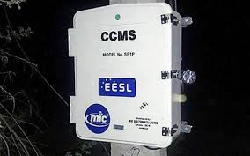
Introduction
CCMS – Centralized Control & Monitoring System
Switch ON and OFF the lights of a particular switching point and/or networked switching points from Central Control Station. Control lights instantaneously or automatically throughout the year on basis of Sunrise and sunset time depending on the geographical location of the switching point.
Single Switch point can support up to 300 lighting poles. GPRS based remote streetlight monitoring system with self‐protection from short‐circuit.

Slide 3
Problem Statement
Challenge 1:
HOW TO DETECT/IDENTIFY THE DEFECTIVE/NON-FUNCTIONAL
LIGHTS, NUMBER OF LIGHTS CONNECTED TO A PARTICULAR CCMS
THAT ARE NOT FUNCTIONING AND THE WATTAGE OF THESE FAULTY
LIGHTS.

Slide 4
Solution
We have to number the every street light with unique ID, like A01.
We are using the Sensors to know the functional/non functional street lights, we use sensors like light detective sensor.
If the system will found any non functional street light than it cut downs power of the particular street light using power Cut-down sensor.
We use Radar sensor to dim down the light when there is no motion. If it motion is found then the lights dim up.
The people who were noticed the non functional street lights they could to send message to the EESL service number with their city name, pin code and the unique ID of particular street light.
We created another table in EESL database called COMPLAINTS that contains the fields namely pin code, city name and the unique ID of the street light.
By taking this information, the EESL will provide the notification to the admin that there is non functional street light in a particular area with Unique ID. For Ex. A01.

Slide 5
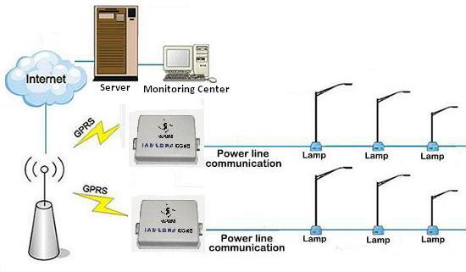

Slide 6
Challenge 2:
THE PRESENT CONSUMER COMPLAINT DATA TO BE ANALYSED FOR PREDICTIVE ANALYSIS OF THE FAULTS AND UNDERSTANDING SO THAT EESL COULD TAKE PREEMPTIVE MEASURES AND ADDRESS THE COMPLAINTS BEFORE THEY EVEN OCCUR.(SUGGEST WAYS TO REDUCE FAULT RATE.)

Slide 7
Solution :
By analysing the previous complaints the system automatically predict the fault occurrence in a particular area.
Another way to detect/reduce the fault rate is by fixing the voltage threshold to for the particular CCMS. We fix the threshold by analysing previous records.
If the usage exceeds the threshold, the system will be notify where the theft occurred by using the CCMS ID to the admin.
By using weather report of particular location the system will reduces the power or it cut downs the power when occurrence of lighting and thunder using power cut-down sensors.
By using automated system i.e. an intelligent algorithm the system will monitoring the street lights( Switch On/Off).

Slide 8


Slide 9
Thank You…….

