Slide 1

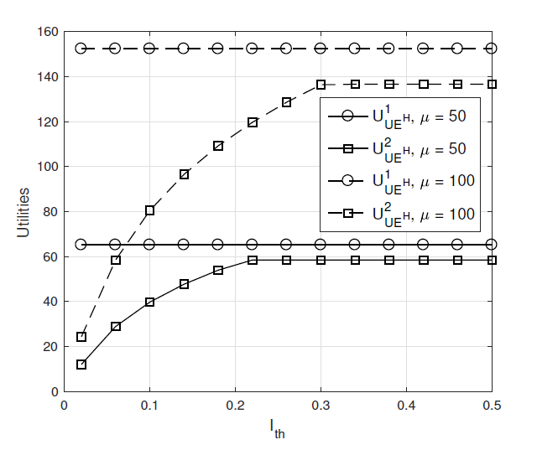
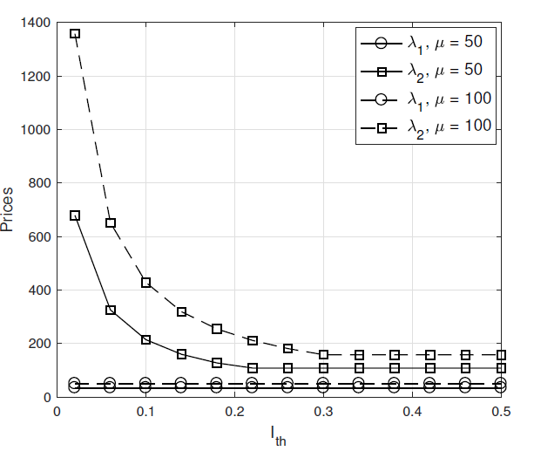
D2D Cooperative Communications for Disaster Management
Krishna Koushik, Manikanta Avinash, Vidhyardhara Prasad Agni
Department of Computer Science and Engineering, Amrita School of Engineering, Coimbatore
15CSE378 Introduction to Game Theory 2018-19 Elective – CASE STUDY
ABSTRACT
2) Follower Level: The BS acts as the follower role who sells its energy service to UH to support the connection between the healthy area and the disaster area, which aims to maximize its utility function defined as the difference between the energy payment from UH and the energy cost.
SOLUTION : INTERFERENCE PRICING ALGORITHM
1) BS initializes the interference price LAMBDA2 at the range [low LAMBDA2 , up LAMBDA2 ].
2) Set ETA is a small positive value.
3) For count = low LAMBDA 2 : ETA : up LAMBDA2
a) BS calculate the received interference PB and its utility function UB,2.
b) If IB(LAMBDA2(count)) Ith, then, UB,2 =LAMBDA2(count)
(1-THETA )Ps|h|^2;
else UB,2 = LAMBDA2(count)(1-THETA )Ith.
4) end
5) Output LAMBDAopt2 <- argmaxLAMBDA2 UB,2(LAMBDA2).
A disaster management system using D2D cooperative communications. Specifically, we consider two D2D cells, one is in healthy area and the other is in disaster area, where a user equipment (UE) in healthy area aims to assist a UE in the disaster area to recover wireless information transfer (WIT) via an energy harvesting (EH) relay. In the healthy area, a cellular base station (BS) shares the spectrum with the UE even though they may belong to different service providers. In return, this UE will have to provide some incentives to the BS by paying prices for causing interference and for trading energy. We formulate these processes as two Stackelberg games, interference pricing and energy trading, where their Stackelberg equilibriums are derived in closed-form solutions. Finally, numerical results are provided to validate our proposed schemes. It is shown that the energy trading scheme outperforms the interference pricing scheme in terms of assistance efficiency for the disaster area. A “harvest - then - transmit” protocol is preferred between base station user equipment's and energy harvesting relay.
System model
We consider a system model that includes one BS, denoted by B; and one UE, denoted by UH in the healthy area, where B provides power to UH to facilitate its future information transfer. In the disaster area, there are one EH relay1, denoted by R; and one UE, denoted by UD. In case of a disaster, UH has to recover communication with UD in disaster area via the relay R due to long distance. Due to energy limitation of the UE and the EH relay, it is assumed that there is no sufficient power supply for information transfer. Therefore, ‘harvest then-transmit’ is employed at UH who harvests power from the BS and then transmits the information to UD via the EH relay. Note that a power splitting (PS) scheme is considered at the EH relay who also harvests power to support information forwarding. The whole transmission is performed during the time period T. In the first time period of T (0 < theta< 1), the BS of the healthy area provides energy to UH to support the connection with the disaster area. In the second time period (1-theta)T, UH establishes the communications with UD via the EH relay, which also cause the interference to the BS. In addition, we split the time period (1-theta)T into two sub phases: in the first period (1-theta)T/2, UH transmits information and power to the EH relay R, and then, the EH relay decode the information and forward to UD by using harvested power in the remaining time period. We assume that the channel coefficients between B and UH, UH and R, R and UD, as well as UH and B are denoted as g, hsr, hrd and h, respectively. We assume the Coefficients values to be between 0 and 1
RESULT
lambda_2_opt = []
ith = 0
ith_list = []
while ith<=0.5:
ith_list.append(ith)
count = lambda_2_low
while count<=lambda_2_up:
pb = **// TO BE CALCULATED USING STACKELBERG GAMES//**
u_b2 = lambda_2*(1-theta)*ps*(abs(h)*abs(h))
if ib*lambda_2*count <= ith:
u_b2 = lambda_2*count*(1-theta)*ps*(abs(h)*abs(h))
else:
u_b2 = lambda_2*count*(1-theta)*ith
count += eta
lambda_2_opt.append(lambda_2*u_b2)
print(u_b2)
ith += 0.05
Utility versus target interference Ith Prices versus target interference Ith
APPROACH
Stackelberg Game
Interference pricing game: In this game, the BS is considered as the leader who announces an interference price LAMBDA2 to maximize its own utility, and UH is formulated as the follower to obtain the optimal transmit power allocation and the optimal PS ratio to maximize its own utility.
1) Leader Level: The BS announces a price for the interference
to maximize its own profit, which is defined
as the total payment from UH.
2) Follower Level: UH pays a price for the interference to maximize its utility function defined as the difference between the achievable throughput and the total payment to the BS.
Energy trading game: In this game, we formulate UH as the leader who pays a price LAMBDA1 on per unit of energy harvested from the RF signals radiated by the BS, referred as to the energy price, whereas the BS is formulated as the follower who optimizes its transmit power based on the released energy price to maximize its profits. Now, we write this energy trading
game as follows:
1) Leader Level: UH is considered as the leader role which pays a price to purchase the energy service from the BS to recover the connection with the disaster area. It aims to maximize its utility function defined as the difference between the achievable throughput and the total energy payment to the BS
CONCLUSION
we implemented the disaster management in two cell D2D cooperative communications. Specifically, the UE in healthy area aims to assist the connection with the UE in disaster area via an EH relay. In healthy area, we considered a practical scenario that both BS and UE belong to the different service providers. Thus, the UE needs to pay prices to the BS as incentives for two reasons: causing interference and energy transfer service. These two processes can be formulated as two Stackelberg games: interference pricing and energy trading games. Integrating Clustering Techniques for the same Stackelberg game performs efficiently in terms of coverage, energy efficiency, and cluster formation to extend the communication area.
CONTACT DETAILS
Maddukuri Krishna Koushik CB.EN.U4CSE16331 m.krishnakoushik@gmail.com
Panuganti Manikanta Avinash CB.EN.U4CSE16138 avinashpanuganti@gmail.com
Kota Vidhyardhara Prasad Agni CB.EN.U4CSE16125 kvpagni10@gmail.com

