Slide 1
Gitflow
Code/Astro 2025

Slide 2
By the end of this lesson, you will be able to:
Describe the basic git workflow (“gitflow”)
Create multiple branches within a git repository
Make a pull request from one branch into another

Slide 3
Class-sourced Vocabulary List
A: Git:
B: GitHub:
C: source control:
D: repository (AKA “repo”):
E: commit:
F: branch:
G: clone:
5. A piece of software that defines, reads, and modifies repositories.
6. A website that stores repositories (among other things).
1. The practice of storing changes you’ve made to your code alongside the code itself.
2. The current version of all code and documentation for a project, plus its history.
4. The smallest unit of a code’s history. A set of changes. (fun fact: at Google, these are called “CLs,” short for “change lists”).
7. A pointer to a version of the main code that diverges from the main line of development.
3. To create a copy of a repository that you can edit on your computer.
Code/Astro vocab list

Slide 4
Why do we Need Gitflow?
When you’re working on big projects, many people are committing at once. Source control allows people to edit the same code base at the same time, using different branches.

Slide 5
Gitflow is a way of using Git and GitHub
Allows for multi-user development and testing
“Protects” the main code
Easy to go back to a stable point if something breaks
Work is performed in parallel on one or more feature branches.

Slide 6
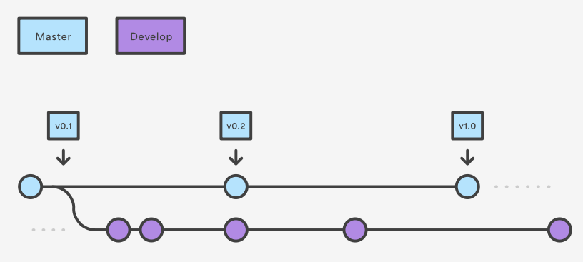
How It Works
1: Make a development branch off main
Main

Slide 7
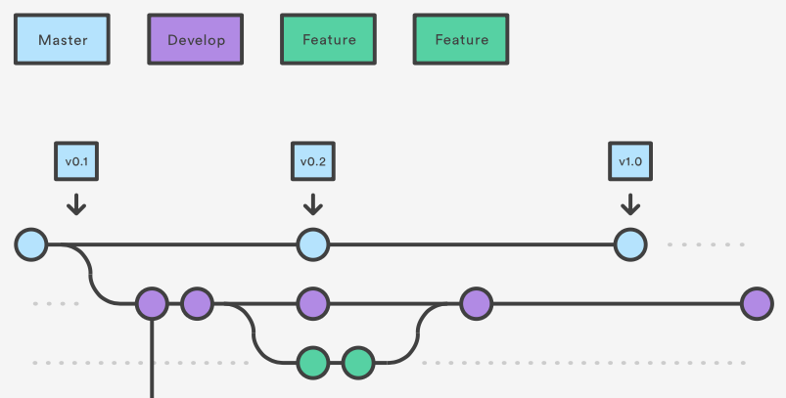
2. Create a feature branch from develop
Main

Slide 8
3. Merge into Develop
Main
Pull Request # 1

Slide 9
4. Merge into main
Main
Pull Request # 2
Pull Request # 1

Slide 10
4. Merge into main
Main
Pull Request # 2
Pull Request # 1

Slide 11
4. Merge into main
Allows for multi-user development and testing
“Protects” the main code
Easy to go back to a stable point if something breaks
Work is performed in parallel on one or more feature branches.
Main

Slide 12
Confession: I don’t always follow gitflow.
I tend not to make a “develop” branch unless I expect a lot of changes to happen at once.
I did use a develop branch:
Just before releasing major new versions (v2.0.0, v3.0.0).
When working on industry code.
Each developer will follow their own flavor of gitflow.

Slide 13
Demo: Gitflow
In this demo, you will learn how to:
Raise an issue in a repository
Create and manipulate multiple branches within a git repo (main, develop, feature)
How to use these branches in a “standard” git workflow
Submit a pull request on Github to merge two branches
Notes:
Demo tasks:
Raise an issue in the codeastro repository
Create a new repository from github
Create main, develop, & feature1 branches
Create PRs for feature1 to develop
Merge the PR

Slide 14
Summary of process to add a feature
Pull latest code from develop/main branch.
Create feature branch from develop/main branch.
Make your changes, stage, commit, then push to feature branch
Submit pull request on GitHub & merge feature into develop/main.
<< Repeat until enough features have been merged into develop, then make a pull request from develop -> main. >>

Slide 15
Some Relevant Git Commands
> git checkout –b <new_branch> <orig_branch>
Make a new branch off of <orig_branch> (default: main)
> git checkout <branch>
Switch to desired branch
> git branch -a
List all available branches, highlighting the one you are currently on
> git branch –d <branch_name>
Delete a branch from your local repo
There are a lot of “Git cheat sheets” online if you want a summary of more commands! Here’s the one I have bookmarked:
https://training.github.com/downloads/github-git-cheat-sheet.pdf

Slide 16
Activities [15 mins]
1. Make sure you can “git pull” the most recent version of the codeastro repo (main branch)
If you have local changes that you would like to save, you can do the following:
> git stash
> git pull origin main
> git stash pop
2. Within your project groups, create a repository (either a dummy repo or a repo for your project), and do the following:
Create main, develop, and (at least) 2 feature branches.
Raise an issue.
Clone the repo to your machine, make changes on each of the feature branches, and open pull requests to merge them into main.
Perform the merges.
NOTE: To push to the same repository, the repository creator will need to add others as collaborators. To do this from the repo’s homepage:
Settings -> Collaborators -> Add People (next to Manage Access)

